Slide 1
VECTOR DATABASE

Slide 2
Existing Problem:
While easy, retrieving and storing vector embeddings locally, such as in a dataframe, is quite time-consuming when the operation is scaled to include multiple documents. This can give rise to latency issues in our semantic search application, especially when real-time search and retrieval are required.

Slide 3
Vector Stores
a vector store is a data storage system that is specially designed to store, index and retrieve high-dimensional vectors quickly. They can store and retrieve vectors much faster than traditional relational databases (RDBMS) and local storage options such as dataframes or flat files (.csv, .xlsx etc.).

Slide 4
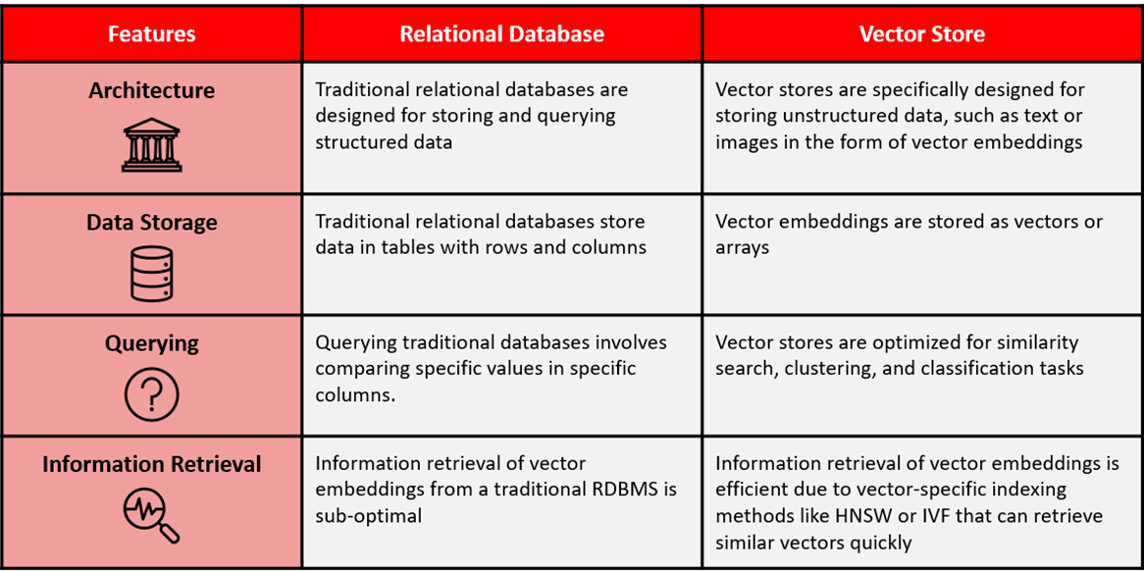
RDMS vs Vector Store

Slide 5
What is a Vector Database?
All of these new applications rely on vector embeddings, a type of data representation that carries within it semantic information that’s critical for the AI to gain understanding and maintain a long-term memory they can draw upon when executing complex tasks.
Embeddings are generated by AI models (such as Large Language Models) and have a large number of attributes or features, making their representation challenging to manage. In the context of AI and machine learning, these features represent different dimensions of the data that are essential for understanding patterns, relationships, and underlying structures.
That is why we need a specialized database designed specifically for handling this type of data. Vector databases like Chroma DB fulfill this requirement by offering optimized storage and querying capabilities for embeddings. Vector databases have the capabilities of a traditional database that are absent in standalone vector indexes and the specialization of dealing with vector embeddings, which traditional scalar-based databases lack.

Slide 6
Type of Vector Store
vector libraries
vector databases
Vector libraries (also referred to as vector indices or vector search libraries) are popular for quick prototyping purposes and when the data size is considerably small.
These libraries do not support the usual create, read, update and delete (CRUD) support that traditional relational databases and vector databases offer; hence, they are not suitable for building scalable applications.
Vector databases are optimized for storage and the retrieval of vector embeddings with the additional capabilities to store and update the vector embeddings, as they support CRUD operations natively.
This makes them a great choice for applications that require low-latency search, such as recommendation systems, search engines and chatbots. Vector databases are typically more focused on enterprise-level production deployments as opposed to vector libraries that are used for quick prototyping.

Slide 7
Vector Libraries vs Vector DB
Facebook- FAISS
Spotify- ANNOY
Google – SCaNN
NMSLIB
Chroma
PineCone
Milvus
Weviate
Qdrant

Slide 8
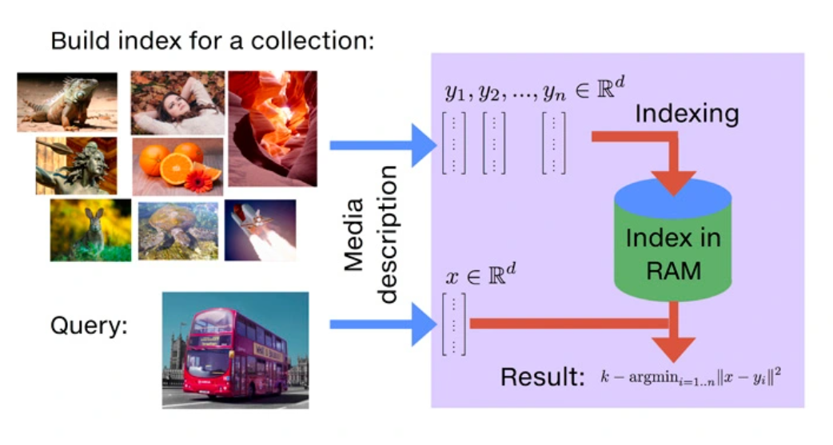
Vector Library
Faiss: Faiss is a library for efficient similarity search and clustering of dense vectors. It supports various index types and offers features such as searching multiple vectors at once, different distance metrics, and saving the index to disk. Faiss is primarily developed by the Metas Fundamental AI Research group and is widely used for similarity search

Slide 9
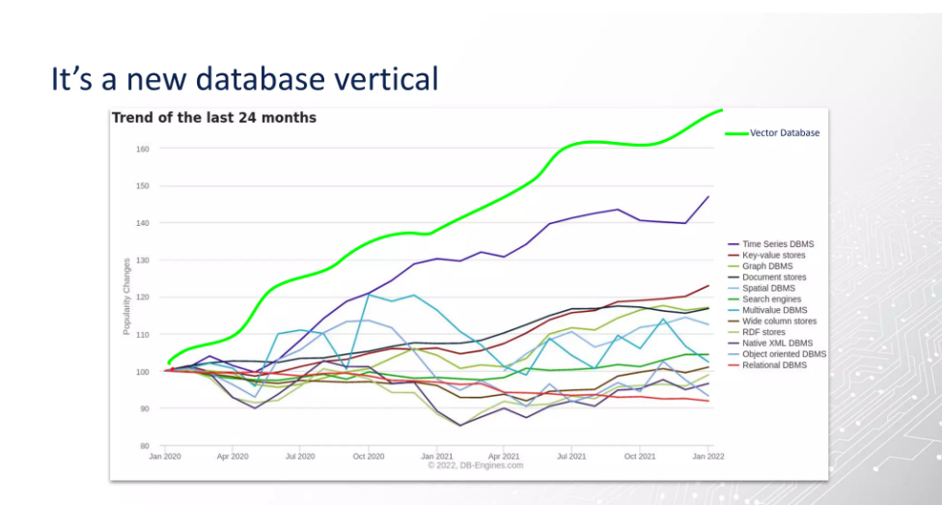

Slide 10
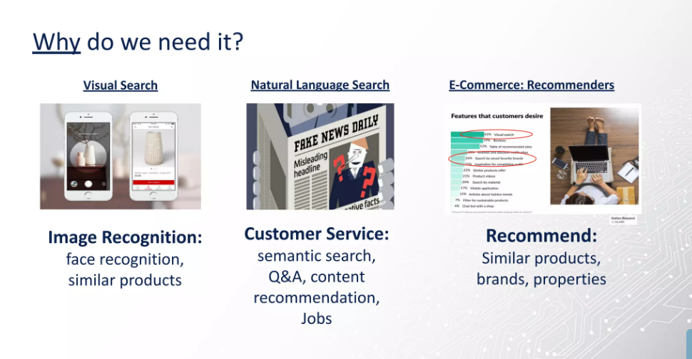

Slide 11
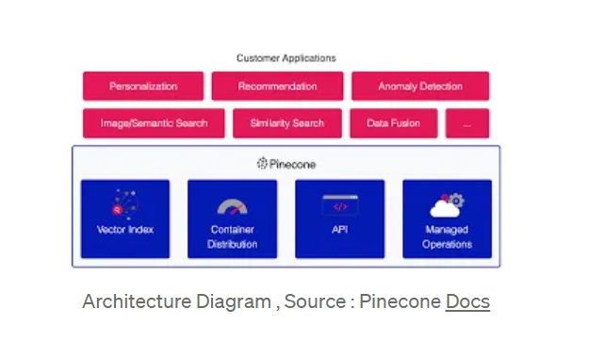
Types of Vector Database
Pinecone: Pinecone is a cloud-based managed vector database designed for building and deploying large-scale machine learning applications. It offers a simple and intuitive interface, making it developer-friendly. Pinecone uses closed-source code and provides an infrastructure management layer, allowing developers to focus on application development

Slide 12
Types of Vector Database
Chroma: Chroma is a flexible vector database solution that can be deployed on the cloud or as an on-premise solution. It supports multiple data types and formats, making it suitable for a wide range of applications, especially audio-based search engines and music recommendations

Slide 13
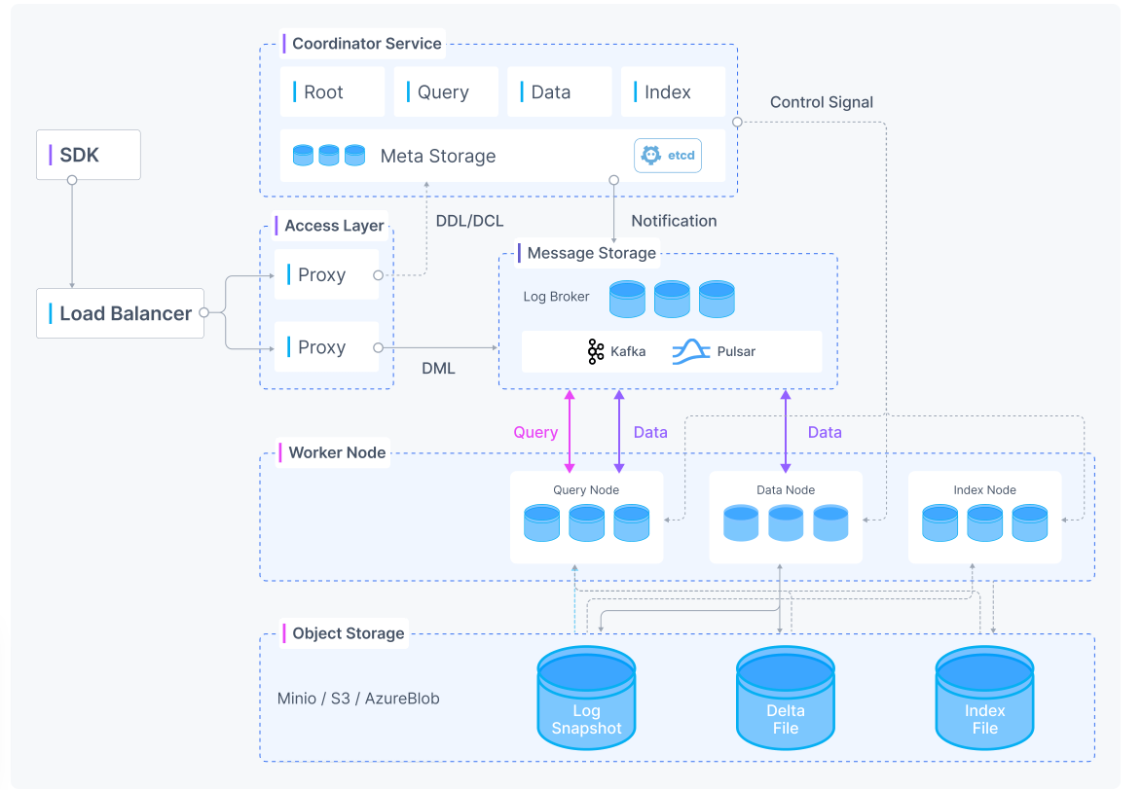
Types of Vector Database
Milvus: Milvus is an open-source vector database that can manage trillions of vector datasets. It supports multiple vector search indexes and built-in filtering. Milvus is designed for scalability and provides features such as time travel and user-defined functions (UDFs)

Slide 14
Need for Vector DB
Traditional databases and search engines are not designed to handle the complexity and high dimensionality of modern data, such as images, videos, and text embeddings.
Vector databases index data as vectors and use similarity search algorithms to efficiently search for and retrieve similar data points based on their distance or similarity to a query point.
This enables faster and more accurate analysis of high-dimensional data, unlocking the potential for a wide range of applications, such as e-commerce recommendations, autonomous vehicle systems, and natural language processing.
Vector databases like Pinecone can provide real-time indexing and search capabilities, making them well-suited for applications with low latency requirements.

Slide 15
Need for Vector DB
Vector databases can also be easily scaled to handle large amounts of data and traffic, and can be integrated with a variety of existing systems and platforms.
The need for vector databases will only continue to grow as the amount of high-dimensional data continues to increase, making them an important technology for data-driven industries and applications

Slide 16
Need for Vector DB
Scalability: One of the main advantages of Pinecone is its scalability. It can scale to handle large datasets without sacrificing performance. However, as the dataset size increases, the cost of running Pinecone may also increase, depending on the specific use case.
Performance: Pinecone’s real-time similarity search capabilities are a major advantage, particularly in applications where real-time decisions need to be made. However, achieving high performance may require specialized hardware or software, which could increase the overall cost of using Pinecone.
Flexibility: Pinecone can be used for a variety of applications, making it a flexible tool for developers. However, it may require some level of technical expertise to use effectively.
Maintenance: Pinecone is relatively easy to maintain and update, which can save time and resources. However, ongoing support and monitoring may be required to ensure the system continues to perform optimally.

Slide 17


Slide 18
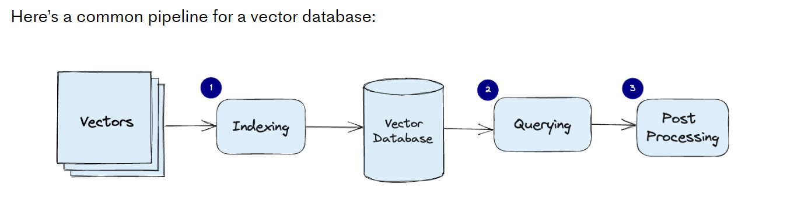
How does a vector database work?
n traditional databases, we are usually querying for rows in the database where the value usually exactly matches our query. In vector databases, we apply a similarity metric to find a vector that is the most similar to our query.
A vector database uses a combination of different algorithms that all participate in Approximate Nearest Neighbor (ANN) search. These algorithms optimize the search through hashing, quantization, or graph-based search.
These algorithms are assembled into a pipeline that provides fast and accurate retrieval of the neighbors of a queried vector. Since the vector database provides approximate results, the main trade-offs we consider are between accuracy and speed. The more accurate the result, the slower the query will be. However, a good system can provide ultra-fast search with near-perfect accuracy.

Slide 19
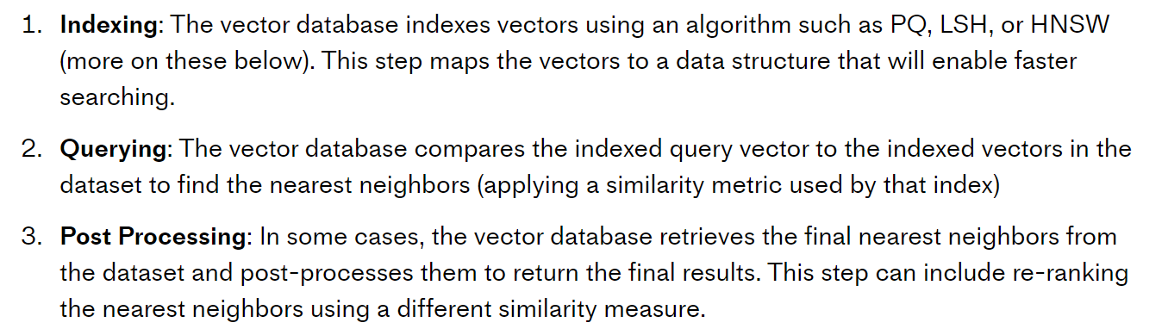

Slide 20
Vector Database - Chroma
Chroma DB is an open-source vector storage system (vector database) designed for the storing and retrieving vector embeddings. Its primary function is to store embeddings with associated metadata for subsequent use by extensive language models. Moreover, it can serve as a foundation for semantic search engines that operate on textual data. Vector database offers an ideal solution for managing large volumes of unstructured and semi-structured data.

Slide 21
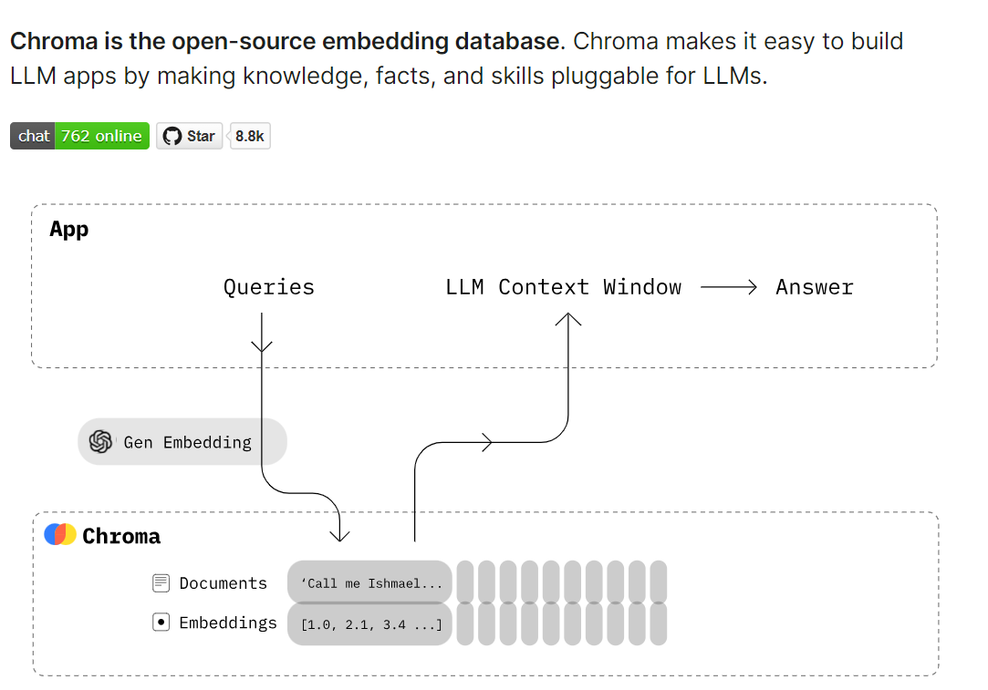

Slide 22


Chroma gives you the tools to:
store embeddings and their metadata
embed documents and queries
search embeddings
Chroma prioritizes:
simplicity and developer productivity
analysis on top of search
it also happens to be very quick
Link: https://docs.trychroma.com/api-reference

Slide 23
Import functions
.create_collection()
.list_collections()
.delete_collections
Collection.add()
Collection.peak()
Collection.get()

Slide 24
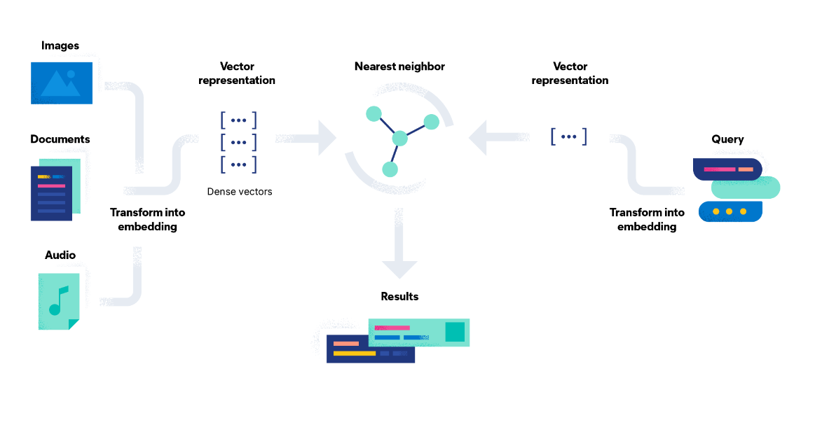
Types of Vector Database
Elasticsearch: Elasticsearch is a distributed search and analytics engine that supports various types of data. It also supports vector fields, which store dense vectors of numeric values. Elasticsearch added support for indexing vectors into a specialized data structure to enable fast k-nearest neighbor (kNN) retrieval. It also added support for native natural language processing (NLP) with vector fields

