Slide 1

7 Practical Design Patterns for Agentic Systems
A practical guide to building LLM-powered applications — from tightly controlled workflows to fully autonomous multi-agent systems.

Slide 2
What Are Agentic Systems?
Andrew Ng's Insight
Our Definition
"Rather than having to choose whether or not something is an agent in a binary way, it would be more useful to think of systems as being agent-like to different degrees."
Agentic systems use LLMs to decide the execution flow of an application with varying degrees of autonomy — from limited decisions within structured workflows to fully autonomous task execution with minimal human intervention.
The degree of "agenticity" is defined by how much decision-making authority is delegated to the LLM.

Slide 3
7 Patterns at a Glance
01
02
03
Controlled Flows
LLM as a Router
Parallelization
Fixed sequence, LLMs act within steps
Smart routing to specialized workflows
Multiple LLMs working simultaneously
04
05
06
Reflect & Critique
Human in the Loop
Agents
Generator + evaluator feedback loop
Human oversight at critical points
LLM-driven step sequencing with tools
07
Multi-Agent
Collaborative networks of agents

Slide 4
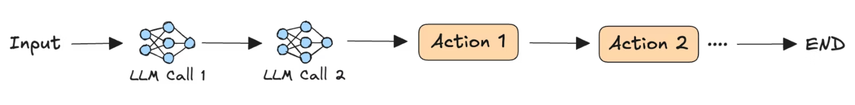
PATTERN 1
Controlled Flows
LLMs perform tasks like content generation and analysis within each step, but the sequence of steps and transition rules are fixed by design. The LLM operates freely within a step but cannot choose what comes next.
When to Use
Use Cases
Tasks decomposable into well-defined subtasks where reliable, deterministic outcomes are required despite LLM usage.
Content review: Automate grammar, style, and fact-checking before human technical review
NL to query: Sequential workflow to identify query parameters and synthesize answers

Slide 5
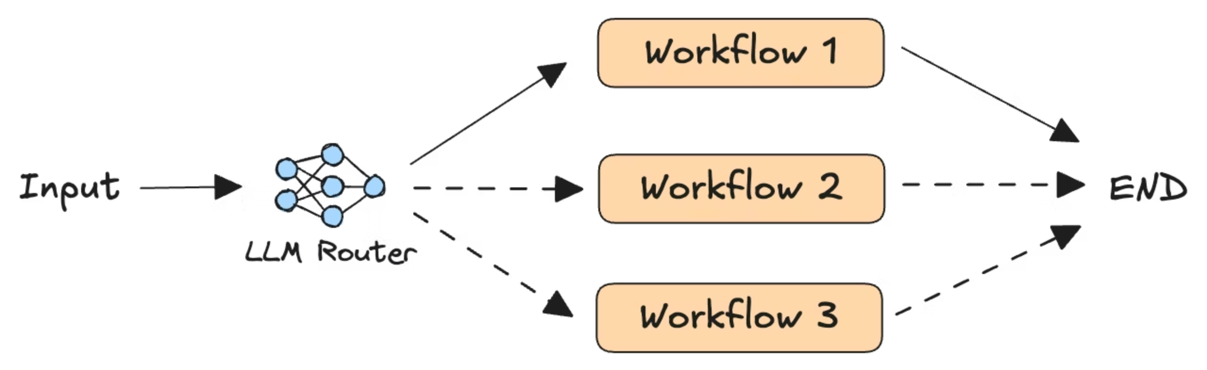
PATTERN 2
LLM as a Router
Queries are routed among a set of specialized workflows based on an LLM's categorization of the input — like a smart switch directing traffic. Workflows may use different prompts, model sizes, fine-tuned models, or microservices.
When to Use
Use Cases
Incoming requests span diverse topics and complexity levels that can be reliably categorized by content.
Customer service: Route requests to the appropriate department workflow
Resource-efficient routing: Simple questions → smaller LLMs; complex questions → reasoning models

Slide 6
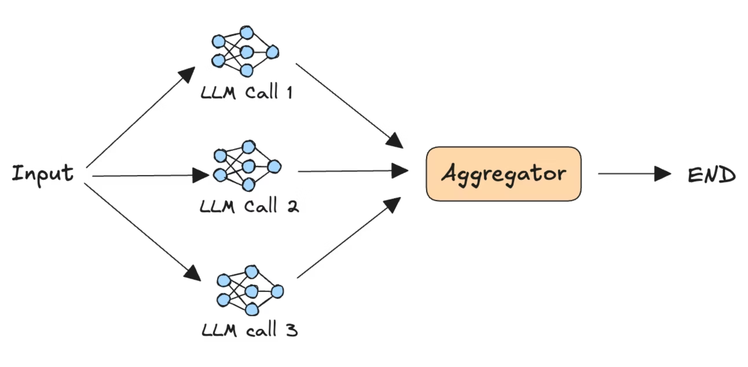
PATTERN 3
Parallelization
Several LLMs work simultaneously on the same task or subtasks, with outputs aggregated by another LLM or custom logic. Benefits include reduced latency and improved focus — each LLM concentrates on a specific part of the problem.
When to Use
Use Cases
Tasks that can be split into independent subtasks, or where multiple LLMs attempting the same task improves reliability.
LLM-as-a-judge: Multiple LLMs simultaneously evaluate different aspects of a response
Code generation: Different LLMs generate code; the most efficient snippet is selected

Slide 7
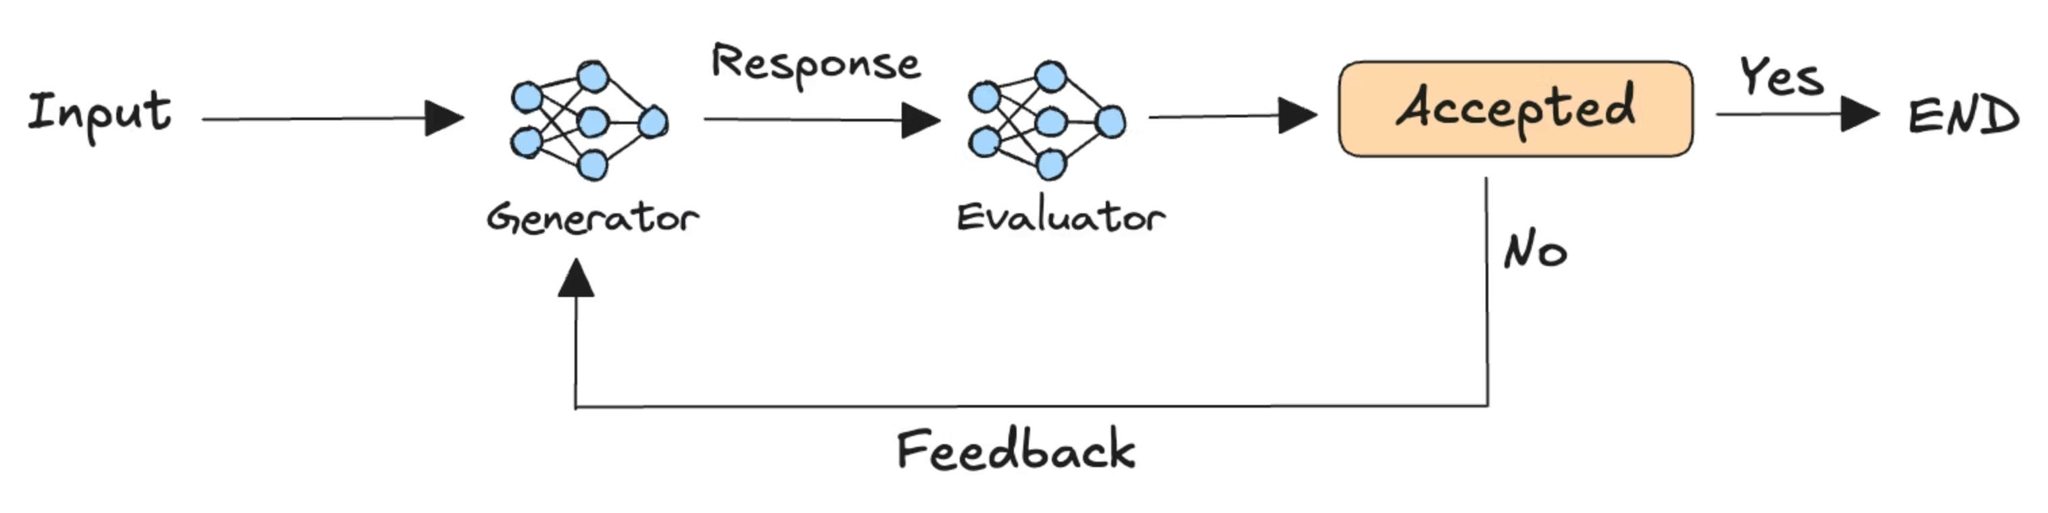
PATTERN 4
Reflect and Critique
A generator LLM produces a response while an evaluator LLM reflects on it and provides feedback. The loop continues until the evaluator accepts the output. Evaluation criteria must be clearly defined for effective reasoning.
When to Use
Use Cases
Tasks where iterative refinement based on human-like feedback yields more accurate, reliable, or cohesive results.
Report generation: Evaluator checks style, detail, and diagrams; recommends improvements
Code refinement: Generator writes code; evaluator acts as reviewer suggesting optimizations

Slide 8
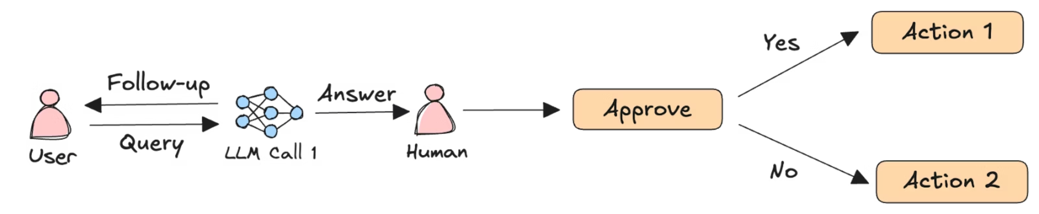
PATTERN 5
Human in the Loop
Human input is incorporated into an otherwise automated LLM pipeline. Humans can review, validate, edit, or override LLM outputs at critical points, and LLMs can seek clarification during multi-turn conversations — significantly improving reliability for sensitive tasks.
When to Use
Use Cases
Complete automation is infeasible or undesirable due to potential consequences of bad outcomes. Human clarification benefits all LLM workflows given natural language ambiguity.
Computer use: Automate web tasks, but authentication steps (2FA, CAPTCHAs) require humans
Insurance claims: LLMs analyze and recommend; human adjusters make final determinations

Slide 9
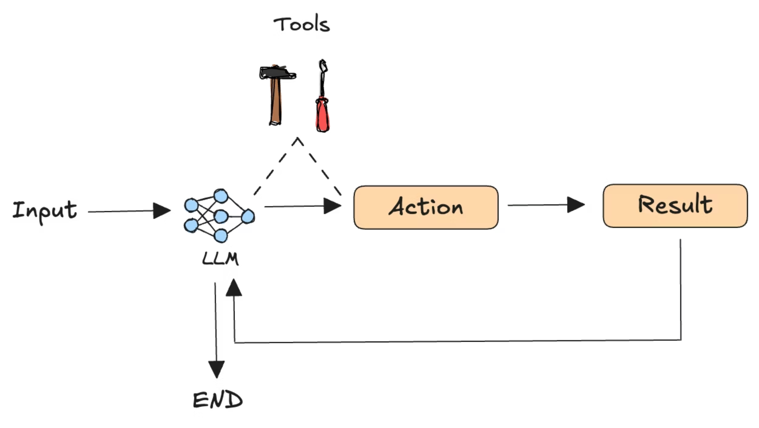
PATTERN 6
Agents
The classic "AI agent" pattern. Unlike earlier patterns, agents use LLMs to determine the sequence of steps required to complete a task. They take actions via tools and reason through previous results to inform next actions — making them extremely flexible for complex tasks.
When to Use
Use Cases
Tasks without a structured workflow, with high latency tolerance, where non-deterministic outputs are acceptable.
Adaptive learning: Analyze student performance to adjust topics and difficulty dynamically
Building software: Iteratively generate, test, debug, and refine full-stack applications
You can combine human-in-the-loop and reflect-and-critique patterns with agents to improve reliability.

Slide 10
PATTERN 7
Multi-Agent Systems
The ultimate evolution of AI agents — multiple agents collaborating to accomplish complex tasks. Three primary architectures exist depending on your application's needs.
Supervisor
Network
Custom
A single supervisor agent interfaces with a group of agents to determine the next course of action.
Each agent can communicate with every other agent and decide which one to call next or end execution.
You decide which agents interact with each other and how control flows between them.

Slide 11
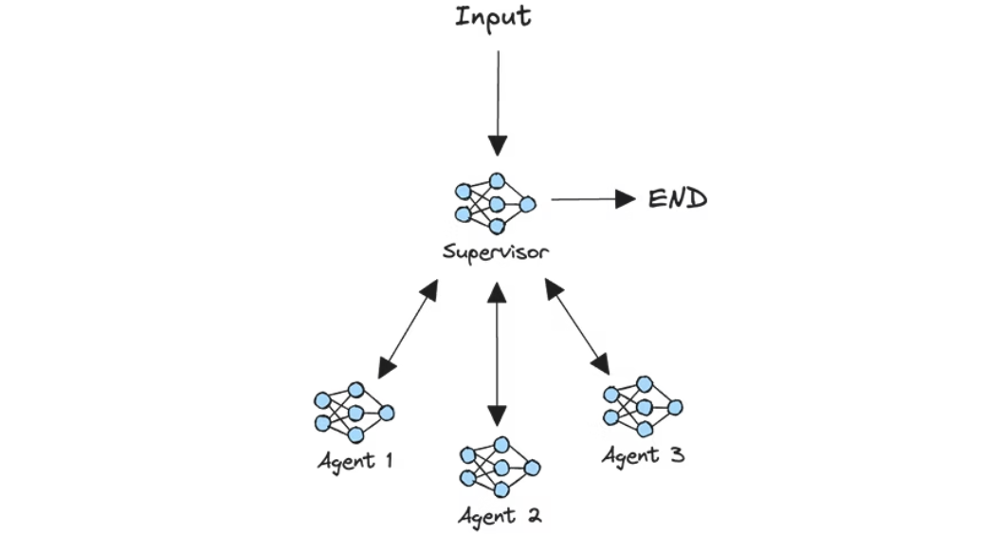
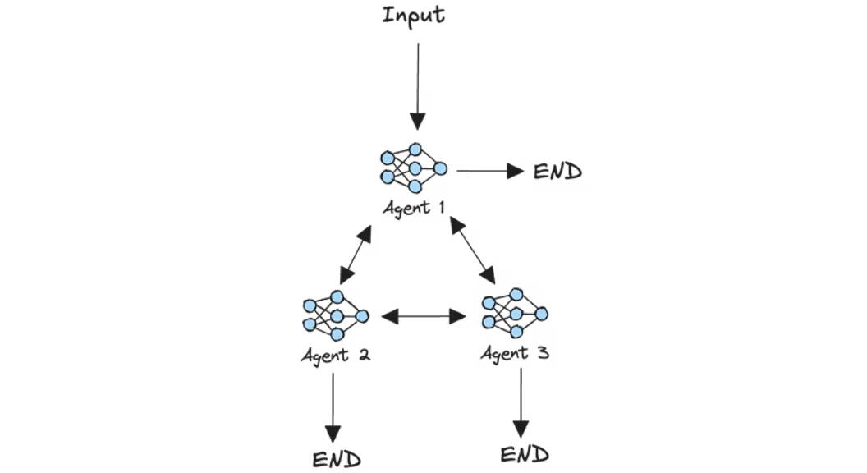
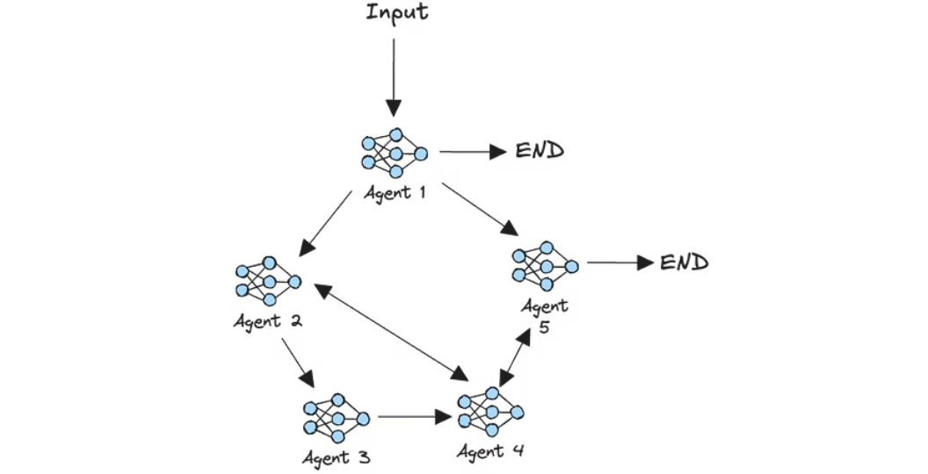
Multi-Agent: Architecture Diagrams
Supervisor Architecture
Network Architecture
Custom Architecture

Slide 12
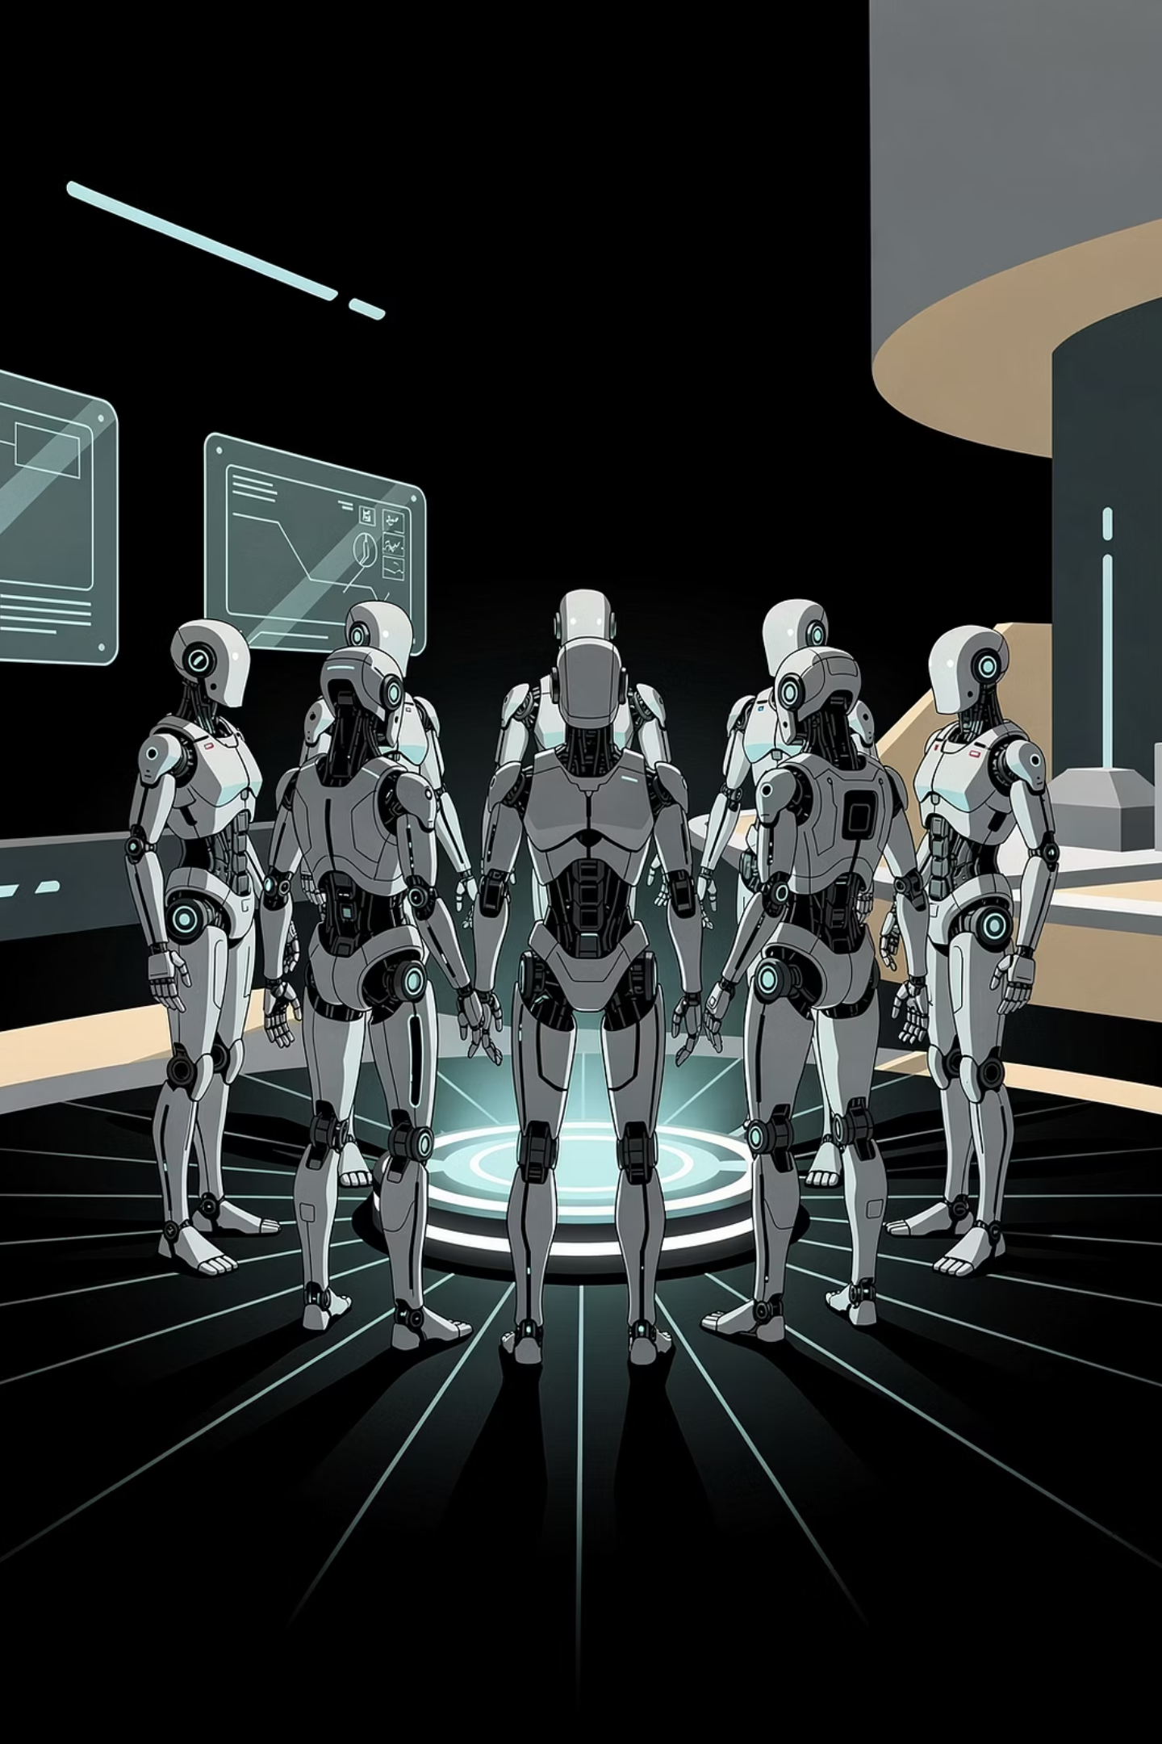
Multi-Agent: When to Use & Use Cases
When to Use
Use Cases
Multi-agent architectures push LLM autonomy for open-ended or experimental tasks. For real-world use cases, start with simpler patterns first. Use multi-agent only when unpredictable outcomes are acceptable — they come with higher costs, latency, and debugging complexity.
Scientific discovery: Agents specialized in literature review, experimental design, testing, and validation collaborate to generate and test novel hypotheses
Multimedia storytelling: Agents with different artistic specialties create storylines, characters, visuals, and music for generative storytelling

Slide 13


Choosing the Right Pattern
The right design pattern depends on your application's core requirements. Consider these key parameters:
Reliability
Workflow Structure
How critical is it that outputs are accurate and deterministic?
Is the task well-defined and sequential, or open-ended?
Task Complexity
Consequence of Failure
Can the task be decomposed into clear subtasks?
What are the stakes if the LLM produces a bad outcome?
Start with the simplest architecture that could work. Add complexity only when there is clear evidence it is needed.

Slide 14
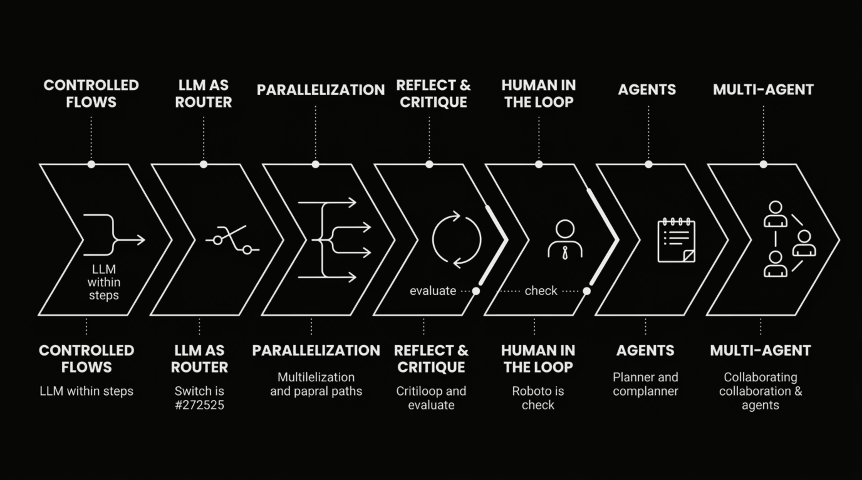

Autonomy Spectrum
The seven patterns span a spectrum from tightly controlled to highly autonomous. Use this as a guide when selecting your starting point.
Each step up the spectrum increases flexibility and capability — but also raises costs, latency, and unpredictability. Match the pattern to your actual requirements, not the most impressive-sounding option.

Slide 15

Conclusion & Next Steps
We covered 7 agentic design patterns ranging from tightly controlled systems to highly autonomous ones. Rather than chasing the latest innovation, focus on your specific needs. Start simple, evaluate carefully, and add components only when clearly needed.
🧠 AI Learning Hub
💻 GenAI Showcase
💬 Community Forums
Explore MongoDB's extensive AI resources and tutorials to get started building agentic systems.
Browse the MongoDB Developer GitHub repo for notebooks and agent examples.
Share your own agentic design patterns in the MongoDB Generative AI community forums.

