Slide 1

Introduction to Agentic AI

Slide 2
Agenda-Day1
AI journey: Rule-based → ML → Deep Learning → Generative AI •
From Chatbots to Autonomous Agents
Limitation of GenAI
Telecom use case examples (customer care, network ops, churn, sales assist)

Slide 3
AI Use Cases in Telecommunications
1. Network Optimization
AI helps telecom companies optimize network traffic, bandwidth allocation, and service quality in real time.
Key Applications
Intelligent traffic routing
Load balancing
Congestion prediction
Dynamic bandwidth allocation
5G network optimization
Benefits
Reduced downtime
Better customer experience
Improved network reliability
Lower operational costs

Slide 4
AI Use Cases in Telecommunications
2. Predictive Maintenance
AI models analyze network equipment and infrastructure data to predict failures before they occur.
Key Applications
Tower equipment monitoring
Hardware failure prediction
Automated fault detection
Preventive maintenance scheduling
Benefits
Reduced outages
Lower repair costs
Faster issue resolution
Improved SLA compliance

Slide 5
AI Use Cases in Telecommunications
AI-Powered Customer Support
Telecom providers use AI chatbots and virtual assistants to automate customer interactions.
Key Applications
AI chatbots
Voice bots
Smart IVR systems
Automated ticket resolution
Multilingual customer support
Benefits
24x7 support
Faster response times
Reduced call center workload
Personalized customer interactions

Slide 6
AI Use Cases in Telecommunications
Fraud Detection and Revenue Assurance
AI systems monitor telecom transactions and usage patterns to identify suspicious activities.
Key Applications
SIM fraud detection
Subscription fraud detection
Roaming fraud monitoring
Billing anomaly detection
Benefits
Reduced financial losses
Faster fraud identification
Improved compliance
Revenue protection

Slide 7
AI Use Cases in Telecommunications
. Personalized Customer Experience
AI analyzes customer behavior and usage patterns to deliver personalized services.
Key Applications
Personalized data plans
Targeted marketing
Churn prediction
Recommendation engines
Smart offers and upselling
Benefits
Higher customer retention
Increased ARPU (Average Revenue Per User)
Better engagement
Improved customer satisfaction

Slide 8
Generative AI
A subset of Artificial Intelligence (AI)
Enables machines to generate new, original content
Uses machine learning algorithms to create novel outputs
Can generate text, images, music, and more
Trained on large datasets to learn patterns and relationships
Notes:
it's a type of AI that enables machines to generate new, original content. This can be anything from text to images to music, and it's all made possible by machine learning algorithms and large datasets

Slide 9
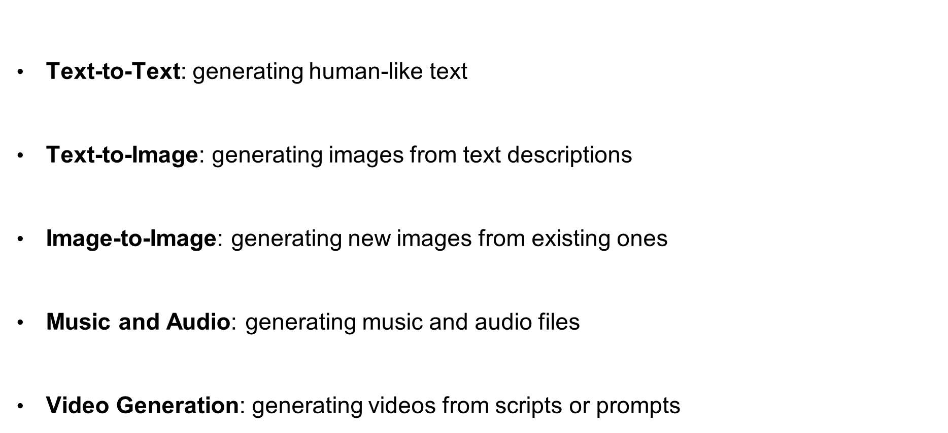
Types of GenAI
Text-to-Text: generating human-like text
Text-to-Image: generating images from text descriptions
Image-to-Image: generating new images from existing ones
Music and Audio: generating music and audio files
Video Generation: generating videos from scripts or prompts
Notes:
From generating human-like text to creating new images and music, the possibilities are endless. Each type of GenAI has its own unique applications and use cases.

Slide 10
Limitation of GenAI
It generates responses based on prompts but doesn't autonomously pursue long-term objectives or complete tasks without continuous prompting.
Generative models usually lack persistent memory across sessions.
Generative AI struggles with multi-step reasoning or breaking down complex tasks
Generative AI doesn’t interact with external tools or systems (APIs, databases, web browsers) unless explicitly connected.
ChatGPT or other LLMs just respond to prompts — no looped execution or self-initiated action.
Generative AI is a single-agent model, not designed for coordination between multiple AI entities.
LLMs may hallucinate but don’t typically verify or improve their answers over time.

Slide 11

AI Agents
AI agent is an autonomous entity capable of perceiving its environment, making decisions, and taking actions to achieve specific goals. Agents can vary in complexity from simple reactive agents that respond to stimuli to more advanced intelligent agents that learn and adapt over time.
Types of agents include:
Reactive Agents: Respond directly to environmental changes without internal memory.
Model-Based Agents: Use internal models of the world to make decisions.
Goal-Based Agents: Plan actions based on achieving specific goals.
Utility-Based Agents: Evaluate potential actions based on a utility function to maximize outcomes.

Slide 12
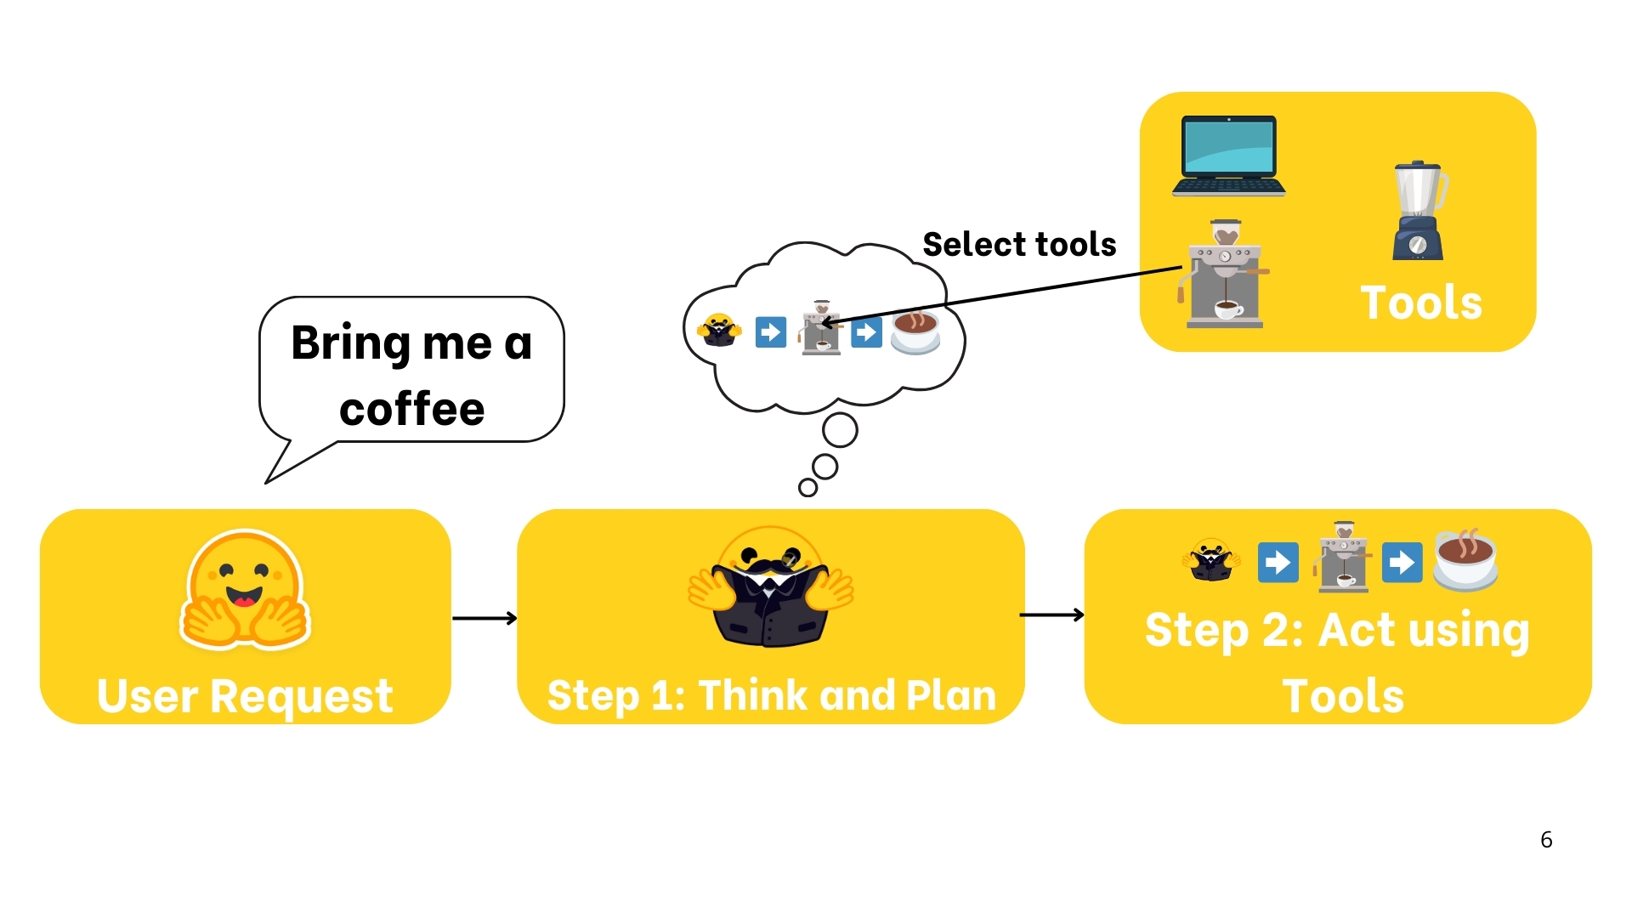
What is AI Agent

Slide 13
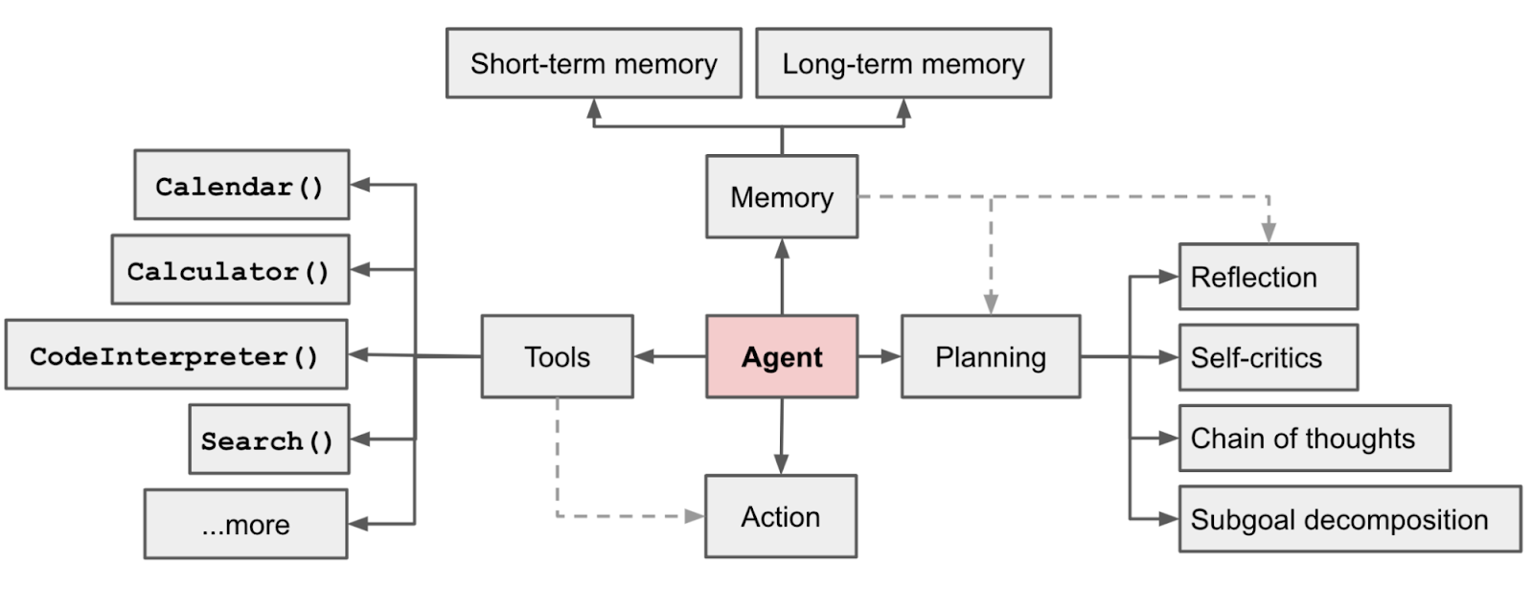
Agent
Source: https://lilianweng.github.io/posts/2023-06-23-agent/

Slide 14
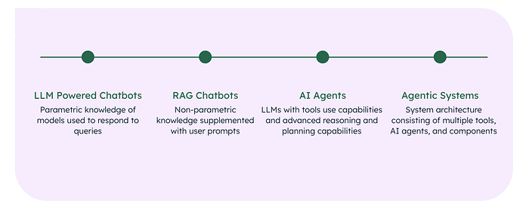
From LLMs to AI agents
1.1 Traditional chatbots to LLM-powered chatbots
Heuristic-Based Responses:
Traditional chatbots operated on rule-based logic (“if-then” statements).
Limited to predefined rules and unable to manage complex or ambiguous queries.
Canned Responses:
Responses were static and predefined.
Triggered by detecting specific keywords or phrases.
Lacked flexibility and conversational depth.
Human Handoff:
Always included a “Speak to a human” button for unresolved queries.
Human intervention remained essential for handling complex issues.

Slide 15
1.2 Introduction of LLM-Powered Chatbots
Launch of ChatGPT: On November 30, 2022, OpenAI introduced ChatGPT, powered by GPT-3.5, as the first mainstream LLM application. ChatGPT retained the familiar chatbot interface but was backed by advanced LLM technology trained on a vast internet corpus.
Limitations:
Personalization: Struggles to maintain consistent, personalized interactions over long conversations.
Hallucinations: Can produce factually incorrect but coherent responses, generating outputs based on probabilities rather than verified knowledge.
1.3 From LLM-Powered Chatbots to RAG Chatbots and AI Agents
RAG Chatbots: Retrieval-Augmented Generation (RAG) combines external data retrieval with LLM capabilities to produce accurate and contextually grounded responses.
Sources of Knowledge:
Non-Parametric Knowledge: Real-time data retrieved from external sources like the internet or proprietary databases.
Parametric Knowledge: Embedded knowledge within the LLM from its training.

Slide 16
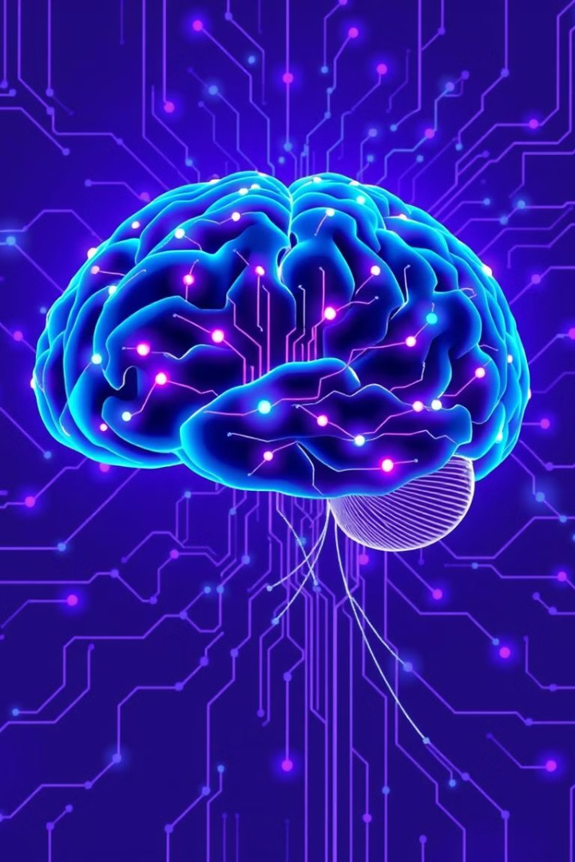
Key Characteristics of AI Agent
1
Goal-Oriented
2
Autonomous
AI Agent systems are designed with specific goals in mind, driving their actions and decisions.
They can operate independently, making decisions and taking actions without constant human intervention.
3
Self-Learning
4
Contextual Awareness
AI Agent continuously learns and improves its performance based on data and feedback.
They can understand and adapt to changing contexts, making decisions based on real-time information.

Slide 17

Use cases
Customer Service Automated chatbots handling initial customer inquiries
Virtual assistants providing 24/7 support
AI agents resolving common issues without human intervention
Personal Productivity Digital assistants managing calendars and scheduling
Email sorting and prioritization agents
Task management systems with intelligent recommendations
Healthcare Diagnostic support agents analyzing patient symptoms
Medication management assistants for patients
Administrative agents handling appointment scheduling and records
Financial Services Robo-advisors managing investment portfolios
Fraud detection agents monitoring transactions
Insurance claim processing automation

Slide 18
Sales and Marketing Lead qualification and scoring agents
Personalized product recommendation engines
Marketing automation tools optimizing campaigns
Manufacturing and Supply Chain Predictive maintenance agents monitoring equipment
Inventory optimization systems
Quality control agents detecting defects
Education Tutoring agents providing personalized learning
Grading assistants evaluating assignments
Course recommendation agents suggesting appropriate classes
Home Automation Smart home assistants controlling devices and systems
Security monitoring agents detecting unusual activity
Energy optimization agents managing consumption
Sales and Marketing Lead qualification and scoring agents
Personalized product recommendation engines
Marketing automation tools optimizing campaigns
Manufacturing and Supply Chain Predictive maintenance agents monitoring equipment
Inventory optimization systems
Quality control agents detecting defects
Education Tutoring agents providing personalized learning
Grading assistants evaluating assignments
Course recommendation agents suggesting appropriate classes
Home Automation Smart home assistants controlling devices and systems
Security monitoring agents detecting unusual activity
Energy optimization agents managing consumption

Slide 19
✅ When to use agents / ⛔ When to avoid them
Task: You want to build a system that automatically collects product reviews from competitor websites, analyzes sentiment, extracts feature requests, and emails a summary to the product team every Monday.
Solution Using an AI Agent
An AI Agent is a good fit because the task is:
Goal-driven: "Get weekly insights from competitor reviews"
Multi-step: Browse → Scrape → Analyze → Summarize → Email
Tool-based: Needs access to browser tools, NLP libraries, and email API
Autonomous: Should run weekly without manual intervention
Example Workflow for the Agent:
Web Scraper Tool: Extracts latest reviews from competitor websites.
Sentiment Analyzer (NLP pipeline): Analyzes each review.
LLM Tool: Extracts key themes, complaints, and feature requests.
Summarizer: Generates a weekly insights report.
Email Tool: Sends the report to a Slack channel or email inbox.
Agent Advantages:
Can adapt if some pages fail or URLs change.
Can log errors and retry steps.
Can evolve over time with feedback and memory.

Slide 20
⛔ When Not to Use an AI Agent
If the task was simpler, like: "Summarize a block of text and send it via email",
a Generative AI prompt + API script would be more efficient. You can:
Paste the reviews manually.
Use a single GPT prompt to summarize them.
Trigger an email function.
🛑 Why Not an Agent?
No need for autonomy or adaptive planning.
Simpler, faster, and cheaper to do in one shot.
Easier to debug and deploy.

Slide 21
Build An Agent

Slide 22
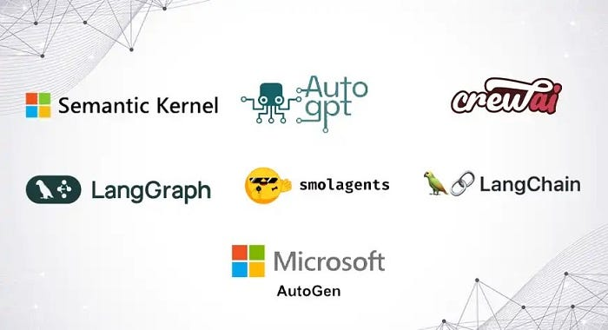
Agentic Framework

Slide 23




Frameworks
Framework | Language | Description | Best For
LangGraph | Python, Javascript | A graph-based framework built on top of LangChain, designed to coordinate multiple agents and tools with memory. | Structured agent workflows with LLMs.
CrewAI | Python | Simple and intuitive agent orchestration framework for teams of LLM agents. Uses a “Crew” and “Agent” model with roles and goals. | Task-oriented multi-agent collaboration.
AutoGen | Python | Microsoft’s framework for building LLM-powered agents that communicate via messaging. Supports human-AI and AI-AI collaboration. | Multi-agent chat and complex interactions.
AgentVerse | Python | Designed for simulating and evaluating large numbers of agents. Ideal for research on collective behaviors. | Multi-agent simulations and social dynamics.
OpenAgents | Python | Open-source project combining LangChain, FastAPI, and other tools. Allows UI integration and multi-agent task execution. | Developer-friendly agent apps.
MiniAGI | Python | Lightweight framework for building LLM-based agents using memory, tools, and recursive reasoning. | Quick experimentation with agents.
MetaGPT | Python | Treats AI agents like team members in a software company (e.g., PM, engineer, QA). Modular and production-oriented. | Building software with agent teams.

Slide 24
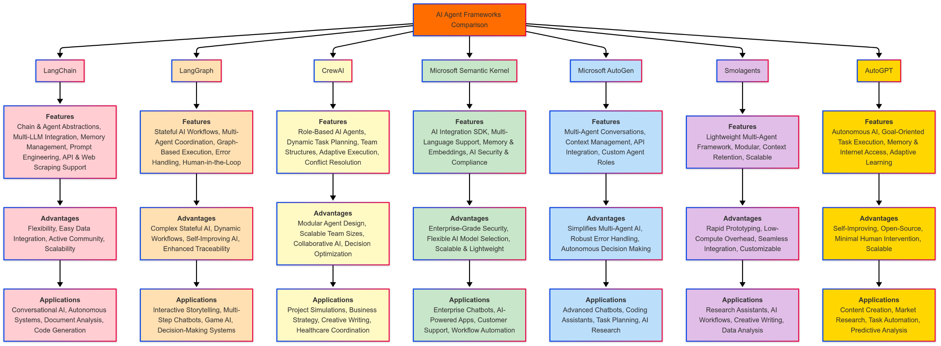

Slide 25
DEMO

Slide 26
AI Agent Pattern
Agent patterns in AI refer to design approaches that enable AI systems to act more autonomously and intelligently. These patterns, like Reflection, Tool Use, Planning, and Multi-Agent Collaboration, empower AI to reason, plan, execute tasks, and learn from their actions, mimicking human-like problem-solving capabilities.

Slide 27
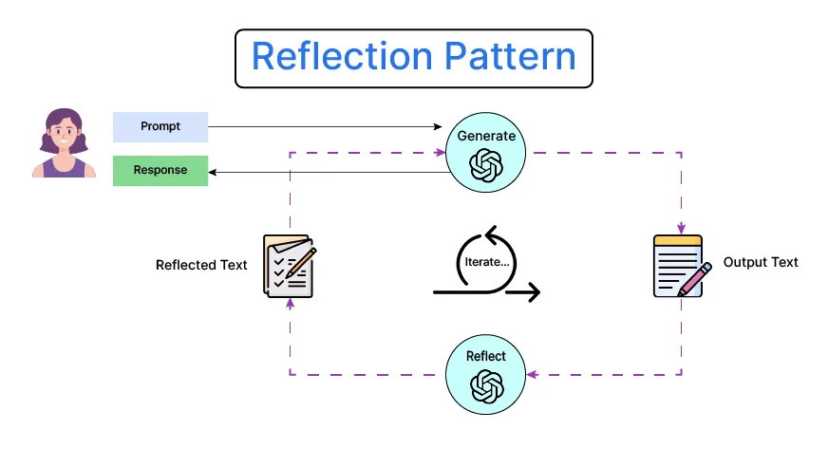
Reflection pattern
The Reflection Pattern enables an AI agent to pause and evaluate its current progress, strategy, and understanding. It often involves meta-cognition—thinking about what has been done and what needs to be adjusted to reach a goal more efficiently.
Encourages introspection and self-evaluation.
Useful for complex or multi-step tasks.
Helps identify errors and improve reasoning.
Often implemented via checkpoints or "thought loops".
Can be combined with memory modules for deeper reasoning.

Slide 28
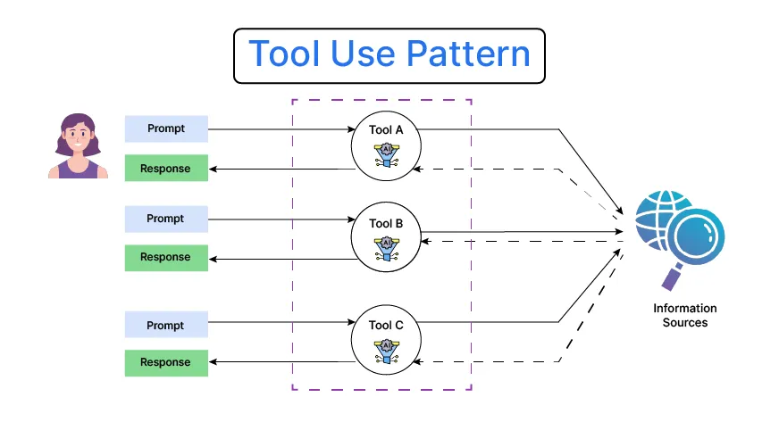
Tool Use Pattern
The Tool Use Pattern allows agents to call upon external APIs, databases, calculators, or plugins to extend their capabilities beyond native reasoning. This empowers agents to handle a wider range of tasks effectively.
Agent invokes tools like search engines, calculators, or code interpreters.
Enables solving tasks beyond language-only capabilities.
Often implemented in frameworks like LangChain or ReAct.
Requires mechanisms for selecting and invoking tools dynamically.
Important for real-world applications like retrieval-augmented generation (RAG).

Slide 29
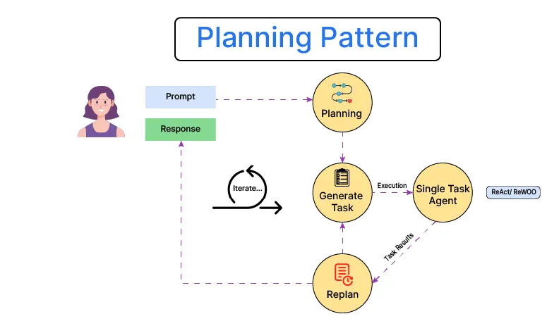
Planning pattern
The Planning Pattern involves creating a step-by-step plan before executing actions. This structure ensures logical task progression, especially for multi-step or high-stakes tasks requiring accuracy.
Agent outlines goals and subgoals in advance.
Reduces trial-and-error and improves efficiency.
Useful for code generation, reasoning, and long documents.
Often uses a planner-executor model.
Enhances transparency and traceability in agent behavior.

Slide 30
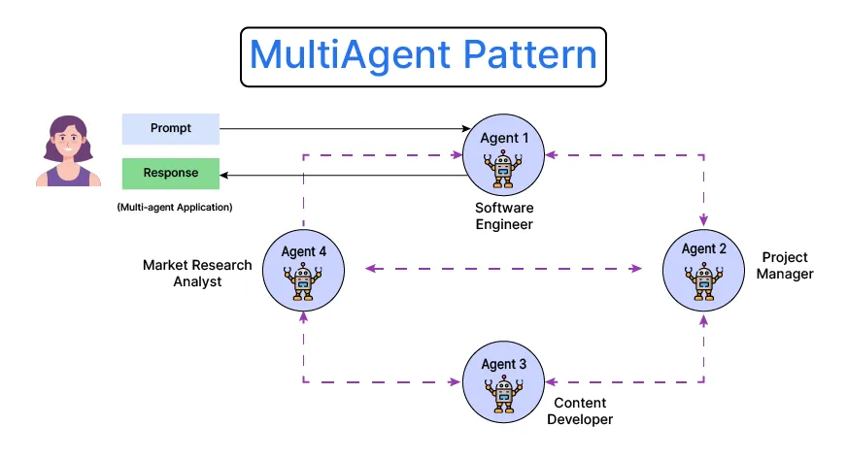
Multi-agent pattern
The Multi-Agent Pattern distributes a task across multiple specialized agents, each responsible for a specific role. These agents can collaborate, compete, or coordinate, enabling more scalable and modular solutions.
Supports parallelism and specialization.
Agents can be role-based (e.g., writer, reviewer, executor).
Encourages emergent behavior and coordination.
Ideal for complex tasks like research, code review, or game playing.
Can integrate with human feedback or supervisor agents.

Slide 31
Patterns
Each pattern offers unique strengths for building intelligent systems. Depending on task complexity, environment, and goals, one or more patterns can be combined for optimal performance.
Pattern | Strengths | Best For
Reflection | Improves self-awareness and adaptability | Debugging, strategy adjustment
Tool Use | Extends capabilities via external tools | Math, retrieval, real-world tasks
Planning | Provides structure and foresight | Multi-step reasoning, code generation
Multi-Agent | Enables collaboration and modularity | Complex, distributed task environments

Slide 32
What is agentic AI?
Agentic AI is an artificial intelligence system that can accomplish a specific goal with limited supervision. It consists of AI agents—machine learning models that mimic human decision-making to solve problems in real time. In a multiagent system, each agent performs a specific subtask required to reach the goal and their efforts are coordinated through AI orchestration.
Unlike traditional AI models, which operate within predefined constraints and require human intervention, agentic AI exhibits autonomy, goal-driven behavior and adaptability. The term “agentic” refers to these models’ agency, or, their capacity to act independently and purposefully.
Agentic AI builds on generative AI (gen AI) techniques by using large language models (LLMs) to function in dynamic environments. While generative models focus on creating content based on learned patterns, agentic AI extends this capability by applying generative outputs toward specific goals. A generative AI model like OpenAI’s ChatGPT might produce text, images or code, but an agentic AI system can use that generated content to complete complex tasks autonomously by calling external tools. Agents can, for example, not only tell you the best time to climb Mt. Everest given your work schedule, it can also book you a flight and a hotel.

Slide 33
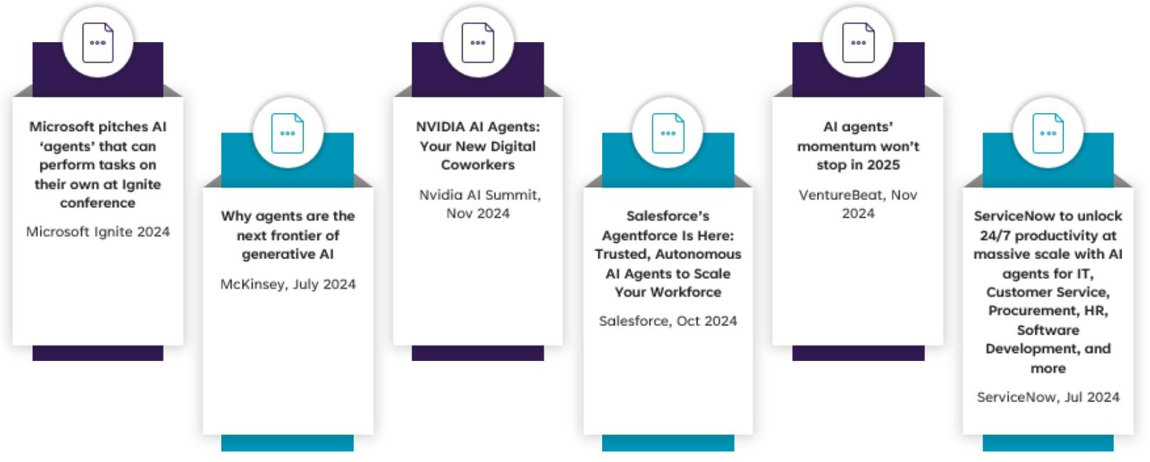
Agentic AI in the News

Slide 34
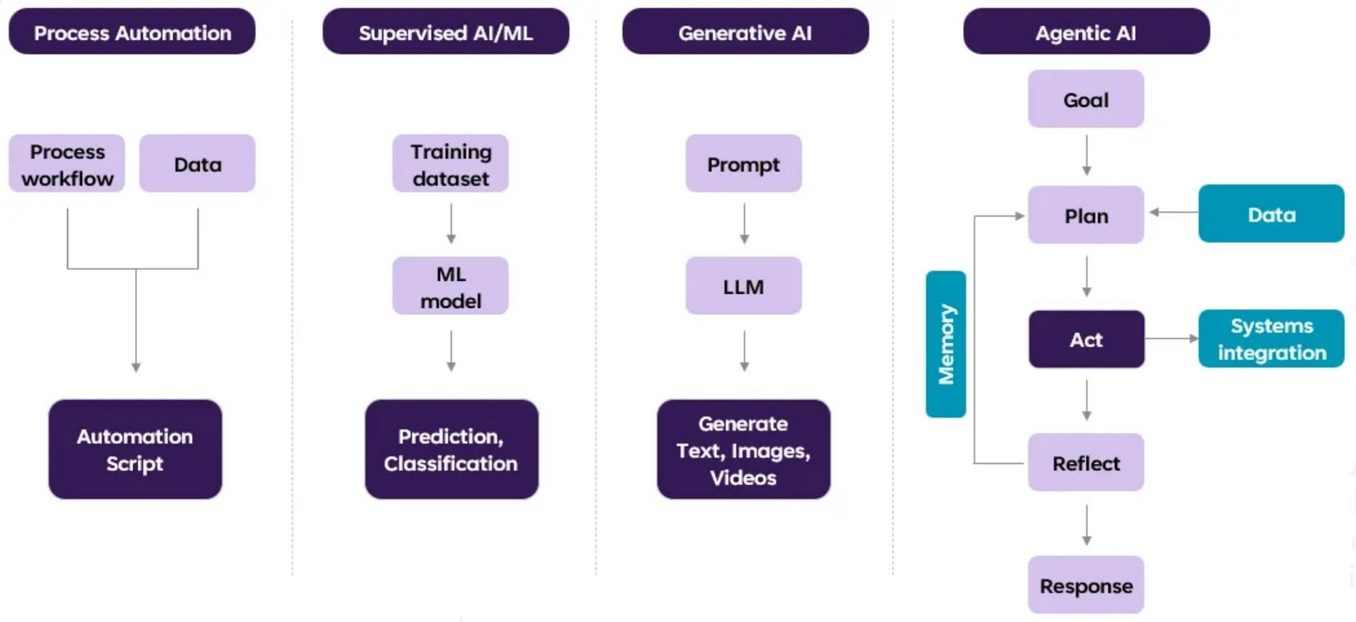
Agentic AI Evolution

Slide 35
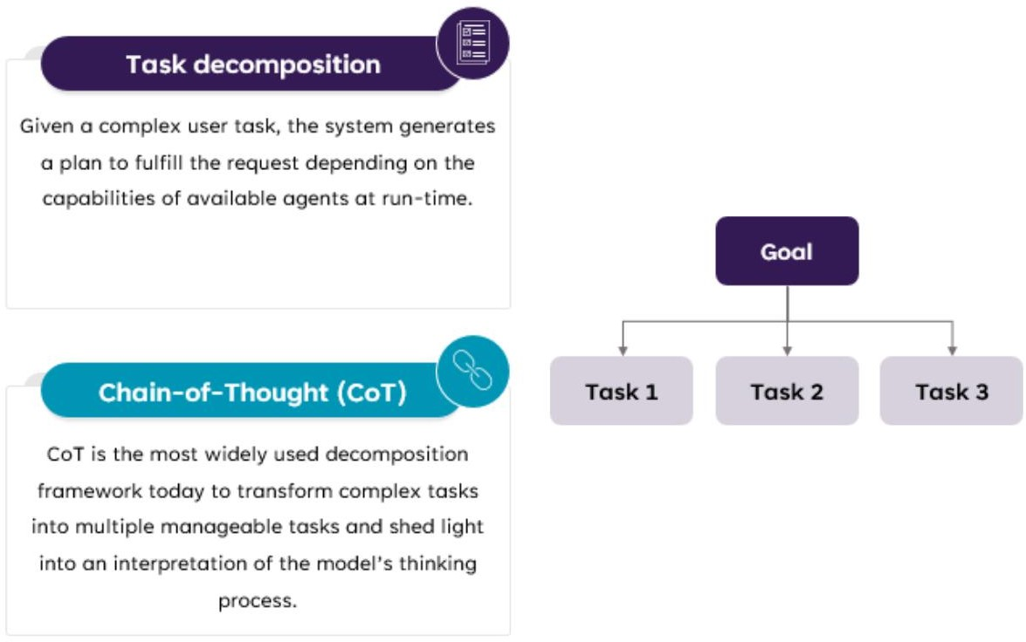
Agentic AI capabilities – Task Decomposition

Slide 36
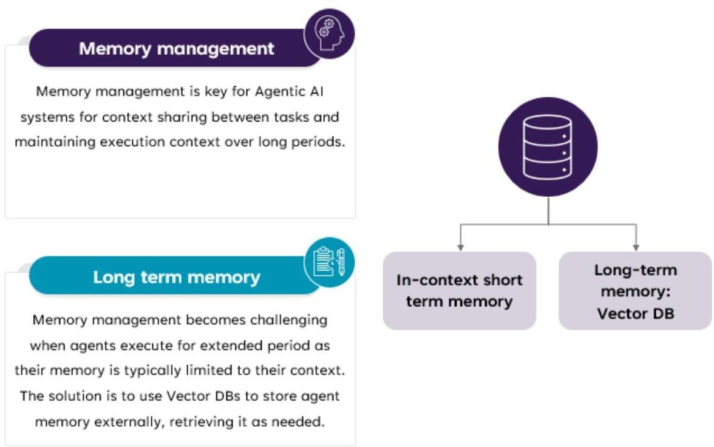
Agentic AI capabilities – Memory Management

Slide 37
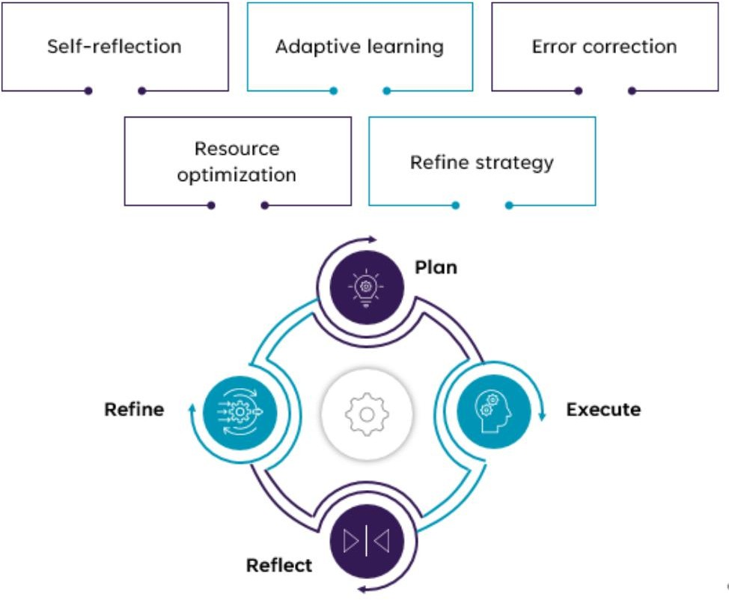
Agentic AI capabilities – Reflect & Adapt

Slide 38
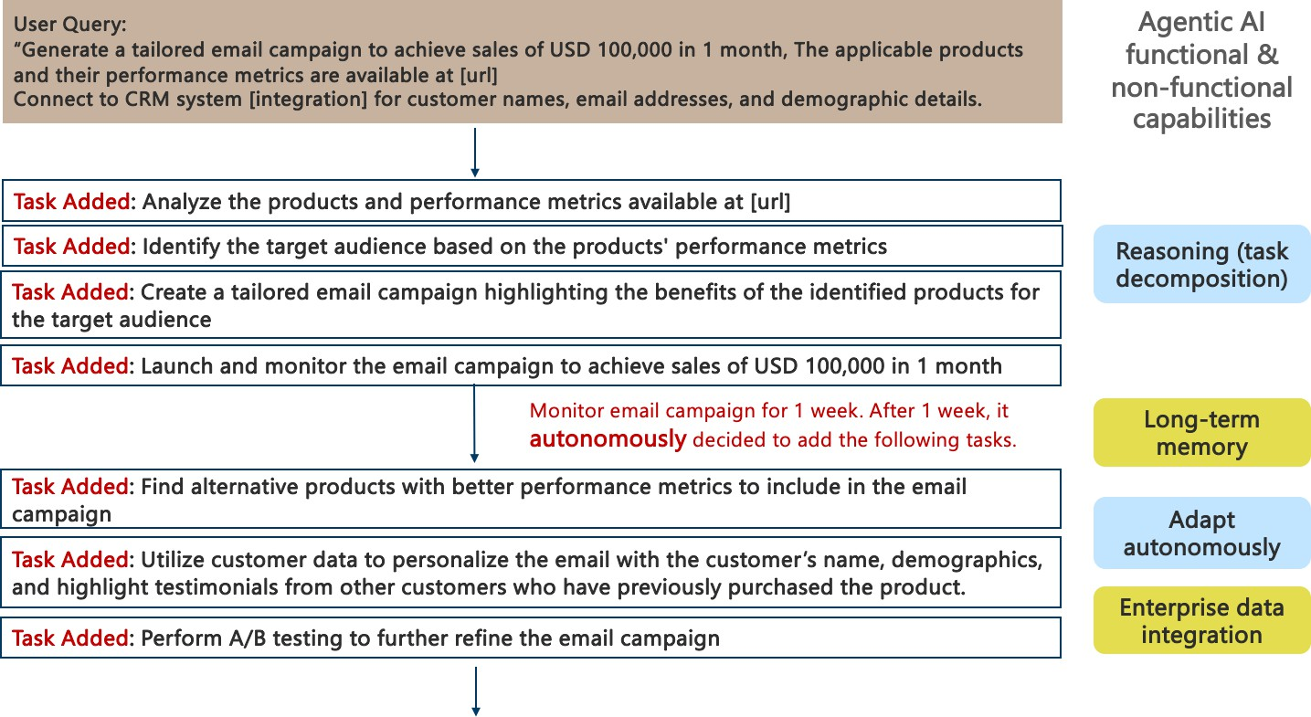
Agentic AI Use-case: Funds Email Marketing Campaign

Slide 39
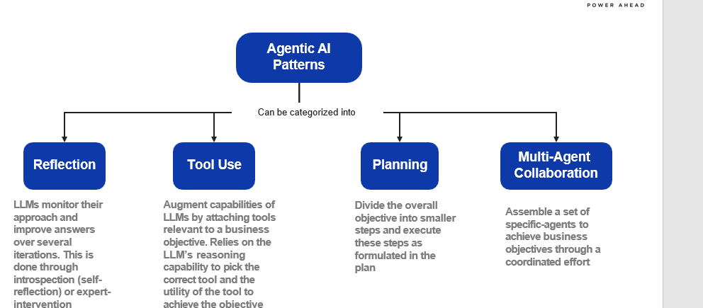
Agentic AI Pattern

Slide 40
Agentic AI Reference Architecture

Slide 41
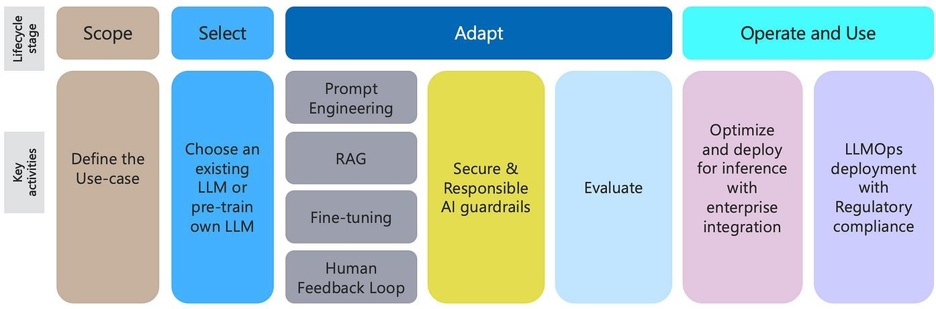
Generative AI Lifecycle

Slide 42
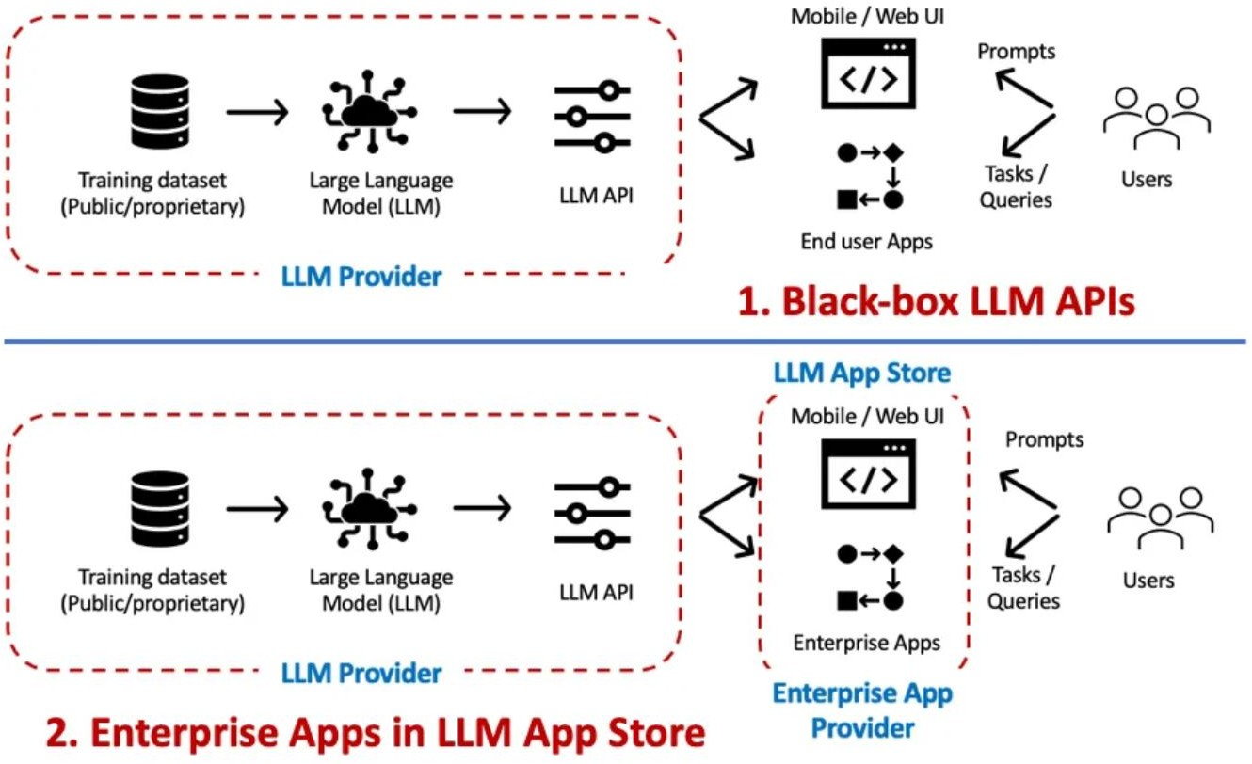
Gen AI Architecture Patterns – APIs & Embedded Gen AI
Black-box LLM APIs: This is the classic ChatGPT example, where we have black- box access to a LLM API/UI. Prompts are the primary interaction mechanism for such scenarios.
While Enterprise LLM Apps have the potential to accelerate LLM adoption by providing an enterprise ready solution; the same caution needs to be exercised as you would do before using a 3rd party ML model — validate LLM/training data ownership, IP, liability clauses.
* D. Biswas. Generative AI – LLMOps Architecture
Patterns. Data Driven Investor, 2023 ( link)

Slide 43
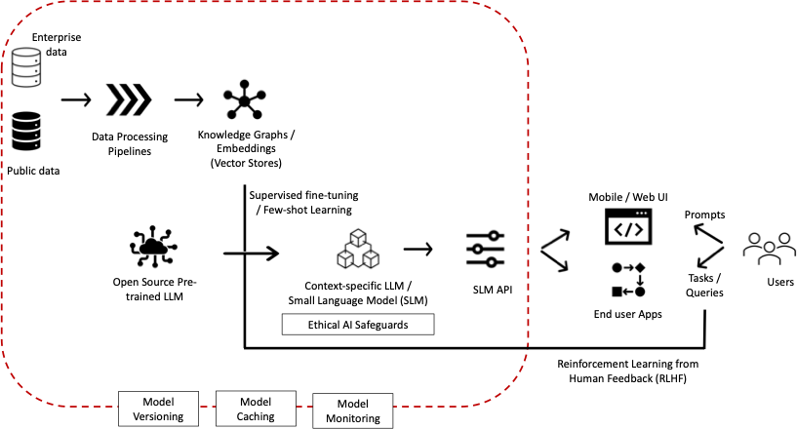
Gen AI Architecture Patterns – Fine-tuning
LLMs are generic in nature. To realize the full potential of LLMs for Enterprises, they need to be contextualized with enterprise knowledge captured in terms of documents, wikis, business processes, etc.
This is achieved by fine-tuning a LLM with enterprise knowledge / embeddings to develop a context- specific LLM.

Slide 44
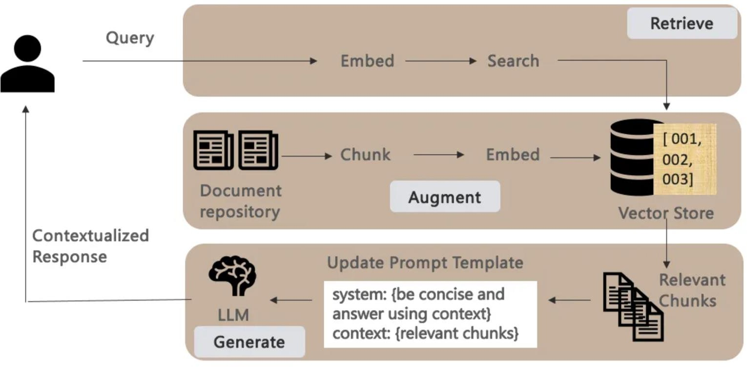
Gen AI Architecture Patterns – Retrieval-Augmented- Generation (RAG)
Fine-tuning is a computationally intensive process. RAG provides a viable alternative by providing additional context with the prompts — grounding the retrieval / responses to the given context.
Given a user query, a RAG pipeline literally consists of
the 3 phases below:
Retrieve: Transform user queries to embeddings to
compare its similarity score with other content.
Augment: with search results / context retrieved from a vector store that is kept current and in sync with the underlying document repository.
Generate: contextualized responses by making
retrieved chunks part of the prompt template that provides additional context to the LLM on how to answer the query.

Slide 45
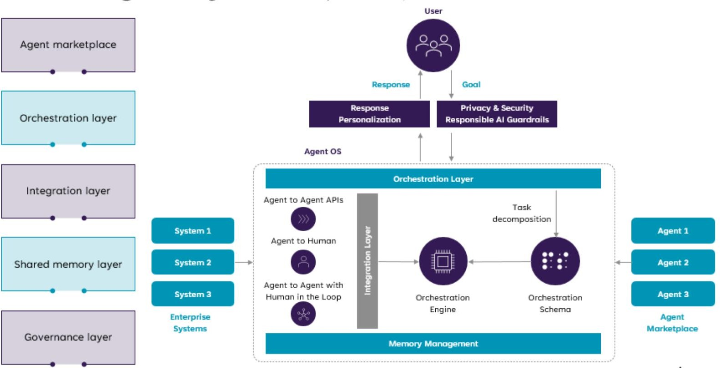
Agentic AI Platform Reference Architecture
The future where enterprises will be able to develop new Enterprise AI Apps by orchestrating / composing multiple existing AI Agents.
* D. Biswas. Stateful Monitoring and Responsible Deployment of AI Agents. 17th International Conference on Agents and Artificial Intelligence (ICAART), 2025 ( link)

Slide 46
AI Agents Marketplace & Discovery for Multi- agent Systems

Slide 47
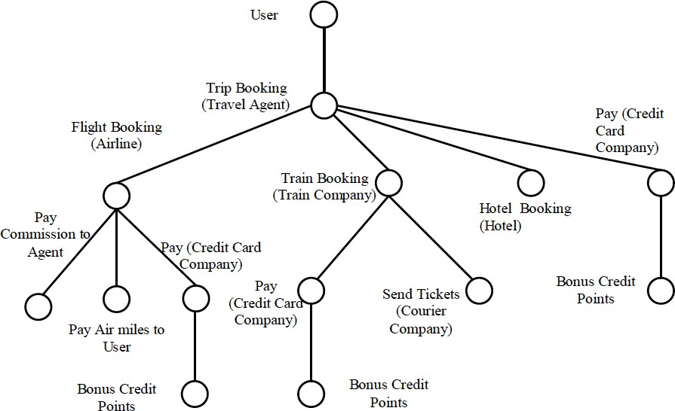
(Complex) Agentic AI Task Decomposition
A high-level approach to solving complex tasks:
- decomposition of the given complex task into a hierarchy or workflow of) simple tasks,
followed by
- composition of agents able to execute the simpler tasks.
This can be achieved in a dynamic or static manner.
Dynamic: given a complex user task, the system comes up with a plan to fulfil the request depending on the capabilities of available agents at run-time.
Static: given a set of agents, composite agents
are defined manually at design-time combining their capabilities.

Slide 48
Agentic AI Scenarios:
Agentic RAGs
Reinforcement Learning Agents

Slide 49
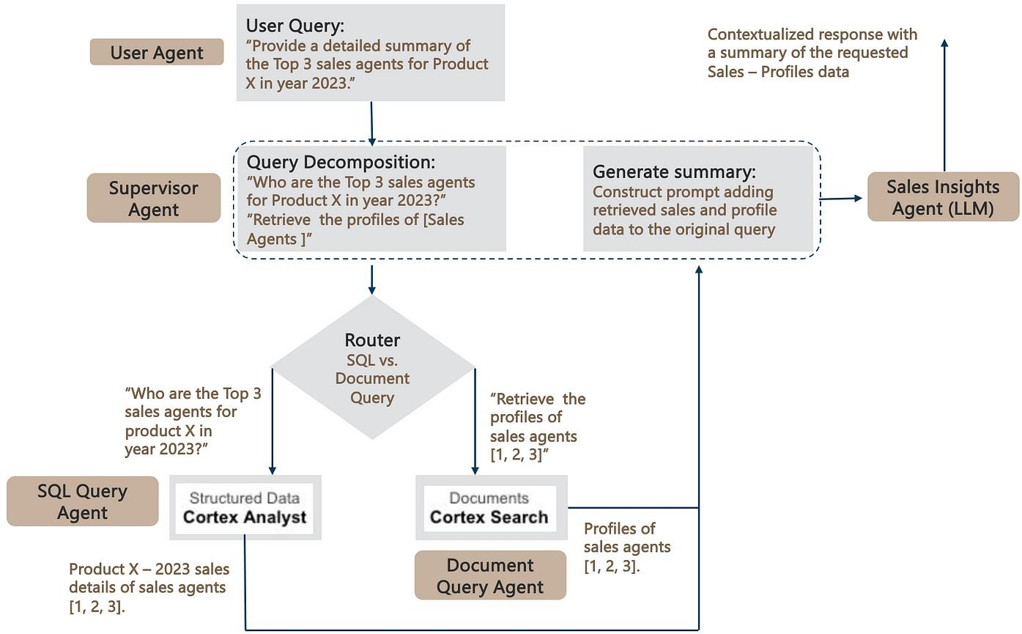
Agentic RAGs: extending RAGs to SQL Databases
Agentic AI framework to build RAG pipelines that work seamlessly over both structured and unstructured data stored in Snowflake.
The SQL & Document query agents leverage the respective Snowflake Cortex Analyst and Search components detailed earlier to query the underlying SQL and Document repositories.
Finally, to complete the RAG pipeline, the retrieved data is added to the original prompt — leading the generation of a contextualized response.
* D. Biswas. Agentic RAGs: extending RAGs to SQL Databases. AI Advances, 2024 (link)

Slide 50
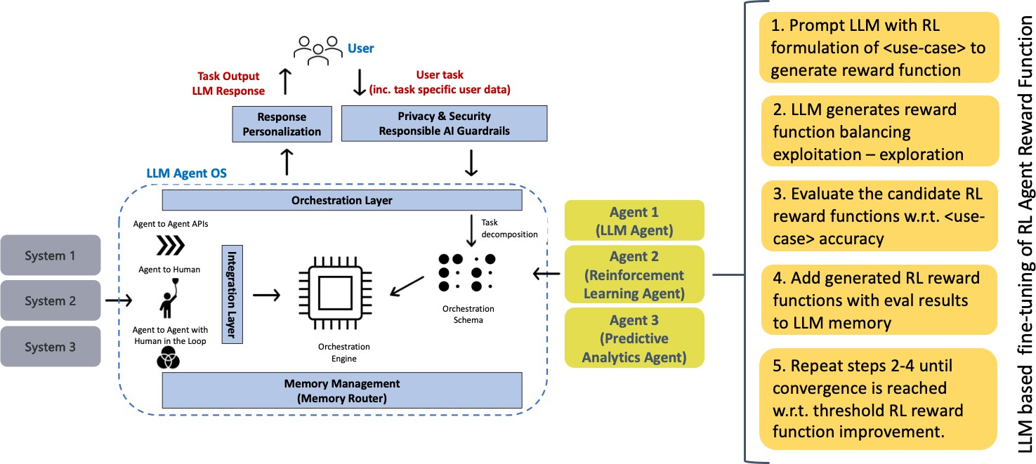
Reinforcement Learning Agents
When we talk about AI agents today, we mostly talk about LLM agents, which loosely translates to invoking (prompting) an LLM to perform natural language processing (NLP) tasks
Some agentic tasks might be better suited to other ML techniques, e.g., Reinforcement Learning (RL), predictive analytics, etc. — depending on the use-case objectives.
* D. Biswas. LLM based fine-tuning of Reinforcement Learning Agents. AI Advances, 2024 (link)

Slide 51
DEMO

