Slide 1

Enterprise Gen AI Platform Architecture
A deep dive into the layers, patterns, and design principles that power production-grade Generative AI systems in the enterprise. Each layer solves a specific concern — from user experience to governance and MLOps.

Slide 2
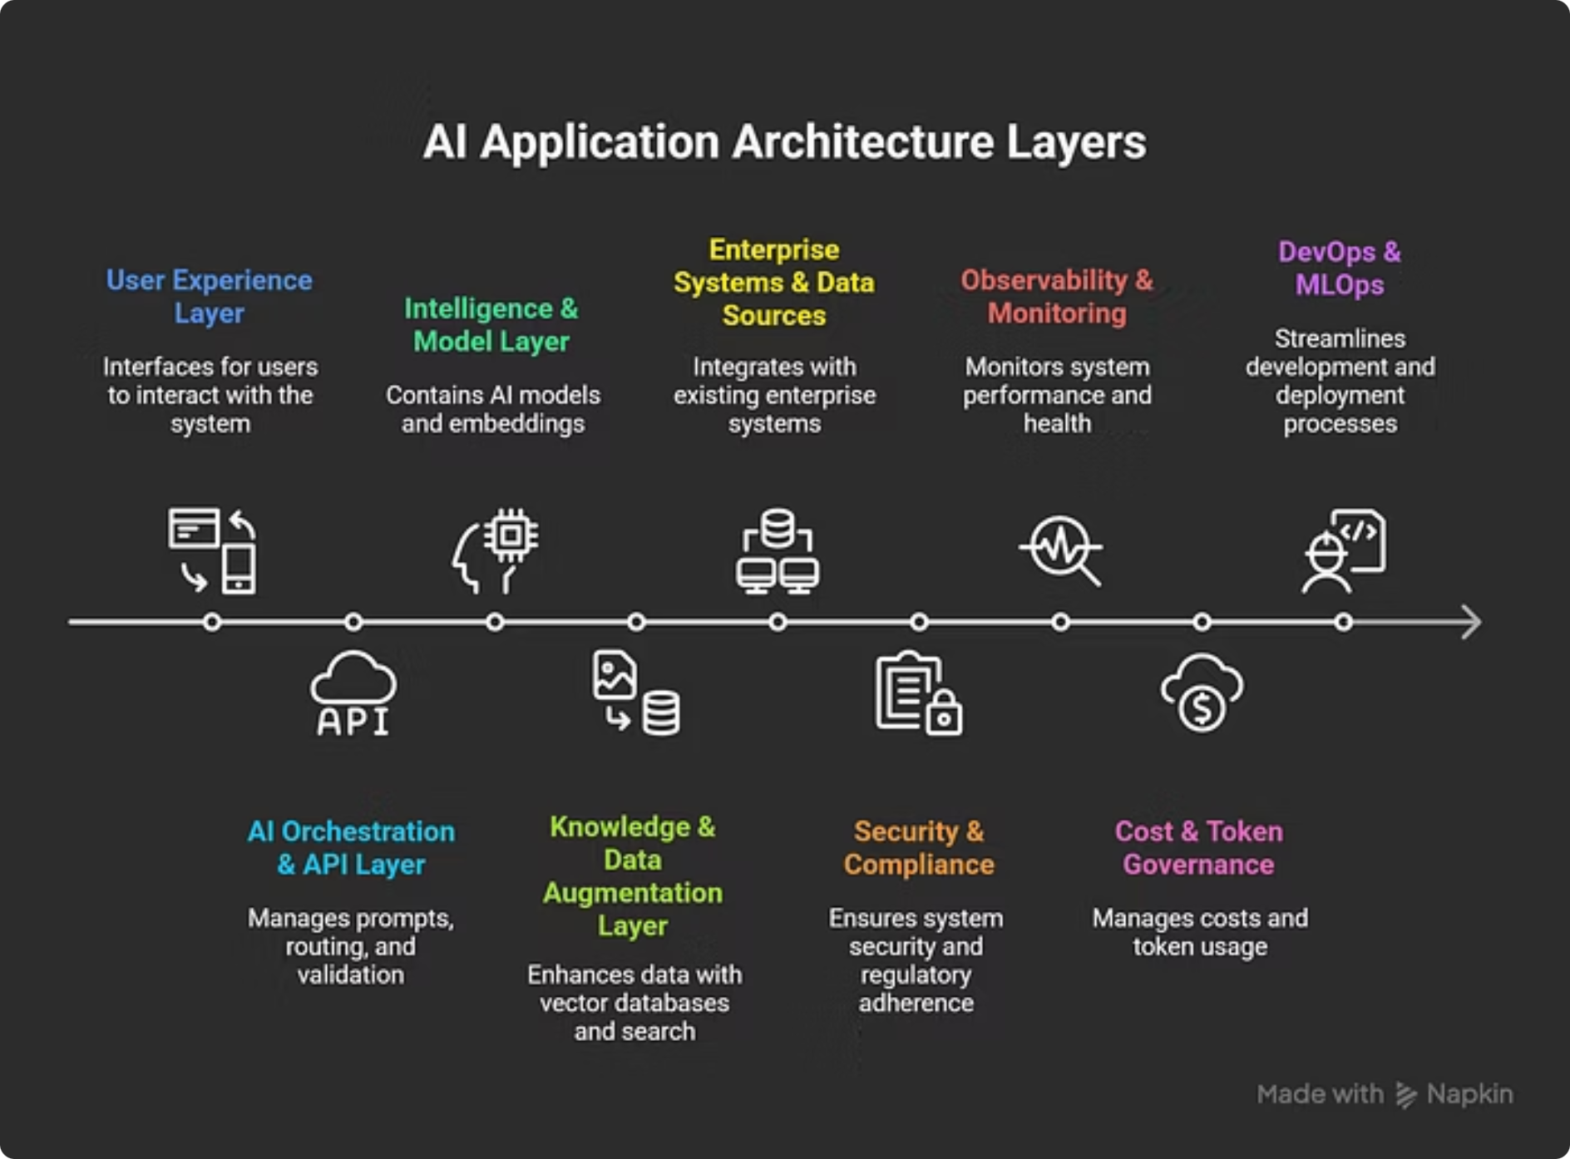
AI Application Architecture Layers
Each layer of the enterprise Gen AI platform addresses a distinct architectural concern — from how users interact with the system, to how models are governed, monitored, and deployed at scale.

Slide 3
Layer 1: User Experience
This layer defines how users interact with Gen AI capabilities. The frontend never talks directly to the LLM — it calls an enterprise-controlled API, enabling governance, logging, and security enforcement.
Typical Interfaces
Key Enterprise Concerns
Web apps (React, Angular, Vue)
Internal enterprise portals
Chat-based copilots
Developer APIs & IDE extensions
Authentication (SSO, OAuth, SAML)
Role-based access control (RBAC)
Session continuity
Accessibility and localization

Slide 4
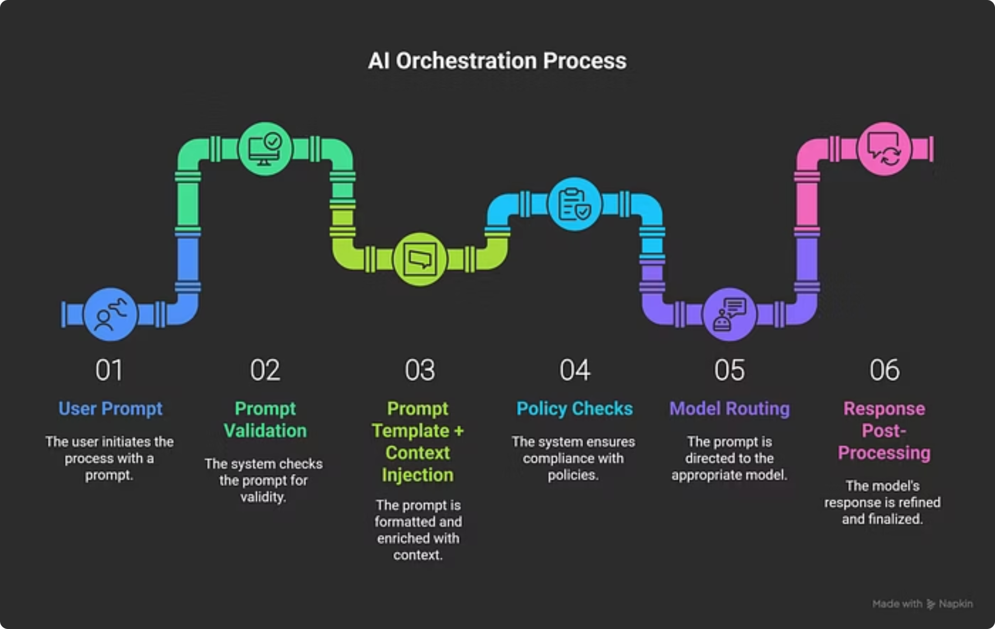
Layer 2: AI Orchestration & API
This is the brain of the platform. Enterprises never expose LLMs directly to users. The orchestration layer manages prompt templates, policy enforcement, model routing, input validation, and agent orchestration.

Slide 5
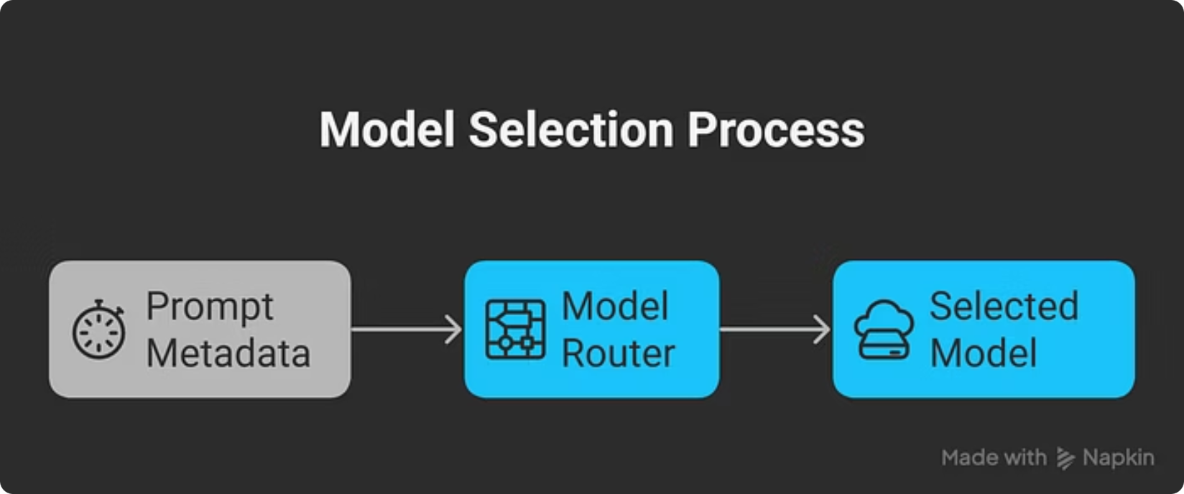
Layer 3: Intelligence & Model Layer
What Lives Here
Foundation models (cloud or on-prem)
Fine-tuned models
Embedding models
Multimodal models (text + image)
Enterprise Design Considerations
Multi-model strategy (avoid vendor lock-in)
Latency SLAs & data residency
Model versioning

Slide 6

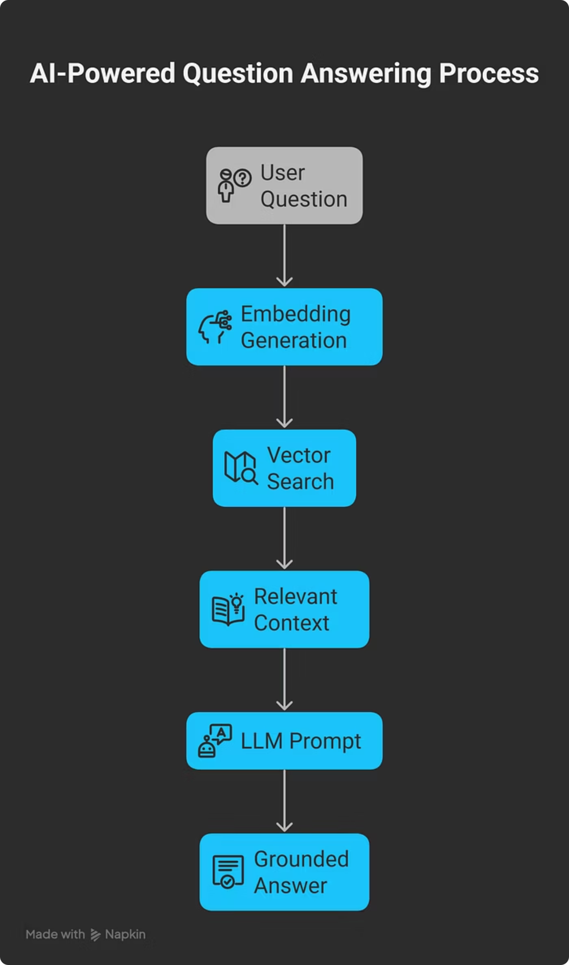
Layer 4: Knowledge & Data Augmentation (RAG)
LLMs do not know internal data, cannot be trusted for factual accuracy, and must not hallucinate. Retrieval-Augmented Generation (RAG) is mandatory in enterprise deployments to ground responses in real, verified data.

Slide 7
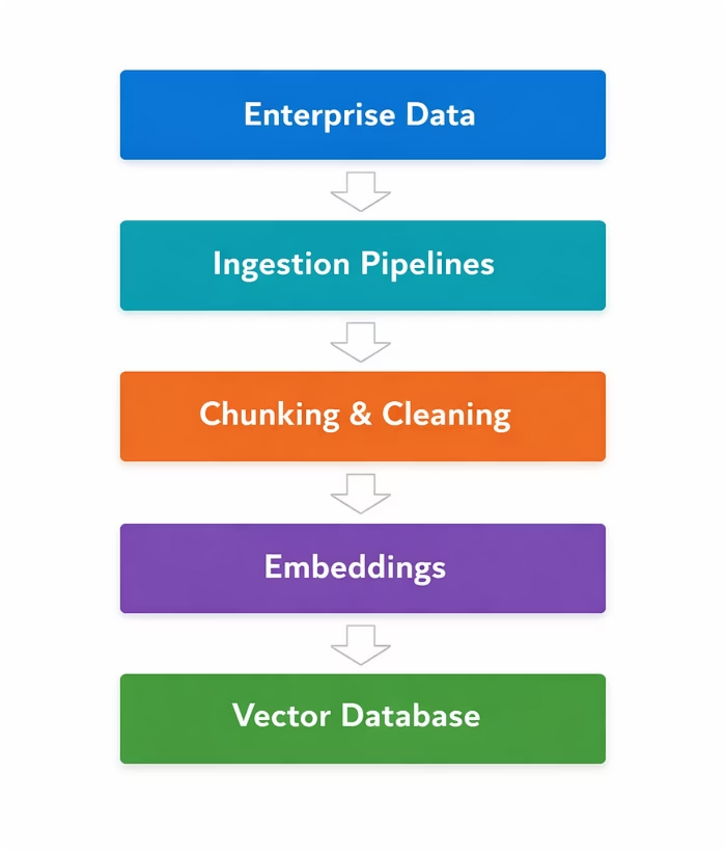
Layer 5: Enterprise Data & System Integration
Typical Data Sources
Databases (Postgres, Oracle)
Document stores (SharePoint, Confluence)
CRM / ERP systems
Logs and analytics systems
Best Practices
Never embed raw PII
Use metadata filters
Maintain data lineage

Slide 8
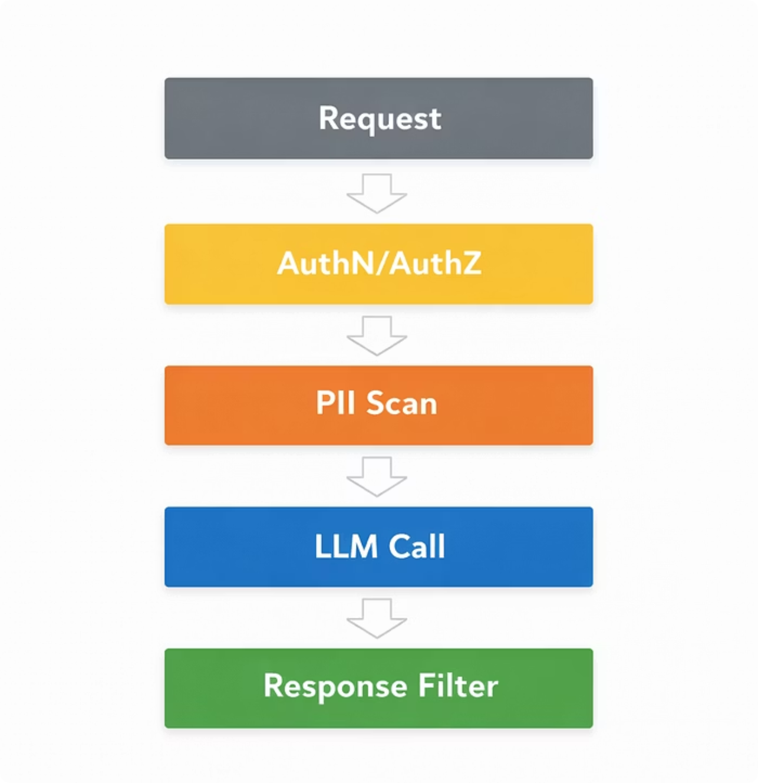
Layer 6: Security, Compliance & Governance
Security is a cross-cutting concern that spans every layer of the platform. Every request must pass through authentication, PII scanning, and output filtering before a response is returned.
Enterprise Must-Haves
Prompt logging and audit trails
PII detection and masking
Access control per role
Data encryption at rest and in transit
Model output filtering

Slide 9
Layer 7: Observability, Cost & Token Governance
Gen AI is expensive and unpredictable without controls. Tracking usage at a granular level is non-negotiable for sustainable enterprise deployments.
5
$0
100%
Key Metrics
Uncontrolled Cost
Audit Coverage
Tokens per request, cost per user/team, latency, hallucination rate, and prompt effectiveness must all be tracked continuously.
Without token governance, costs can spiral unpredictably across teams and use cases.
Every prompt and response should be logged for compliance, debugging, and cost attribution.

Slide 10
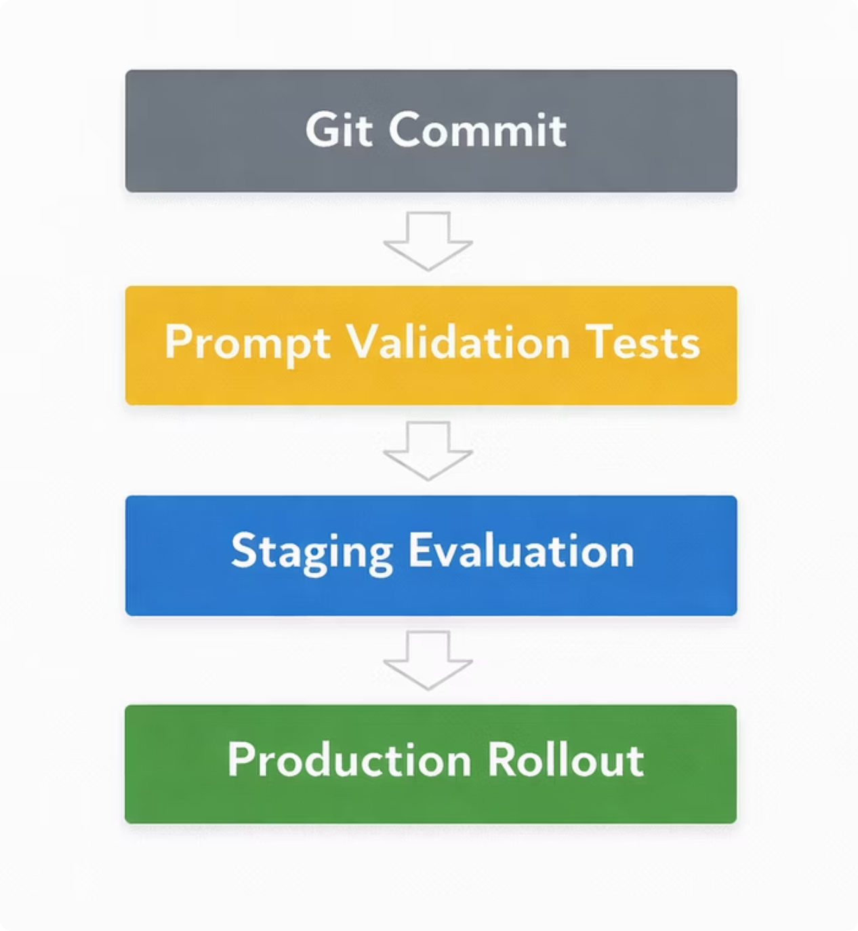
Layer 8: DevOps & MLOps for Gen AI
In Gen AI platforms, prompts are code, data is a dependency, and models are versioned artifacts. CI/CD pipelines must be adapted accordingly.
Key Insight
Prompts are code — version and test them
Data is a dependency — track lineage
Models are versioned artifacts — manage rollouts carefully

Slide 11
All 8 Layers at a Glance
1
2
User Experience
AI Orchestration & API
Interfaces for users to interact with the system via portals, APIs, and copilots.
The platform brain — routing, validation, policy enforcement, and agent orchestration.
3
4
Intelligence & Model
Knowledge & Data (RAG)
Foundation, fine-tuned, embedding, and multimodal models with multi-model strategy.
Retrieval-Augmented Generation to ground LLM responses in enterprise data.
1
2
Enterprise Data Integration
Security & Compliance
Connects databases, document stores, CRM/ERP, and analytics systems.
Cross-cutting governance: PII masking, audit trails, encryption, output filtering.
3
4
Observability & Cost
DevOps & MLOps
Token tracking, latency monitoring, hallucination rate, and cost attribution.
CI/CD pipelines treating prompts as code and models as versioned artifacts.

