Slide 1
Agentic AI: A2A & MCP — Concepts, Mechanisms & Use Cases
Understanding how AI agents interact with each other and with tools / data

Slide 2
Agentic AI: A2A & MCP — Concepts, Mechanisms & Use Cases
Agenda / What We Will Cover
What is Agentic AI & why protocols matter
A2A (Agent-to-Agent) — theory, interaction types, message passing, coordination & negotiation
MCP (Model Context Protocol) — what it is, how it standardizes tool/data access
Using A2A and MCP together — how they complement each other
Example Scenario: end-to-end workflow using A2A + MCP
Summary & Key Takeaways

Slide 3
What is Agentic AI?
Agentic AI: AI that pursues a goal on its own — it plans, acts and adapts instead of just answering one prompt.
Built on LLMs + tools: the model reasons; tools, data and other agents let it act.
The challenge: agents need a standard way to reach tools (MCP) and to talk to each other (A2A).
1 Perceive
Read the goal, context & data
2 Plan
Break the goal into steps
3 Act
Call tools / delegate to agents
4 Reflect
Check results, adapt, repeat

Slide 4
Why Protocols are Important for Agentic AI
Without standards: each agent/tool integration becomes bespoke → unscalable, brittle
Protocols bring interoperability, consistency, scalability.
Helps agents from different frameworks/platforms to communicate, share data, and collaborate — enabling real-world multi-agent ecosystems.

Slide 5
A2A (Agent-to-Agent) Protocol

Slide 6

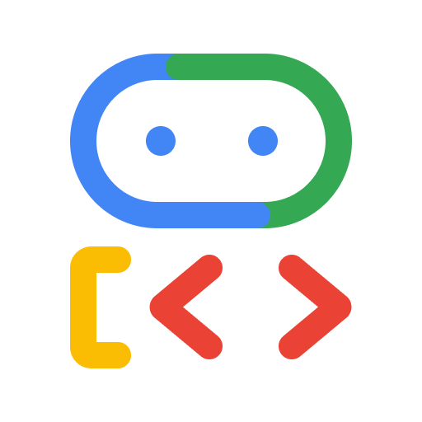

Remote
Hotel Agent
What Can it do?
Send?
Response?
Communicate?
Personal Agent
Communicate?
Car Rental Agent
What Can it do?
Send?
Response?
Communicate?
Client
Remote

Slide 7
What is A2A (Agent2Agent)
The Agent2Agent (A2A) protocol is a communication protocol for artificial intelligence (AI) agents, initially introduced by Google in April 2025. This open protocol is designed for multi-agent systems, allowing interoperability between AI agents from varied providers or those built using different AI agent frameworks.
Purpose: allow agents to discover each other, send tasks/messages, share outputs, coordinate workflows.
Works over standard channels (e.g. HTTPS + JSON-RPC / structured messaging) for secure, interoperable data exchange.

Slide 8
A2A Agent
Remote
Hotel Agent
Message
HTTPS
Personal Agent
What Can it do:
AgentCard
Communication:
  Messages
Execution:
  Agent Executor
A2A Agent
Car Rental Agent
Message
Client
HTTPS
Hotel_agent: localhost:1001
Car_rental_agent: localhost:1002
Remote

Slide 9
Core architectural components
The Agent2Agent protocol consists of several building blocks for agent interactions:
A2A client
Agent card
Task
Message
Artifact
Part
A2A server

Slide 10
A2A client
Agent card
Task
A2A server
The A2A client, also known as the client agent, can be an app, service or other AI agent that delegates requests to remote agents. It uses the Agent2Agent protocol to initiate communication.
The A2A server, also called the remote agent, takes requests, processes tasks and responds with status updates or results. It exposes an HTTP endpoint that’s compatible with the Agent2Agent protocol.
This JSON file outlines agentic AI metadata and can be accessed using a URL. It contains basic information about an agent, including its name, description, version, service endpoint URL, supported modalities or data types and authentication requirements.
A task represents a unit of work needed to accomplish a request. It has a unique ID and progresses through a lifecycle of defined states (submitted, working, input-required, completed, failed). Tasks are useful for multi-turn processing or long-running agent-to-agent collaboration.

Slide 11
Message
Artifact
Part
As a fundamental unit of communication, a message depicts a single exchange or turn in a conversation. It contains one or more parts holding the actual content.
Messages relay answers, context, instructions, prompts, questions, replies and status updates.
An artifact is a tangible product generated by the A2A server as a result of its work. It can be a document, image, spreadsheet or any other deliverable. Like messages, artifacts consist of one or more parts and can be incrementally streamed.
A part is a piece of content inside a message or an artifact. Parts have various types based on the data they carry. A TextPart is a vessel for text, a FilePart represents files and a DataPart encompasses structured JSON (JavaScript Object Notation) data.

Slide 12
Agent Card: How an Agent Describes Itself
Agent Card
agent.json
Name
Description
URL
Version
Default input/output mode
Skills: [ AgentSkill(
Id
Name
Descpription
Tags
Examples
)]
🤖 AI Assistant
🏨 Hotel Reservation Agent
💱 Currency Conversion Agent
🚌 Local Tours Agent
✈️ Flight Booking Agent

Slide 13
Message
{
role: “user”
parts: [{“type”: “text”,…}]
messageId: “123”
taskId: “ABC”
contextId: “xyz”
}
SendMessageSuccessResponse
{
id: str|int
result: message|task
}
Message
Task
{
role: “user”
parts: [{“type”: “text”,…}]
messageId: “123”
taskId: “ABC”
contextId: “xyz”
}
{
id: “user”
artifacts:
contextId: “xyz”
status: {
message: …
state: submitted|working| input_required|completed| canceled|failed
}
}

Slide 14
How A2A protocol Works
The A2A protocol follows a client-server model setup with a three-step workflow:
Discovery
Communication
Authentication

Slide 15
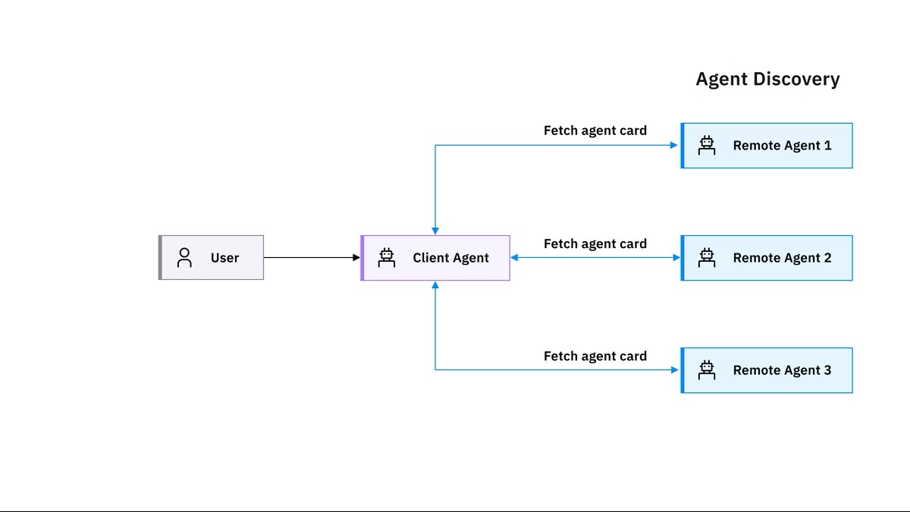
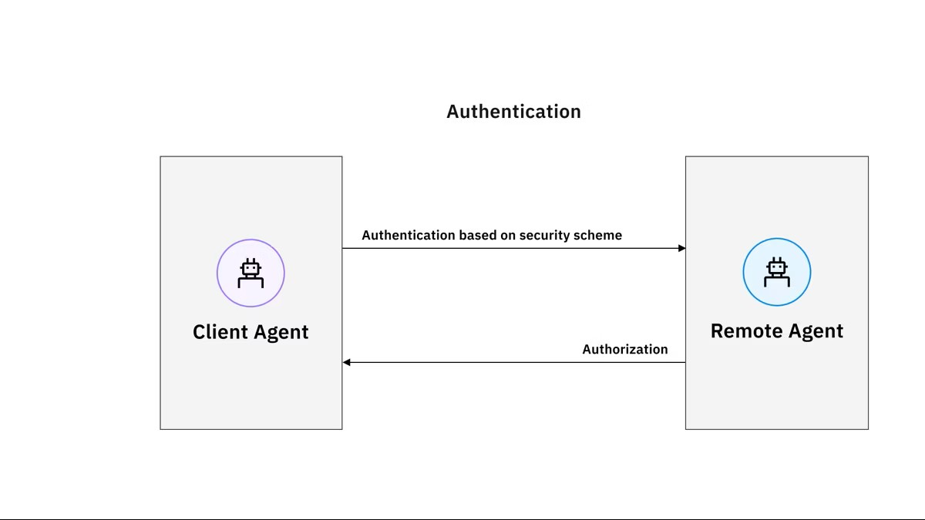
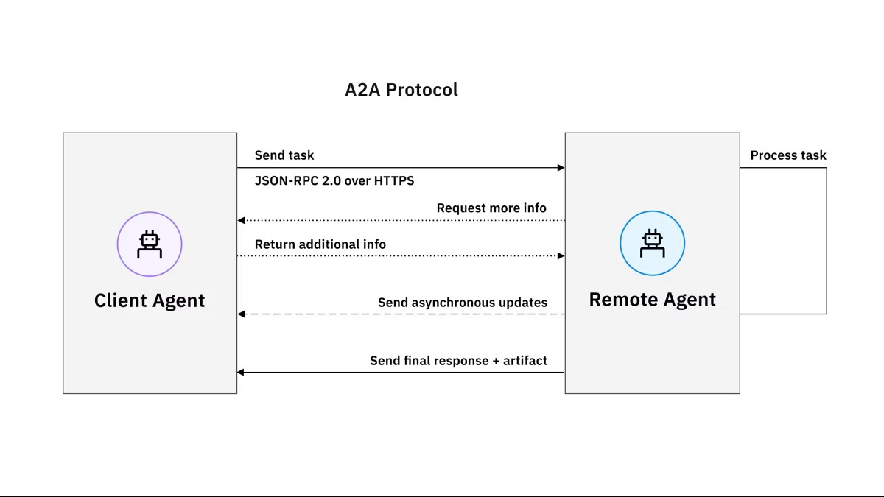
Authentication
Communication
Discovery

Slide 16
Discovery
Communication
Authentication

Slide 17
Discovery
Authentication
Communication

Slide 18
A2A Agent Executor
Agent Executor
Class ExampleAgentExecutor(AgentExecutor):
def __init__(self):
self.agent = ExampleAgent()
def execute(self, request, taskId, contextId,..):
TODO:
def cancel(self, request, taskId, contextId,..):
TODO:

Slide 19
Client
Example:
Get weather for delhi
Request
A2a Starlette Application/Server
Client Agent
agent_card
Weather Agent Executor
Weather Agent
RPC
Message
Message

Slide 20
Types of Agent Interactions under A2A
Task Delegation / Offloading: one agent gives a task to another specialized agent.
Collaboration / Parallel Processing: agents cooperate, each doing parts of a larger job (e.g. data-gathering, analysis, summarization).
Negotiation / Coordination: agents negotiate which one should do what, manage roles, split tasks intelligently for efficiency.
State / Context Sharing: agents share intermediate data, context, results, so downstream agents have what they need.

Slide 21
Why A2A Matters: Benefits & Use-Cases
Enables specialized agents (e.g. data-fetch agent, analysis agent, report-generator) to work together → modular & maintainable.
Task orchestration for complex, multi-step tasks that a single agent can’t handle reliably (e.g. research, automation, multi-domain tasks)
Interoperability: agents built with different frameworks/languages can still communicate via A2A — no lock-in.
Scalability & Flexibility: new agents can be added/removed without reworking the whole system — scalable architecture.
Privacy: The protocol treats agentic AI as opaque agents. So autonomous agents can collaborate without having to reveal their inner workings, such as internal memory, proprietary logic or particular tool implementations.
Seamless integration: A2A is built on established standards, including HTTP, JSON-RPC and SSE. This makes it easier for enterprises to adopt the protocol and helps ensure compatibility with their current technology stack.
Security: The Agent2Agent protocol is designed with security in mind. It supports enterprise-grade authentication and authorization mechanisms and allows for secure information exchange.

Slide 22
MCP (Model Context Protocol)

Slide 23
What is MCP (Model Context Protocol)
MCP is an open standard protocol introduced by Anthropic in late 2024 that defines a standard way for AI agents/LLMs to access external data, tools, and services.
It acts like a universal “connector” (some call it “USB-C for AI”) to plug models into any data source or tool, irrespective of tool or model provider.
MCP uses a client–server architecture: the agent (MCP client) sends requests to an MCP server which exposes tools, APIs, data sources, or context resources.

Slide 24
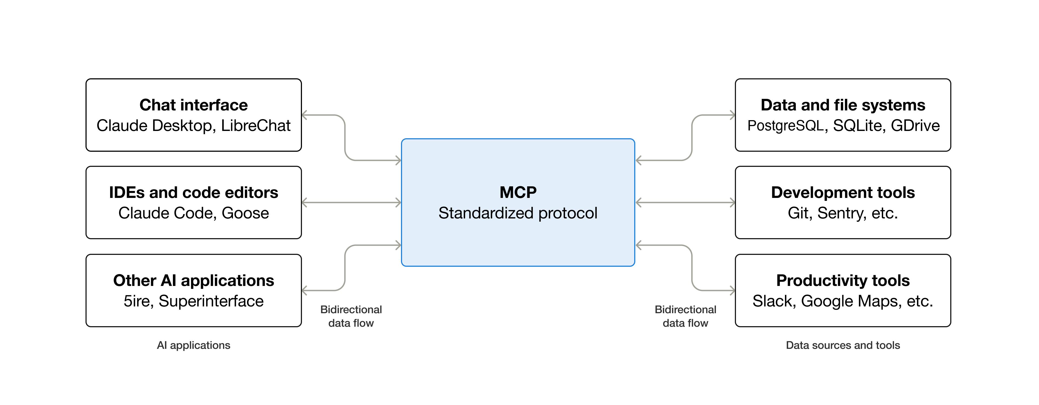
MCP at a Glance

Slide 25
What MCP Enables: Tool & Data Integration
Allows LLM-based agents to fetch real-time data, access databases or APIs, read/write files, invoke external services, rather than relying only on pre-trained knowledge.
Standardizes calls: developers don’t need bespoke integration for each tool — one MCP connector works across many services.
Enables more powerful, context-aware AI agents: because agents can work with up-to-date external data, perform actions, and combine reasoning + tooling.

Slide 26
How MCP Works: Architecture
The MCP client/server model can be broken down into three key architectural components:
MCP host: An AI application receives the user requests and seeks access to context through the MCP. This integration layer can include IDEs such as Cursor or Claude Desktop. It contains the orchestration logic and can connect each client to a server.
MCP client: Communication in the MCP ecosystem between the host and server must go through a client. This client exists within the host and converts user requests into a structured format that the open protocol can process. Multiple clients can exist with a singular MCP host but each client has a 1:1 relationship with an MCP server.

Slide 27
How MCP Works: Architecture
MCP server: The external service that provides the context to the LLM by converting user requests to server actions. Examples of MCP server integrations include Slack, GitHub, Git, Docker or web search. These servers are typically GitHub repositories available in various programming languages (C#, Java™, TypeScript, Python and others) and provide access to MCP tools.
  Resources: Information retrieval from internal or external databases. Resources return data but do not execute actionable computations.
  Tools: Information exchange with tools that can perform a side effect such as a calculation or fetch data through an API request.
  Prompts: Reusable templates and workflows for LLM-server communication.

Slide 28
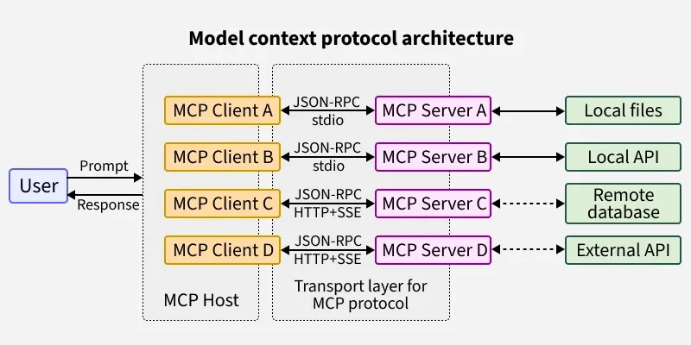
How MCP Works: Architecture

Slide 29
How MCP Works: Data Flow
Agent (MCP client) → sends request via MCP protocol → MCP server (tool/data provider) → server executes tool or returns data → returns response via MCP → agent receives & uses data.
Protocol is transport-agnostic: JSON-RPC 2.0 messages over stdio (local servers) or Streamable HTTP (remote servers) — flexible across environments
Ensures type-safe, structured data exchange — enables reliable, repeatable integrations, reduces custom API-by-API work.

Slide 30
Advantages of MCP
Scale: MCP servers can be defined and hosted once and used by many AI systems. This capacity limits the need to define access to the same source data, resources and AI tools for multiple generative AI systems.
Data retrieval: Unlike RAG where data retrieval requires preprocessing and vectorizing before query, MCP is dynamic and allows for fluctuations and updates from information sources in real-time.
Complexity: MCP is fairly simple to setup and incorporate into AI applications, as we demonstrate here. You can use config files easily to make an MCP server portable across environments.
Platform-independent: Beyond the fact that you can build MCP servers with Python, TypeScript or other languages, they are also not coupled to a specific LLM solution.
Debugging through a client/server model: The MCP client sends structured JSON-RPC requests to the MCP server, which fetches data from APIs, databases or files — giving the model consistent context and making issues easy to trace. Transports: stdio and Streamable HTTP.

Slide 31
Why MCP Matters: Benefits & Use-Cases
Makes it easy to build AI agents that are tool-aware and data-aware — can query databases, call APIs, fetch live data, control other services.
Promotes modularity and reusability — same MCP server/tool can be used by different agents, reducing duplication.
Makes agents environment-agnostic and interoperable — easier to integrate into enterprise stacks that rely on diverse tools, databases, services.

Slide 32
MCP Use Case: GST Compliance
Use Case: GST Compliance & Financial Reconciliation System
Imagine a finance department where several agents handle tax calculations, invoicing, reconciliation and reporting. They’re meant to dance together, but without MCP they keep stepping on each other’s toes.
Problem Scenario (Without MCP)
A company has an internal multi-agent workflow:
Agent A: Reads invoices (PDF, CSV, ERP exports)
Agent B: Computes GST based on HSN/SAC codes
Agent C: Reconciles books with GSTR-2A/2B data
Agent D: Generates compliance reports

Slide 33
Without MCP: No Standard Interface
Where things break WITHOUT MCP
1. No standard interface for tax tools
Every agent uses its own style to call calculators or lookups:
Agent B expects HSN codes like "0401"
Agent C expects "4-digit-HSN"
Agent A extracts "HSN: 0401 Milk“
GST rate APIs return inconsistent structures.
One uses "gstRate", another uses "rate".

Slide 34
Without MCP: Hidden Data Sources
Reconciliation agent cannot discover data sources
Agent C needs:
Vendor invoices
GSTR-2A summary
ITC eligibility rules
Without MCP, these “tools” are hidden behind custom wrappers.

Slide 35
Without MCP: Tight Coupling
Tight coupling makes updates dangerous
If GST rates change (which they do), every agent must be updated.
Touch one file, three others break.
Touch three, everything breaks.

Slide 36
With MCP: Every Tool Has a Schema
MCP forces every tax-related tool to describe:
Input fields
Output fields
Data types
Validation schema

Slide 37
With MCP: Dynamic Tool Discovery
Dynamic discovery of tax tools
Agents ask MCP:
"What tax tools do we have today?"
MCP replies with a catalog:
invoice_reader_tool
gst_rate_lookup
reverse_charge_checker
gstr2a_fetcher
reconciliation_tool
itc_eligibility_engine
If tomorrow you add E-invoice validation or E-waybill generator, every agent instantly sees it.

Slide 38
With MCP: Safe Context Sharing
Safe context sharing
MCP enforces well-defined formats.
Agents pass validated JSON structures.
None of the fields mysteriously change names like shape-shifting bureaucrats.
Agents only express intent
Agents don’t need to worry about:
  GST rate changes
  API keys
  Authentication
  New tax rules
  Data source URLs

Slide 39
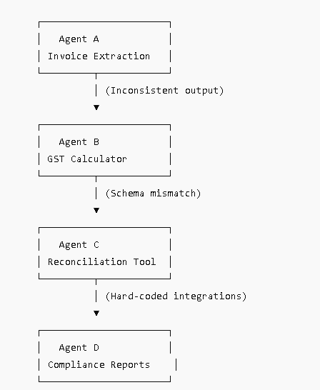
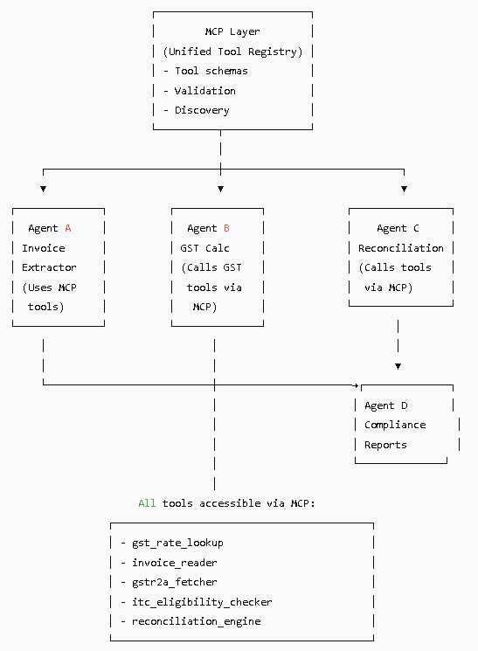

Slide 40
Without vs With MCP: Summary
Aspect | Without MCP | With MCP
GST rate lookup | Hard-coded, inconsistent | Unified schema, auto-discovered
Invoice parsing | Each agent custom-coded | Single shared tool, consistent output
GSTR reconciliation | Manual wiring | Any agent can call reconciliation tool
Adding new compliance rules | Breaks existing agents | Instantly available
Data quality | Mutates unpredictably | Schema-validated, safe

Slide 41
How A2A and MCP Complement Each Other

Slide 42
A2A vs MCP: What Each Does
Protocol | Core Purpose | Operates On... | Key Strength
A2A | Agent-to-Agent communication & coordination | Between agents (peer-to-peer) | Collaboration, multi-agent workflows, specialization, coordination (KDnuggets)
MCP | Tool / Data access for agents | Agent ↔ External tools/data | Standardized integration, tool/data access, enabling context & actions (Wikipedia)
A2A = “network cable / messaging bus between agents”, for agent-to-agent info/task exchange.
MCP = “USB-C / universal connector” for agents to reach tools, data, external systems — enabling them to act meaningfully on real-world tasks.

Slide 43
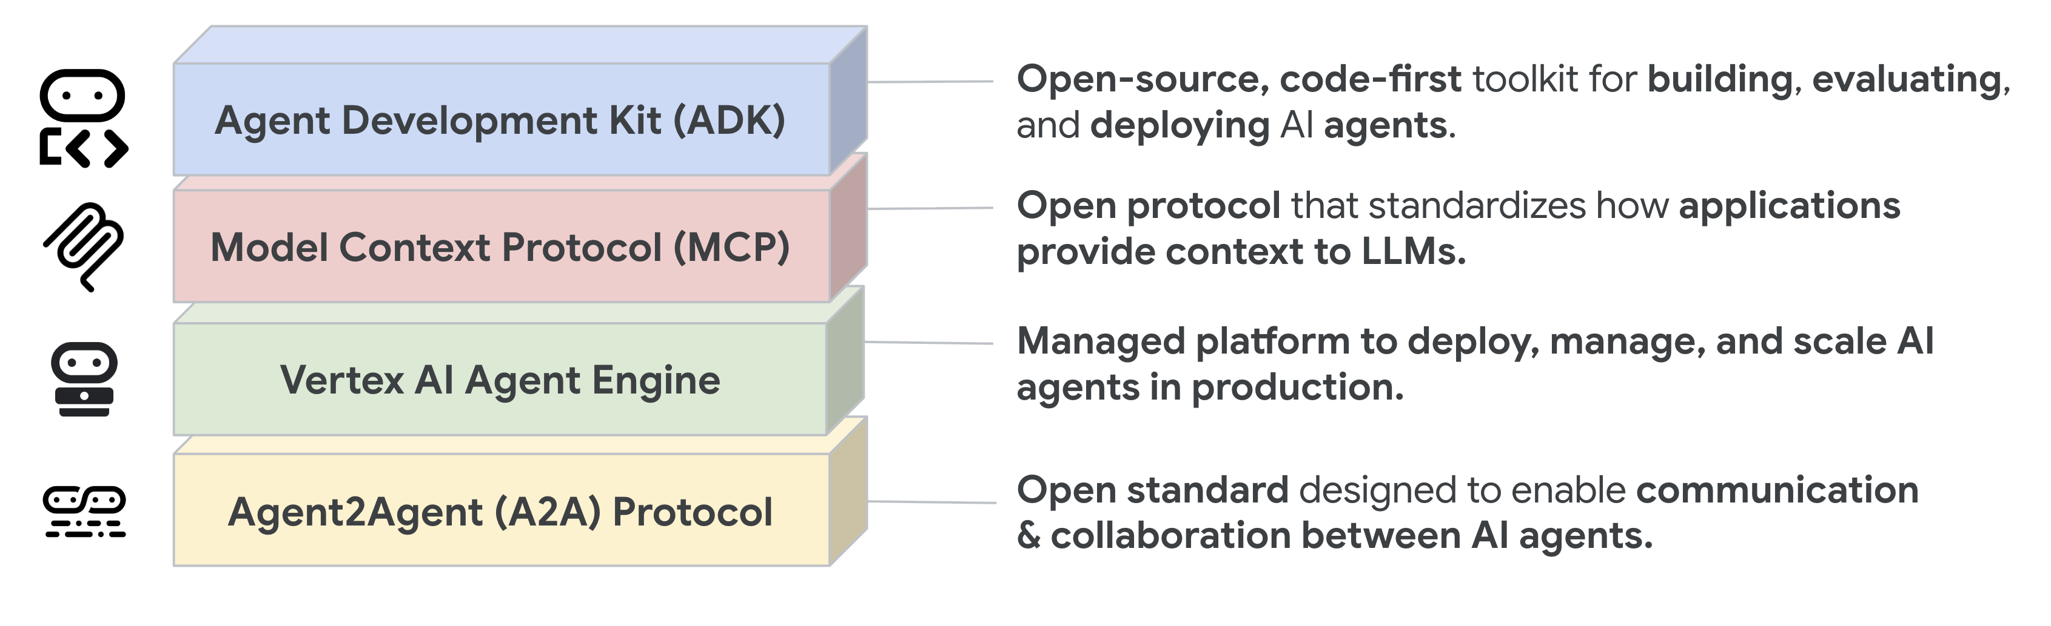
Where A2A & MCP Fit in the Agent Stack

Slide 44
Why Use Both Together?
Multi-agent system where agents collaborate (A2A) AND also need external data/tools (MCP) — combination gives full power: collaboration + context-aware capabilities.
Enables building complex, real-world workflows: e.g. one agent fetches data (via MCP), passes to analysis agent (via A2A), another agent triggers action (via MCP) — all in a coordinated, standardized way.

Slide 45
Example Scenario: Applying A2A + MCP

Slide 46
Scenario Overview
Scenario: Smart Home Management — agents manage weather data, energy prices, devices, and user preferences to optimize home energy consumption.
Agents involved:
  Weather Agent
  Grid-Price Agent
  Device Control Agent
  User Preference Agent
  Energy Optimization Agent

Slide 47
How Agents Interact: MCP + A2A Flow
Weather Agent uses MCP to fetch weather forecast from external API.
Grid-Price Agent uses MCP to fetch real-time energy price data.
User Preference Agent gathers user’s preferences (from local DB via MCP).
All data passed (via A2A) to Energy Optimization Agent which analyzes and computes optimal device schedule.
Energy Optimization Agent sends instructions (via A2A / MCP) to Device Control Agent to adjust smart devices.
Device Control Agent executes, sends status back; the user sees updated schedule or report.

Slide 48
Benefits of This Setup (Why A2A + MCP helps)
Modular: each agent handles one responsibility (data fetch, optimization, control) — easy to maintain & update.
Scalable: new agents (e.g. Security Agent, Maintenance Agent) can be added without re-architecting entire system.
Real-time & dynamic: agents fetch live data, react to changes (weather, price), adapt schedule.
Interoperable: agents built on different frameworks/tools still communicate via A2A; data/tools via MCP.

Slide 49
What Could Go Wrong & What to Monitor
Data freshness issues: If external APIs fail or data outdated → wrong scheduling decisions
Communication failure: agent discovery / message passing errors — need robust error handling & retries
Conflicting instructions: two agents sending contradictory commands to devices — need coordination/locking mechanism
Security & access control: external APIs, device controls must be authorized, authenticated — protocol-level security important

Slide 50
Summary & Takeaways

Slide 51
Key Concepts Recap
Agentic AI benefits when agents collaborate & specialize
Protocols essential for scalable, interoperable agent ecosystems
A2A: agent-to-agent communication & coordination
MCP: tool/data integration & context-aware capabilities
Combining A2A + MCP gives power: modular, flexible, real-world capable multi-agent systems

Slide 52
When to Use What / Design Advice
Use MCP when agents need external data/tools — good for single agent or small systems needing tool access
Use A2A when you have multiple agents handling different roles/tasks — need collaboration, task delegation, specialization
For complex, real-world systems — design with both: data/tool access + agent collaboration
Always ensure security, error-handling, clear roles, and data governance when integrating agents & external tools

Slide 53
Further Reading & Resources
Article: “Building AI Agents? A2A vs. MCP Explained Simply” — good primer.
Survey: “A survey of agent interoperability protocols: MCP, A2A, ACP, ANP” — deeper conceptual & technical coverage.
Blog: “Agentic AI Protocols: MCP, A2A, and ACP” — practical use-cases & combinations.
Official MCP specification: modelcontextprotocol.io
Official A2A specification: a2a-protocol.org
https://www.ibm.com/think/topics/agent2agent-protocol#684929709
https://www.ibm.com/think/topics/model-context-protocol#179371084
https://www.geeksforgeeks.org/artificial-intelligence/model-context-protocol-mcp/
https://youtu.be/mFkw3p5qSuA?si=Nv7KawFQh4CjpOGV

Slide 54
Thank You

