Slide 1
NRTL
How to Code

Slide 2
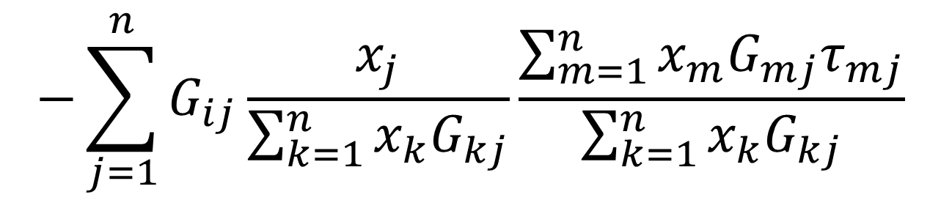
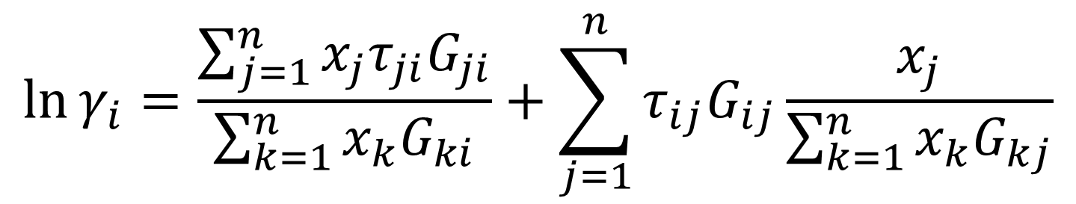
$$\ln{γ_{i}}=\frac{\sum_{j=1}^{n}{x_{j}τ_{ji}G_{ji}}}{\sum_{k=1}^{n}{x_{k}G_{ki}}}+\sum_{j=1}^{n}{τ_{ij}G_{ij}\frac{x_{j}}{\sum_{k=1}^{n}{x_{k}G_{kj}}}}$$
$$−\sum_{j=1}^{n}{G_{ij}\frac{x_{j}}{\sum_{k=1}^{n}{x_{k}G_{kj}}}}\frac{\sum_{m=1}^{n}{x_{m}G_{mj}τ_{mj}}}{\sum_{k=1}^{n}{x_{k}G_{kj}}}$$

Slide 3
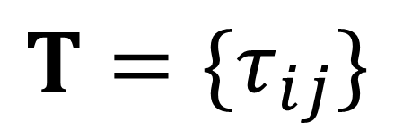
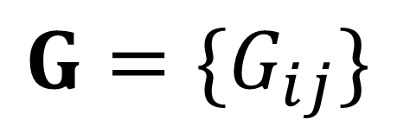
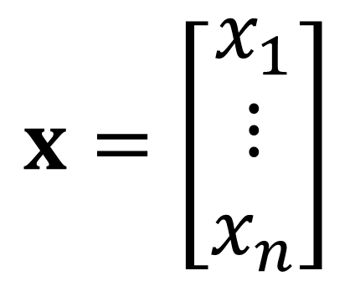

$$T=\{τ_{ij}\}$$
$$G=\{G_{ij}\}$$
$$TG=\{τ_{ij}G_{ij}\}$$
$$x=\left[\begin{matrix}x_{1} \\ ⋮ \\ x_{n}\end{matrix}\right]$$

Slide 4
$$\ln{γ_{i}}=\frac{\sum_{j=1}^{n}{x_{j}τ_{ji}G_{ji}}}{\sum_{k=1}^{n}{x_{k}G_{ki}}}+\sum_{j=1}^{n}{τ_{ij}G_{ij}\frac{x_{j}}{\sum_{k=1}^{n}{x_{k}G_{kj}}}}$$
$$−\sum_{j=1}^{n}{G_{ij}\frac{x_{j}}{\sum_{k=1}^{n}{x_{k}G_{kj}}}}\frac{\sum_{m=1}^{n}{x_{m}G_{mj}τ_{mj}}}{\sum_{k=1}^{n}{x_{k}G_{kj}}}$$

Slide 5
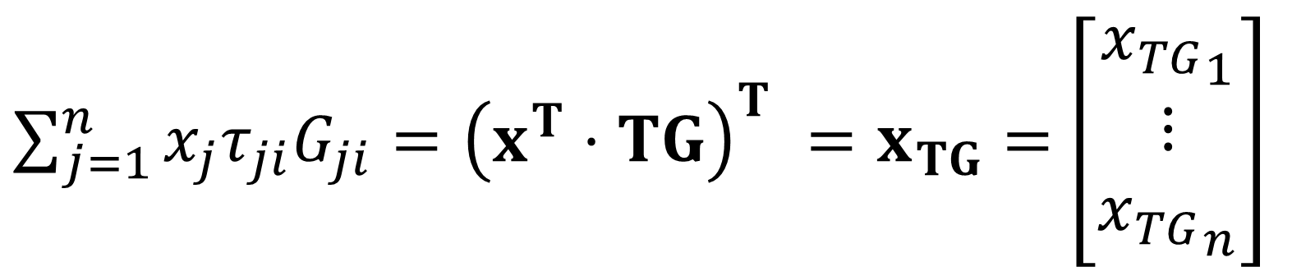
$\sum_{j=1}^{n}{x_{j}τ_{ji}G_{ji}}={\left(x^{T}⋅TG\right)}^{T} =x_{TG}=$ $\left[\begin{matrix}{x_{TG}}_{1} \\ ⋮ \\ {x_{TG}}_{n}\end{matrix}\right]$

Slide 6
$$\ln{γ_{i}}=\frac{\sum_{j=1}^{n}{x_{j}τ_{ji}G_{ji}}}{\sum_{k=1}^{n}{x_{k}G_{ki}}}+\sum_{j=1}^{n}{τ_{ij}G_{ij}\frac{x_{j}}{\sum_{k=1}^{n}{x_{k}G_{kj}}}}$$
$$−\sum_{j=1}^{n}{G_{ij}\frac{x_{j}}{\sum_{k=1}^{n}{x_{k}G_{kj}}}}\frac{\sum_{m=1}^{n}{x_{m}G_{mj}τ_{mj}}}{\sum_{k=1}^{n}{x_{k}G_{kj}}}$$

Slide 7
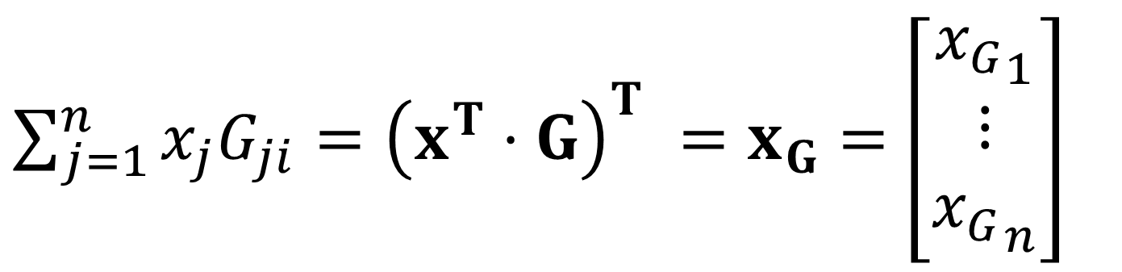
$\sum_{j=1}^{n}{x_{j}G_{ji}}={\left(x^{T}⋅G\right)}^{T} =x_{G}=$ $\left[\begin{matrix}{x_{G}}_{1} \\ ⋮ \\ {x_{G}}_{n}\end{matrix}\right]$

Slide 8
$$\ln{γ_{i}}=\frac{\sum_{j=1}^{n}{x_{j}τ_{ji}G_{ji}}}{\sum_{k=1}^{n}{x_{k}G_{ki}}}+\sum_{j=1}^{n}{τ_{ij}G_{ij}\frac{x_{j}}{\sum_{k=1}^{n}{x_{k}G_{kj}}}}$$
$$−\sum_{j=1}^{n}{G_{ij}\frac{x_{j}}{\sum_{k=1}^{n}{x_{k}G_{kj}}}}\frac{\sum_{m=1}^{n}{x_{m}G_{mj}τ_{mj}}}{\sum_{k=1}^{n}{x_{k}G_{kj}}}$$

Slide 9
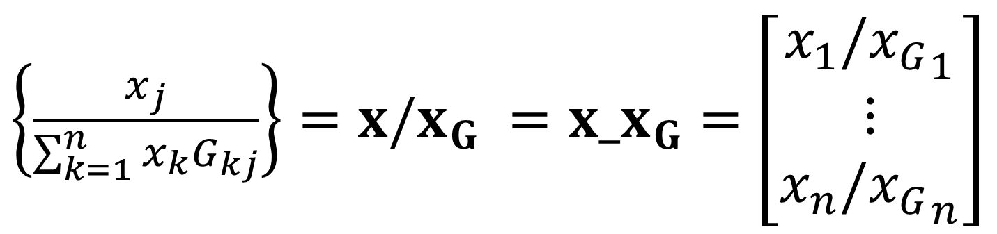
$\left\{\frac{x_{j}}{\sum_{k=1}^{n}{x_{k}G_{kj}}}\right\}=x/x_{G} ={x_x}_{G}=$ $\left[\begin{matrix}x_{1}/{x_{G}}_{1} \\ ⋮ \\ {{x_{n}/x}_{G}}_{n}\end{matrix}\right]$

Slide 10
$$\ln{γ_{i}}=\frac{\sum_{j=1}^{n}{x_{j}τ_{ji}G_{ji}}}{\sum_{k=1}^{n}{x_{k}G_{ki}}}+\sum_{j=1}^{n}{τ_{ij}G_{ij}\frac{x_{j}}{\sum_{k=1}^{n}{x_{k}G_{kj}}}}$$
$$−\sum_{j=1}^{n}{G_{ij}\frac{x_{j}}{\sum_{k=1}^{n}{x_{k}G_{kj}}}}\frac{\sum_{m=1}^{n}{x_{m}G_{mj}τ_{mj}}}{\sum_{k=1}^{n}{x_{k}G_{kj}}}$$

Slide 11
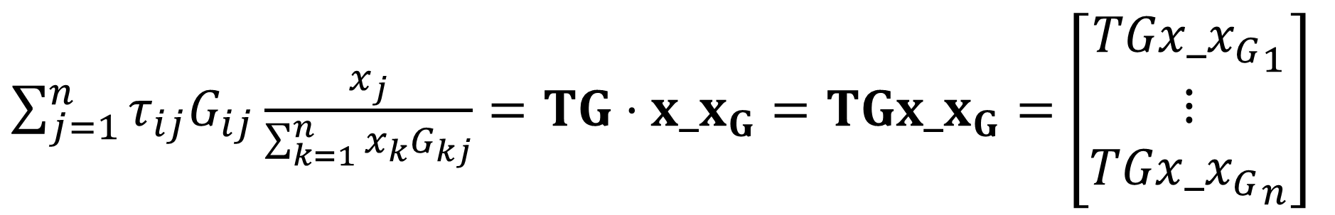
$\sum_{j=1}^{n}{τ_{ij}G_{ij}\frac{x_{j}}{\sum_{k=1}^{n}{x_{k}G_{kj}}}}=TG⋅x_x_{G}=TG{x_x}_{G}=$ $\left[\begin{matrix}TGx_{x_{G}}_{1} \\ ⋮ \\ TGx_{x_{G}}_{n}\end{matrix}\right]$

Slide 12
$$\ln{γ_{i}}=\frac{\sum_{j=1}^{n}{x_{j}τ_{ji}G_{ji}}}{\sum_{k=1}^{n}{x_{k}G_{ki}}}+\sum_{j=1}^{n}{τ_{ij}G_{ij}\frac{x_{j}}{\sum_{k=1}^{n}{x_{k}G_{kj}}}}$$
$$−\sum_{j=1}^{n}{G_{ij}\frac{x_{j}}{\sum_{k=1}^{n}{x_{k}G_{kj}}}}\frac{\sum_{m=1}^{n}{x_{m}G_{mj}τ_{mj}}}{\sum_{k=1}^{n}{x_{k}G_{kj}}}$$

Slide 13
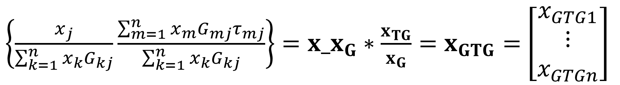
$\left\{\frac{x_{j}}{\sum_{k=1}^{n}{x_{k}G_{kj}}}\frac{\sum_{m=1}^{n}{x_{m}G_{mj}τ_{mj}}}{\sum_{k=1}^{n}{x_{k}G_{kj}}}\right\}=x_x_{G}∗\frac{x_{TG}}{x_{G}}=x_{GTG}=$ $\left[\begin{matrix}x_{GTG1} \\ ⋮ \\ x_{GTGn}\end{matrix}\right]$

Slide 14
$$\ln{γ_{i}}=\frac{\sum_{j=1}^{n}{x_{j}τ_{ji}G_{ji}}}{\sum_{k=1}^{n}{x_{k}G_{ki}}}+\sum_{j=1}^{n}{τ_{ij}G_{ij}\frac{x_{j}}{\sum_{k=1}^{n}{x_{k}G_{kj}}}}$$
$$−\sum_{j=1}^{n}{G_{ij}\frac{x_{j}}{\sum_{k=1}^{n}{x_{k}G_{kj}}}}\frac{\sum_{m=1}^{n}{x_{m}G_{mj}τ_{mj}}}{\sum_{k=1}^{n}{x_{k}G_{kj}}}$$

Slide 15
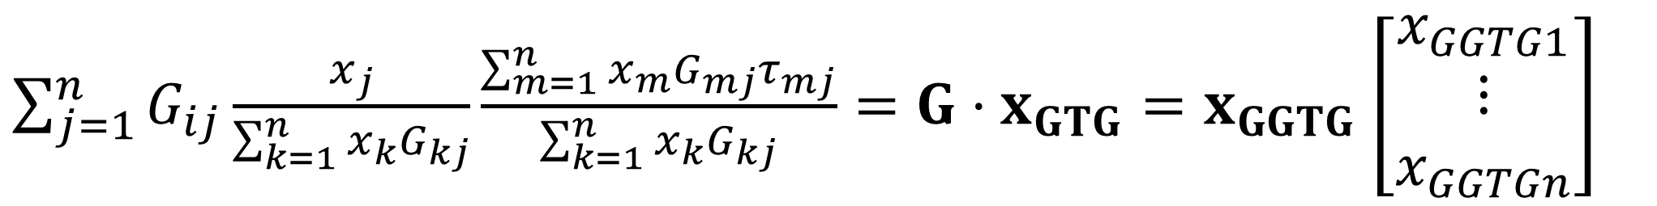
$\sum_{j=1}^{n}{G_{ij}\frac{x_{j}}{\sum_{k=1}^{n}{x_{k}G_{kj}}}}\frac{\sum_{m=1}^{n}{x_{m}G_{mj}τ_{mj}}}{\sum_{k=1}^{n}{x_{k}G_{kj}}}=G⋅x_{GTG}=x_{GGTG}$ $\left[\begin{matrix}x_{GGTG1} \\ ⋮ \\ x_{GGTGn}\end{matrix}\right]$

Slide 16
$$\ln{γ_{i}}=\frac{\sum_{j=1}^{n}{x_{j}τ_{ji}G_{ji}}}{\sum_{k=1}^{n}{x_{k}G_{ki}}}+\sum_{j=1}^{n}{τ_{ij}G_{ij}\frac{x_{j}}{\sum_{k=1}^{n}{x_{k}G_{kj}}}}$$
$$−\sum_{j=1}^{n}{G_{ij}\frac{x_{j}}{\sum_{k=1}^{n}{x_{k}G_{kj}}}}\frac{\sum_{m=1}^{n}{x_{m}G_{mj}τ_{mj}}}{\sum_{k=1}^{n}{x_{k}G_{kj}}}$$

Slide 17
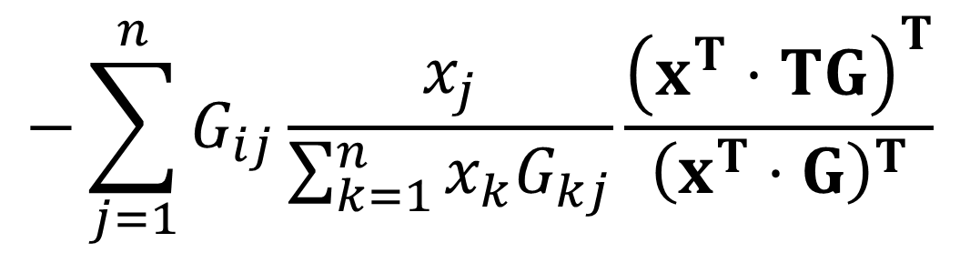
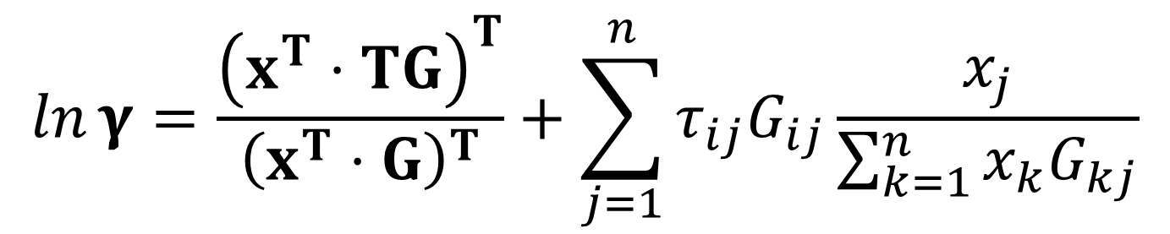
$$\ln{γ}=\frac{{\left(x^{T}⋅TG\right)}^{T}}{{\left(x^{T}⋅G\right)}^{T}}+\sum_{j=1}^{n}{τ_{ij}G_{ij}\frac{x_{j}}{\sum_{k=1}^{n}{x_{k}G_{kj}}}}$$
$$−\sum_{j=1}^{n}{G_{ij}\frac{x_{j}}{\sum_{k=1}^{n}{x_{k}G_{kj}}}}\frac{{\left(x^{T}⋅TG\right)}^{T}}{{\left(x^{T}⋅G\right)}^{T}}$$

Slide 18
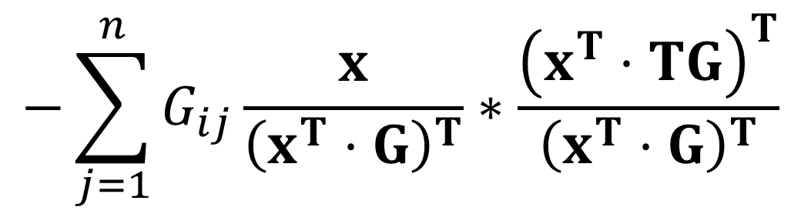
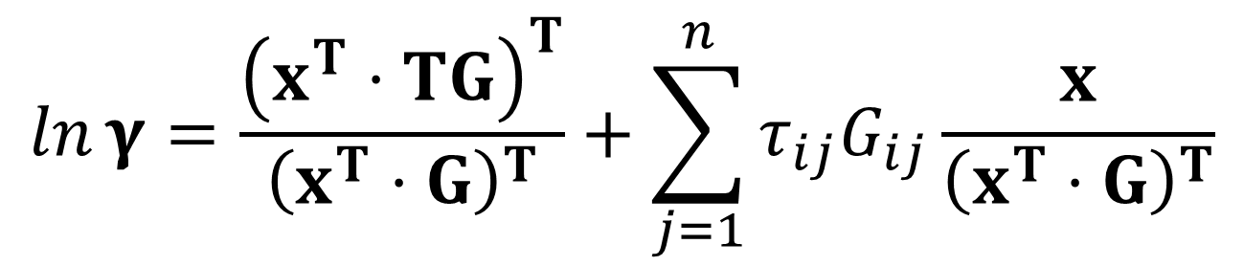
$$\ln{γ}=\frac{{\left(x^{T}⋅TG\right)}^{T}}{{\left(x^{T}⋅G\right)}^{T}}+\sum_{j=1}^{n}{τ_{ij}G_{ij}\frac{x}{{\left(x^{T}⋅G\right)}^{T}}}$$
$$−\sum_{j=1}^{n}{G_{ij}\frac{x}{{\left(x^{T}⋅G\right)}^{T}}}∗\frac{{\left(x^{T}⋅TG\right)}^{T}}{{\left(x^{T}⋅G\right)}^{T}}$$

Slide 19
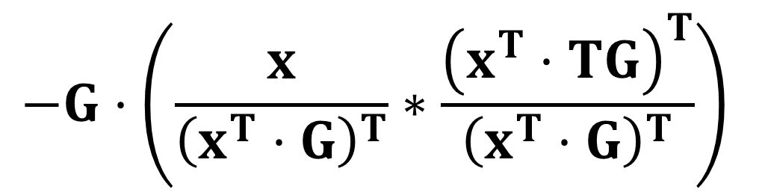
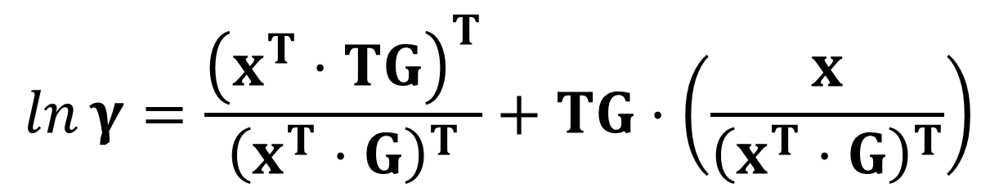
$$\ln{γ}=\frac{{\left(x^{T}⋅TG\right)}^{T}}{{\left(x^{T}⋅G\right)}^{T}}+TG⋅\left(\frac{x}{{\left(x^{T}⋅G\right)}^{T}}\right)$$
$$−G⋅\left(\frac{x}{{\left(x^{T}⋅G\right)}^{T}}∗\frac{{\left(x^{T}⋅TG\right)}^{T}}{{\left(x^{T}⋅G\right)}^{T}}\right)$$

