Slide 1
CBI HACKATHON 2026 · PHASE II
TEAM SOLARIS · MNNIT ALLAHABAD
TrustLayer
Continuous AI Behavioral Biometric Authentication for Secure Digital Banking
"Protecting Sessions, Not Just Logins."
[Member 1]
[Member 2]
[Member 3]
Backend & ML Pipeline
Frontend & SDK
Research & Data
June 30, 2026

Slide 2
THE PROBLEM
The Mid-Session Security Gap
Banks verify identity at login. Fraud happens after. Between OTP verification and logout, there is zero continuous identity verification — and attackers know it.
₹29,082 Cr
47%
34%
Banking fraud FY24
YoY growth
Bot-driven
India total · RBI Annual Report
In digital banking fraud · RBI 2024
Automated script attacks · CERT-In 2024
Account Takeover (ATO)
Automated Bot Scripts
Stolen session cookies or credentials let attackers hijack active sessions while the legitimate user is away. RAM scraping and Remote Access Trojans (RATs) amplify the threat.
Headless browsers fill forms at 0 ms speed. API abuse with stolen session tokens bypasses traditional CAPTCHA using ML-based solvers.

Slide 3
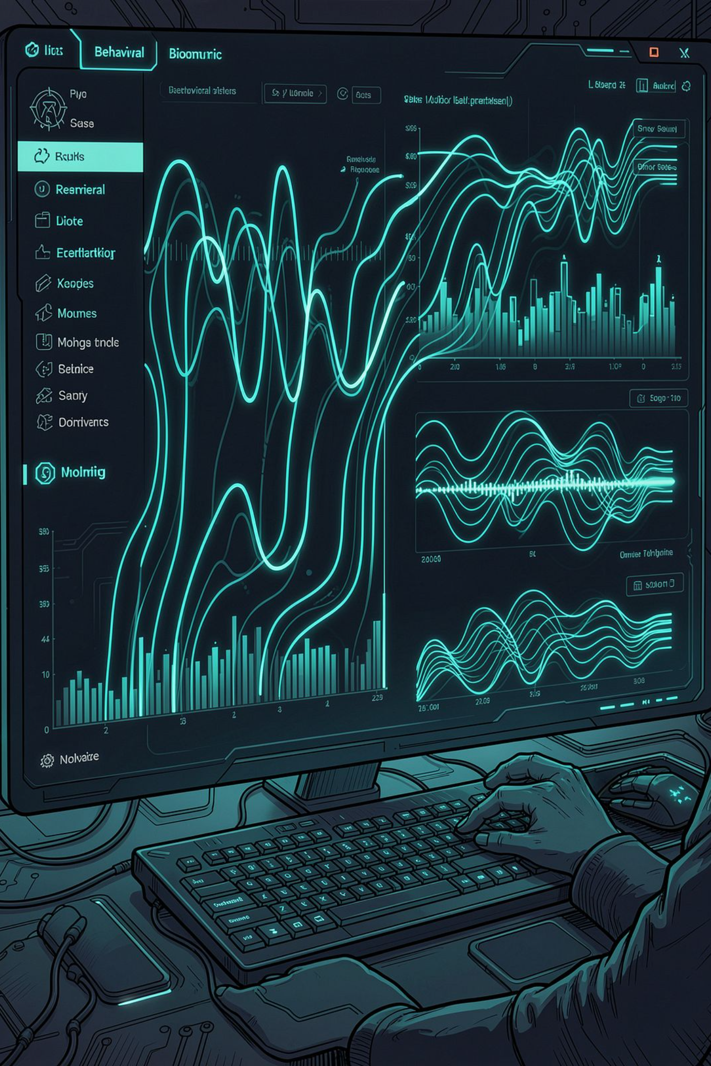
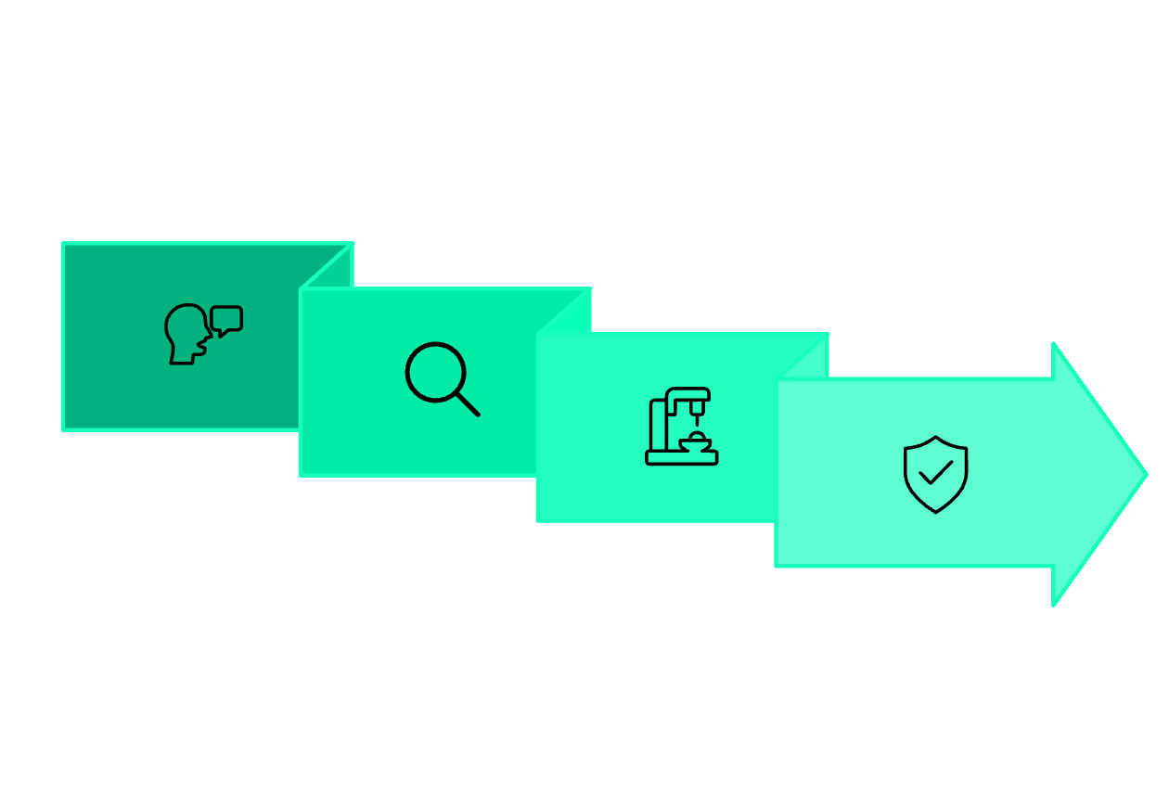




THE SOLUTION
TrustLayer — Continuous Behavioral Trust
Zero friction for legitimate users. One JS file added to any portal. TrustLayer silently verifies identity throughout the entire banking session — not just at the front door.
SDK Captures
Adaptive Response
User Types
ML Analyses
Invisible
Drop-In Layer
Zero friction. No OTP added to normal flow. Operates 100% silently. Legitimate users never notice it.
One sdk.js file. No server infrastructure changes. Works with existing NetBanking. PSB-ready REST API.
Privacy First
Only mean (μ) and std (σ) stored. Raw keystrokes never leave the browser. No biometric database to breach.
Adaptive Response
Proportional, not binary. GREEN to RED-CRIT — every action scaled to threat level in real time.

Slide 4







ARCHITECTURE
System Architecture
Three-tier pipeline: Browser → FastAPI Backend → SOC Dashboard. Designed for production-grade security at every layer.
Browser · User Device
1
2
bank.html (BSB Portal) + sdk.js client SDK. Captures keystroke events, mouse coords, device fingerprint, nonce + timestamp.
Rate Limiter
CORS Guard
5 auth/min/IP · auto IP block for persistent bots
Origin whitelist · trusted origins only
FastAPI Backend
3
4
48 endpoints · WebSocket broadcaster. Rate limiter, CORS guard, anti-replay nonces, full ML pipeline. SQLite WAL mode, 9 tables, auto-init.
Anti-Replay
ML Engine
UUID nonce check · 60-second expiry window
LSTM Keystroke → LSTM Mouse → XGBoost (0-100) → SHAP-lite
SOC Dashboard · Analyst
Real-time session feed, SHAP explainability, force freeze / dismiss controls, full audit search.

Slide 5




MACHINE LEARNING
Three-Model ML Pipeline
Bot Pre-Screen → LSTM Keystroke → LSTM Mouse → XGBoost Fusion. Each stage feeds the next, building a complete behavioral trust score.
83.68%
77.37%
Accuracy
Recall ★
XGBoost Fusion classifier
Key metric — over 3 in 4 intruders caught
88.54%
82.58%
Precision
F1 Score
Minimizing false alarms
Balanced performance
Model 1: LSTM Keystroke
Model 2: LSTM Mouse
CMU Keystroke Dynamics · 51 subjects, 17,340 sequences. GRU encoder-decoder. Output: reconstruction error → anomaly score.
Balabit Mouse Dynamics (CC BY 4.0) · 10 users, 76,543 segments. Features: velocity, acceleration, jerk, curvature → trajectory anomaly.
Model 3: XGBoost Fusion
SHAP Feature Importance
KMT dataset · 88 users, 1,760 real sessions. GroupKFold(5) — zero subject leakage. 27 combined features → Risk Score 0-100.
Keystroke features: 45.4% · Session metadata: 25.0% · Mouse features: 20.9% · Enrollment data: 8.7%. Inference under 2 ms.

Slide 6
ADAPTIVE RESPONSE
Adaptive Risk Response — 7 Bands
No binary block/allow. Every action is proportional to the threat level.
GREEN 0-30
AMB-LOW 31-45
AMB-MID 46-60
AMB-HIGH 61-70
RED-LOW 71-82
RED-HIGH 83-95
Silent continue · 30s interval
10s polling started
Soft challenge modal
Transfers blocked + OTP
Session freeze overlay
Freeze + SOC alert
RED-CRIT 96-100
Instant lockdown
No binary block/allow. Every action is proportional to the threat level.

Slide 7





SECURITY & COMPLIANCE
Core Features & Security Hardening
Innovations and production-grade security built directly into the codebase — not bolted on after.
Explainable AI (SHAP-lite)
Cold Start Solver (EMA)
ShieldBotCheck Pre-ML Layer
PBKDF2-SHA256 Password Hash
CMU/Balabit global prior blending. +5% personal weight per session.
Real-time SHAP attribution scores. Plain English SOC alerts.
Headless/WebDriver flag check, 0 ms dwell time. Blocks scripts before ML runs.
100,000 iterations. Random 16-byte salt per user.
Anti-Replay Nonces
Stat-Only Biometric Storage
NIST SP 800-63B
RBI Digital Payment Guidelines
crypto.randomUUID() on sdk.js calls. 60s timestamp window server-side.
Password standards compliant design
Only μ and σ stored. Raw events stay in browser. IT Act 2000 & GDPR compliant.
Data minimisation aligned. OWASP API Top 10 compliant.

Slide 8
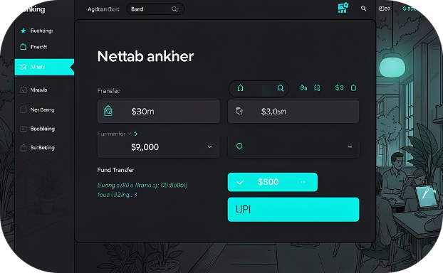
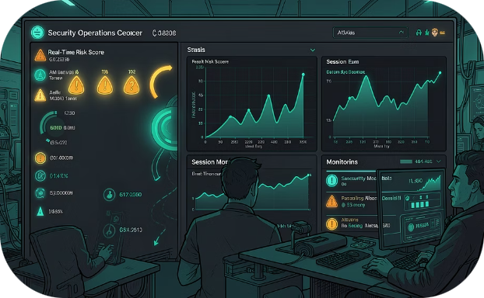
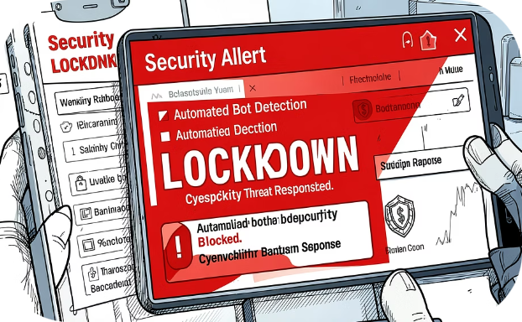
LIVE PROTOTYPE
Live Prototype — Bharat Suraksha Bank + SOC Dashboard
Running at localhost:8080 · Three threat personas · Unedited live demo
Legitimate Owner → GREEN
Human Intruder → AMBER
Automated Bot → RED CRITICAL
Keystroke rhythm matches baseline. Risk stays below 25. Silent continue — user notices nothing.
Hesitant rhythm, wrong flight times. Step-up challenge modal triggered. SOC notified for review.
0 ms dwell detected pre-ML. Instant UI freeze. Score set to 97. Session terminated on the spot.

Slide 9



ENGINEERING CHALLENGES
Challenges & How We Solved Them
Three core engineering problems encountered and resolved during development.
Real-Time SOC Sync
Dataset Bias
Problem: WebSocket disconnections caused stale session state during live demos.
Solution: Exponential Backoff + State Replay. Reconnect: 5s → 10s → 30s. Full state re-fetched from REST on reconnect. Missed events replayed from SQLite audit log. Heartbeat ping/pong for early TCP drop-out detection.
Cold Start Problem
Problem: CMU and Balabit are Western datasets. Indian banking users type differently — bilingual, regional scripts, different layouts.
Solution: KMT Retraining + EMA Drift. Retrained XGBoost on KMT (88 real banking users). GroupKFold(5) — zero subject leakage. Isolation Forest fallback for mouse when keystroke data is sparse.
Problem: New users have no personal baseline — nothing to compare against on session 1.
Solution: EMA Progressive Blend. CMU global prior as starting profile. +5% personal weight per session (Exponential Moving Average). Fully personalised by session 15. Device class tracked separately for new-device scenarios.

Slide 10
ROADMAP
Expected Impact & Roadmap
8 Billion
₹29,082 Cr
77.4%
Monthly UPI transactions
Annual banking fraud
Intruder recall
Each one a potential fraud vector. TrustLayer can protect every session at the moment of payment.
Addressable by continuous session verification at the NetBanking layer. Source: RBI Annual Report.
Over 3 in 4 attackers caught silently — with ZERO added friction for legitimate customers.
NOW · Done
Phase 3
Web portal NetBanking · Continuous auth active · LSTM + XGBoost live · SOC dashboard running
Native mobile SDK · iOS + Android · Gyroscope biometrics · Touch pressure + area
1
2
3
4
Phase 2
Phase 4
UPI-specific layer · VPA pattern scoring · Transaction velocity · UPI PIN timing analysis
Federated learning · Indian population prior · On-device retraining · Zero PII to server
"Zero infrastructure change. One JavaScript file. Any existing PSB portal is protected."
TrustLayer — Protecting Sessions, Not Just Logins.

