Slide 1
THEME: RENEWABLE /SUSTAINABLE ENERGY
TITLE: SMART MANAGEMANT OF STREET LIGHTS FOR ENERGY CONSERVATION
TEAM MEMBERS:
HARINI B ( 20IT016, III year, IT)
SRI VARSINI S K ( 20IT045, III year, IT)
SWETHA K ( 20IT055, III year, IT)
AMITHA S ( 20IT301, III year, IT)

Slide 2
INTRODUCTION
Global trends in street lighting show that 18-38% of the total energy bill goes towards road lighting and therefore this is one domain that needs major attention if we look at improving efficiency of power consumption with an objective of saving energy.
The objective of our project is to make the lights glow brighter when there are more number of vehicles in the road and reduce its brightness when there is less number of vehicles. Thus, we could save electricity.
We can also deploy wind turbines in the center of the road, piezoelectric pads to generate electricity.

Slide 3
LITERATURE SURVEY
REF NO | CATEGORY TOPIC | STUDY METHOD | RESULT
4 | An Innovation in the Field of Street Lighting System with Cost and Energy Effciency | The system starts to works only at low or poor lighting conditions. Piezoelectric crystal strips are embedded on the roads6 at calibrated intervals. | When vehicles move over the piezo embedded road, the microcontroller reads a digital HIGH and the code actuates the street light to glow with full intensity
5 | Energy Efficient Smart Street Lighting System | Light-emitting diodes (LEDs) are components used in electronic devices to signalise light | This system the energy saving is around 30-40% with hightraffic and more than 60% for low traffic .

Slide 4
PROBLEM STATEMENT
Smart management of street lights for energy conservation.
India has vast length of roads within cities, towns and villages. Also connected to them are the national highways (total length of national highways being about 1.3 million km).
Most of the streets are illuminated from evening to morning averaging about 12 hours per day within the habitations. It is well understood that some of the streets may not have vehicles or even pedestrians passing through them throughout the night.
In such scenarios there is wastage of electrical energy for illumination of streets. Smart street light management would mean that sensors can sense a movement in an area and switch on the lights before the vehicle or pedestrian passes by and switch it off during no movement thus saving electrical energy.

Slide 5
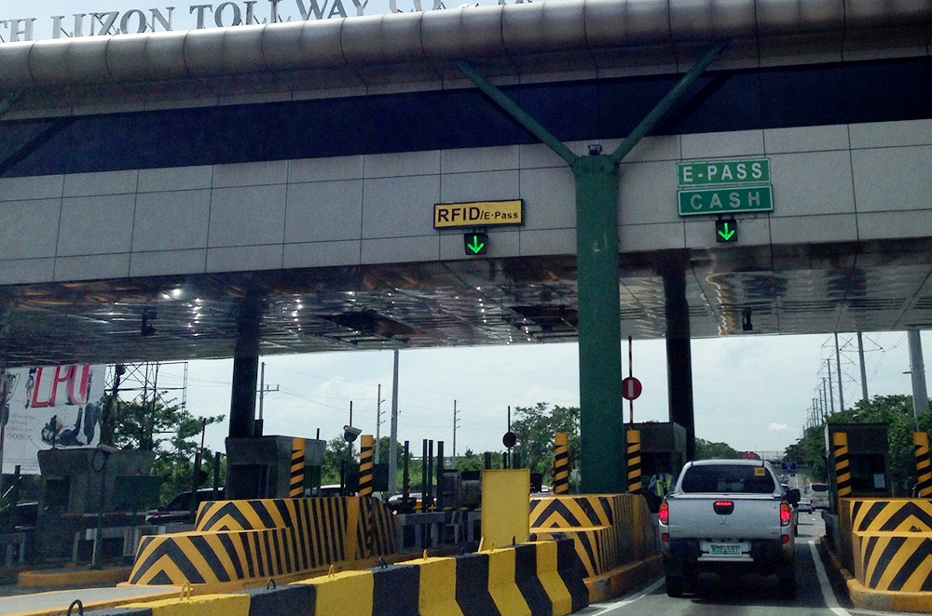
Solution / Idea

Slide 6
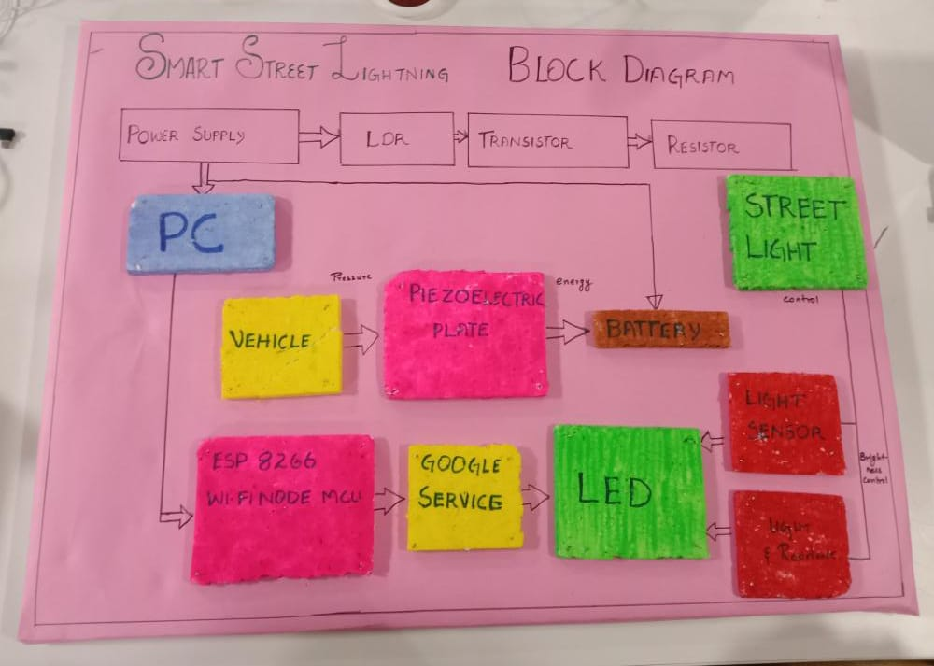
FLOW/SOLUTION

Slide 7
Solution
Google uses people’s GPS location, their search terms and previous traffic data to accurately predict the current traffic density on the road. By obtaining this data, we may be able to control the lights automatically.
RFID tags are used to pay money at toll gates. Using that, the number of vehicles in a highway could be calculated real-time, thus controlling the brightness of lights and reducing it automatically to save energy.
We have also planned to generate electricity from vehicles that are running on the road. This could be done by using piezoelectric technology by converting mechanical energy to electrical energy and also by placing turbines in the center of highway by which the electricity can be generated as when the vehicle moves faster, it creates air movement around it.

Slide 8
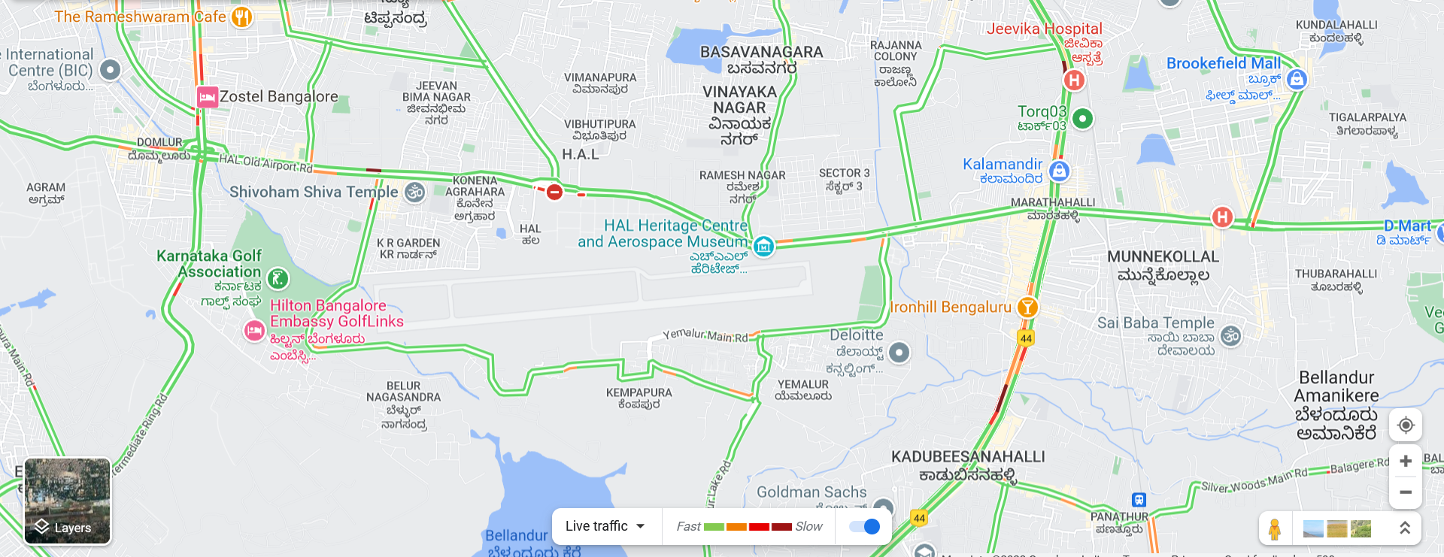
Solution / Idea

Slide 9
WORKING PRINCIPLE
Principle of Street Lighting
For designing the street lighting scheme, the following two general principles are usually employed −
1.Diffusion Principle
2.Specular Reflection Principle
Diffusion Principle
In the diffusion principle of design of street lighting, the lamps fitted with suitable reflectors are used. The design of the reflectors is such that they direct the light downwards and spread it as uniformly as possible over the surface of the road. To avoid the glare, the reflectors are made to have a cut-off between 30° to 45° so that the lamp filament is not visible except below the lamp.
As the surface of the road has diffusing nature causes the reflection of a certain portion of the incident light in the direction of the observer and hence the road surface appears bright to the observer.

Slide 10
Specular Reflection Principle
In case of specular reflection principle, the reflectors are curved upward so that the light is thrown on the road at a very large angle of incidence.
This case, the observer requires to see the objects about 30 meters away.
This method of street lighting is only suitable for straight sections of the road.
This method of street lighting is more economical than diffusion method, but it suffers from the disadvantage that it produces glare for the observers.

Slide 11
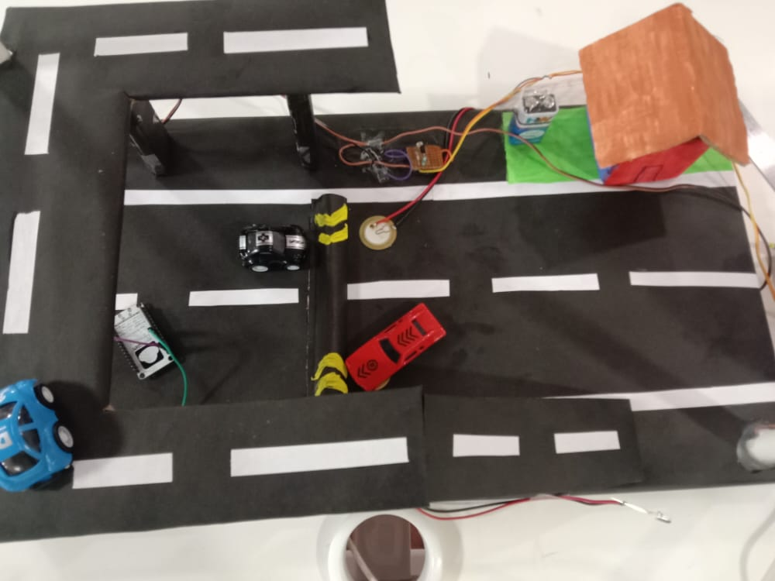
PROTOTYPE

Slide 12



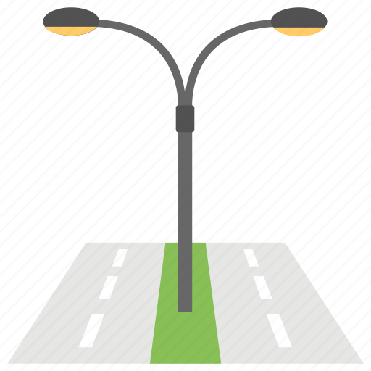
INNOVATIVE TECHNOLOGY
The innovation in the project is to get real-time traffic density data in either of two ways – i) Google calculates real time traffic data based on GPS. ii) Toll gates have RFID scanner and vehicles have RFID tag, which can be used to find how many vehicles are there in the current road, and control the brightness of the lights based on that.
GOOGLE
TRAFFIC DATA
OR
RFID TOLL GATE TRAFFIC DATABASE

Slide 13
SIMILARITY
Some similar projects are :-
Based on motion sensors, it detects movement nearby and turns on the light in that area.
LDR can be used to turn on/off the lights automatically.
SOLAR CELLS
Chinas first high tech solar highway which produces electricity.
SOUND BARRIER
a highway sound barrier witrh solar panel that produce renewable energy.

Slide 14
COMPARISION OF EXISTING PROJECT AND MODIFIED PROJECT
Advantages of System Automatic
switching of street lights Maintenance
cost reduction
Reduction in CO₂ emission
Reduction of light pollution
Wireless communication
Energy savingReduction of manpower

Slide 15
Disadvantages of Existing System
Manual switching off/on of street lights
More energy consumption
High expense
More manpower
Now moving to the proposed system automated with the use of light sensors, not just the saving of energy and ensuring safety, we can also see a few more advantages following the Proposed

Slide 16
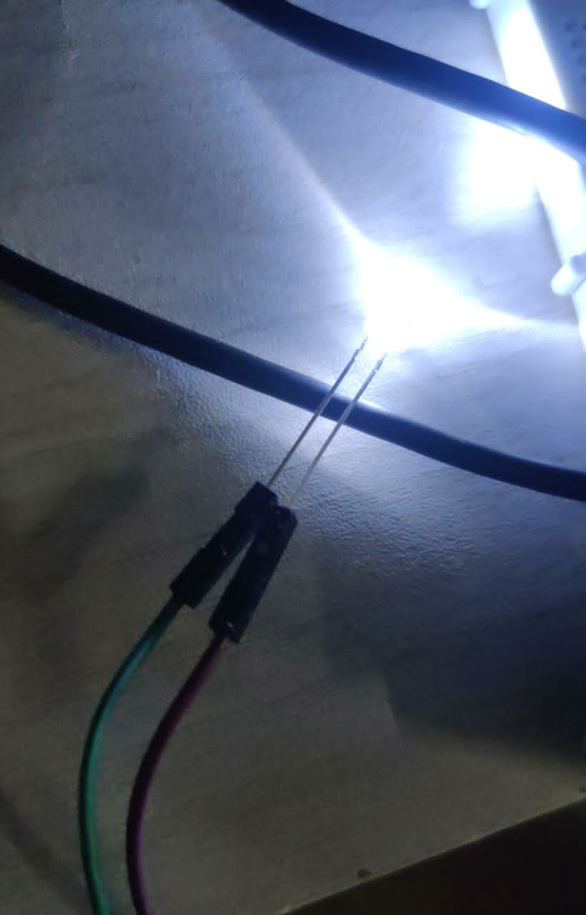
Design Specification and Mathematical Analysis
1.POWER OF STREETLIGHT:
Required Streetlight Watt = (Lux per Sq. Meter X Surface Area of Street Light) / Lumen per Watt.
2.PIEZOELECTRIC PLATE:
1.Electric power could be generated by a piezoelectric material by applying our weight on it…
FORMULA: P=V² / R
2. voltage of piezoelectric crystal can be calculated by using
FORMULA: V = P×g× t
where P is the pressure applied in N/(sq.m )
g is the sensitivity of the material
t is the thickness of the material
V is output voltage

Slide 17
MARKET DEMAND
Street lighting is provided along the road sides to make traffic and obstructions on the road clearly visible in order promote safety and convenience. Street lights also make the street more attractive. Street lighting improves the traffic speed and the traffic flow conditions.
The popularity of solar lights has surged in the past 5 years due to emerging green technologies and rising energy street light cost. Among this shift in moving towards more renewable energy sources for lighting,
According to the market demand nowadays they wish to have a future modifiable and innovative technology
1.Quality of LED bulbs
2.energy saver
3.cost reduction
4.Reduction in CO₂ emission
5.Reduction of light pollution
6.Wireless communication

Slide 18
PRICE OF THE PROTOTYPE PROJECT
LED street light = Rs. 150/-
Wifi module = Rs.500/-
LDR = Rs. 400/-
JUMPER WIRES= Rs.250/-
PIPES AND CONNECTIONS=Rs.200/-
BATTERY=Rs.30/-
PIEZOELECTRIC PLATE=Rs.2000/-
Total Amount Charges =Rs.3,550/-

Slide 19
PRICE OF THE PRODUCT
RAW MATERIALS
S NO5 | DESCRIPTION | AMOUNT | QUANTITY | TOTAL
1 | ESP 8266 MCU | 200 | 500 | 100000
2 | LDR | 200 | 500 | 100000
3 | LED | 650 | 1000 | 650000
4 | PIEZOELECTRIC PLATE | 300 | 1500 | 450000
5 | CAPACITOR | 1500 | 500 | 750000
TOTAL :2050000

Slide 20
Conclusion
For now, we have built a prototype with LDR which detects whether the surrounding is dark or not.
And another prototype, which can be fed with real time traffic data and control the brightness of light. For now, we are manually using some sample data to control the intensity of the light to show how this project works. If this project gets implemented, then we could get traffic data through RFID at toll gate and based on that, lights can be automated. Also, google doesn’t provide their raw traffic data for public. But if any government or organization request for that, they might provide it.
Thus, we have established an idea and a sample prototype of how to make street lights smart and control electricity.

Slide 21
Reference
https://www.sciencedirect.com/science/article/abs/pii/S0196890409000697
https://developers.google.com/maps/documentation/javascript/trafficlayer#maps_layer_traffic-javascript
https://stackoverflow.com/questions/4600656/access-googles-traffic-data-through-a-web-service
https://electricalfundablog.com/smart-street-light-system-architecture-works/

