Slide 1
Python - An Overview
Hari Amoor

Slide 2
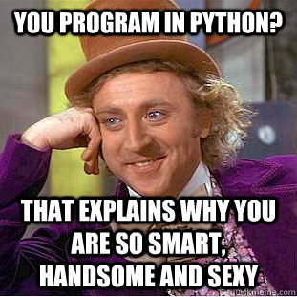
What is Python?
Interpreted
Object-oriented
Has some functional programming support
Dynamic/weak typing (static typing optional in Python 3.6)
Use cases:
Agile software development
Scripting
Glue language

Slide 3
Why Python?

Slide 4
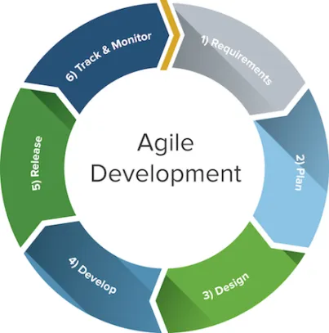
Agile (or Rapid/Extreme) Software Development
Promotes simplicity and increased collaboration
Relies on frequently pushing incremental and test-able changes
Python is ideal for this
Code is easily divisible into small snippets
Supports paradigm with release after each iteration

Slide 5
Scripting and “Glue” for Services
Common use cases:
Small script (<200 lines) to process data in a specific format and aggregate results
Daemon to process data from one data source and feed to another (ETL pipeline)
Intermediary layer in pipeline of services (talk to two different services, provide common layer of truth)

Slide 6
IRL Applications of Python

Slide 7
Project Requirements - HackRU
Ludicrous Card System (LCS):
Common backend and persistence layer for HackRU’s suite of user-facing apps and internal systems
Rapid release cycle - 6ish months in between each HackRU event, lots of requirements changing!
Sporadic production traffic - lots of traffic 2x a year, minimal traffic the rest of the time

Slide 8
Solution - Python Microservices
AWS Lambda - Function-as-a-Service (FaaS) platform - for deployment
Pay in terms of number of requests
Auto-scale - don’t have to own hardware
Thirteen different REST endpoints (and counting), each of which provide some backend service intrinsic to HackRU’s operations
Python 3 standard library and API calls used extensively throughout each microservice

Slide 9

Project Requirements - Facebook
Android Crash Categorizer:
Tens of millions of crash reports from people’s phones every day - needed to categorize crashes/figure out who broke what
“Glue” pipeline of services together with HTTP REST calls to/from each microservice
Script to validate test data against Hive database used by team

Slide 10
Solution - Categorization Service using Python
Exposed to rest of pipeline with Apache Thrift - language-agnostic RPC framework
Deployed as microservice using Tupperware, an internally-used containerization mechanism
Uses PyThrift (Thrift API for Python) for bidirectional communication between multiple services

Slide 11
Drawbacks of Python at Facebook
Bugs everywhere!!!!!! (OK FINE I WROTE MOST OF THEM)
No compile-time bug detection
Type system and API changes across different versions of Python
Multiple inheritance necessitated classes that would otherwise be unnecessary
Extremely difficult to change Python versions
Moving from Py2 ==> Py3
Different versions of the standard library
Needed third-party modules to fix problems in standard library

Slide 12
Demonstration

Slide 13
Project Requirements
Calculator - takes input from stdin and releases input from stdout
Format:
“Num1 + Num2”
“Num1 - Num2”
“Num1 * Num2”
“Num1 / Num2”
All numbers inputted should be integers
Calculator should detect invalid operations, i.e. divide by 0

Slide 14
Solution
Write your own code!
My solution is given here.

Slide 15
The End

