Slide 1
E-Commerce
Description
eShop: a simple, modern e-commerce web app
Users can browse products, add to cart, checkout, and track orders
Admins can manage the catalog and monitor orders
Built with Angular (frontend) and Python Flask microservices (backend)

Slide 2
Architecture used: Microservices
Separate services: Gateway + Auth, Products, and Orders
Each service owns its own database, reducing coupling
Services communicate over HTTP/JSON through a single entry point
Easier to update or scale parts independently without touching others

Slide 3
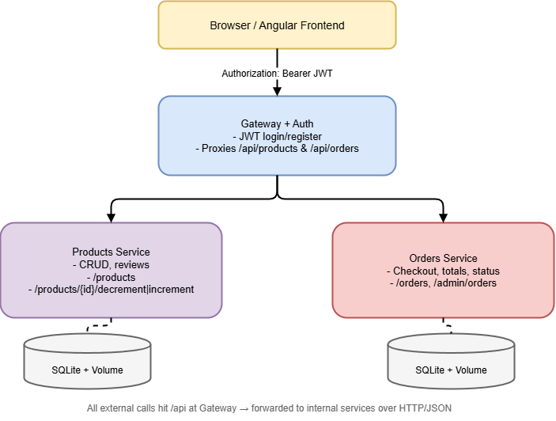
Architecture diagram

Slide 4
Services & APIs
Gateway + Auth: login, register, and current-user lookups; routes all /api traffic to internal services
Products service: product CRUD, search/filtering, reviews, and stock updates
Orders service: create orders, compute totals, track status, and admin order views
Cross-service logic:Orders validate items with Products and reserve/return stock during checkout/cancel

Slide 5
Containerization
Four containers: Frontend, Gateway, Products, and Orders
Named volumes for persistence: uploads and user data at Gateway; databases for Products and Orders
Internal networking by service name (for example, “products” and “orders”)
Auto-restart policy and clear external ports for easy local access

Slide 6
Deployment (how we run it with compose)
Build images, then start the full stack in the background
Verify the health endpoint, then open the frontend in the browser
A first-time admin account is available; sign in and add products to get started
Stopping and starting later keeps all data intact thanks to volumes

