Slide 1
CozyHaven Hotel Booking System
Trainer’s Name: Presented By:
Mr.Javeed Haribaskar S

Slide 2
Introduction
Hospitality businesses require efficient reservation management.
Manual booking processes are time consuming.
Seamless digital booking improves occupancy rates
CozyHaven provides a modern hotel booking system and management platform.

Slide 3
Scope
• Enable guests to book rooms online in real-time, reducing manual coordination and improving the overall booking experience.
• Store and manage guest preferences and stay history electronically for personalized service and easy access by hotel staff.
• Simplify administrative tasks such as managing room inventory, housekeeping schedules, and staff records.

Slide 4
Definition
Design and develop CozyHaven, a full-stack hotel booking and management application.
Streamline reservation management and hospitality services.
Enable interaction between guests, hotel owner, and administrators.
Ensure efficient bookings, guest records, and communication.

Slide 5
Modules
Guest Module
Hotel Owner Module
Admin Module
Booking Module
Security Module

Slide 6
Technologies Used
Frontend: React
Backend: Spring Boot
Database: MySQL
Authentication: JWT

Slide 7
Guest Features Owner Features
• Register/Login
• Search Hotels
• Make Bookings
• Cancel Bookings
• Register/Login
• Add Hotels
• Edit Hotels
• Manage Bookings
Admin Features
• Login
• Manage Users
• Manage Bookings
• Manage Hotels

Slide 8
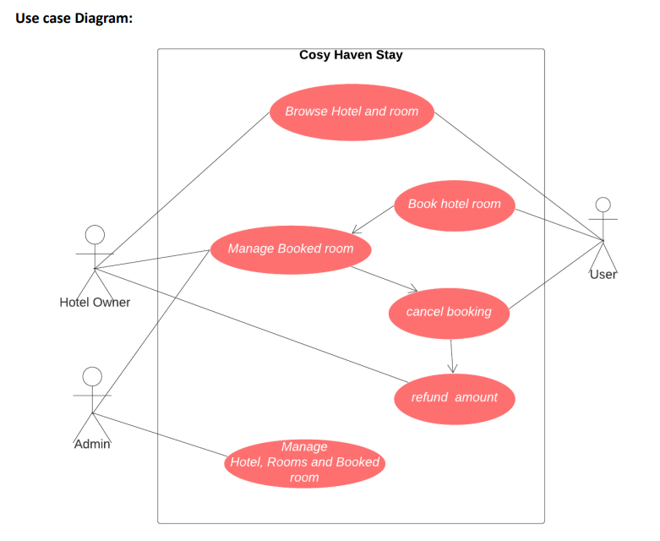

Slide 9
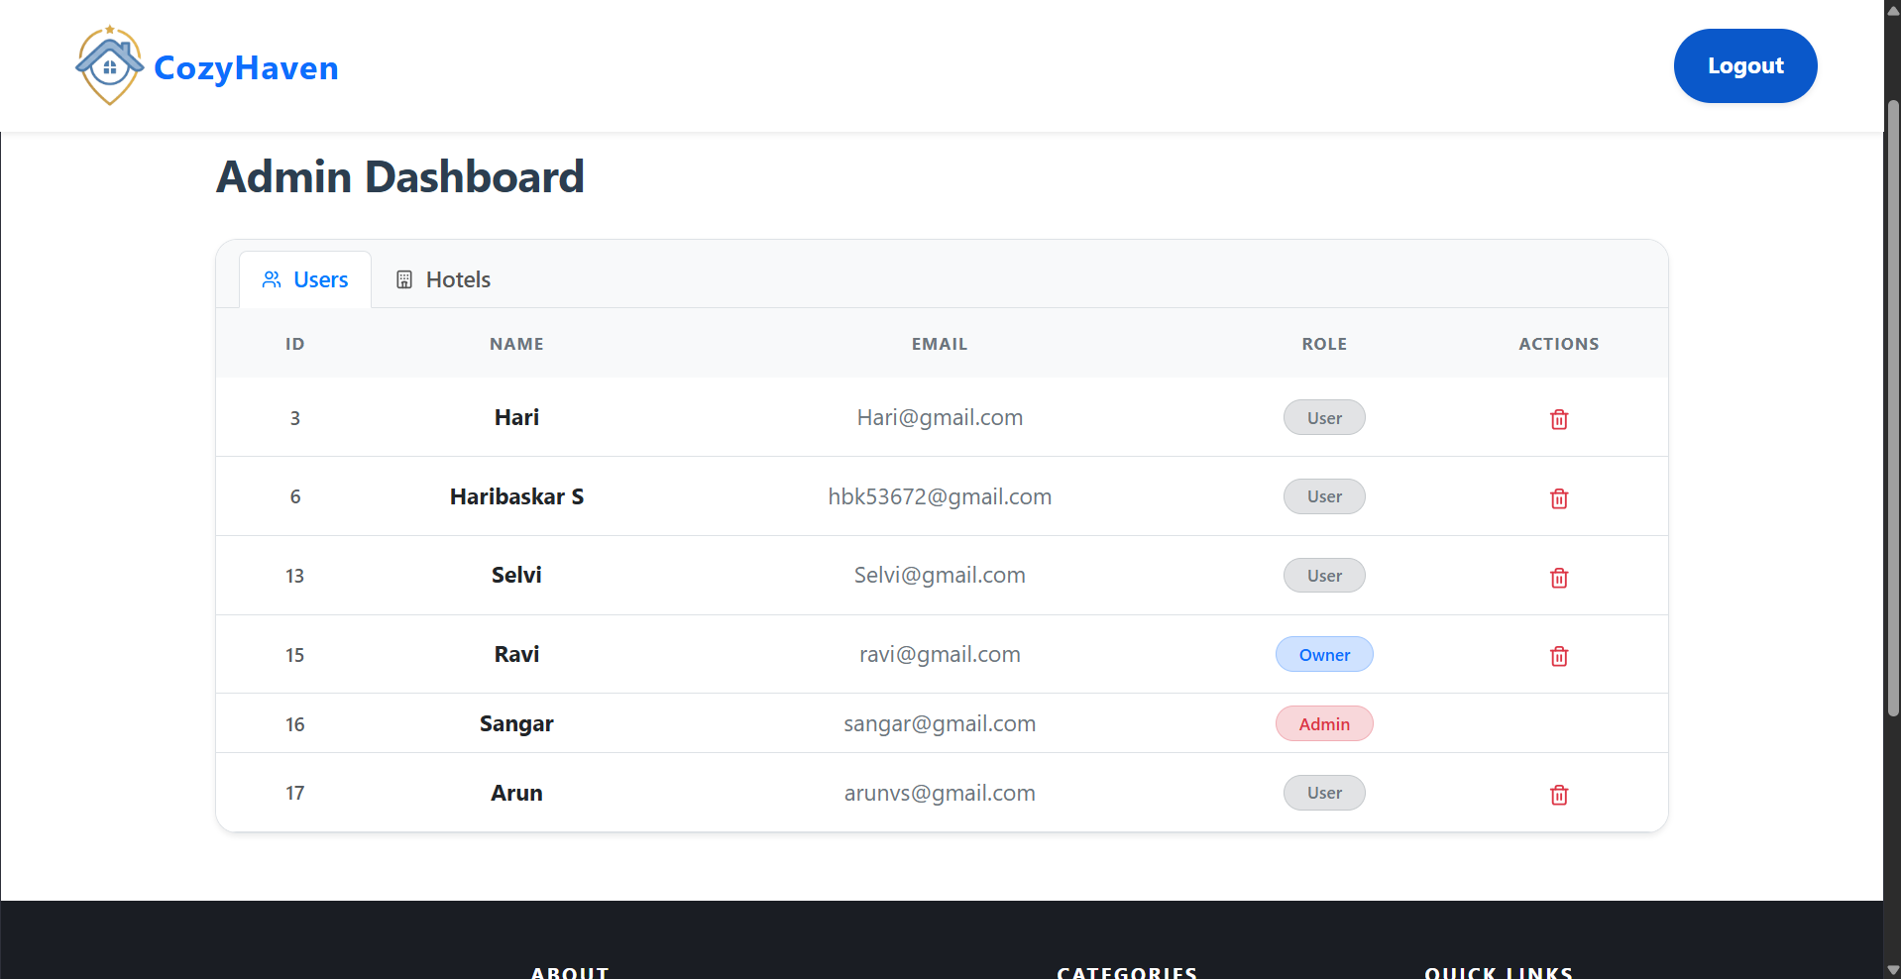
Screenshots

Slide 10
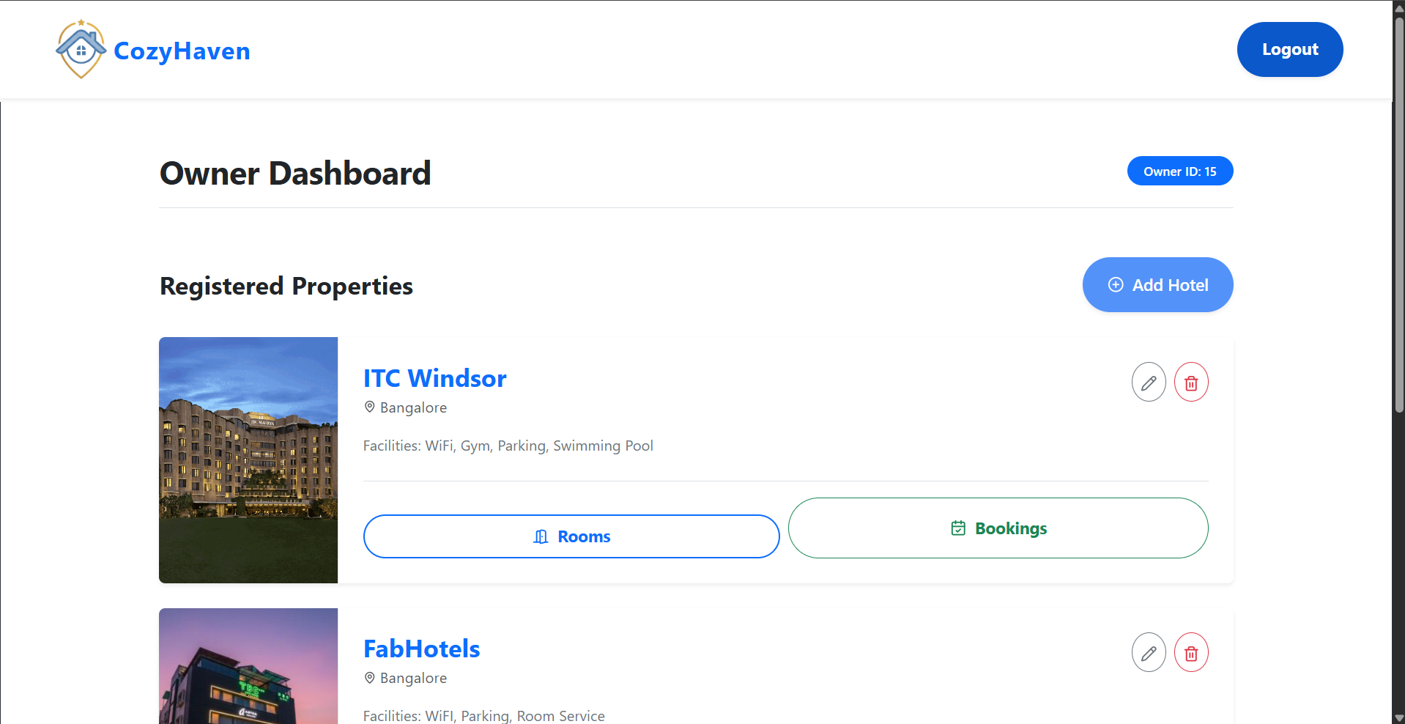
Screenshots

Slide 11
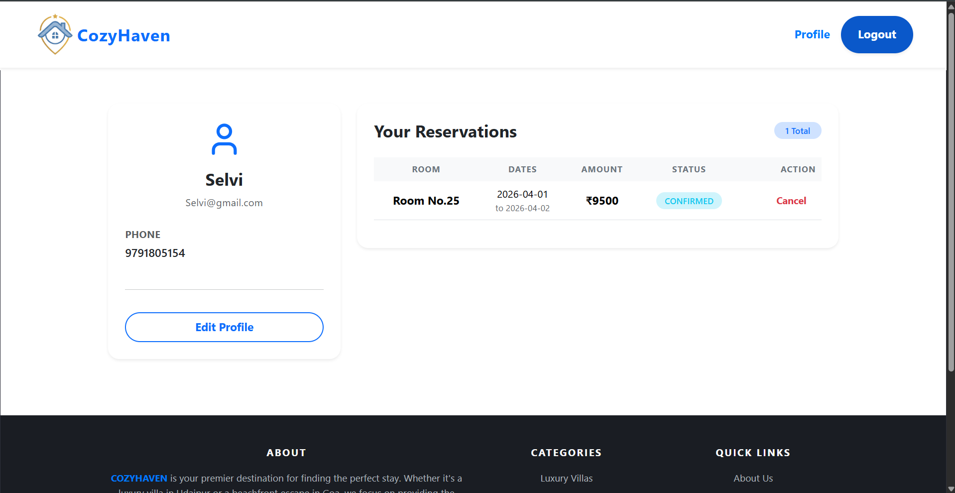
Screenshots

Slide 12
Conclusion
CozyHaven simplifies hospitality and hotel management
Improves operational efficiency and guest communication.
Provides a secure and scalable solution for businesses.
Improves the overall guest experience and stay quality.

