Slide 1
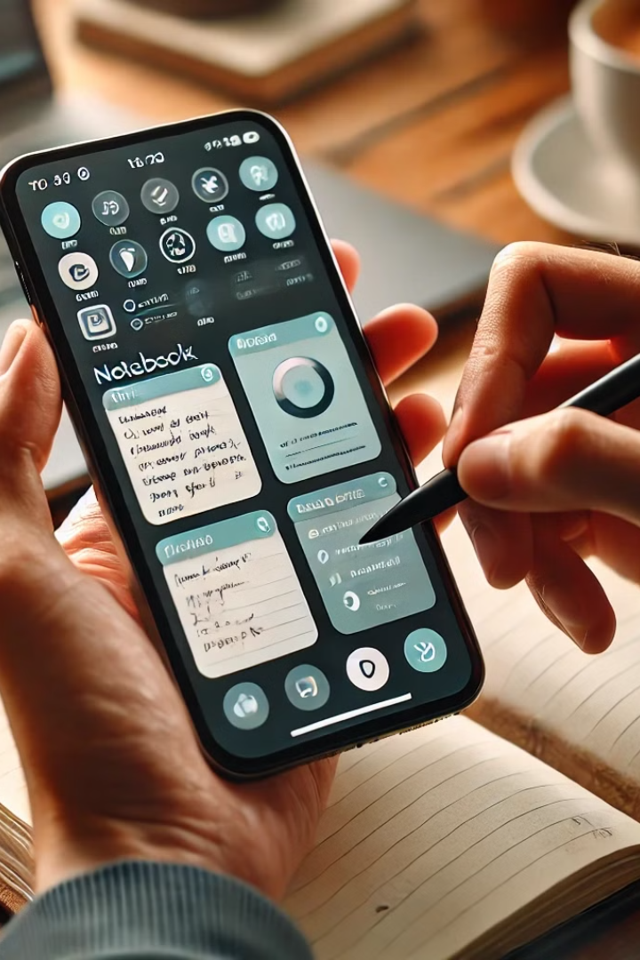
MyNotebook: Structured, Multi-Media Note-Taking For Dyslexia Support
Tired of messy notes? MyNotebook offers a structured, multi-media experience. Capture text, images, videos, and audio in one organized system. Designed with dyslexia-friendly features like text-to-speech, it ensures an accessible and seamless note-taking experience. Start capturing and organizing your ideas the smart way
Project Title: MyNotebook
Team: Zeroandone

Slide 2
The Problem: Students, including school-goers ,dropouts and individuals with dyslexia , struggle to maintain their notes in an organized and structured way, leading to note loss and difficulty in retrieval.
1
Scattered Notes
2
Lack of Centralized Space
3
Collaboration Issues
Notes scattered across different platforms.
No centralized space to organize & retrieve notes.
Lack of collaboration & checklist tracking for study progress.

Slide 3
What is Dyslexia?
1
Clarity
2
Prevalence
3
Impact
Dyslexia is a learning disability that primarily affects reading, writing, and spelling abilities.
Affects 3–7% of the population, with up to 20% experiencing some degree of symptoms.
The impact of dyslexia varies among individuals, leading to challenges in spelling, reading fluency, and comprehension.
4
Diagnosis Rates
5
Information Retention Issues
Identification rates have more than doubled in Texas public schools, reaching 6% in the last decade.
Hard to remember key concepts due to difficulty in processing written material.

Slide 4
MyNotebook: The Feature of Smart Note-Taking (Solution)
1
Customizable Organization:
2
Integrated Checklist:
Easily organize notes by topic, project, or category.
Track what’s completed & pending.
3
Multi-Format Notes:
4
AI-Based Summarization:
Text, images, audio, and videos.
Quickly find and summarize key information, Choose between
Tamil & English speech with Dyslexia Support
5
MyNotebook:
6
Unit-Wise Important Topics:
The ultimate smart note-taking solution for all users.
Provides State Board students with key topics for every unit to help them study effectively and score better in exams.
7
Class-Wise One-Word Quiz Practice:
Provides students with important one-word questions tailored to their class and subject, helping them prepare effectively and improve their exam performance.

Slide 5



AI-Powered Summarization: Quick Revision, Enhanced Learning
Quick Revision
2
Rapidly review key points, saving time and improving comprehension.
Summarization
1
Generate concise summaries of notes, research papers, and meeting minutes.
Choose between Tamil & English speech
With Dyslexia Support
Enhanced Learning
3
Improve understanding and retention through AI-extracted key points.

Slide 6
Technology Stack & Implementation
Frontend
Backend
Database
Authentication
React.js, Bootstrap for a responsive and interactive user interface.
Node.js, Express.js for robust server-side logic and API handling.python for AI Summarize
MongoDB for flexible and scalable data storage.
JWT (JSON Web Tokens) for secure user authentication and authorization.
Our Approach to Building MyNotebook
Our approach revolves around user-centric design, AI-powered features, dyslexia support, and scalability to ensure that MyNotebook becomes the go-to smart note-taking solution for students, professionals, and educational institutions. By integrating accessibility-focused innovations.

Slide 7
Business Potential : Partnering with School
Colleges: Shaping the Future of Education
1
Phase 1
Launch B2C (Students) version & get traction.
Freemium Model: Basic features free, premium for AI summaries & cloud storage.
Subscription Plans: Monthly/Yearly for additional storage & AI-powered features.
2
Phase 2
Partner with coaching schools & colleges (B2B SaaS).
LMS Integration: Seamless syncing with existing educational platforms.
Bulk Subscription Packages: Schools can provide accounts for students.
3
Phase 3
Introduce AI-based features & expand globally in Future.

Slide 8
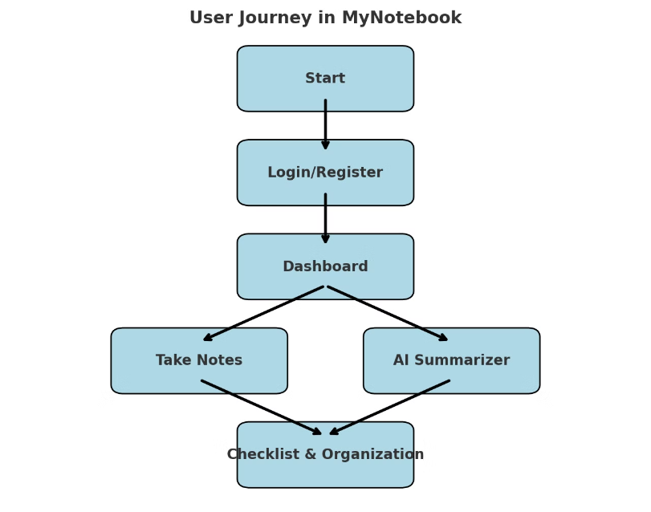
visual representation
IMPORTANT LINKS:
GITHUB
Demo video

Slide 9
Impact of MyNotebook
1
Supports Tamil Students &
Dropouts
2
Increases accessibility
3
Quiz Feature
Summarizes content in both Tamil and English.
For students with dyslexia and learning difficulties.
Enhances learning by testing knowledge on specific topics.
Conclusion
MyNotebook enhances learning with AI summaries supporting Tamil and English , and quizzes, bridging gaps for Tamil students, dropouts, and individuals with dyslexia. Secure and cloud-based, it’s more than notes—it’s a learning companion.

Slide 10
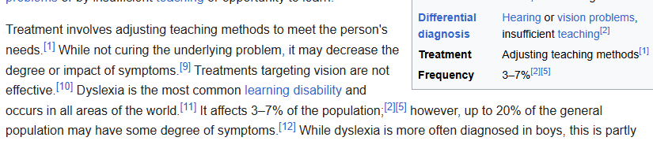
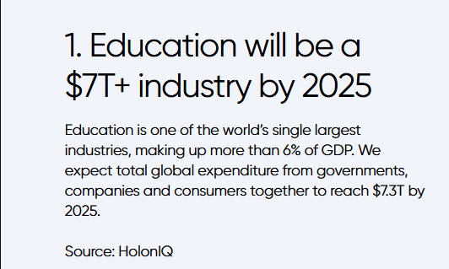
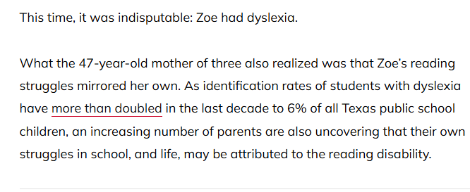
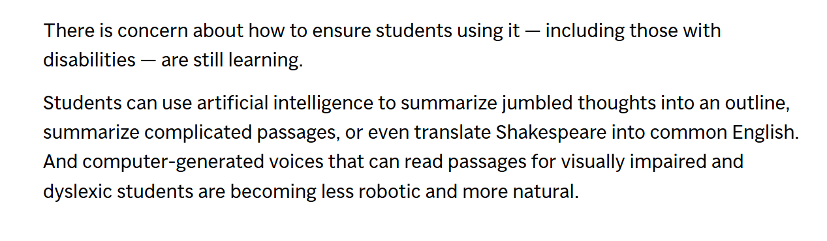
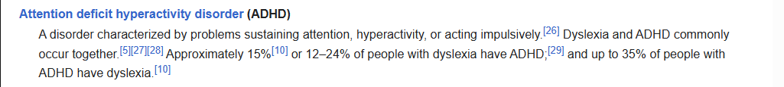
Dyslexia: Research Overview

