Slide 1
Crowd Management System
A presentation by
Abhinav Golas
Mohit Rajani
Nilay Vaish
Pulkit Gambhir

Slide 2
Abstract
Need to monitor crowd and environment in large gatherings.
System to achieve the same must be scaleable, portable and require minimal configuration.
Intent : Building such a system on a robust ad-hoc network backbone.

Slide 3
Why ad-hoc networks ?
Easy deployability
Scalability much beyond any other wired or wireless network solution
Zero infrastructural requirement
Self configurable and Self healing networks
Global networking parameters determined by purely local decision making
Minimal external computation required

Slide 4
System Specifications
(Network Mote + Sensor Board) deployed at every entrance and exit
Each network mote logs data about environment
Data routed in a efficient store and forward manner to a base station
Base station may deploy data over an alternative network interface such as LAN or GPRS

Slide 5
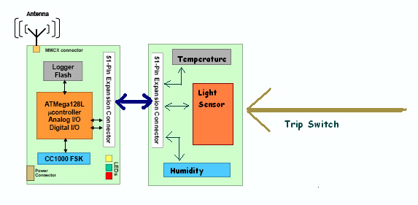
Mote & Sensors

Slide 6
Hardware Requirement
Berkeley MPR410 wireless motes containing
ATMega128L µ-controller
CC1000 radio transceiver
512Kb Flash logger
Pluggable MTS400CA sensor boards to detect personnel movement and environment monitoring
MIB510 Programming board
Serial interface to PC
Easy on-board testing of motes

Slide 7
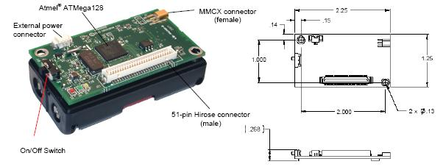
MPR410

Slide 8
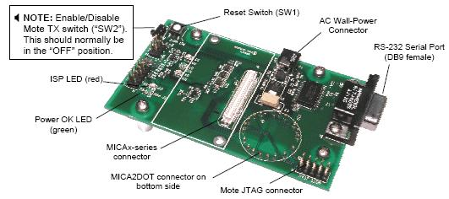
MIB 510

Slide 9
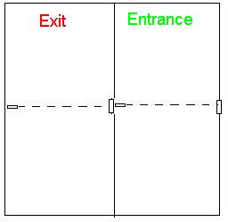
Door setup
Door will be divided into entry, exit points
Each entry/exit point will have a light beam focused onto the light sensor of the mote
When light beam is cut, counter increases by 1
This information will be passed onto server

Slide 10
Door setup
Sensitivity – can detect person if beam is cut for min. 0.8 sec
Temperature and humidity information also collected periodically
People count will be decided at server, by subtracting the 2 counts
Suitable contraption will be designed to ensure no other light gets to sensor
Advantage over single entry/exit
Single entry/exit system may not be able to handle concurrent user crossings

Slide 11
Issues in ad-hoc network setup
Collisions and packet loss
Need for algorithms that are fault tolerant and depend only on local information in network
Time Synchronization
Interference in network, need to work with minimum message exchanges
Efficient power management – need to look into radio stack implementation

Slide 12
Networking Setup
We use a flooding type protocol to do time synchronization initially.
During this flooding stage lots of packets are broadcasted in the network, and the network “configures itself”
During “configuration” we try and determine parameters essential for network routing, network scheduling and other optimizations.

Slide 13
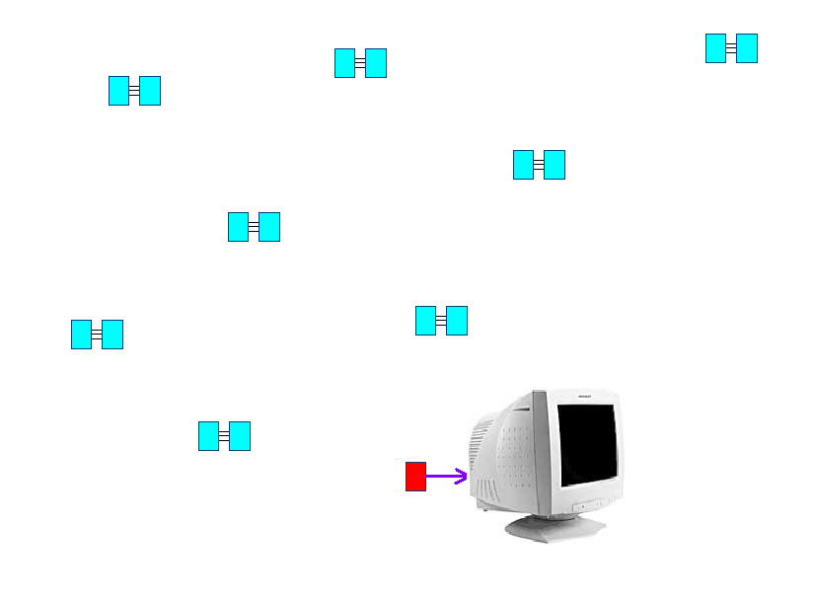
Networking Setup

Slide 14
Configuration Parameters
We can currently determine :-
  Children and Parent of every network node. In the routing tree. This means we can establish two-way communication in our network hierarchy.
  Network sub-tree size below every node. This can be useful for efficient scheduling.
Currently we are exploring ways to do post-order traversals in the tree for the purpose of polling the nodes.

Slide 15
Work Distribution
Nilay, Pulkit – Currently working on network scheduling and routing
Abhinav, Mohit – Currently working on Trip switch
Simultaneous work going on in algorithm building by all four ( accounts for most of present work )

Slide 16
Progress
Programming :
Trip switch reports number of crossings of users in either direction
Motes build routing tree for the ad – hoc network for 2 – way routing (without need for broadcast) and network size estimation

Slide 17
Progress
Other progress :
Routing algorithm finalized. Ensures zero packet loss and minimizes power consumption.
Scheduling algorithm close to completion
Trip switch testing in progress

Slide 18
Future Plan
Improve sensitivity of trip switch – 10th September
Complete implementation of routing and scheduling algorithms to set up ad – hoc network – 30th September
Develop interactive web interface for accessing information – 10th October - end

