Slide 1
INSTITUTE OF AERONAUTICAL ENGINEERING (Autonomous) Dundigal, Hyderabad - 500 043
Academic Year: 2024-25
Department of Information Technology
Third Review
Title : “Signature Fraud Detection Using Deep Learning”
By:
22951A1221: P. Hari Bharadwaj
22951A1228: K. Aravind
23955A1207: P. Pradham Kushal Reddy
Mentor:
Ms. K Venkata Ramana Devi,
B. Tech., M.Tech.,
Assistant Professor

Slide 2
Outline
Problem Statement
Literature Papers
Proposed System
Modules For Proposed system
UML Diagrams

Slide 3
Problem Statement
With the increasing reliance on signatures for authentication in banking, legal, and financial transactions, signature fraud has become a serious security concern. Traditional signature verification methods, which involve manual inspection or simple rule-based techniques, are often time-consuming, inconsistent, and vulnerable to human error. This creates significant risks, including financial losses, identity theft, and unauthorized access to sensitive information.
Additionally, existing fraud detection systems may lack accuracy and efficiency, as they do not leverage advanced feature extraction and deep learning techniques. Handwritten signatures vary due to factors like age, health conditions, or writing tools, making it even more challenging to distinguish between genuine and forged signatures accurately.
To overcome these challenges, a Signature Fraud Detection System using Deep Learning is needed. By integrating SURF (Speeded-Up Robust Features), SIFT (Scale-Invariant Feature Transform), and CNN (Convolutional Neural Networks), the system will extract signature features, analyze patterns, and classify signatures with good accuracy.

Slide 4
Literature Papers
S. No | Author/Title/ Journal / Year | Observation
1 | Tolosana R., Vera-Rodriguez R., Fierrez J., Ortega-Garcia J. DeepSign: Deep On-Line Signature Verification IEEE Transactions on Biometrics, Behavior, and Identity Science 2021 | Introduces a deep learning approach for on-line signature verification, utilizing a recurrent neural network (RNN) architecture to capture temporal features of signatures. Utilizes diverse datasets, indicating the importance of varied training data to enhance model generalization in real-world scenarios.
2 | Jain A., Singh S.K., Singh K.P. Handwritten Signature Verification Using Shallow Convolutional Neural Network Multimedia Tools and Applications 2020 | Proposes a shallow convolutional neural network for handwritten signature verification, emphasizing simplicity and efficiency in implementation. Suggests potential for real-time signature verification systems due to reduced complexity and faster processing times.

Slide 5
Literature Papers
S. No | Author/Title/ Journal / Year | Observation
3 | Ghosh R. A Recurrent Neural Network Based Deep Learning Model for Offline Signature Verification and Recognition System Expert Systems with Applications 2021 | Develops a recurrent neural network model specifically for offline signature verification and recognition, focusing on sequential feature extraction. Provides thorough evaluation metrics, including precision and recall, showcasing the model's robustness in various testing scenarios.
4 | Yapıcı M.M., Tekerek A., Topaloğlu N. Deep Learning-Based Data Augmentation Method and Signature Verification System for Offline Handwritten Signature Pattern Analysis and Applications 2021 | Introduces a deep learning-based data augmentation method to enhance the training dataset for offline handwritten signatures, improving model performance. Suggests applicability to various handwritten signature datasets, making it a flexible solution for different signature verification tasks.

Slide 6
Literature Papers
S. No | Author/Title/ Journal / Year | Observation
5 | Tahir N.M., Ausat A.N., Bature U.I., Abubakar K.A., Gambo I. Off-Line Handwritten Signature Verification System: Artificial Neural Network Approach / 2021 | Emphasizes the role of effective feature extraction techniques in improving verification accuracy, albeit with more straightforward models. Acknowledges limitations in terms of generalization to more complex datasets, suggesting further research into advanced models for improved performance.
6 | Khurana, S., et al., Efficient Signature Fraud Detection with Hybrid Deep Neural Networks, Expert Systems with Applications, 2022. | Proposes a hybrid model using CNNs and LSTMs to capture spatial and sequential features of signatures. Improves adaptability to varying styles and complex forgeries.

Slide 7
Literature Papers
S. No | Author/Title/ Journal / Year | Observation
7 | Ahmed, R., et al., Improved Offline Handwritten Signature Verification Using Convolutional Neural Networks (CNN), 2023. | Explores CNNs to enhance signature verification accuracy by directly learning features from raw image data. Achieves robustness against inter-class variations, eliminating the need for handcrafted features.
8 | Abdirahman, A.A., et al., Advancing Handwritten Signature Verification Through Deep Learning, IJETT, 2024. | Utilizes deep learning architectures like CNNs to address variations in signature samples and improve detection rates. Employs robust local features like Local Binary Patterns (LBP) for handling distortions.

Slide 8
Proposed System
Modular Design: Create a modular pipeline for pre-processing and feature extraction, allowing easy addition of new algorithms like SURF, SIFT to adapt the system as needed.
Configurable Interface: Develop an interface that lets users adjust settings, view feature extraction outputs, and experiment with different parameters to refine forgery detection and recognition.
Enhanced Accuracy (90-95%): Implement an accuracy-tracking module that fine-tunes parameters within the CNN layers, feature extraction algorithms, and forgery detection thresholds, enabling continuous improvement based on performance feedback.

Slide 9
Modules for Proposed System
User Interface:
Manages login, registration, and access permissions for users.
Allows users to submit signature images for verification.
Image Preprocessing Module:
Converts the signature image to grayscale for consistent feature extraction.
Removes unwanted noise using filters like Gaussian Blur to improve signature clarity.
Feature Extraction Using SURF:
Identifies distinctive points in the signature for fraud detection.
Converts detected keypoints into numerical values for further processing.

Slide 10
Modules for Proposed System
Feature Extraction Using SIFT:
Ensures extracted features remain unaffected by changes in size and orientation.
Captures fine-grained details in signatures for better fraud detection.
CNN-Based Classification Model:
Uses convolutional layers to analyze signature patterns and extract key features.
Applies a classification layer to determine the authenticity of the signature.
Final Output:
Displays whether the signature is Genuine or Forged as the result.
Calculates confidence scores to determine whether a signature is genuine or forged.

Slide 11
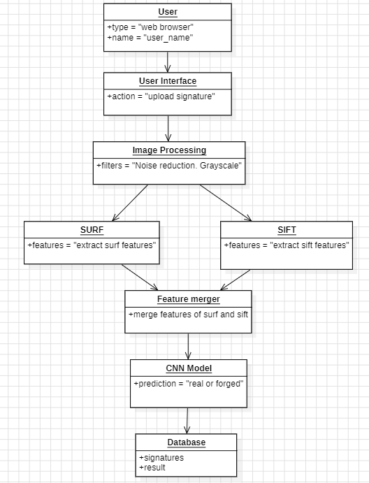
Object Diagram

Slide 12
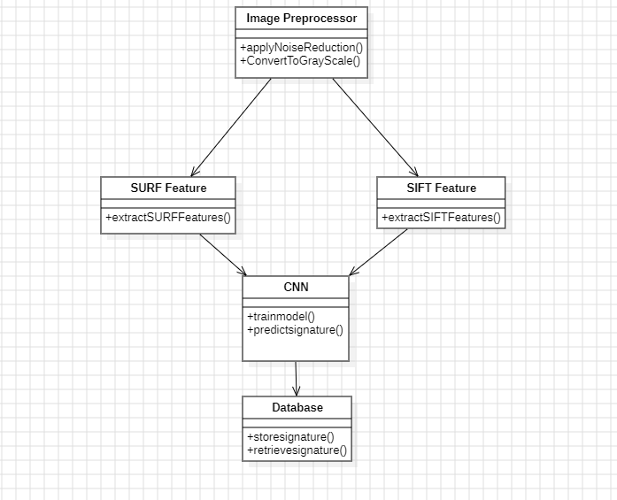
Class Diagram

Slide 13
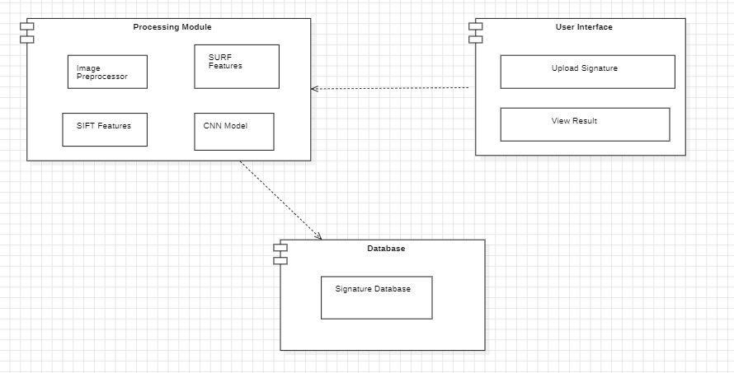
Component Diagram

Slide 14
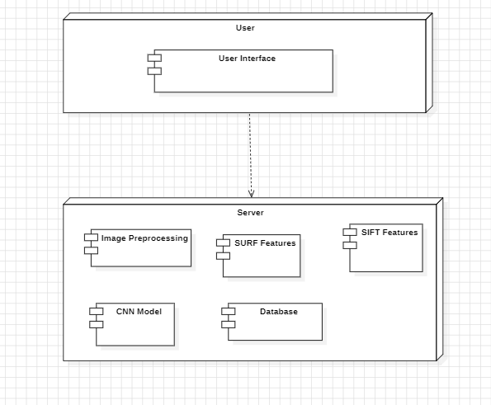
Deployment Diagram

Slide 15
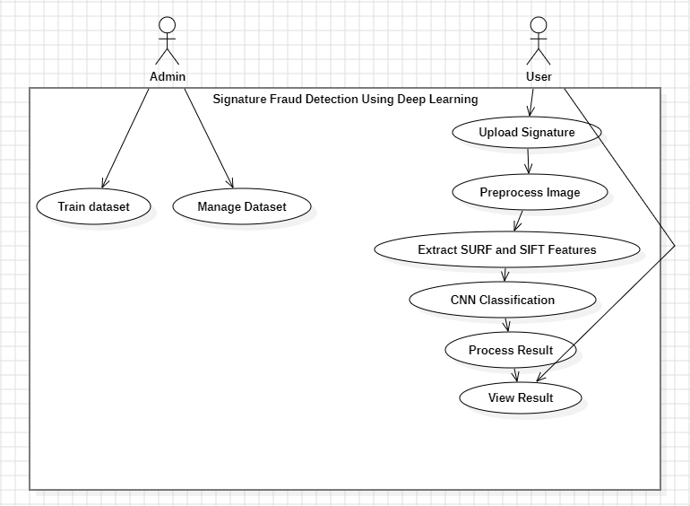
Use Case Diagram

Slide 16
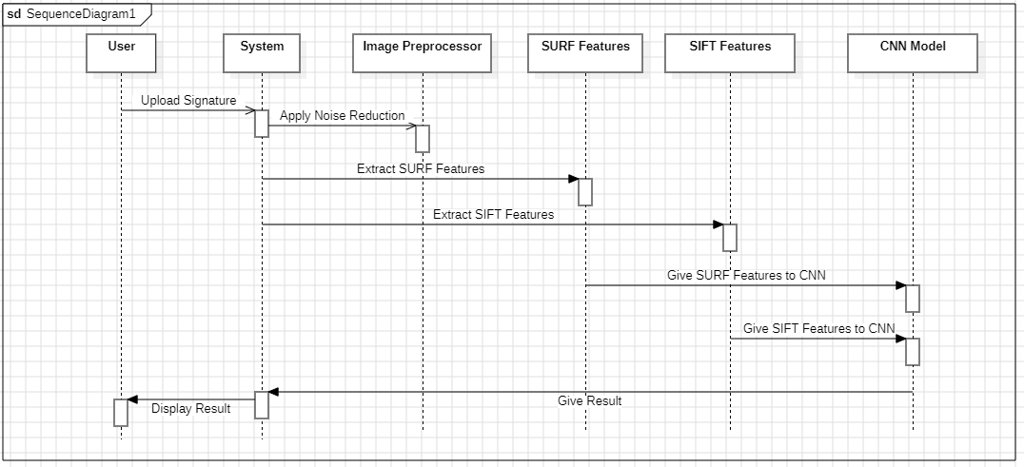
Sequence Diagram

Slide 17
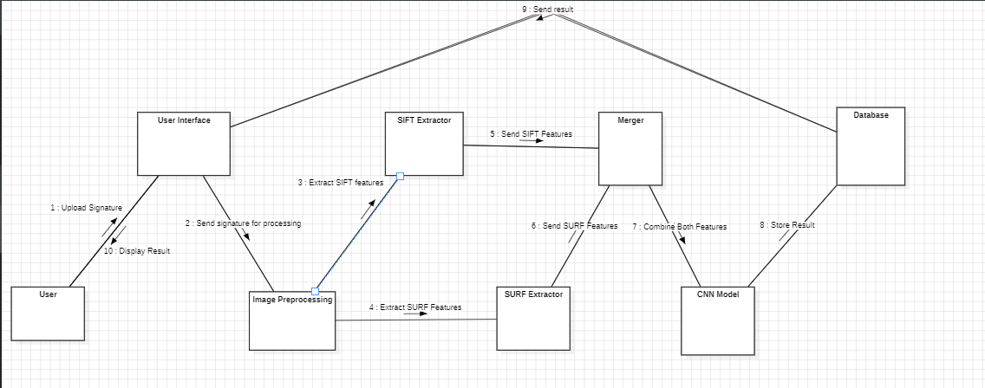
Collaboration Diagram

Slide 18
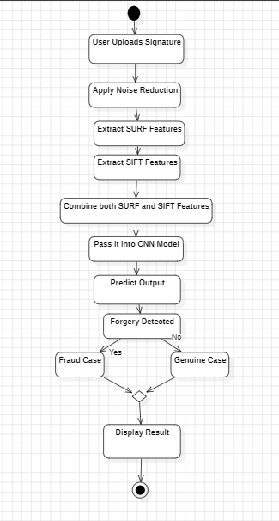
Activity Diagram

Slide 19
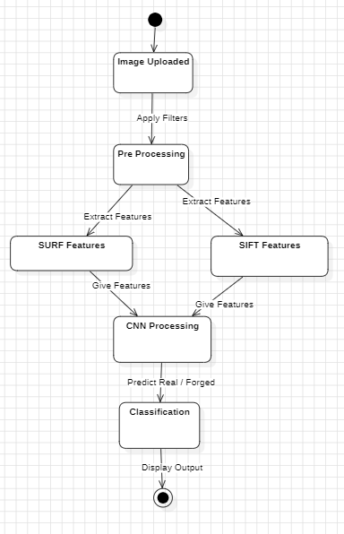
State Chart Diagram

Slide 20
THANK YOU

