Slide 1
INSTITUTE OF AERONAUTICAL ENGINEERING (Autonomous) Dundigal, Hyderabad - 500 043
Academic Year: 2024-25
Department of Information Technology Fourth Review
Title : “Signature Fraud Detection Using Deep Learning”
By:
22951A1221: P. Hari Bharadwaj
22951A1228: K. Aravind
23955A1207: P. Pradham Kushal Reddy
Mentor:
Mrs. K Venkata Ramana Devi,
B. Tech., M.Tech.,
Assistant Professor

Slide 2
Objective of Project
Utilizes advanced deep learning techniques to identify and classify forged signatures with precision.
Analyzes unique handwriting characteristics, including stroke patterns, pen pressure, and writing speed.
Provides high accuracy in distinguishing between authentic and forged signatures, minimizing the chances of false positives.
Ensures secure, reliable, and automated signature verification for applications in financial, legal, and government sectors.
Adapts to various signature styles and formats, making the system robust and applicable across diverse cultural and linguistic settings.

Slide 3
Abstract
Secure authentication plays a major role in ensuring the identity of a person. Everyone has an individual and unique signature, which is used as their personal identification in all their legal transactions. Even though a lot of things got digitalized, traditional signatures are still used in a lot of places, such as check payments and government offices, and they still rely on a human manually verifying them. So, forgery detection plays a key role in reducing these kinds of overhead. Manual verification is not only difficult to check if two signatures are the same but also very time-consuming. Pandemic further made people do tasks digitally, which also included uploading their own signatures digitally. This increases the urgency of implementing a system to identify and verify the user’s signature. This paper proposes a method to pre-process the signature to make verification simple as well as use method Scale-Invariant Feature Transform (SIFT) to identify forged signatures and compare the results obtained with various parameters.

Slide 4
Methodology
Collecting a diverse dataset of genuine and forged signatures, ensuring variations in style and quality. Preprocess the images by converting them to grayscale, resizing for uniformity, and reducing noise to enhance feature extraction.
Extracting key points and descriptors using SIFT algorithm. This method identify distinctive features that are robust to noise, scale, and rotation, forming a comprehensive feature representation for each signature.
Developing a method that processes feature extracted by SIFT. Train the model with a combination of raw images and extracted features to enhance its ability to detect forgery patterns.

Slide 5
Literature Papers
S. No | Author/Title/ Journal / Year | Observation
1 | Tolosana R., Vera-Rodriguez R., Fierrez J., Ortega-Garcia J. DeepSign: Deep On-Line Signature Verification IEEE Transactions on Biometrics, Behavior, and Identity Science 2021 | Introduces a deep learning approach for on-line signature verification, utilizing a recurrent neural network (RNN) architecture to capture temporal features of signatures. Utilizes diverse datasets, indicating the importance of varied training data to enhance model generalization in real-world scenarios.
2 | Jain A., Singh S.K., Singh K.P. Handwritten Signature Verification Using Shallow Convolutional Neural Network Multimedia Tools and Applications 2020 | Proposes a shallow convolutional neural network for handwritten signature verification, emphasizing simplicity and efficiency in implementation. Suggests potential for real-time signature verification systems due to reduced complexity and faster processing times.

Slide 6
Literature Papers
S. No | Author/Title/ Journal / Year | Observation
3 | Ghosh R. A Recurrent Neural Network Based Deep Learning Model for Offline Signature Verification and Recognition System Expert Systems with Applications 2021 | Develops a recurrent neural network model specifically for offline signature verification and recognition, focusing on sequential feature extraction. Provides thorough evaluation metrics, including precision and recall, showcasing the model's robustness in various testing scenarios.
4 | Yapıcı M.M., Tekerek A., Topaloğlu N. Deep Learning-Based Data Augmentation Method and Signature Verification System for Offline Handwritten Signature Pattern Analysis and Applications 2021 | Introduces a deep learning-based data augmentation method to enhance the training dataset for offline handwritten signatures, improving model performance. Suggests applicability to various handwritten signature datasets, making it a flexible solution for different signature verification tasks.

Slide 7
Literature Papers
S. No | Author/Title/ Journal / Year | Observation
5 | Tahir N.M., Ausat A.N., Bature U.I., Abubakar K.A., Gambo I. Off-Line Handwritten Signature Verification System: Artificial Neural Network Approach / 2021 | Emphasizes the role of effective feature extraction techniques in improving verification accuracy, albeit with more straightforward models. Acknowledges limitations in terms of generalization to more complex datasets, suggesting further research into advanced models for improved performance.
6 | Khurana, S., et al., Efficient Signature Fraud Detection with Hybrid Deep Neural Networks, Expert Systems with Applications, 2022. | Proposes a hybrid model using CNNs and LSTMs to capture spatial and sequential features of signatures. Improves adaptability to varying styles and complex forgeries.

Slide 8
Literature Papers
S. No | Author/Title/ Journal / Year | Observation
7 | Ahmed, R., et al., Improved Offline Handwritten Signature Verification Using Convolutional Neural Networks (CNN), 2023. | Explores CNNs to enhance signature verification accuracy by directly learning features from raw image data. Achieves robustness against inter-class variations, eliminating the need for handcrafted features.
8 | Abdirahman, A.A., et al., Advancing Handwritten Signature Verification Through Deep Learning, IJETT, 2024. | Utilizes deep learning architectures like CNNs to address variations in signature samples and improve detection rates. Employs robust local features like Local Binary Patterns (LBP) for handling distortions.

Slide 9
Problem Statement
With the increasing reliance on signatures for authentication in banking, legal, and financial transactions, signature fraud has become a serious security concern. Traditional signature verification methods, which involve manual inspection or simple rule-based techniques, are often time-consuming, inconsistent, and vulnerable to human error. This creates significant risks, including financial losses, identity theft, and unauthorized access to sensitive information.
Additionally, existing fraud detection systems may lack accuracy and efficiency, as they do not leverage advanced feature extraction and deep learning techniques. Handwritten signatures vary due to factors like age, health conditions, or writing tools, making it even more challenging to distinguish between genuine and forged signatures accurately.
To overcome these challenges, a Signature Fraud Detection System using Deep Learning is needed. By using SIFT (Scale-Invariant Feature Transform), the system will extract signature features, analyze patterns, and classify signatures with good accuracy.

Slide 10
Existing System
The existing offline signature recognition and forgery detection system employs several methods for robust authentication:
Recognition: Convolutional Neural Networks (CNNs) identify unique features in signatures with accuracy (85-89%) by learning from a dataset of signature images.
Forgery Detection:
The Crest-Trough Method analyzes specific contour patterns in signatures, focusing on crest and trough points to detect inconsistencies.
Harris algorithms identify and compare distinctive corner points between test signatures and originals, achieving forgery detection accuracy of 85-89%.

Slide 11
Proposed System
Modular Design: Create a modular pipeline for pre-processing and feature extraction, allowing easy addition of new algorithms as SIFT to adapt the system as needed.
Configurable Interface: Develop an interface that lets users adjust settings, view feature extraction outputs, and experiment with different parameters to refine forgery detection and recognition.
Enhanced Accuracy (90-95%): Implement an accuracy-tracking module that fine-tunes parameters within the CNN layers, feature extraction algorithms, and forgery detection thresholds, enabling continuous improvement based on performance feedback.

Slide 12
Modules for Proposed System
User Interface:
Manages login, registration, and access permissions for users.
Allows users to submit signature images for verification.
Image Preprocessing Module:
Converts the signature image to grayscale for consistent feature extraction.
Removes unwanted noise using filters like Gaussian Blur to improve signature clarity.
Feature Extraction Using SIFT:
Ensures extracted features remain unaffected by changes in size and orientation.
Captures fine-grained details in signatures for better fraud detection.
Final Output:
Displays whether the signature is Genuine or Forged as the result.
Calculates confidence scores to determine whether a signature is genuine or forged.

Slide 13
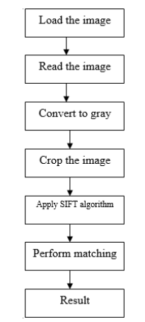
System Architecture

Slide 14
System Design
1. Input
Signature image (genuine or forged) uploaded via web app.
2. Preprocessing
Resize image (e.g., 300x300).
Convert to grayscale.
Apply optional Gaussian blur (noise reduction).
3. Feature Extraction: SIFT
Detect keypoints, Extract descriptors.
Convert descriptors into a fixed-size feature vector.
4. Tech Stack
OpenCV (SIFT), Scikit-Learn (SVM)
Streamlit (App Interface)
Joblib/Pickle (Model saving)

Slide 15
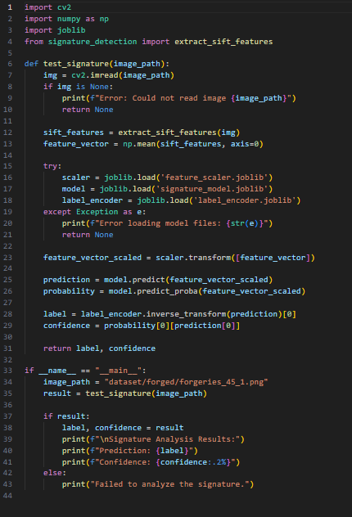
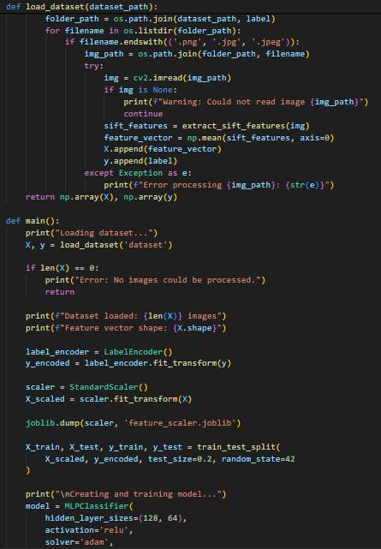
Implementation

Slide 16
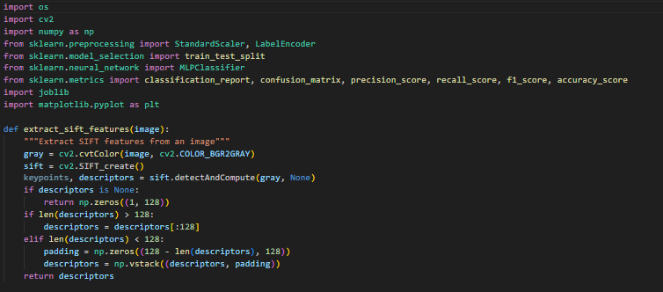
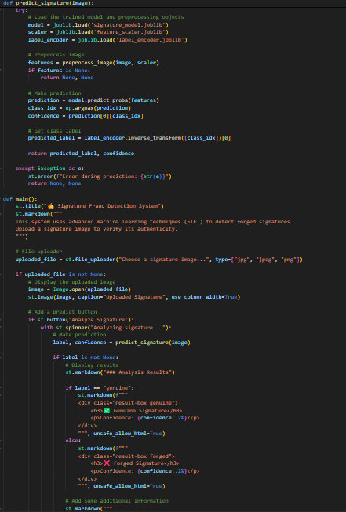
Implementation

Slide 17
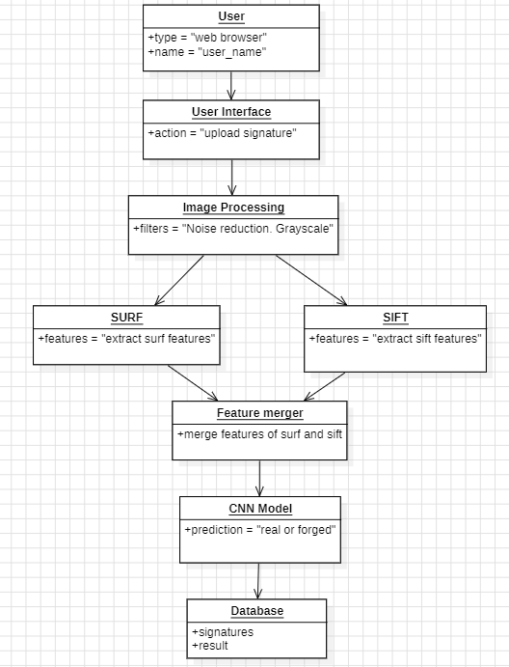
Object Diagram

Slide 18
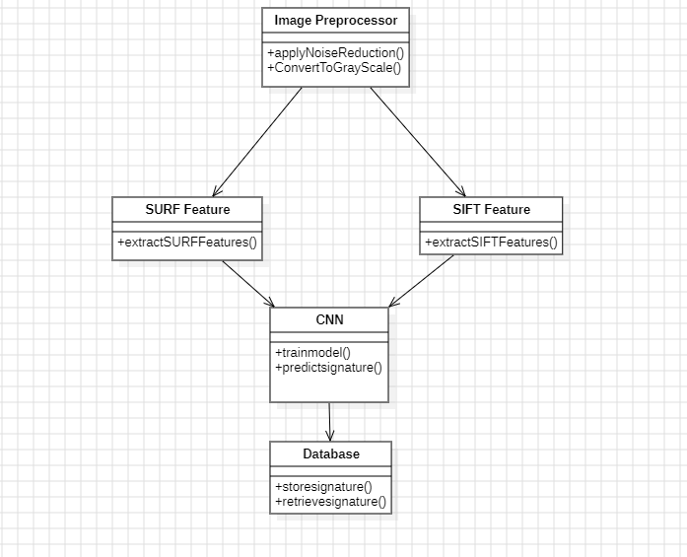
Class Diagram

Slide 19
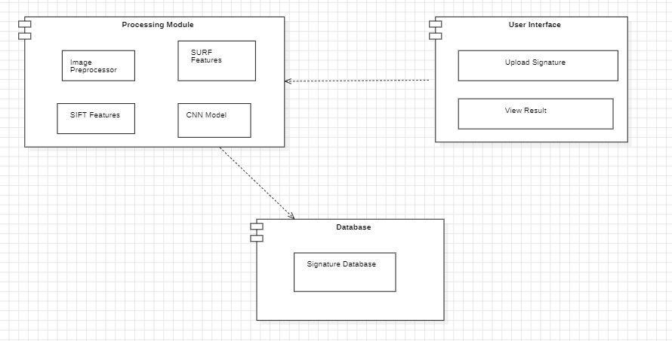
Component Diagram

Slide 20
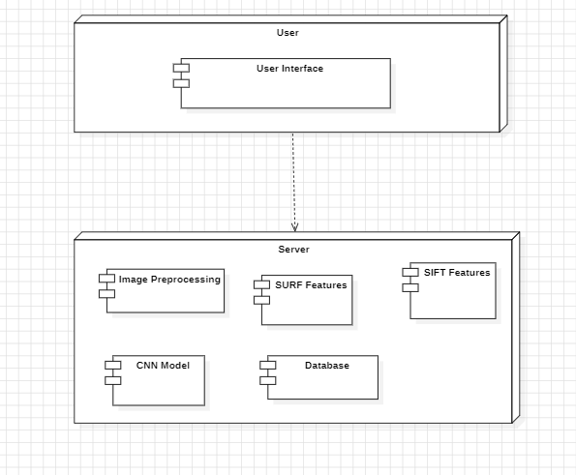
Deployment Diagram

Slide 21
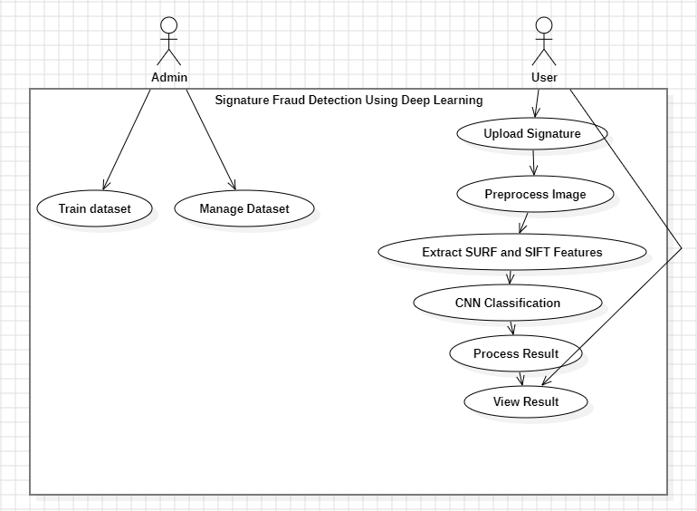
Use Case Diagram

Slide 22
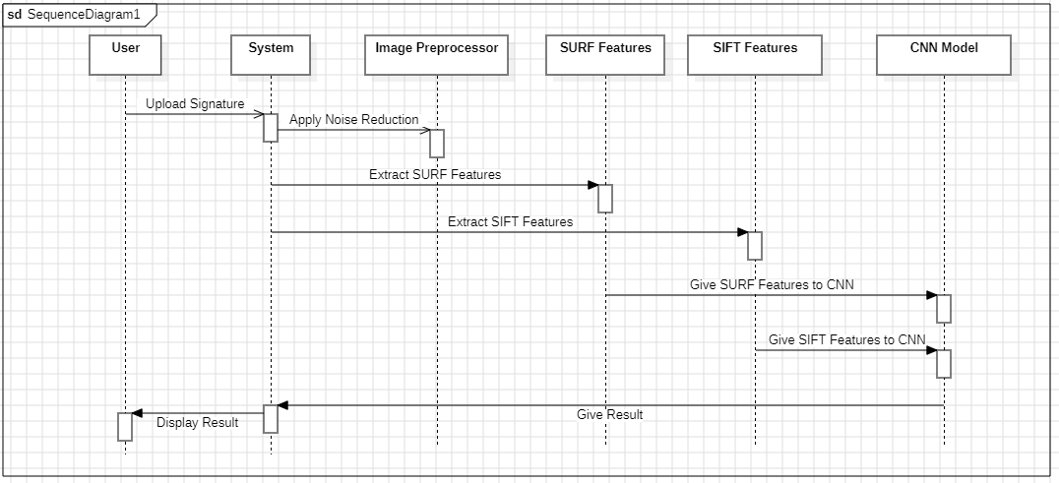
Sequence Diagram

Slide 23
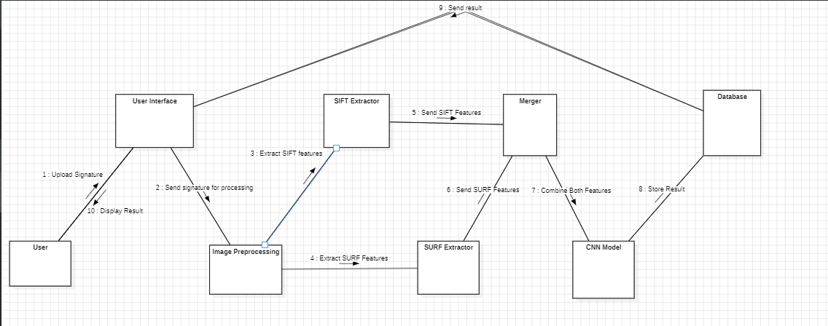
Collaboration Diagram

Slide 24
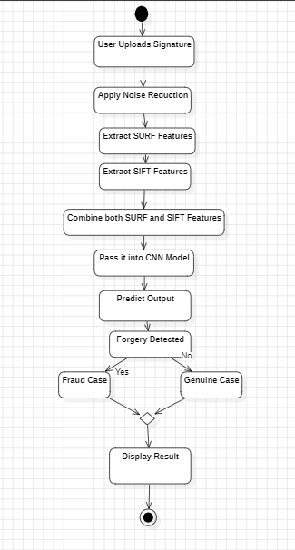
Activity Diagram

Slide 25
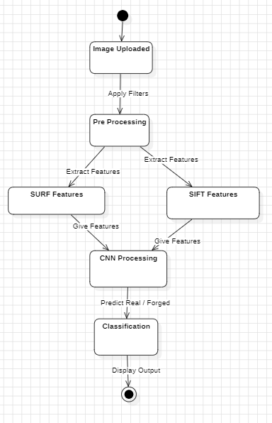
State Chart Diagram

Slide 26
References
Tolosana, R., Vera-Rodriguez, R., Fierrez, J., Ortega-Garcia, J. (2021). DeepSign: Deep On-Line Signature Verification. Ieee Transactions On Biometrics, Behavior, And Identity Science. 3, 229-239
Jain, A., Singh, S.K., Singh, K.P. (2020). Handwritten signature verification using shallow convolutional neural network. Multimed Tools Appl. 79, 19993-20018.
Ghosh, R. (2021). A Recurrent Neural Network based deep learning model for offline signature verification and recognition system. Expert Systems with Applications. 168.
Yapıcı, M.M., Tekerek, A., Topaloğlu, N. (2021). Deep learning-based data augmentation method and signature verification system for offline handwritten signature. Pattern Anal Applic. 24, 165-179.
Tahir, N.M., Ausat, A.N., Bature, U.I., Abubakar, K.A., Gambo, I. (2021). Off-line Handwritten Signature Verification System: Artificial Neural Network Approach. 1, 45.57.

Slide 27
THANK YOU

