Slide 1
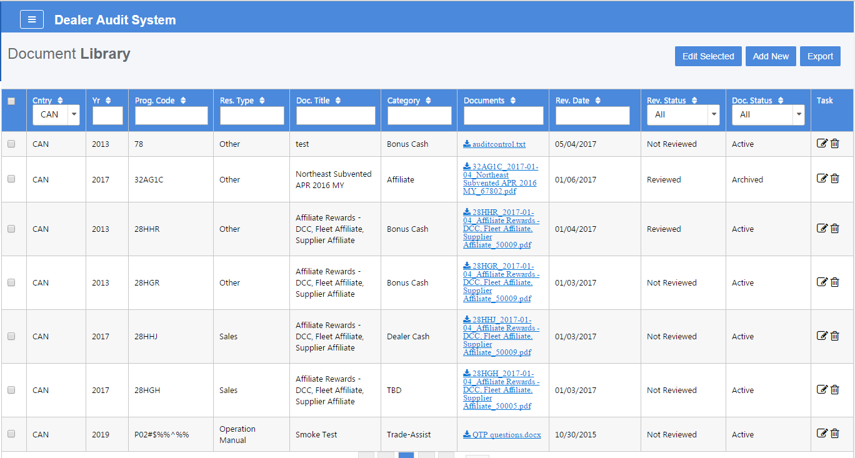
Document Library

Slide 2
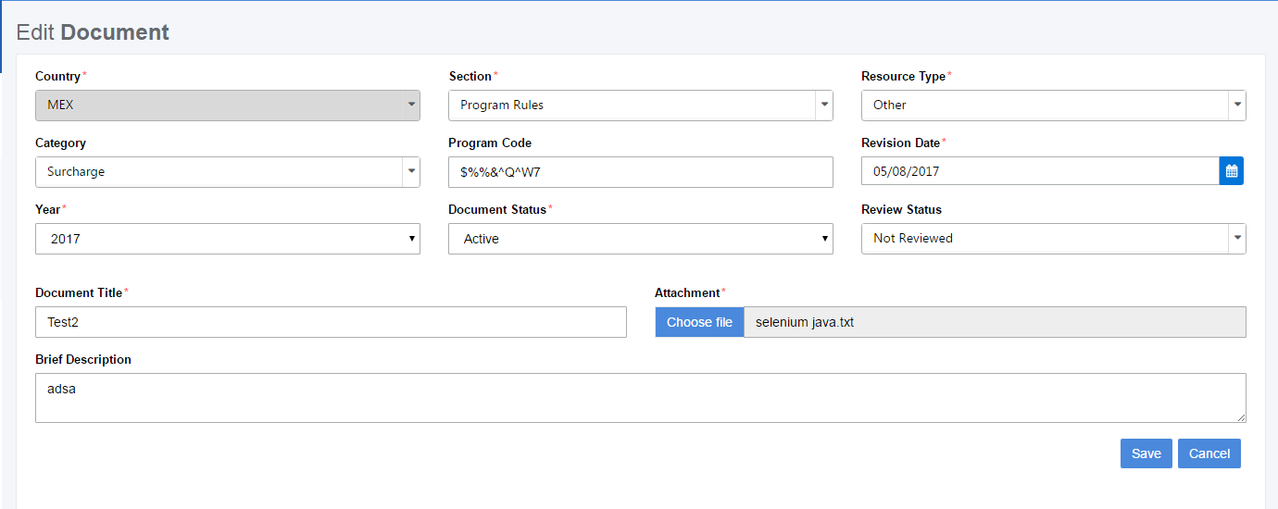
New/Edit Document

Slide 3

Edit Selected Documents

