Slide 1
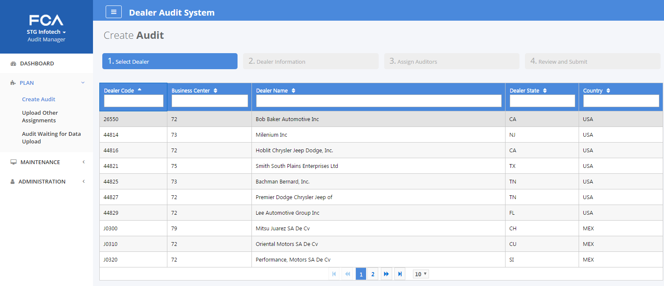
Create Audit - Select Dealer

Slide 2
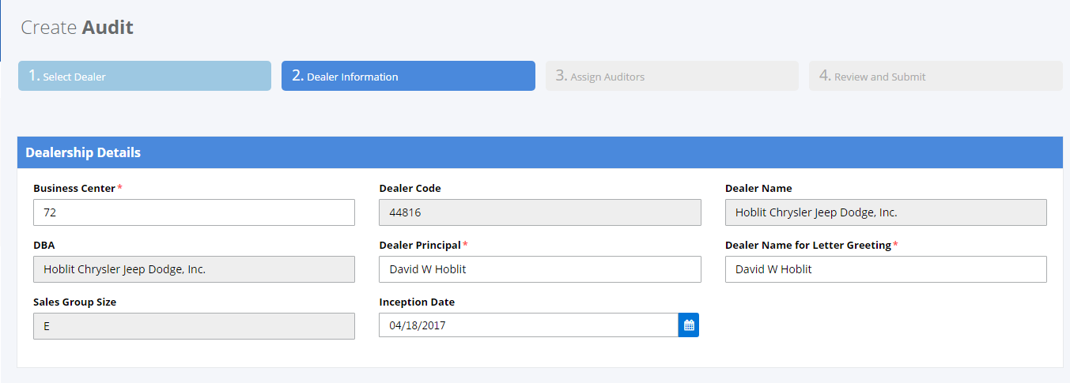
Create Audit - Dealer Information (1)

Slide 3
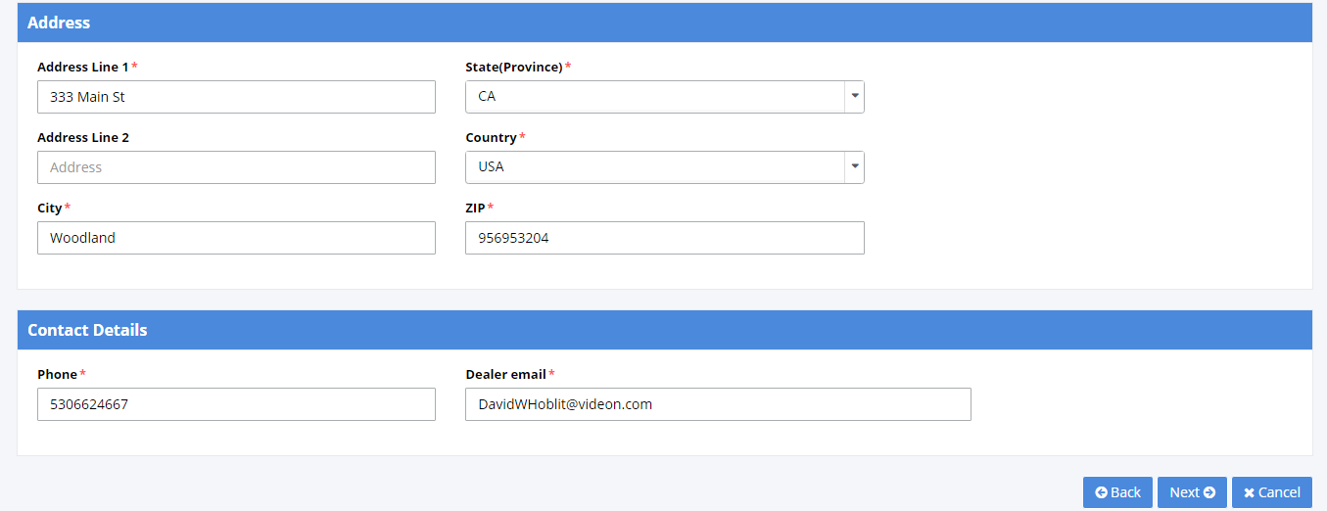
Create Audit - Dealer Information (2)

Slide 4
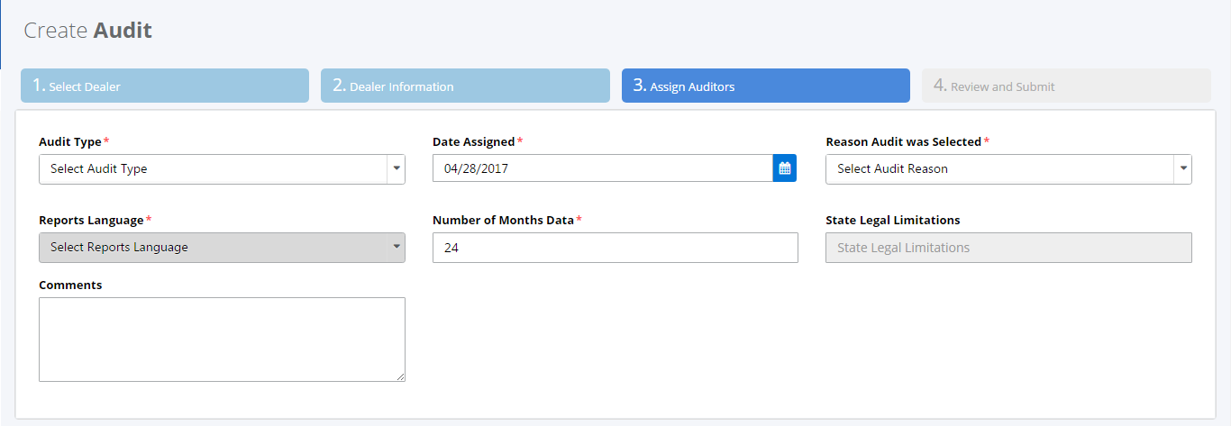
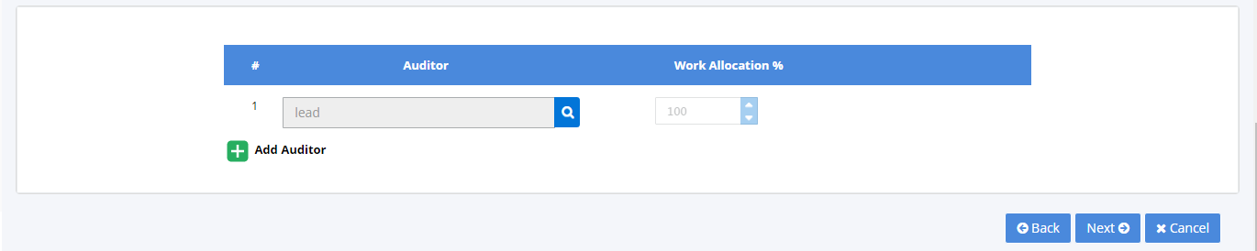
Create Audit - Assign Auditor

Slide 5
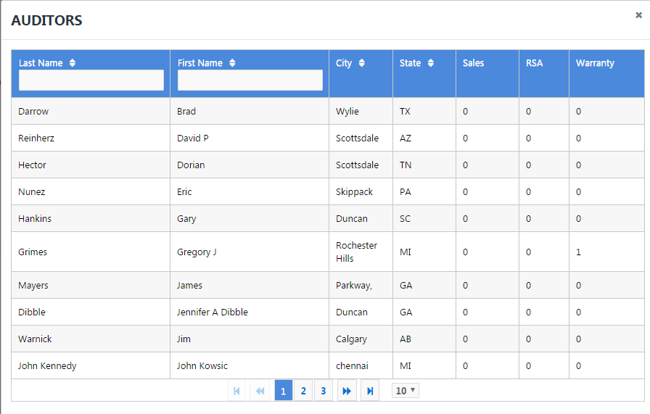
Create Audit - List of Auditors

Slide 6
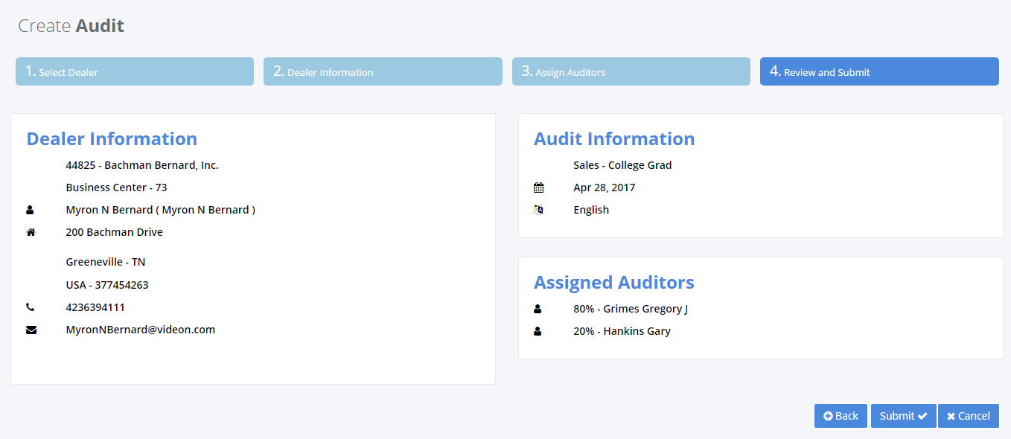
Create Audit - Review & Submit

