Slide 1
Unit Testing
CS 240 – Advanced Programming Concepts

Slide 2

F-22 Raptor Fighter

Slide 3
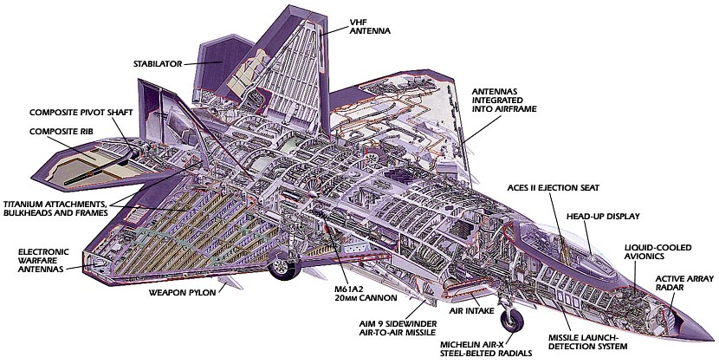
F-22 Raptor Fighter
Manufactured by Lockheed Martin & Boeing
How many parts does the F-22 have?

Slide 4
F-22 Raptor Fighter
What would happen if Lockheed assembled an F-22 with "untested" parts (i.e., parts that were built but never verified)?
It wouldn't work, and you probably would never be able to make it work
Cheaper and easier to just start over

Slide 5
Managing Implementation Complexity
Individual parts should be verified before being integrated with other parts
Integrated subsystems should also be verified
If adding a new part breaks the system, the problem must be related to the recently added part
Track down the problem and fix it
This ultimately leads to a complete system that works

Slide 6
2 Approaches to Programming
Approach #1
"I wrote ALL of the code, but when I tried to compile and run it, nothing seemed to work!“
Approach #2
Write a little code (e.g., a method or small class)
Test it
Write a little more code
Test it
Integrate the two verified pieces of code
Test it
…

Slide 7
Unit Testing
Large programs consist of many smaller pieces
Classes, methods, packages, etc.
"Unit" is a generic term for these smaller pieces
Three important types of software testing are:
Unit Testing (test units in isolation)
Integration Testing (test integrated units)
System Testing (test entire system that is fully integrated)
Unit Testing is done to test the smaller pieces in isolation before they are combined with other pieces
Usually done by the developers who write the code

Slide 8
What Unit Tests Do
Unit tests create objects, call methods, and verify that the returned results are correct
Actual results vs. Expected results
Unit tests should be automated so they can be run frequently (many times a day) to ensure that changes, additions, bug fixes, etc. have not broken the code
Regression testing
Notifies you when changes have introduced bugs, and helps to avoid destabilizing the system

Slide 9
Test Driver Program
The tests are run by a "test driver", which is a program that just runs all of the unit test cases
It must be easy to add new tests to the test driver
After running the test cases, the test driver either tells you that everything worked, or gives you a list of tests that failed
Little or no manual labor required to run tests and check the results

Slide 10
JUnit Testing Design
Write a separate test method for each test
Marked with @Test annotation
Set up method(s) may be executed before each test method
Marked with @BeforeEach or @BeforeAll
Tear down method(s) may executed after each test
Marked with @AfterEach or @AfterAll
Use JUnit Assertions.assert*() methods to implement test cases
Failures reported in various ways, depending on language and tool (command-line, GUI, IDE integrated)
Example:
WordExtractor.java
WordExtractorTest.java

Slide 11
Running Junit Tests from Intellij and Android Studio
To run a single test class, in the “Project” tool window right-click on a test class name, and select “Run Tests” or “Debug Tests”
To run all of your unit tests, right-click on the “test/java” folder, and select “Run All Tests” or “Debug All Tests”

Slide 12
Running Unit Tests from The Command-Line
Write a test driver class whose “main” method invokes the org.junit.runner.JUnitCore class to run your unit tests
Run your test driver program from the command-line:
java –cp build\classes\main;build\classes\test;libs\junit-jupiter-api-5.5.1.jar;libs\junit-platform-console-1.5.1.jar;libs\sqlite-jdbc-3.25.2.jar TestDriver

Slide 13
JUnit 5 Unit Testing Framework
JUnit 5 Documentation
Use JUnit 5 annotations to mark test methods
Annotation | Description
@Test public void method() | The annotation @Test identifies that a method is a test method.
@BeforeEach public void method() | Will execute the method before each test. Can prepare the test environment (e.g. read input data, initialize the class).
@AfterEach public void method() | Will execute the method after each test. Can cleanup the test environment (e.g. delete temporary data, restore defaults).

Slide 14
JUnit 5 Unit Testing Framework
Annotation | Description
@BeforeAll public void method() | Will execute the method once, before the start of all tests. Can be used to perform time intensive activities, for example to connect to a database.
@AfterAll public void method() | Will execute the method once, after all tests have finished. Can be used to perform clean-up activities, for example to disconnect from a database.
@Timeout(5) | Fails if the method takes longer than 5 seconds.
@Timeout(value = 100, unit = TimeUnit.MILLISECONDS) | Fails if the method takes longer than 100 milliseconds

Slide 15
Adding the JUnit Library to Your Project
Maven
<dependency>
<groupId>org.junit.jupiter</groupId>
<artifactId>junit-jupiter-api</artifactId>
<version>5.5.1</version>
<scope>test</scope>
</dependency>
Gradle (build.gradle file)
testCompile group: 'org.junit.jupiter', name: 'junit-jupiter-api', version: '5.5.1'

Slide 16
A More Detailed Example
code-example on website in the unit testing lecture notes
Contains code for web-based spelling checker
“Real” classes are in:
src/main/java/spellcheck/*.java
src/main/java/dataaccess/*.java
“Test” classes are in:
src/test/java/spellcheck/*.java
src/test/java/dataaccess/*.java

Slide 17
Android Testing Framework
Android provides a framework for writing automated unit tests based on Junit
There are two types of Android unit tests
Local Unit Tests
These tests depend only on standard Java classes and can be ran on the development computer instead of on an Android device
You will create local unit tests for the Family Map Server project
Instrumented Unit Tests
These tests depend on Android-specific classes and must be run on an Android device
You will create instrumented unit tests for the Family Map Client project

Slide 18
Android Local Unit Tests
Official Documentation
Can run on the development computer without a device or emulator
Module’s primary source code is located in the folder
<module>/src/main/java/<package>
Local unit test code is located in the folder
<module>/src/test/java/<package>

Slide 19
Database Unit Tests
When writing unit tests for your database code, there are additional things to think about
Put database driver JAR file on the class path
Each unit test should start with a pristine database so prior tests have no effect
Can re-create tables before each test
Or, you can “rollback” the effects of each test so they are undone and don’t affect later tests

