Slide 1

VISAKHAPATNAM STEEL PLANT
A mini project report on
“VEHICLE REGISTRATION SYSTEM”
K.Srividya 08VV1A0505
P.Sirisha 08VV1A0501
G.Amrutharaju 08VV1A0537
B.Srihari 08VV1A0528
Department of Computer Science & Engineering
UNIVERSITY COLLEGE OF ENGINEERING
Vizianagaram Campus
Jawaharlal Nehru Technological University Kakinada

Slide 2
Table of Contents:
 | CONTENT
1 | Introduction
2 | Existing System
3 | Proposed System
4 | Approach/modules
5 | Hardware Requirements
6 | Software Requirements
7 | Conclusion

Slide 3
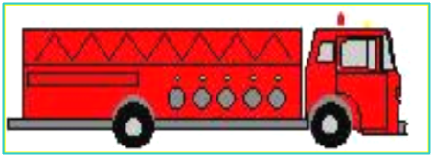
Introduction
The system maintains history of each CISF person and every registration of the vehicle at the time of entering and/or exiting in VSP.
If the documents produced by the transporters are correct, then only VRS allows them to enter into the VSP.
computerize day-to-day manual procedures carried out at the BC Gate, CISF Post.
guard against forgery of documents.

Slide 4
Existing System
Time taking process.
Reduces the efficiency of the organization.
It is not user friendly.
It makes day-to-day operations more difficult.
No Security to information.
.

Slide 5
Proposed System
A three-node network will be proposed to enter all the data feeding and retrieval about vehicle regulation during the process of vehicle entering into, and exiting from VSP
One node will be provided at the In-Gate to enter the person details, who is checking the documents while entering in to VSP.
Another node will be provided at the Out-Gate to enter the person details, who is checking the documents while exiting from VSP through BC Gate.
The third node is provided for In-charge for the same purpose.

Slide 6
Approach/Modules:
MODULES
Vehicle Reg Details Entry
Vehicle Details Module.
Shift Closing
LSGP Details
CISF Person
Details
Vehicle
Tracking
Black Listing

Slide 7
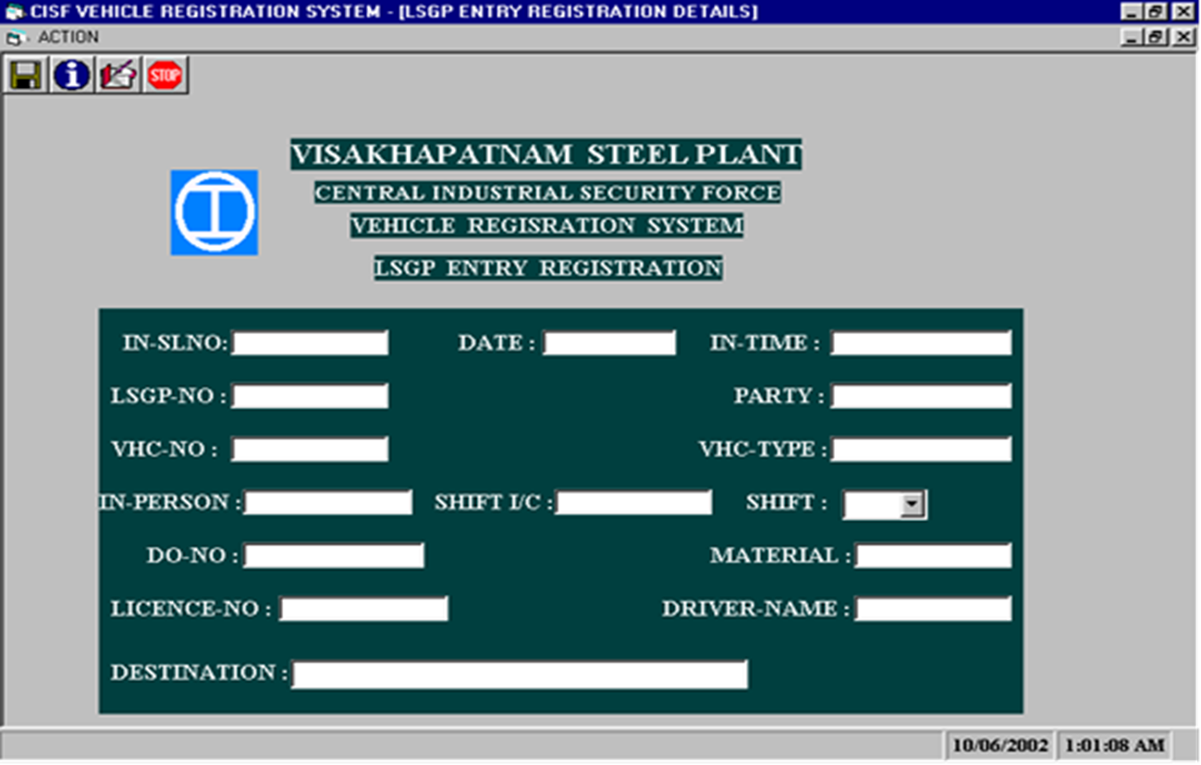
LSGP Details :
ENTRY REGISTRATION

Slide 8
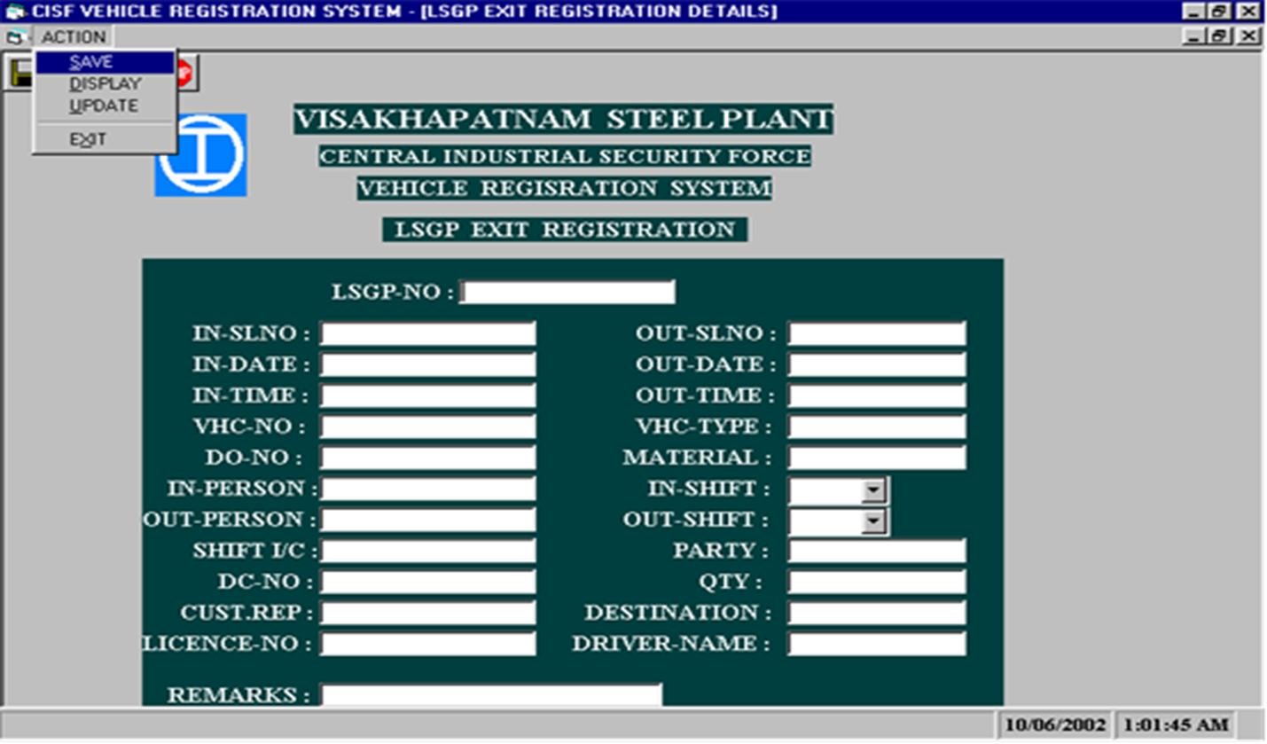
LSGP Details :
EXIT REGISTRATION

Slide 9
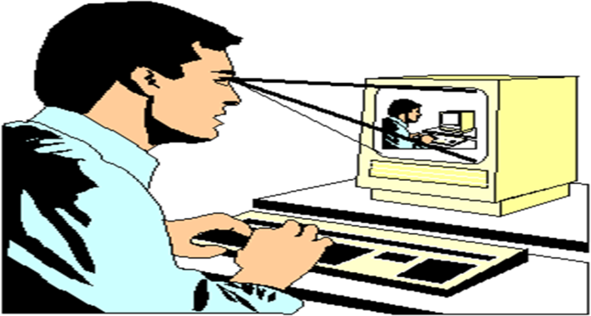
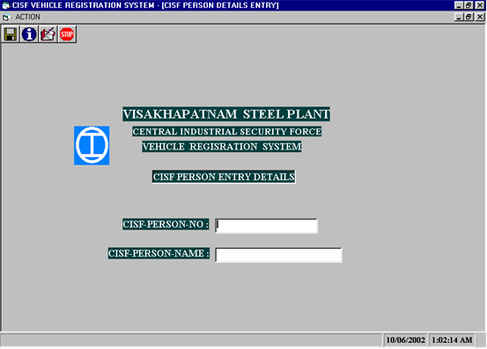
CISF Person Details :

Slide 10
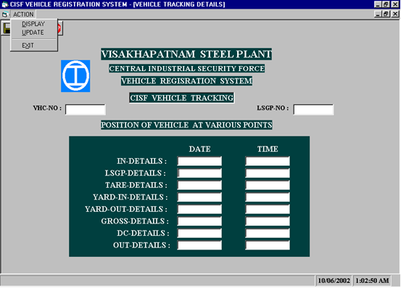
Vehicle Tracking:

Slide 11
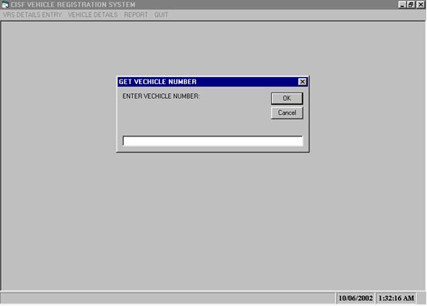
Black Listing:

Slide 12
HardwareRequirements
PENTIUM 4, 1.5 GHz, 512 MB RAM NODES
PRINTER
10/100 BASE-T ETHERNET 16 PORT UTP HUB

Slide 13
Software Requirements
ORACLE 10g
JAVA

Slide 14
Conclusion
Vehicle Registration System will be very useful in providing Quick access to the required information.
Improve the efficiency of the organization.
It also make the working atmosphere healthy in any type of
organization.
It Makes the day-to-day operations smoother and easier.
Guard against forgery of of documents.
.

Slide 15
?
?
?
?
?
Thank You
Queries?
?
?
?
?
?
?

