Slide 1
Predicting False information about Crime using Supervised Learning
By : Anusha Ayyagari
Harikrishna Bhumani

Slide 2
Objective and Research questions:
Our research tries to answer the below questions:
Can we determine if the given information about crime is true or false?
Are the platforms where the statements were made and the labels dependent ?
Are the sources of information and labels dependent?
Are the negative sentiment and the label dependent?
What is the average time required to check if the statement is true or false manually?
Does machine learning algorithms perform better than deep learning algorithms for predicting the class of the statement

Slide 3
Dataset:
PolitiFact.com is an American nonprofit project operated by the Poynter Institute in St. Petersburg, Florida.
It is a reliable source of information as the statements are manually evaluated by the journalists and assign ratings which range from "True" for statements the journalists deem as accurate to "Pants on Fire" if journalists deem the post as "not accurate and makes a ridiculous claim".
We are scraping the data from the website in the categories of crime,guns and marijiuna.

Slide 4
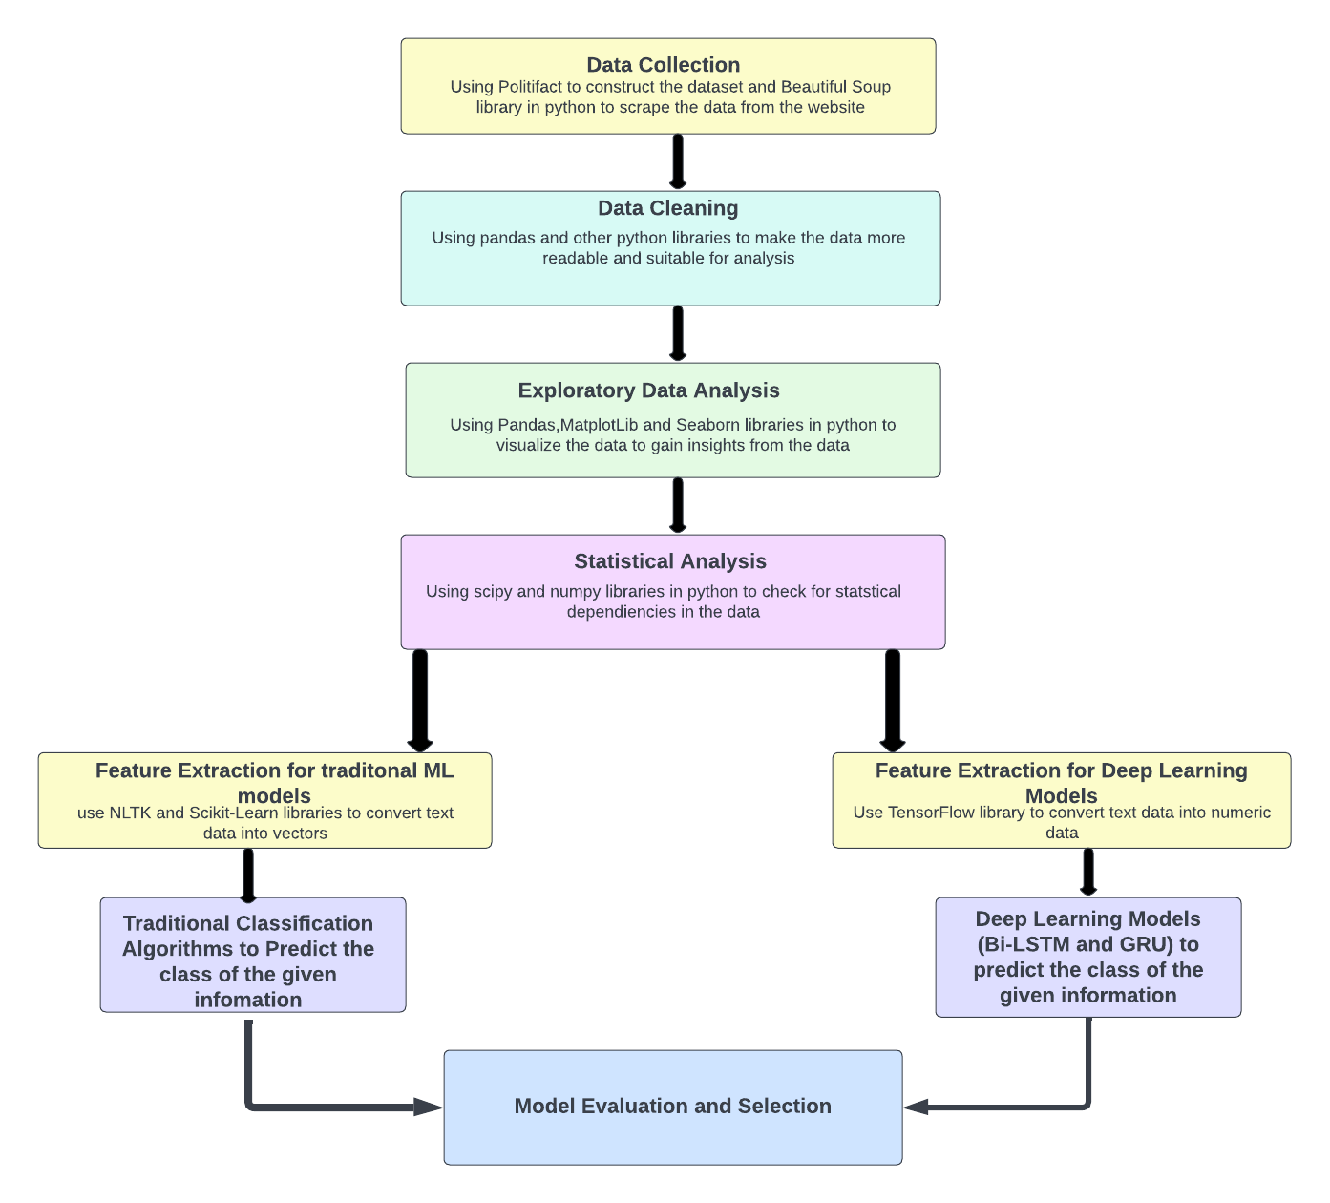
Proposed Model Architecture
Figure 1 Proposed Model Architecture.
Source: (Ayyagari & Bhumani,2022)

Slide 5
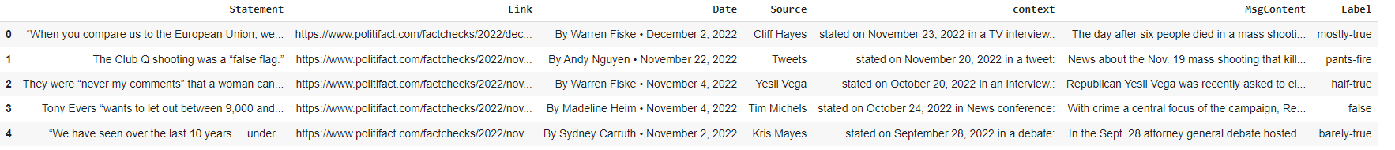
Data Before cleaning:
Figure 2: Data Before Cleaning
Source: (Ayyagari & Bhumani,2022)

Slide 6
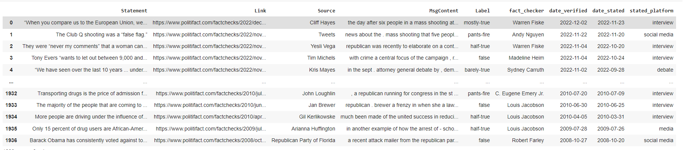
Final data frame
Figure 3: Final Dataframe
Source: (Ayyagari & Bhumani,2022)

Slide 7
EDA
For EDA we are making the below transformations:
Use the VADER library to get the sentiment for the statements to see if sentiments affect the labels.
The labels 'barely-true','pants-fire','false' and 'half-true' labels are converted to false and mostly-true and true are converted to True to build a model.

Slide 8
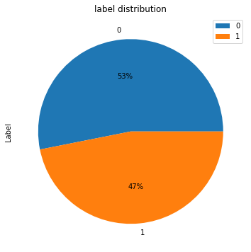
Label distribution:
Figure 4: Label Distribution
Source: (Ayyagari & Bhumani,2022)

Slide 9
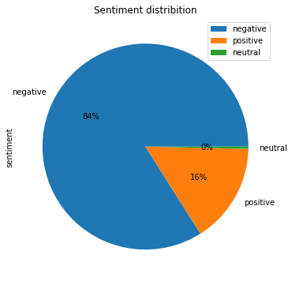
Sentiment distribution:
Figure 5: Sentiment Distribution
Source: (Ayyagari & Bhumani,2022)

Slide 10
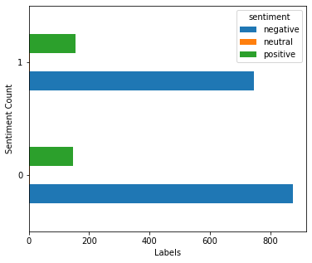
Sentiment Label Count:
Figure 6: Sentiment Label Count
Source: (Ayyagari & Bhumani,2022)

Slide 11
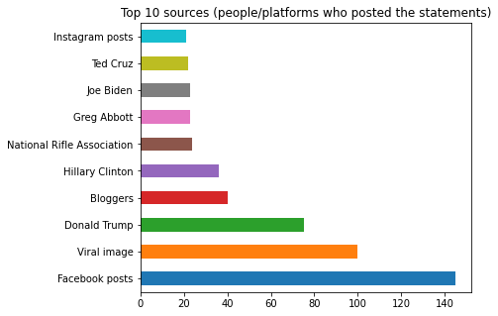
Top 10 information sources:
Figure 7: Top 10 Information Sources
Source: (Ayyagari & Bhumani,2022)

Slide 12
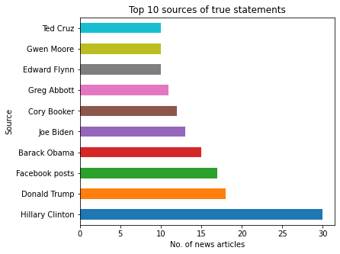
Top 10 sources of true information (people/platforms who posted the statements)
Figure 8: Top 10 Sources of True information
Source: (Ayyagari & Bhumani,2022)

Slide 13
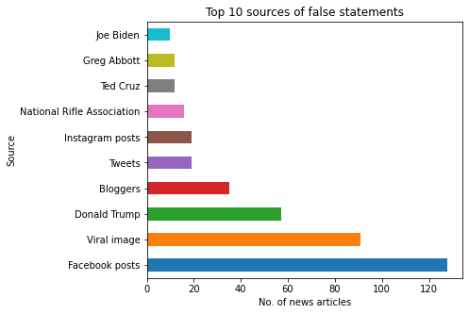
Top 10 sources of misinformation:
Figure 9: Top 10 Sources of misinformation
Source: (Ayyagari & Bhumani,2022)

Slide 14
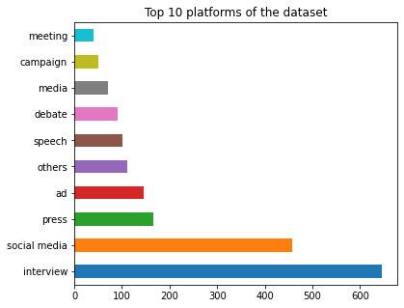
Top 10 platforms of the dataset
Figure 10: Top 10 platforms of the dataset
Source: (Ayyagari & Bhumani,2022)

Slide 15
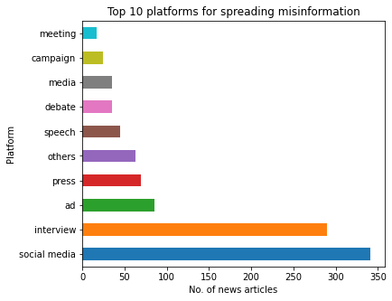
Top 10 platforms for spreading misinformation
Figure 11: Top 10 platforms for spreading misinformation
Source: (Ayyagari & Bhumani,2022)

Slide 16
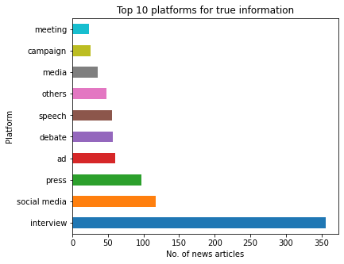
Top 10 platforms for true information
Figure 12: Top 10 platforms for True information
Source: (Ayyagari & Bhumani,2022)

Slide 17
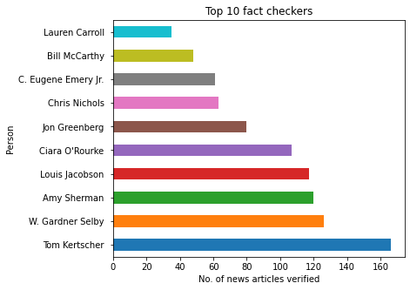
Top 10 fact checkers
Figure 12: Top 10 fact checkers
Source: (Ayyagari & Bhumani,2022)

Slide 18
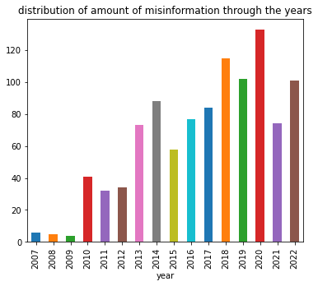
Amount of misinformation through the years
Figure 13: Amount of misinformation over the years
Source: (Ayyagari & Bhumani,2022)

Slide 19
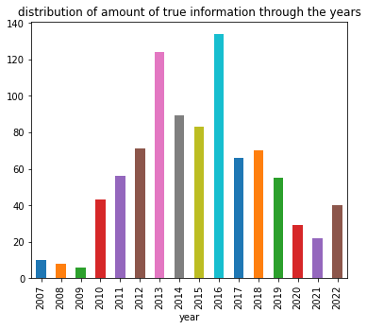
Distribution of true information throughout the years:
Figure 14: Distribution of True information through the years
Source: (Ayyagari & Bhumani,2022)

Slide 20

Statistical Analysis:
To check the dependency between the source and the label.
Null Hypothesis: platform and the labels are independent
Alternative hypothesis: platform and the labels are dependent
Result: p<0.05, hence we reject the null hypothesis.

Slide 21

cont..
2. To check the dependency between the platform and the label.
Null Hypothesis: The Label and platform where the information was posted are independent.
Alternate Hypothesis: The Label and platform where the information was posted are dependent.
Result: We reject the null hypothesis as the p value is less than 0.05

Slide 22

cont..
3. To check the dependency between the negative sentiment and the label.
Null Hypothesis: The Label and negative sentiment are independent.
Alternate Hypothesis: The Label and negative sentiment are dependent.
Result: p>0.05, hence we fail to reject the null hypothesis.

Slide 23
cntd
Average time required over the years to fact check the information: 17.4 days
Average time required over the years to check if the statement is True: 16.73 days
Average time required over the years to check if the statement is false: 17.99 days

Slide 24
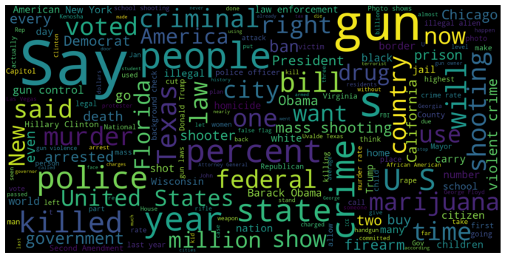
Most Frequent words associated with false label
Figure 15: Most Frequent words of false label
Source: (Ayyagari & Bhumani,2022)

Slide 25
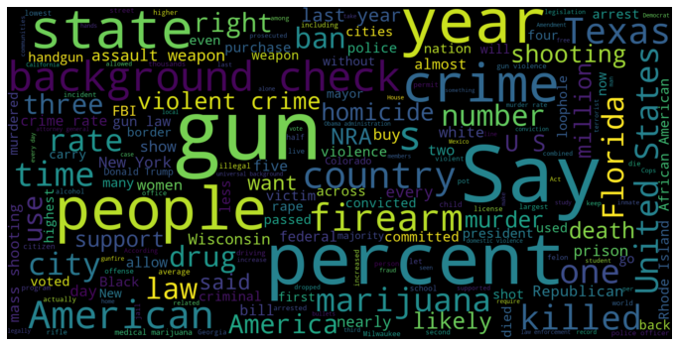
Most Frequent words associated with True label:
Figure 16: Most Frequent words of True label
Source: (Ayyagari & Bhumani,2022)

Slide 26
Feature extraction for Traditional ML models
Remove any alphanumeric and numeric characters from the text.
We are creating variable model_training_dataset to store the information about the MsgContent and model_testing to store the labels.
Splitting the data into training and test datasets.
Using CountVectorizer() to transform a given text into a vector on the basis of the frequency (count) of each word that occurs in the entire text.
We use TfidfTransformer()to transform text into a meaningful representation of numbers which is used to fit machine algorithm for prediction.

Slide 27
Feature extraction for Deep Learning models
We create two variables X and y that store the content and the target variables and split the dataset into training and test datasets.
we use the ‘Tokenizer’ from TensorFlow to split the texts into tokens or words while keeping only the most occurring words in the text corpus. The num_words parameter keeps a prespecified number(in this case 5000 words) of words in the text only.
We then pad the sentences using ‘pad_sequences’ function as the model expects that each sequence(each training example) will be of the same length(same number of words/tokens).
We convert the labels to categorical values (one hot vector encoding).

Slide 28
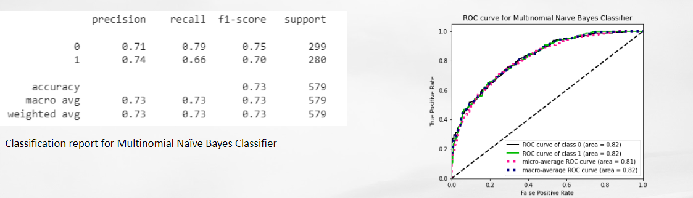
Naive Bayes Classification Model:
Figure 17: Naive Bayes model classification report
Source: (Ayyagari & Bhumani,2022)

Slide 29
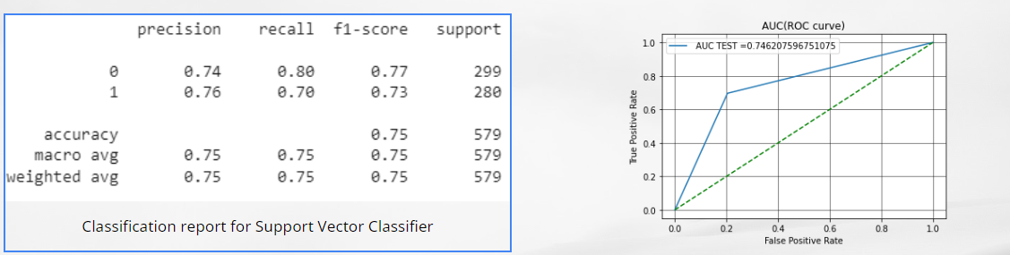
SVM with grid search:
Figure 18: SVM with GridSearchCV
Source: (Ayyagari & Bhumani,2022)

Slide 30
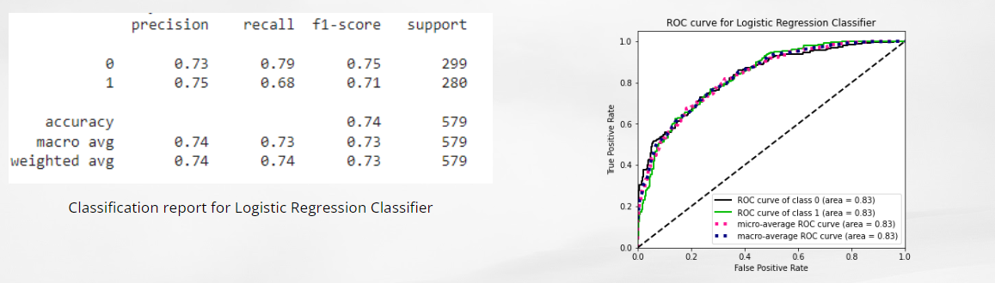
Logistic Regression:
Figure 19: a) Logistic Regression Classification report
b) ROC Curve
Source: (Ayyagari & Bhumani,2022)

Slide 31
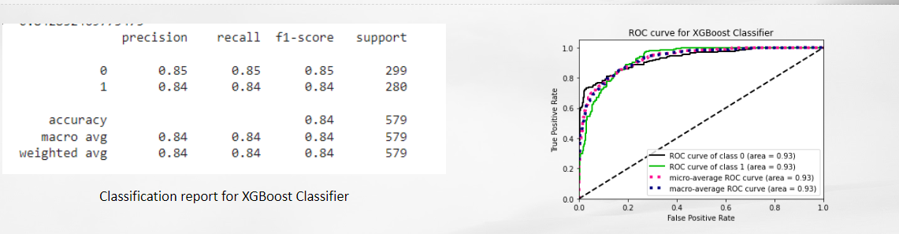
XGBoost(with grid search)
Figure 20: XGBoost Model with GridSearchCV
Source: (Ayyagari & Bhumani,2022)

Slide 32
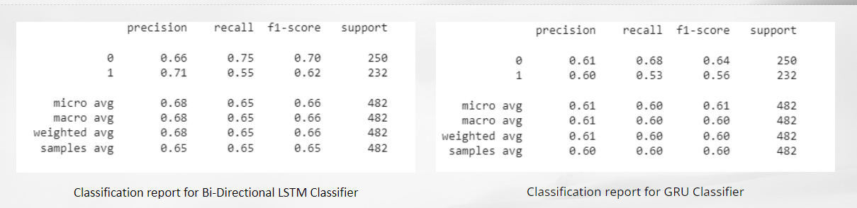
Deep Learning Models
Figure 21: a) Bi-LSTM Model Classification Report
b) GRU Model Classification Report
Source: (Ayyagari & Bhumani,2022)

Slide 33
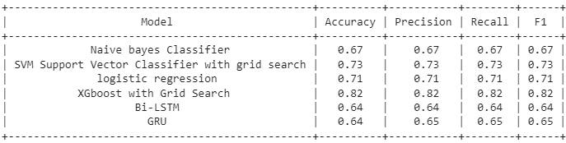
Model Results:
Figure 9: Model Results
Source: (Ayyagari & Bhumani,2022)

Slide 34
Answers to research questions:
Can we determine if the given information about crime is true or false?
Ans: Yes, we were able to determine the label with an accuracy of 82%
Are the platforms where the statements were made and the labels dependent ?
Ans: Yes, they are dependent
Are the sources of information and labels dependent?
Ans: Yes, they are dependent
Are the negative sentiment and the label dependent?
Ans: No, they are independent
What is the average time required to check if the statement is true or false manually?
Ans: 17.4 days
Does traditional machine learning algorithms perform better than deep learning algorithms for predicting the class of the statement?
And: No, traditional machine learning algorithms perform better

Slide 35
Future Scope:
The model can be integrated with any social media platform or an independent website to validate the information posted about crime.
The results of the model can be used to FLAG any false information and inform the users about the nature of the information.
The model can be trained on larger datasets to expand its scope beyond crime and can identify any false information.
The dataset constructed for training and testing the model can be used by others to build their own model.
Attention mechanisms and word embeddings can be used to further increase the accuracy of the model.

Slide 36
Limitations:
Limited words
Multiple Labels
Crime Specific
Requires More Sophisticated Pre-Processing Algorithms
Customized Dataset

Slide 37
Conclusion:

Slide 38
Individual Contributions:
Anusha Ayyagari:
Harikrishna Bhumani:

Slide 39
References:
Anusha Ayyagari and Harikrishna Bhumani.(2022). Supervised Learning to predict false information about crime.

