Slide 1
Welcome
Hari Polnati

Slide 2
Concurrency

Slide 3
Agenda
Basics of Concurrency
Thread
Process
Using Threads (Thread API)
Daemon Threads
Lifecycle and Thread States
Sleeping, Joining and interrupting threads
Race conditions
Synchronization
Monitors and structured locking
The Volatile keyword
Thread Local
Advance Concurrency API’s
Unstructured locks
Executor service
Thread pool and types
Callables and Features (Completable Feature)
Semaphores
ForkJoin

Slide 4
What is Thread
Single sequential flow control
An independent sequential execution of a program
Sequential program instructions that can be executed independently
Allows the program split into simultaneously tasks

Slide 5
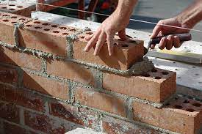
Let's understand with an example
I want to Building A Wall
1.Get Cement
2.Add a layer of cement on top of built wall
3.Get Brick
4.Firmly place brick on layer of mortar
5.Loop (Keep repeat)

Slide 6
One Builder
Let’s imagine only one person/builder/machine is doing this
1.Get Cement
2.Add a layer of cement on top of built wall
3.Get Brick
4.Firmly place brick on layer of mortar
5.Loop back (Keep repeat)

Slide 7
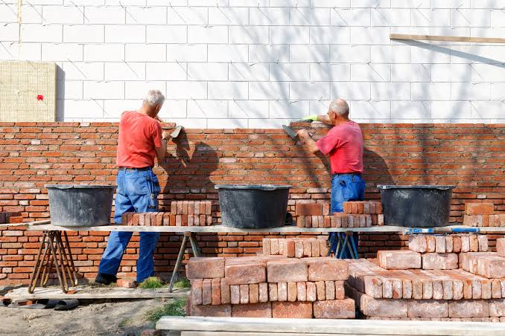
Multiple Builders
Each builder is working on these same instructions is a “Thread”

Slide 8
What is Process
Application/program/App software
Running an application - OS will do below
load program to memory
Allocate resources to program run
“Execute” the program -> Process (run state of an app)

Slide 9
Requirement
A process need some instructions to run in parallel (not sequential)

Slide 10
Solution
Threads
Unit execution of with in a process
Usually has a shared object
Has shared resources like memory, heap storage
Does the work of the process

Slide 11
Process can be
Single threaded -> All instructions executed in sequentially
or
Multithread also -> can spawn into multiple threads that can run in parallel

Slide 12
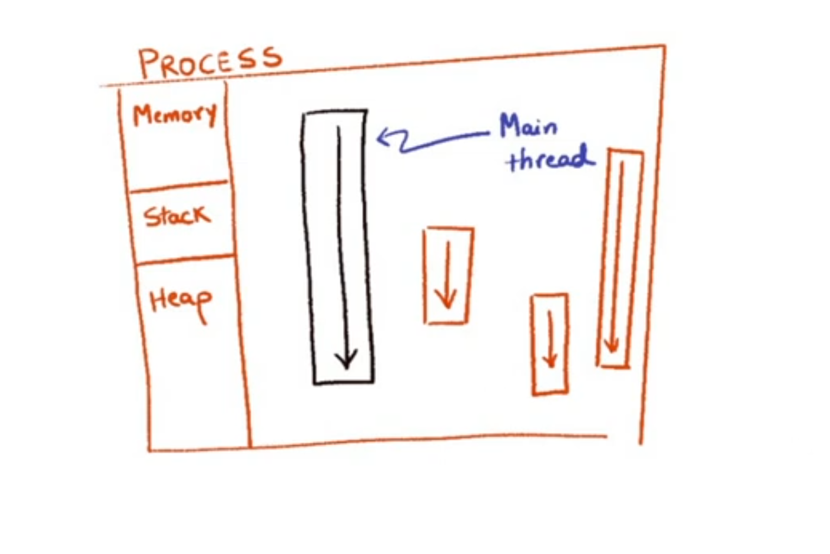
Process with Multiple threads

Slide 13
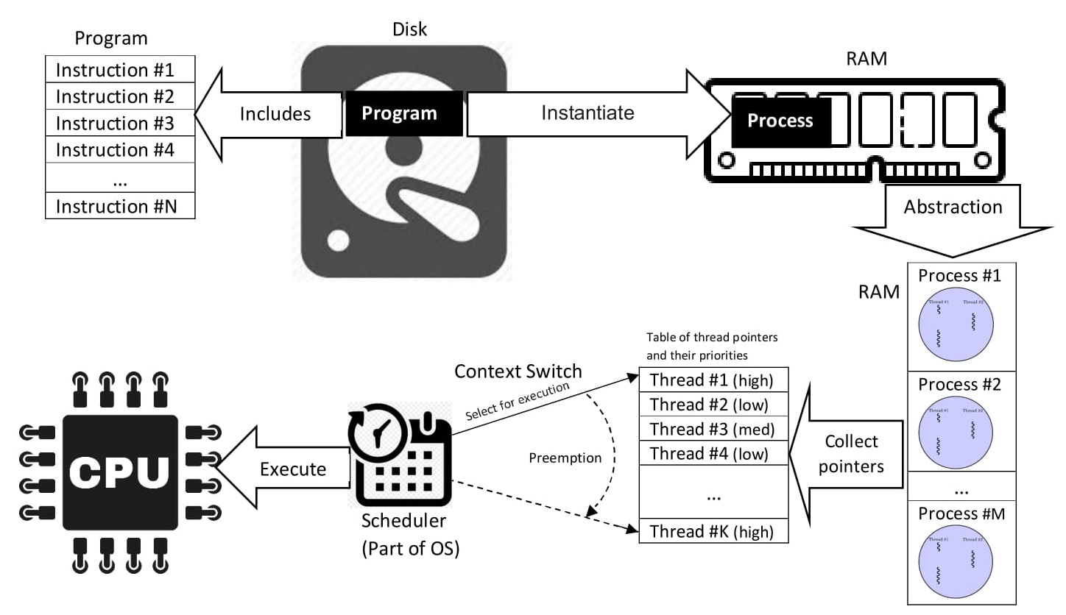
Source: https://en.wikipedia.org/wiki/Process_(computing)

Slide 14
A Java Application
A single process (JVM)
Consists of various threads – Garbage Collector, Security Manager, …
Single Application Thread – responsible for running main method

Slide 15
Single Application Thread
Need more threads
How to created using language api ?

Slide 16
Java language api allow us to create threads using called
Extends Thread class
Implements Runnable Interface
Something that can be run
Has run method

Slide 17
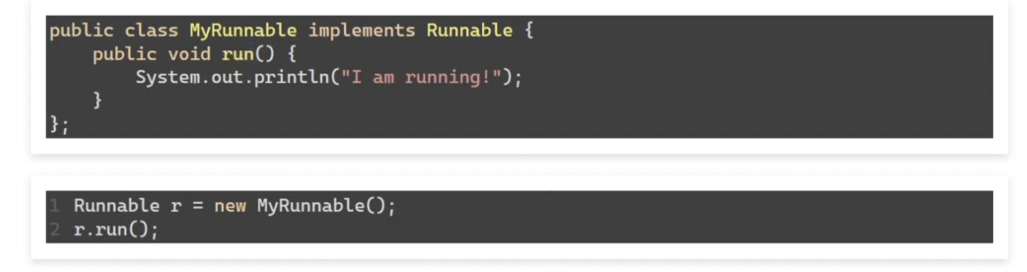
Approach1. Runnable
Using Runnable directly

Slide 18
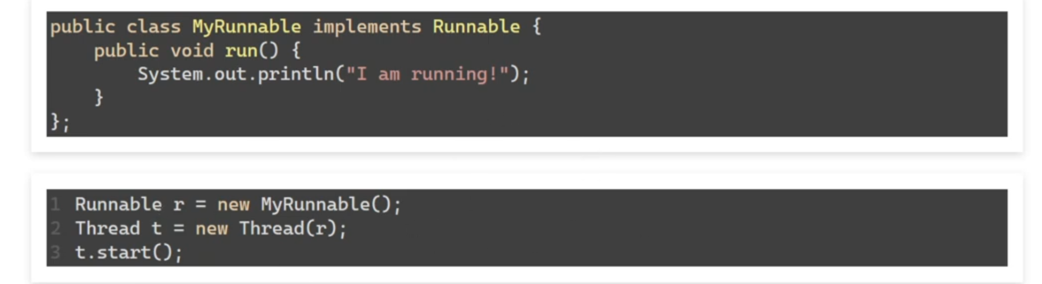
If we want to run in separate Thread

Slide 19
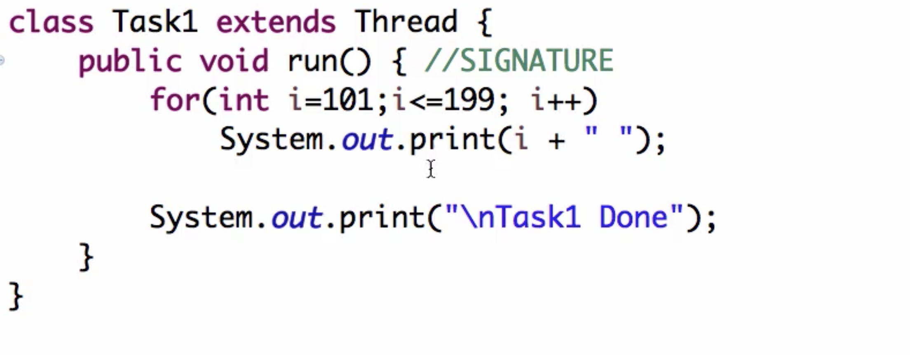
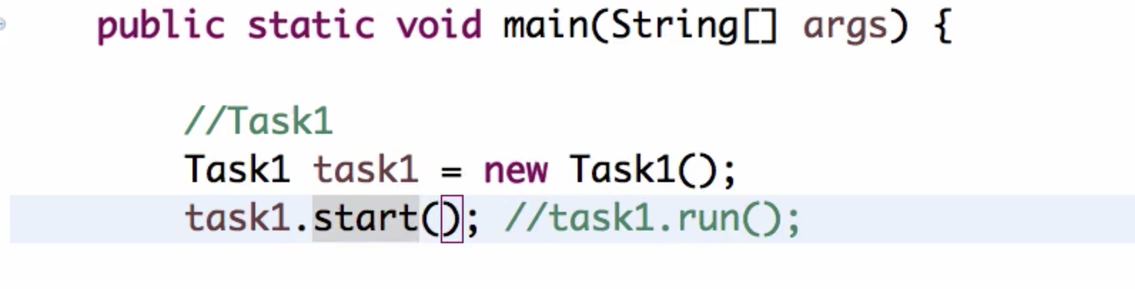
Approach2. Thread Class
}

Slide 20
How this works ?
JVM calls underlying OS threading API

Slide 21
When does a thread end?
When run() method execution completed
When run() method throws exception

