Slide 1
Welcome!
Hari Polnati

Slide 2
Exception Handling

Slide 3
What is an Exception?
An exception is an unwanted or unexpected event, which arises during the execution of a program. When an exception occurs the normal flow of the program is terminated. Therefore, these exceptions are to be handled.
Abnormal condition raises at runtime.
What is an Exception Handling?
It is a mechanism to handle runtime errors
Normal flow of the application maintained

Slide 4
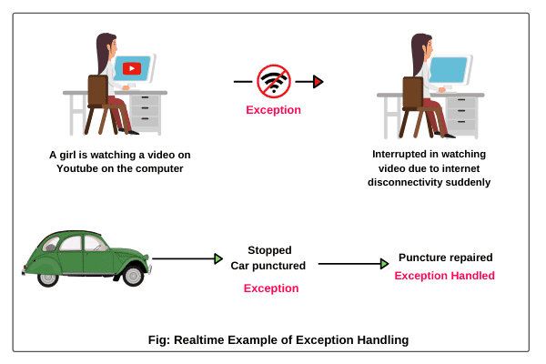
Realtime Example

Slide 5
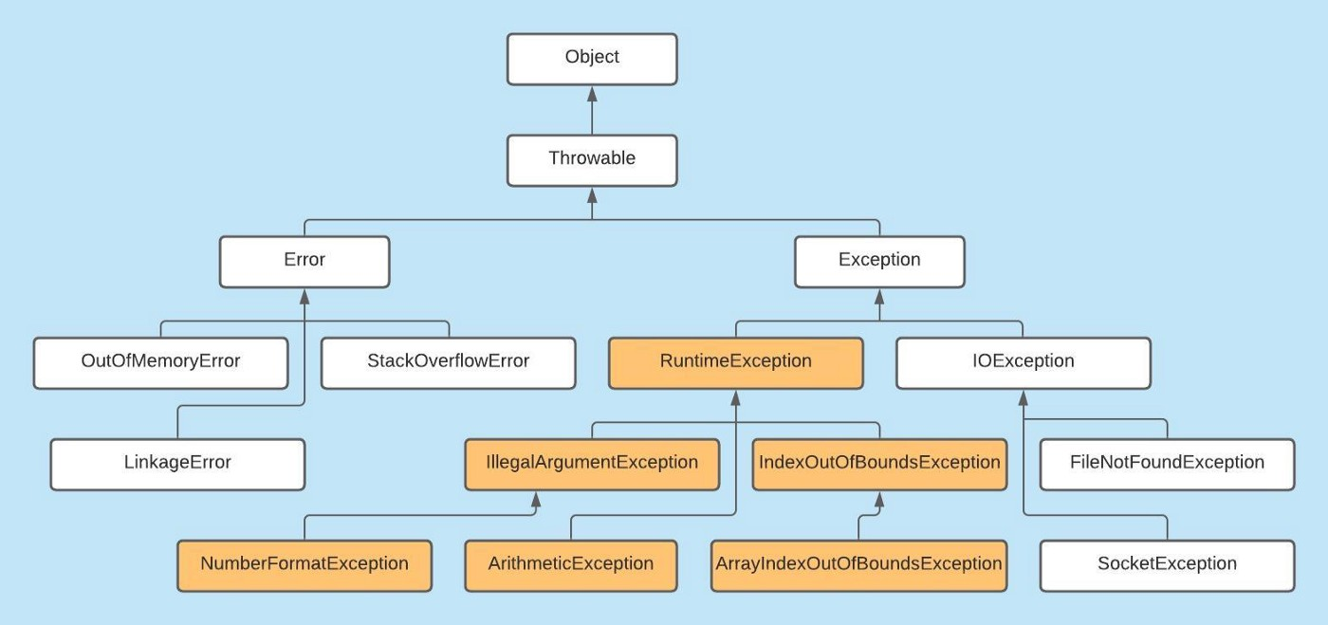

Slide 6
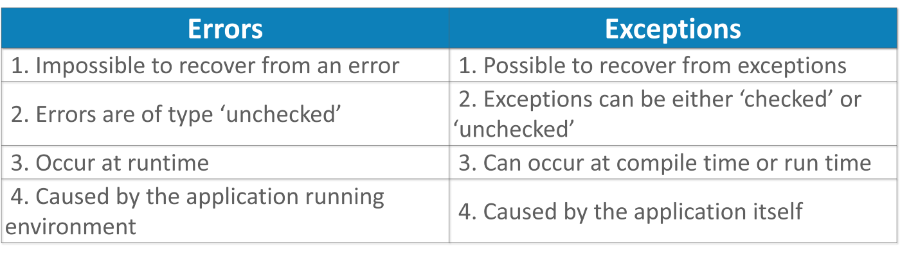
Exception vs Error
Error: Conditions which cannot recovered by handling. Eg: OutOfMemoryError, StackOverflowError, AssertionError
Exception: These are the conditions which are recoverable. All the checked and unchecked exceptions are the examples of this.

Slide 7
Exception Types
Checked Exceptions are checked at compile time which means the system throws a compilation error if you did not handle the checked exception.
Checked Exceptions: Exceptions are checked at compile time. It is created by extending the Exception class. Eg: IOException, SQLException, ClassNotFoundException
Unchecked Exceptions have checked at runtime, these exceptions won't throw any compilation error if you are not handled it.
Unchecked Exceptions: Exceptions are checked at runtime. It is created by extending the RuntimeException class. Eg: ArethemeticException, NullPointerException, NumberFormatException.
**Exceptions are always occurs at runtime

Slide 8
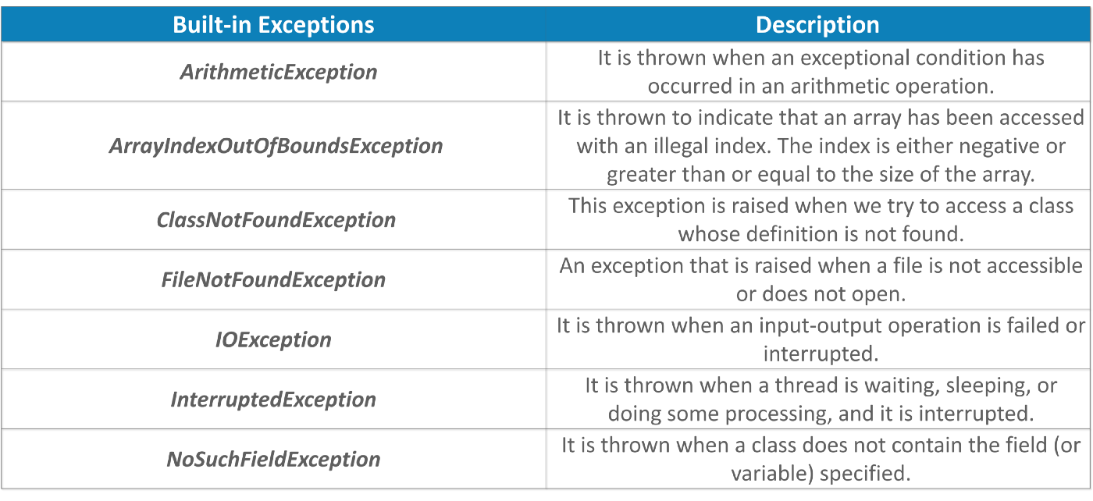
Built-in Exceptions
User Defined Exceptions
Sometimes, the built-in exceptions in Java are not able to describe a certain situation. In such cases, a user(developer) can also create exceptions which are called ‘User-Defined Exceptions’.
Ex: UserNotFoundException, OptumException, MyServiceException, AmountNotFounfException and so on …

Slide 9
Java Exception Handling Keywords
try -> Risky code
catch -> Handling logic
finally -> Always execute irrespective of exception occurs
throw -> Explicitly throw an Exception
throws -> When an exception is not handled, a method can declare the exception with the “throws” clause. When marked as throws, the calling methods have to handle the exception or declare to throw the same.

