Slide 1
Welcome!

Slide 2


Slide 3
Contents
Hooks Introduction
Rules Of Hooks
Why hooks
Basic Hooks:
useState - state
useEffect - side effects
useContext – Context API
useReducer - Reducers
Additional Hooks:
useRef
useMemo
useCallback
useImperativeHandle
useLayoutEffect
useDebugValue
Summary

Slide 4
Introduction
Hooks are a new addition in React 16.8 version.
Hooks don’t replace your knowledge of React concepts. Instead, Hooks provide a more direct API to the React concepts you already know: props, state, context, refs, and lifecycle.
100% bacfiwards-compatible. Hooks don’t contain any breaking changes.
There are no plans to remove classes from React.
Hooks does not work inside classes.

Slide 5
Why Hooks ?
1.Understand this keyword works in JS classes
2.There is no particular way to reuse stateful components logic.
3.Create components for complex scenarios such as data fetching and subscribing events related code is not organized in one place in Class components.
Ex: Data Fetching – In componenetDidMount() and componenetDidUpdate()
Ex: Event Listeners – In componenetDidMount() and componenetWillUnmount()
* Hooks don’t contain any breaking changes and release(16.8 or higher) is backward-compatibility. Classes won’t be removed from React.

Slide 6
Rules of Hooks
Hooks are simply JavaScript functions, but they impose two additional rules:
Only call Hooks at the top level. Don’t call Hooks inside loops, conditions, or nested functions.
Only call Hooks from React function components. Don’t call Hooks from regular JavaScript functions.
one other valid place to call/use Hooks — your own custom Hooks.

Slide 7
useState
Let’s understand Object and Array De-structuring before hooks.
useState returns a pair: the current state value and a function that lets you update it.
It’s similar to this.setState in a class, except it doesn’t merge the old and new state together.
We can use single and many useState hooks.
Hooks execute one after another in a sequence.

Slide 8
useEffect
useEffect, adds the ability to perform side effects from a function component. Operations like fetching data from API, setting up subscriptions and manually changing the DOM in React Component are called “side effects” or effects for short as they can affect other components and can’t be done before rendering.
It serves the same purpose as componentDidMount, componentDidUpdate, and componentWillUnmount in React classes, but unified into a single API
By default, React runs the effects after every render — including the first render.
Just like with useState, you can use more than a single effect in a component.

Slide 9
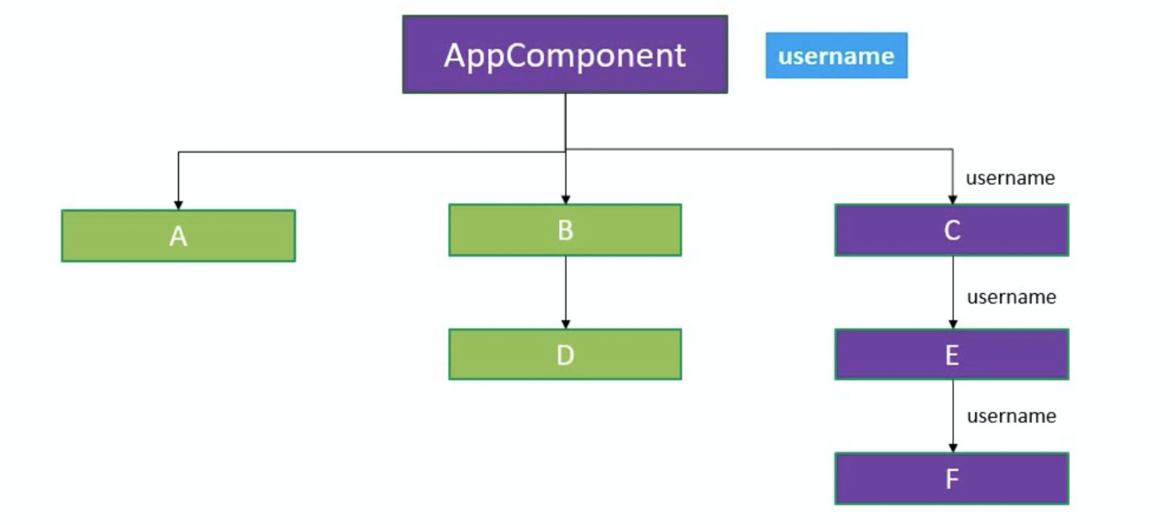
📨useContext
useContext hook makes it easy to pass data throughout your app without manually passing props down the tree.
Context can make a nice simple alternative to Redux when your data is simple and top-down flow or your app is small.

Slide 10
🚀 useReducer
It is used for state management and an alternative for useState hook
useState hook is built using useReducer Hook
convenient for dealing with more complex state changes in React components.
useReducer borrows some theory from Redux, namely the concepts of reducers, action, and dispatch.
useReducer vs useState ?

Slide 11
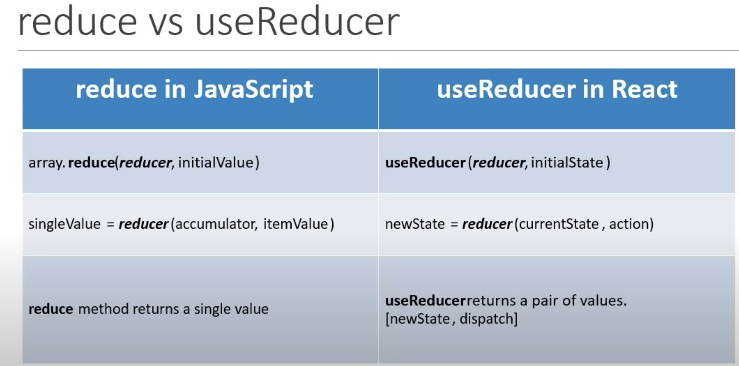

Slide 12
useReducer + useContext
useReducer – Local state management
Share state b/w components – Global state management

Slide 13
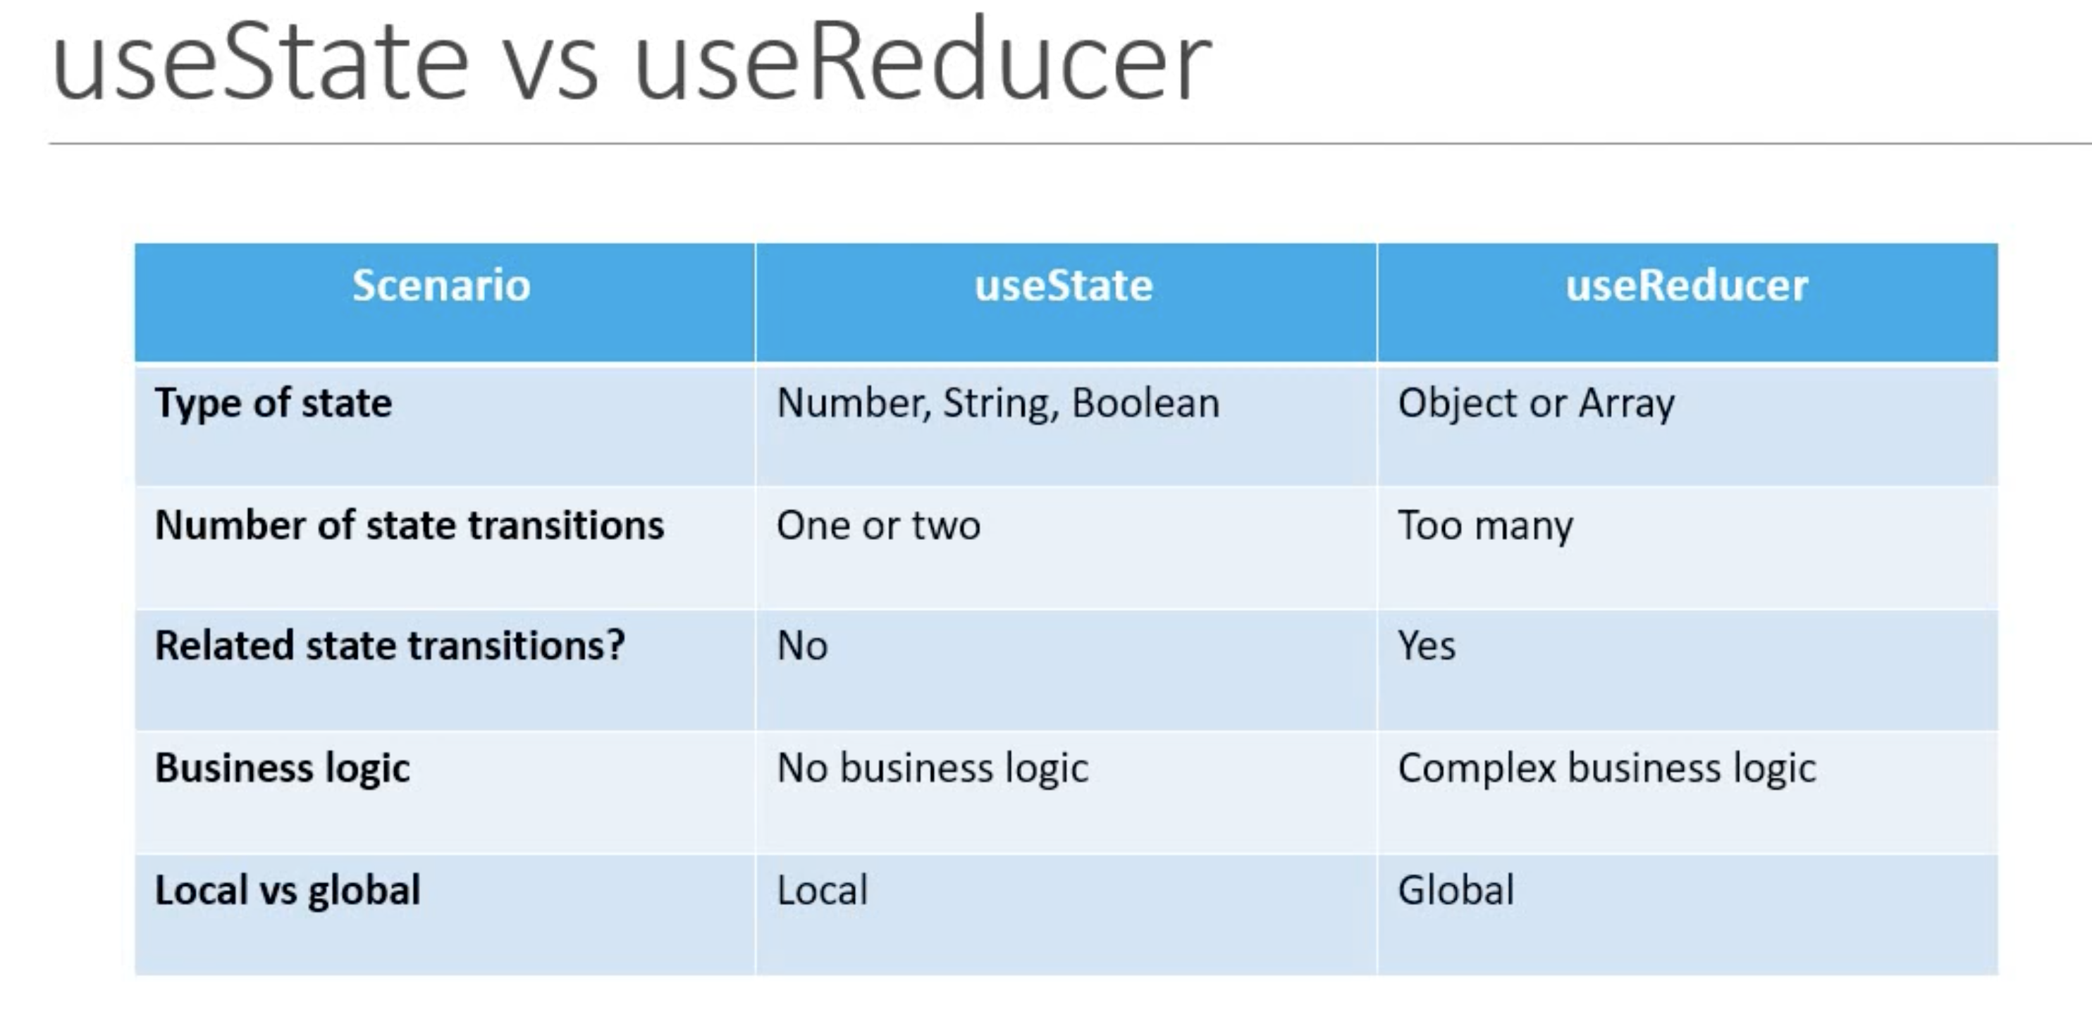

Slide 14
🔗useRef
The useRef Hook is a function that returns a mutable ref object whose
.current property is initialized with the passed argument (initialValue). The returned object will persist for the full lifetime of the component.
A ref created with useRef will be created only when the component has been mounted and preserved for the full lifecycle.

Slide 15
✨useDebugValue
useDebugValue can be used to display a label for custom hooks in React DevTools.

Slide 16
💭useMemo
Returns a memoized value.
Whenever a huge computation is involved, then we can use useMemo hook.
Whenever there is no need of re-rendering If the respective state is not changed.

Slide 17
useCallback
Returns a memoized callback instead of a single value like useMemo.
We use the result as a function, so that if it is required, we can pass parameters to it for doing operations.
Both useMemo and useCallback are equivalent but with the small difference.

Slide 18
🔗useImperativeHandle
useImperativeHandle customizes the instance value that is exposed to parent components when using ref.

Slide 19
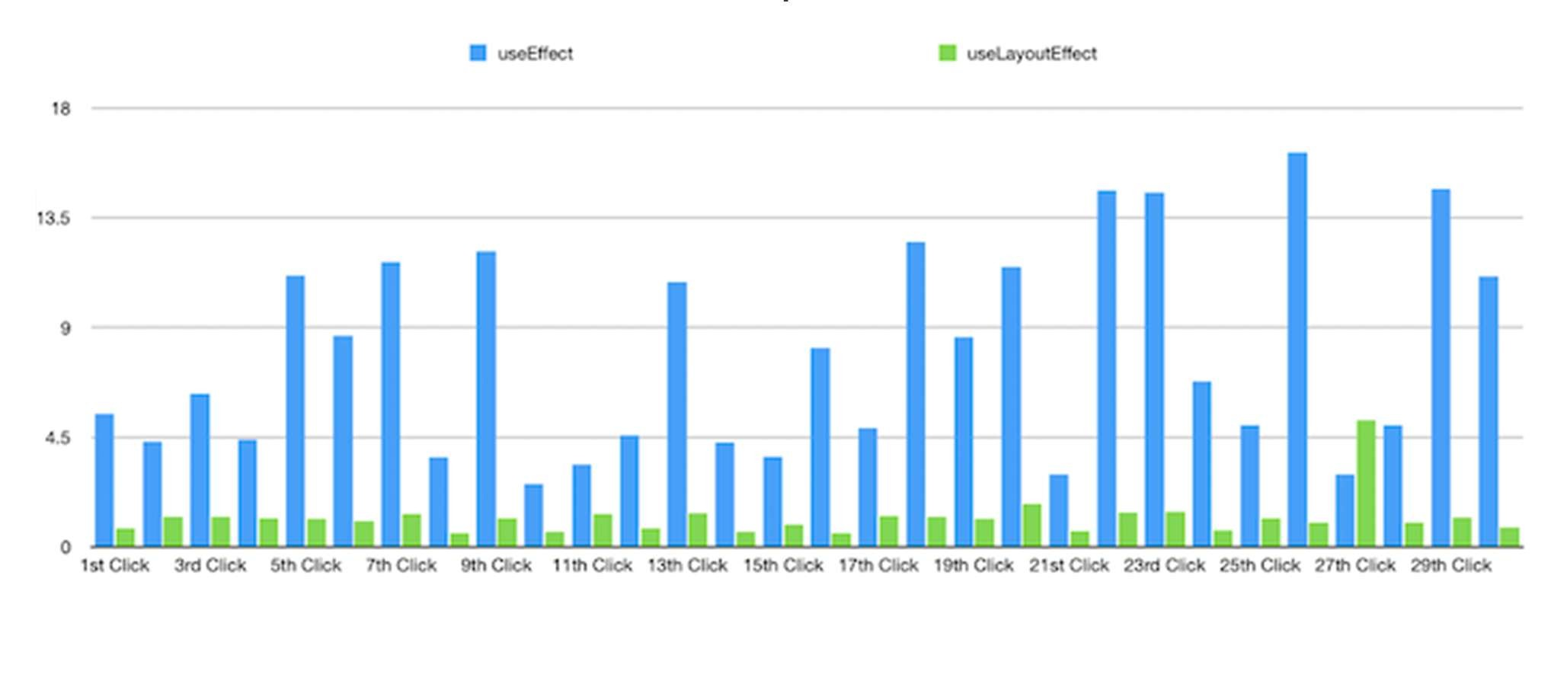


⛔useLayoutEffect
Updates scheduled inside useLayoutEffect will be flushed synchronously, before the browser has a chance to paint.
useEffect
useLayoutEffect

Slide 20
Custom Hooks
Custom Hooks are more of a convention than a feature. If a function’s name starts with ”use” and it calls other Hooks, we say it is a custom Hook.
The state of each component is completely independent. Hooks are a way to reuse stateful logic, not state itself. In fact, each call to a Hook has a completely isolated state — so you can even use the same custom Hook twice in one component.

Slide 21
✨Summary
Hooks are introduced in React 16.8 version.
We have basic hooks such as useState,useEffect, useContext etc., and additional hooks and customHooks that we can create by our own.
We can use hooks in functional components only.
We can’t use in class components.
We should follow 2 rules to use hooks:
Only call Hooks at the top level
Only call Hooks from React function components
We can call in custom hooks as well

