Slide 1
Welcome to ReactJS Training
Hari Polnati

Slide 2
Day 1
Overview on HTML,CSS and JS
ReactJS Introduction
JS vs React
Popularity of React
SPA vs MPA
Applications of React
Virtual DOM
Create Project
Display “Hello World!”

Slide 3
Prerequisites
You should be familiar with the following languages.
HTML
CSS
JavaScript (including ES6 features)

Slide 4
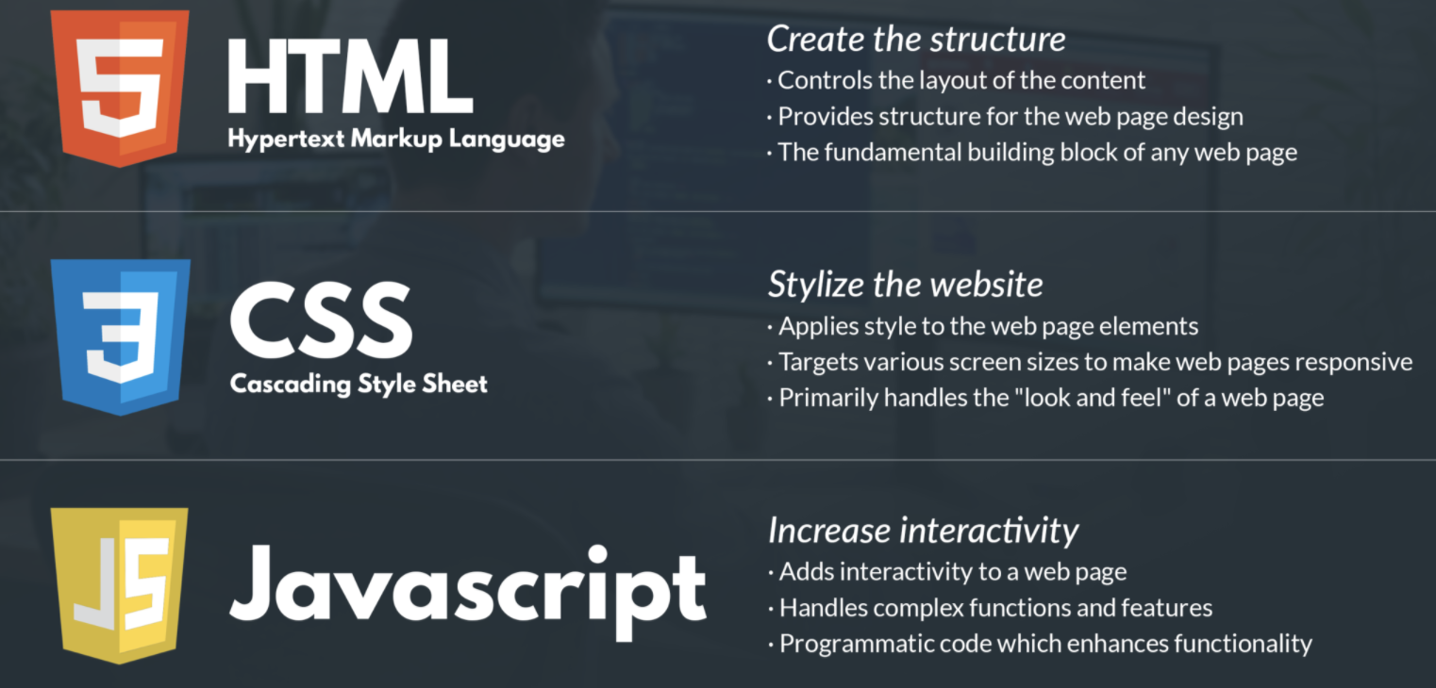
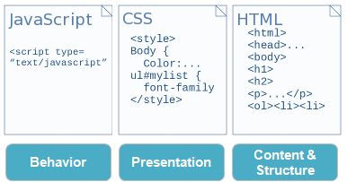
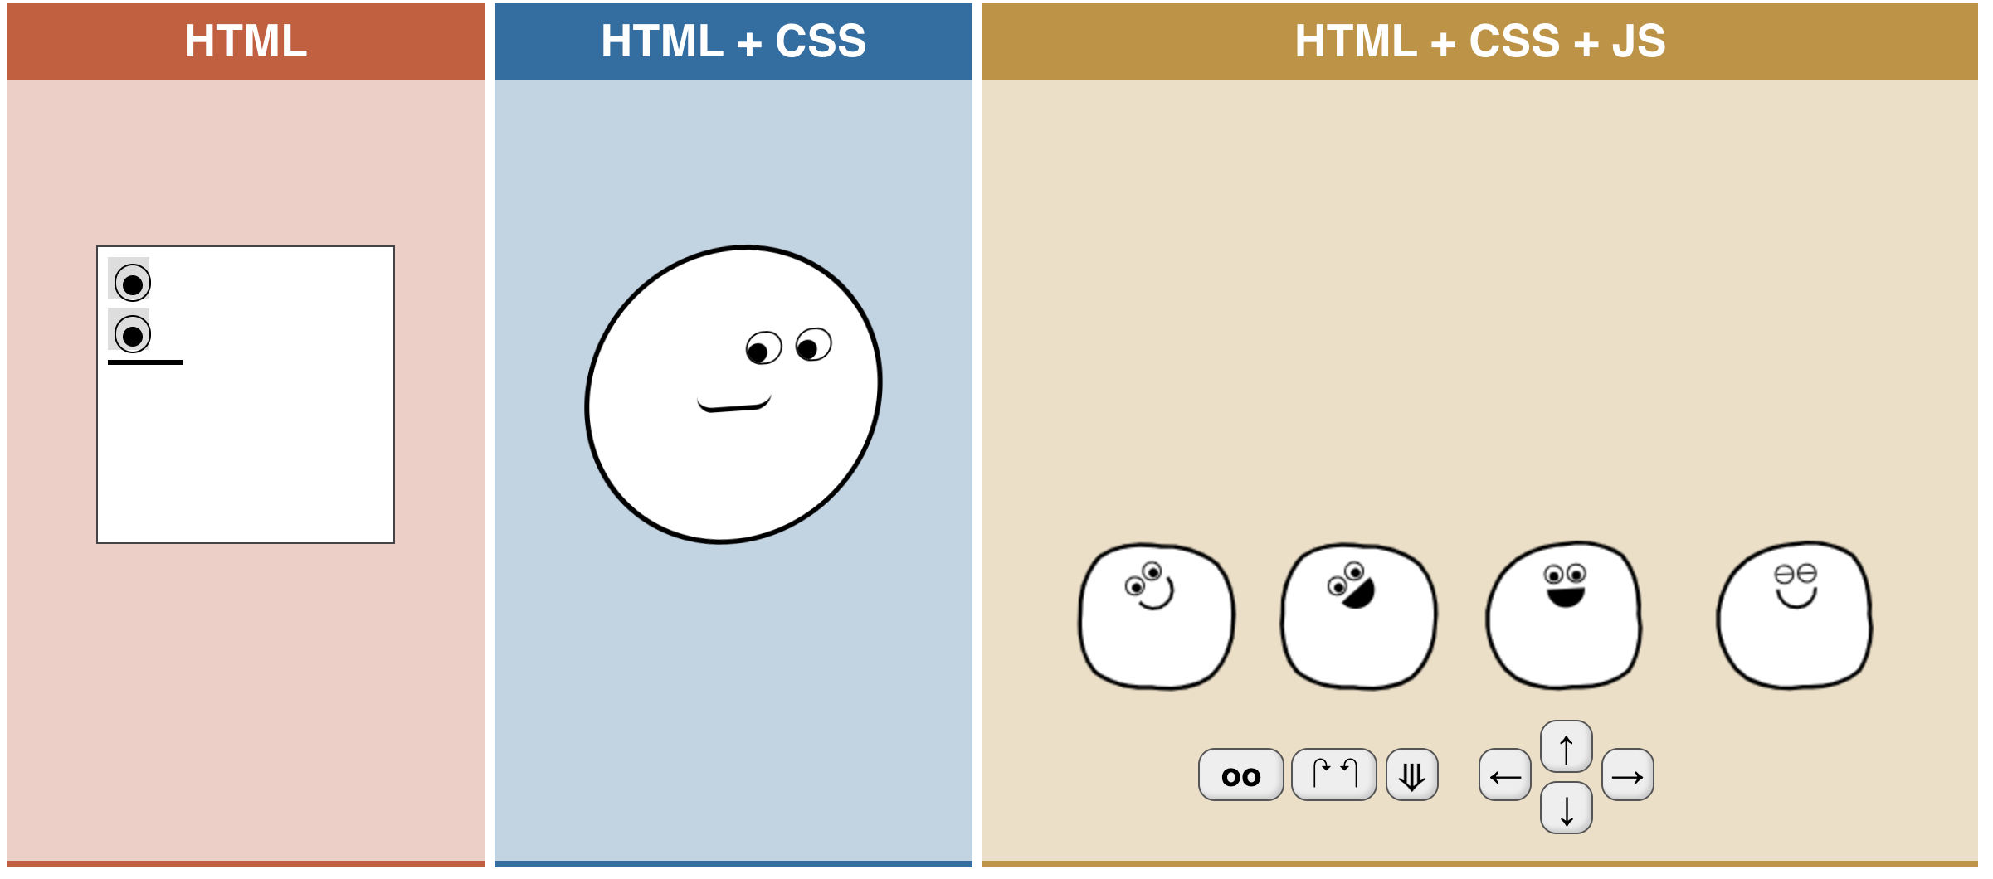
Reference: https://html-css-js.com/

Slide 5

React
React JS is UI Library
Developed By Facebook
It’s Open Source
It’s released on 2013
Current Stable Version 17.0.2
React JS can be used to develop Single Page Web Applications.
React Native with the similar React JS syntax can be used to develop Cross Platform Mobile Applications.
It uses Virtual DOM for updating the DOM changes.
Reference: https://reactjs.org/

Slide 6
React has many benefits over vanilla JS
Compatibility with platforms
Reusability of components
Interactive UI
Virtual DOM
Wide Community

Slide 7
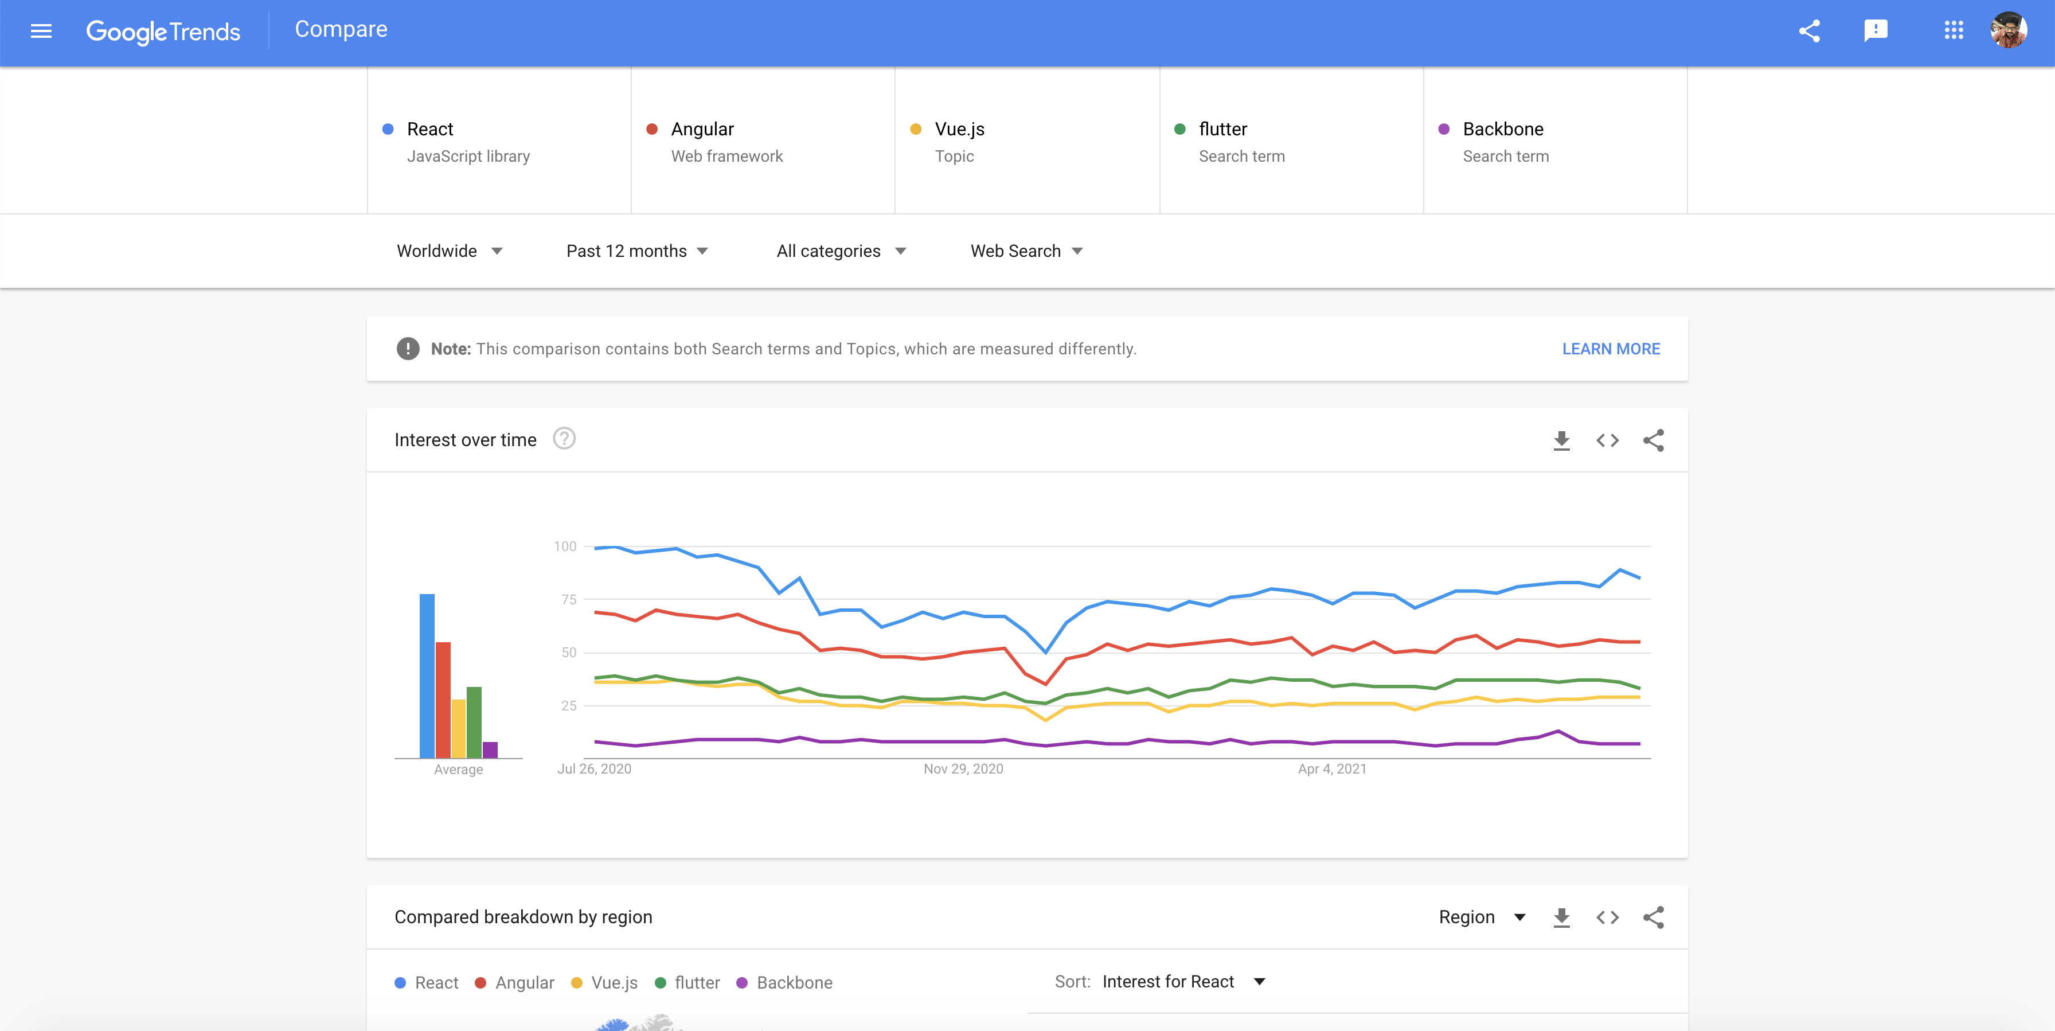
Popularity
: Current Trending Technology for frontend developers.

Slide 8
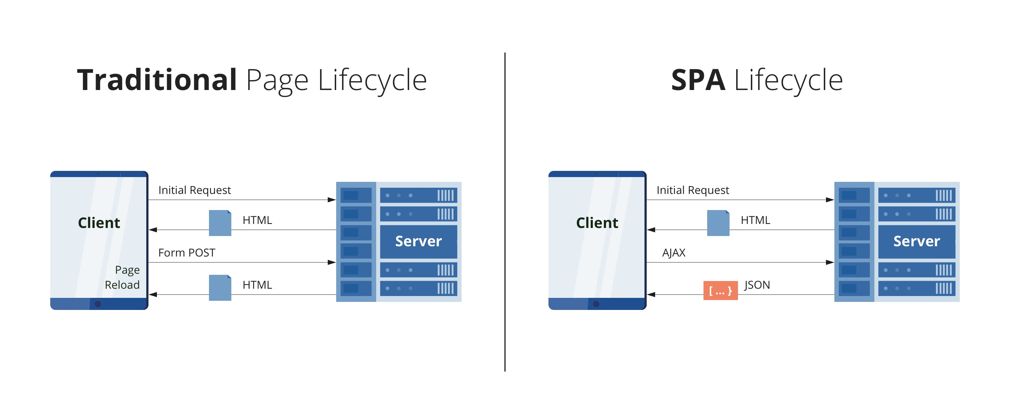
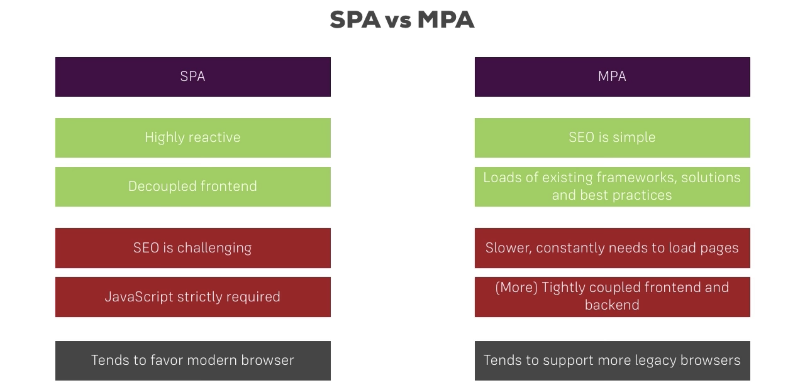
SPA VS MPA

Slide 9
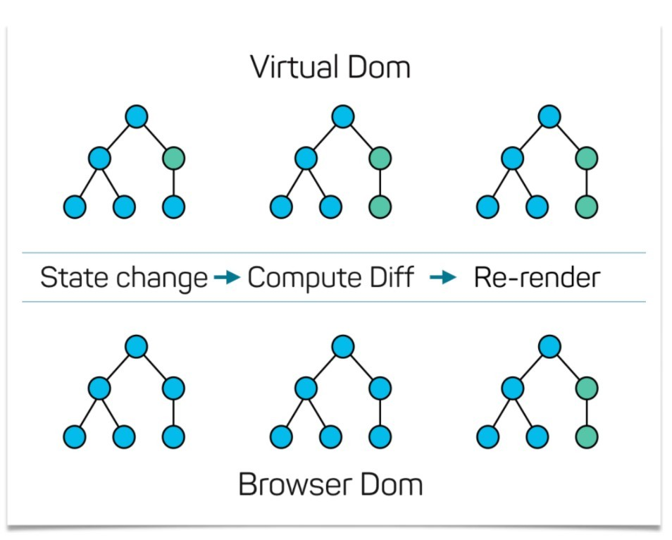
Virtual DOM
It takes lightweight copy of Real DOM and keeps in memory and syncs with the Real DOM by using ReactDOM Library.
It improves lot of performance.

Slide 10
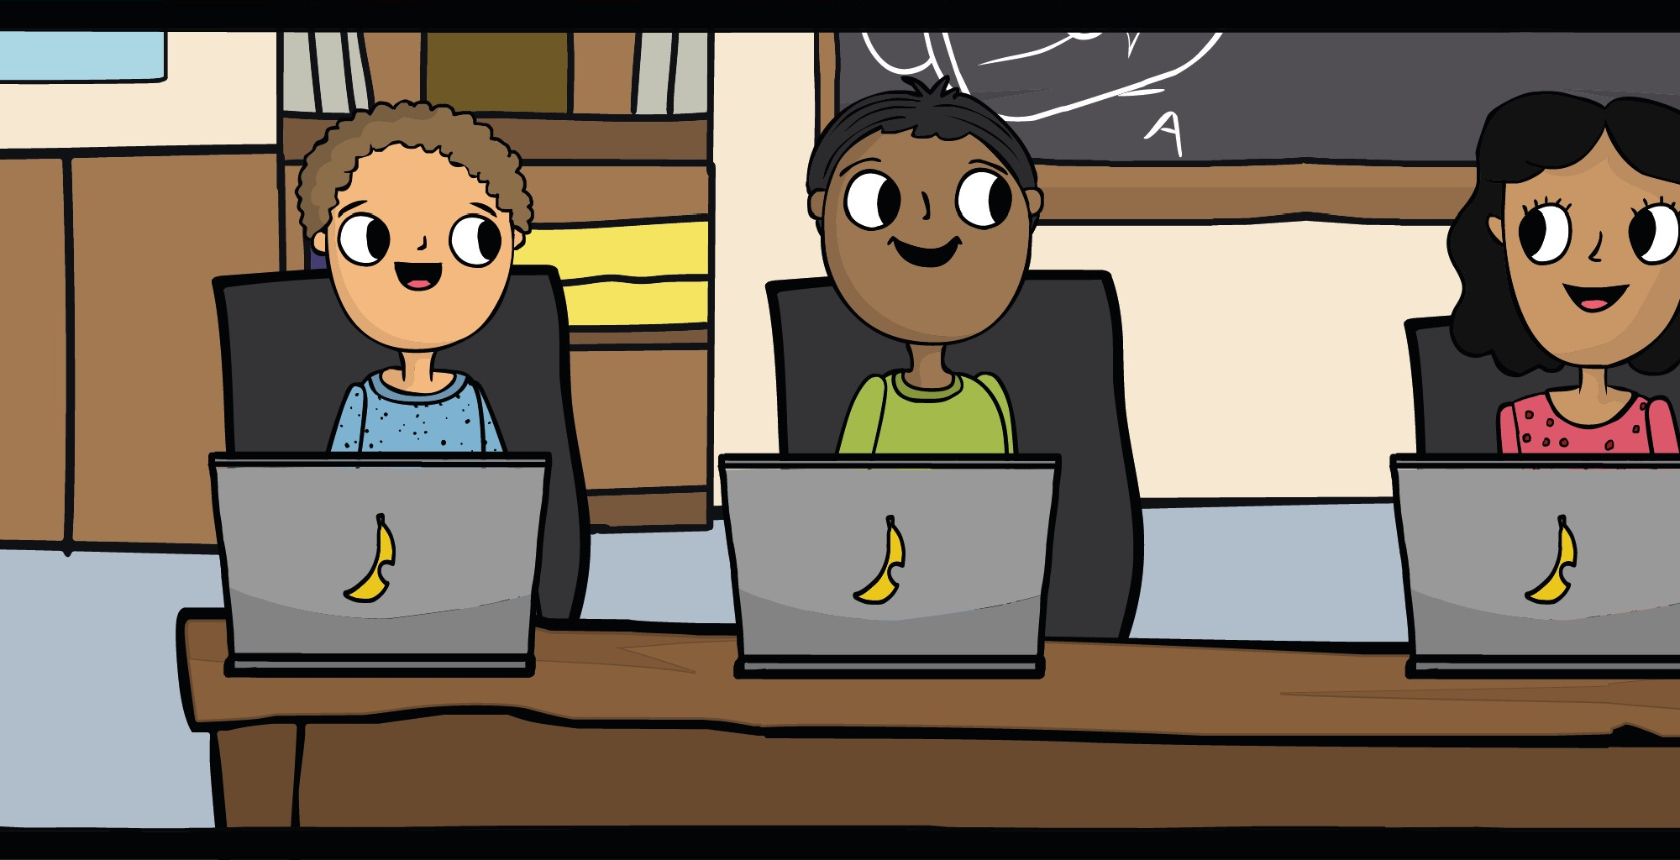
Let’s code Hello React!!!

Slide 11
Required Tools and Softwares
VS code : For development https://code.visualstudio.com/download
NodeJS: https://nodejs.org/en/ We need npm/yarn
Git : Distributed version control where we can usually used for coordinating work among programmers collaboratively developing source code during software development
You can download all above softwares from Appstore https://optum.service-now.com/euts_intake?id=appstore_home

Slide 12
Create a react project:
Settings:
Non-VPN:
npm set registry https://registry.npmjs.org/ - If you face any issues with VPN disconnect and run above command.
VPN:
https://repo1.uhc.com/ui/repos/tree/General/npm-virtual
Create a recat app:
npm install create-react-app –g
create-react-app my-app
(OR)
npx create-react-app my-app
Conventions….
Project Name should be URL Friendly.
It should not contain any special characters except hyphen(-) and underscore(_)
It should not contain any Capital Letters.

