Slide 1
Day 2

Slide 2
Topics:
JSX?
Components
Props
State
Event Handling

Slide 3
What is JSX
JSX stands for JavaScript XML which means combination of both JavaScript and XML syntax.
JavaScript syntax:
let button;
XML syntax:
<button>Click here</button>
JSX syntax:
let button = <button>Click here</button>;

Slide 4
It’s recommended to use JSX for React Applications.
It’s not mandatory, We can use babel syntax instead of JSX.
Babel is a JavaScript compiler that includes the ability to compile JSX into regular JavaScript (old ES5 JavaScript that can run in any browser - https://babeljs.io/)
Babel syntax:
import React from ‘react’;
let button =React.createElement(‘button’,null,’Hello’);
Equivalent syntax in JSX:
let button = <button>Hello</button>;
HTML Tag/React Component
Children
Properties

Slide 5



JSX CSS usage…
class → className
onclick → onClick
onchange → onChange
checked → defaultChecked
selected → defaultValue
for → htmlFor
style=“normal css” → style={ {camel case css}}

Slide 6
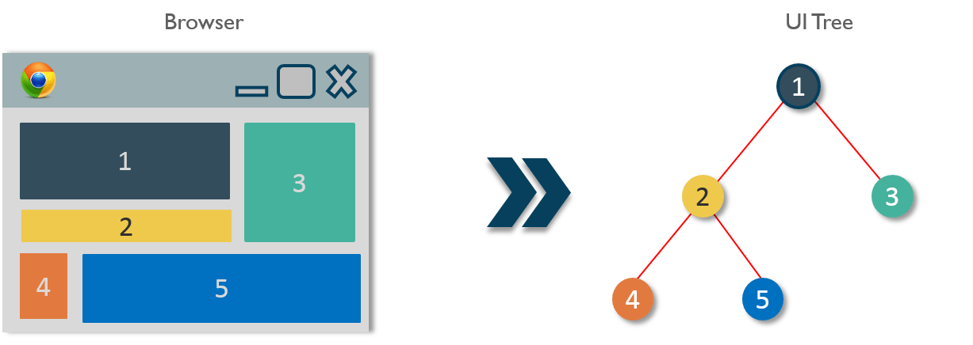
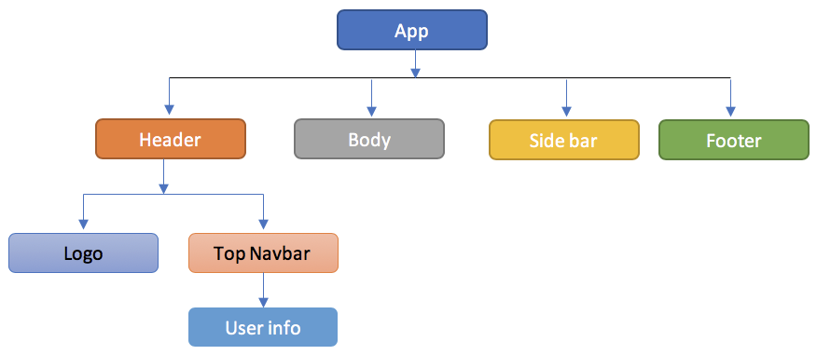
Components: Buildingblocks, Resuable, exists in same space but executes independently

Slide 7
Advantages of Components
Code Re-usability – A component-based approach makes your application development easier and faster. If you want to use a pre-existing functionality in your code, you can just put that code in yours instead of building it from scratch. It also allows your application architecture to stay up to date over time as you can update the specific areas which need up-gradations.
Fast Development – A component-based UI approach leads to an iterative and agile application development. These components are hosted in a library from which different software development teams can access, integrate and modify them throughout the development process.
Consistency – Implementing these reusable components helps to keep the design consistent and can provide clarity in organizing code throughout the application.
Maintainability – Applications with a set of well-organized components can be quickly updated and you can be confident about the areas which will be affected and which won’t.
Scalability – The development becomes easier with a properly organized library of ready to implement components. Ensuring the components are properly namespaced helps to avoid style and functionality leaking or overlapping into the wrong place as the project scales up.
Easy Integration – The component codes are stored in repositories like GitHub, which is open for public use. Application development teams are well-versed in using source code repositories, and so they are able to extract the code as needed and inject it into the application.
Reference : https://www.edureka.co/blog/react-components/

Slide 8
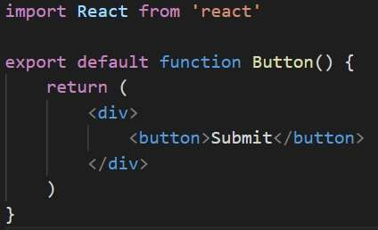
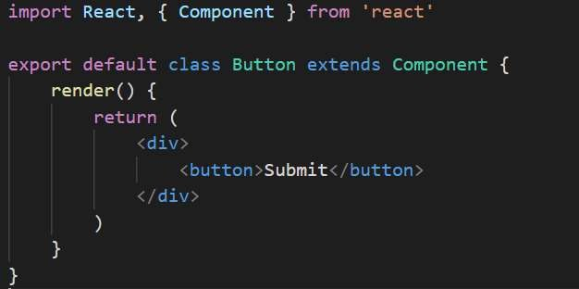
Components types in React:
There are 2 types of components available in React.
1.Functional Component
2.Class Component

Slide 9


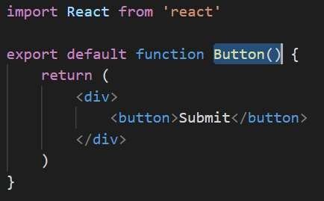
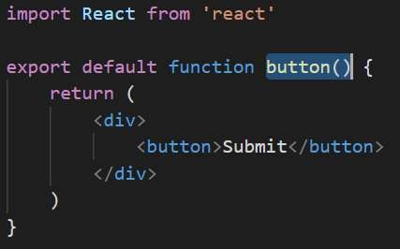
What if we not follow conventions:
React Component Name should start with Capital Letter.

Slide 10
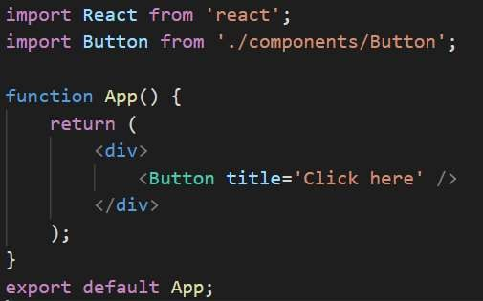
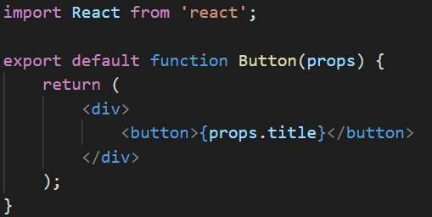

Props:
Props full form is Properties, which means simply attributes.
Props will be used to pass the data between the components.
We can pass any valid JavaScript expression as prop.
App Component Button Component
Output:

Slide 11
Data can be passed in one way only. Unidirectional or top-down. Other way we have to lift up for passing the data from child to parent.
From the below example, title is passed from App component, but Button component won’t know whether it’s value is typed manually or passed from state variable or passed from it’s parent component.
App Component Button Component
Output:

Slide 12
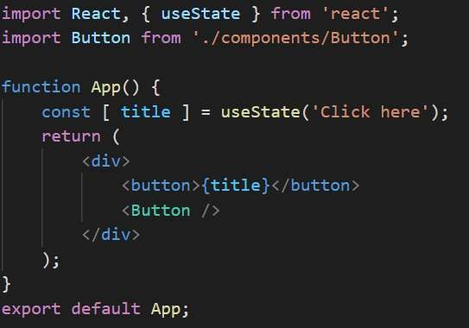
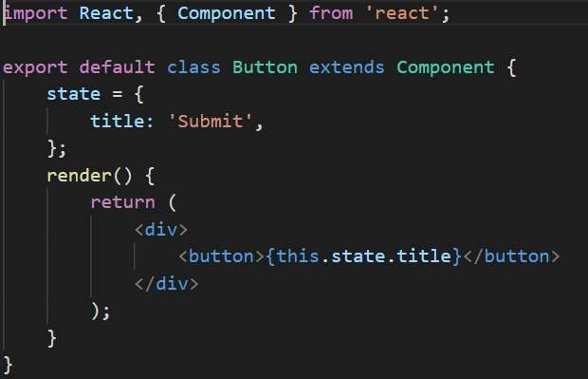
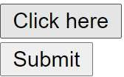

State is a local variable for the component.
Any state in one component won’t be accessible to other components, which means by default states are encapsulated in components.
App Component
Button Component
Output:
Output:

Slide 13
Properties are nothing but attributes, which can be used to pass the data from one component and another component. ( Top –down)
Any valid JavaScript expression can be passed a prop.
State is local variable of the component, which is by default encapsulated to it’s own component.
setState method can be used to update the state values.

