Slide 1
Routing
Routing means simply navigating from one URL to another URL without refreshing the application every time.
Install react-router-dom package.
npm i react-router-dom
Install Bootstrap and import in index.css file
npm i bootstrap@next
@import 'bootstrap/dist/css/bootstrap.min.css';
Primary Components:
There are three primary categories of components in React Router:
routers, like <BrowserRouter> and <HashRouter>
route matchers, like <Route> and <Switch>
navigation, like <Link>, <NavLink>, and <Redirect>
All of the components that you use in a web application should be imported from react-router-dom
react-router-dom (for web)
react-router-native (for mobile)

Slide 2



Browser Router VS Hash Router
Browser Router:
When we have big production-ready applications which serve backend, it is recommended to use <BrowserRouter>
Example: http://localhost:3000/about
As server supports normal url system, it will take the complete path for server side api calls for GET requests.
Hash Router:
When we have small client side applications which doesn't need backend we can use
<HashRouter> because when we use hashes in the URL/location bar browser doesn't make a server request.
Example: http://localhost:3000/ /about
Server will ignore about as it appended after , server only takes the url till / (slash).
forceRefresh can imitate the normal url functionality.
basename can be used to give a global app url for our application.
getUserConfirmation Prompt before moving to another page can be checked
Server

Slide 3
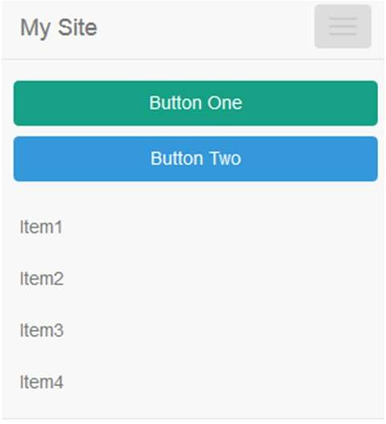
Switch
Switch:
When a <Switch> is rendered, it searches through
its children <Route> elements to find one whose path matches the current URL.
When it finds one, it renders that <Route> and ignores all others.
This means that you should put <Route>s with more specific (typically longer) paths before less-specific ones.
If no <Route> matches, the <Switch> renders nothing (null).
Example:
/projects/:id
/projects
/about
/home
/dashboard
Page 1
Page 2

Slide 4

Route
Route:
*path - (/projects, /home, /dashboard etc.,) Every route has props (match, location, history)
component – we can pass component to render for particular route. (it will create a new React component whenever we render it)
render – we can use inline rendering for particular route. (it won’t create new react component, instead it will take previous route props).
children – we can pass JSX elements to render for particular route. (similar to render but it works even if there is no match).
Page 1
children>component>render
exact – to match exact url.( browser location. Works for /about also /about/ ) strict – to match exact url including slash. (works for /about/ but not /about) sensitive – to match url with case sensitive. (works for /About but not /about)

Slide 5

Navigation
Navigation:
It used to change navigations by using components like <Link>, <NavLink> and <Redirect>
<Link>: uses to prop to navigate to specified path.
<NavLink>: it will do the same like Link but also having extra feature like active link or not.
<Redirect>: it redirects to specified path.

