Slide 1

Nepal Engineering College
Changunarayan,Bhaktapur
Presentation on final year project

Slide 2
DETAILED SURVEY, DESIGN AND COST ESTIMATION OF DISTRICT ROAD FROM BHUMESWOR MAHADEV MANDIR TO MICROSTAND(NEAR NEC)
Advisor Submitted By
Asst. Prof. Binaya Shakya
Hari Lal Chaudhary (017-072)
Jagat Bista (017-051)
Jeeban Bomjan (017-071)
Prabesh Ojha (017-069)
Pratik Tiwari (017-070)

Slide 3
Outline
Introduction
Objectives
Salient Features
Importance of Project
Methodology
Geometric design & standard
Horizontal and vertical curve
Drain design
Design for Extra Widening and super elevation
Design in smart road
Quantity and Cost estimation
Result & Conclusion
Recommendation

Slide 4
Introduction
National development depend on the development of road.
Lack of proper road service generate significant limitation for community.
To facilitate local people with short and comfortable route.
To inter-regional connection and access to the population.
Easy, cost and time effective travel service.

Slide 5
Objectives
To conduct detailed survey.
Design the road and its structure with drawing as per the standard;
To prepare the estimation of the works as per the norms and existing rates
To prepare the drawings and report in standard format.

Slide 6
Salient Features
Name of Project Detailed survey, design and cost estimation of village road from Bhumeswor Mahadev mandir to micro stand (near nec)
Location Bhaktapur district
Region Central development region
Municipality Changunarayan
Start point Bhumeswor Mahadev Mandir
End point Microstand (near nec)
Existing condition Agricultural land, forest, human settlement

Slide 7
Designed road length 1.908 km
Road width 5.25 m
Right of way 10 m
Carriage way 3.75 m
Shoulder 0.75 m at both side

Slide 8
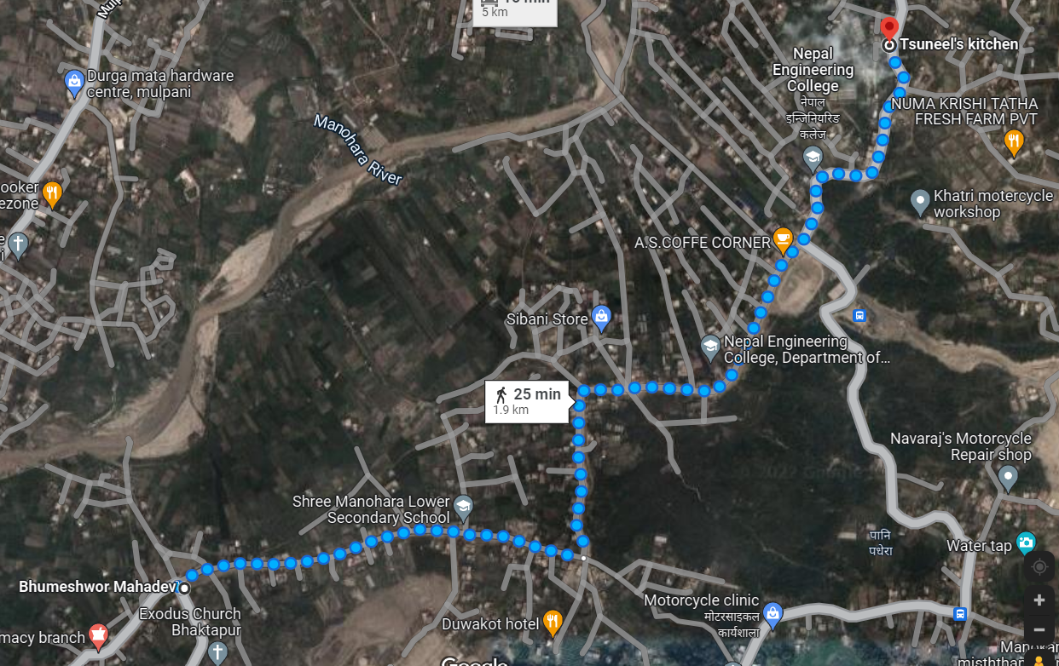
Topographic Map From Google Earth

Slide 9
Importance Of Project
Provides easy transportation service for local people
Tourist attraction.
Enhance the life standard of people.
Proper market for local agriculture product.

Slide 10
Methodology
Project Work
Field work
Desk study( Design work)
1. Map study
2. Design
3. Rate analysis
4. Quantity Estimation
5. Cost Estimation
6. Report preparation
1. Reconnaissance
  2.Topographic survey

Slide 11
Sample survey data:
S.N. | N | E | Z | Remarks
1 | 65542.38 | 42806.82 | 1285.786 | IS1
2 | 65545.38 | 42806.82 | 1285.786 | BS1
3 | 65541.04 | 42810.52 | 1285.675 | RRC
4 | 65542.04 | 42816.18 | 1285.85 | RRC
5 | 65543.43 | 42824.05 | 1286.027 | RRC
6 | 65545.08 | 42833.12 | 1286.221 | RRC
7 | 65544.76 | 42840.69 | 1286.315 | RRC
8 | 65543.9 | 42850.19 | 1286.53 | RRC
9 | 65543.1 | 42857.54 | 1286.704 | RRC
10 | 65543.14 | 42866.71 | 1286.804 | RRC
11 | 65543.23 | 42874.05 | 1286.812 | RRC
12 | 65543.46 | 42886.48 | 1287.008 | RRC
13 | 65543.36 | 42893.99 | 1287.138 | RRC
14 | 65544.09 | 42902.99 | 1287.294 | RRC
15 | 65544.13 | 42911.52 | 1287.318 | RRC

Slide 12
Geometric parameters
Parameters | AS per NRRS 2071 | Values Taken
No of lane | 1 | 1
Carriageway width | 3.75 m | 3.75 m
Shoulder width | 0.75 | 0.75 m(either side)
Formation width | 5.25 m | 5.25 m
Total Right of way | 20 m | 20 m
Stopping sight distance | 20 m | 48 m
Maximum super elevation | 10% | 10%
Minimum radius of curve | 12 m | 22 m
Maximum grade | 12% | 12%

Slide 13
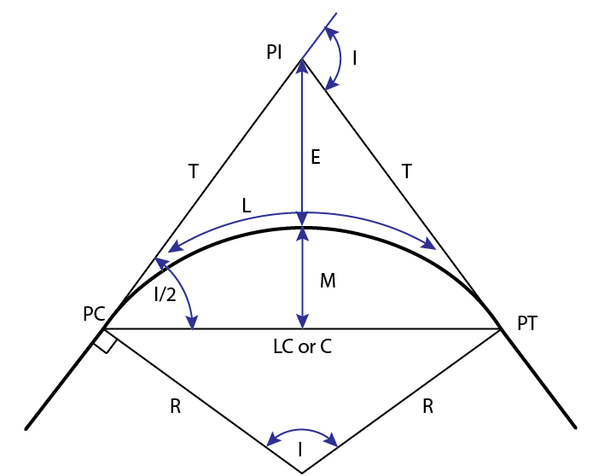
Horizontal Curve
R=V^2/127(e+f)
Where,
e=super elevation=0.07
f=lateral coefficient of friction between the road surfaces amd tires=0.15
V=speed of vehicles in kmph=25 kmph
Hence gives, R=22 m
From NRRS 2071,
Minimum radius of horizontal curve can be taken(R)=12.5
So, we provide minimum radius of horizontal curve(R)=22m

Slide 14
Contd…
Horizontal curve at IP2
Deflection angle( ∆)=78.15
R=25m
Length of curve(L)= ∏R ∆ /180
=34.1m
Tangent length=Rtan ∆/2
=20.29m

Slide 15
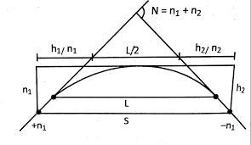
Vertical Curve at IP8
n1=3.03% n2=-3.06%
N= 6.09%,S=48 m
When L<S,
L=2S-(4.4/N)
=23.750m<48m (OK)

Slide 16
Design of EW and Super elevation
Design of Extra Widening
Radius of curve (R)= 22 m
Vehicle length(L)=6.1 m
Extra Widening=(L^2/2R)
= 0.8456 m

Slide 17
Design of Super Elevation
Design speed = 25 KM/Hr
Radius of curve (R)= 25m
Check for super elevation;
We have the formula =
(e+f)=V^2/127R
f=0.15
R=25 m
Now,
e=V^2/225R
=25² / (225*25)
=0.111>0.07 so take e=0.07
Check for the coefficient(f)
e+f=V²/127R
f =25²/(127*25)-0.07
=0.126<0.15
Hence,
Take e=0.07 and f=0.126

Slide 18
Drain design
Hydrological Analysis
Coefficient of runoff(C) = 0.45
Intensity of rainfall(I) = 5 mm/hr
Catchment area(A) = 75 ha
Discharge(Q) = CIA/360
= (0.45*5*75)/(360)
= 0.468 cumecs

Slide 19
Discharge equation,
Q = A*V
    0.468= A* 1.5
  A = 0.312m²
  For trapezoidal section,
    A = y*(b+0.5*z*y)
    Let b = 0.6
    0.312 = y*(0.6+0.5*1*y)
    y = 0.486m~ 0.5m

Slide 20
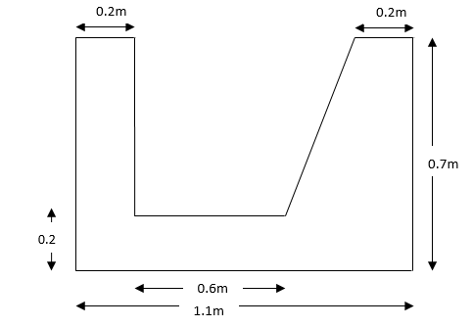
Typical section of drain

Slide 21
Retaining Wall Design
Ka =cosβ((cosβ−√(cosβ)²−(𝑐𝑜𝑠∅)²)/(cosβ−√(cosβ)²−(𝑐𝑜𝑠∅)²))
Here,
β = Angle of backfill slope
Ø = Angle of shearing resistance of the soil
Back fill provided is 2.5:1 (H:V)
Therefore, β= tan⁻¹(1/2.5)=21.8⁰
And we take Ø=28⁰
From above equation we get, Ka =0.489

Slide 22
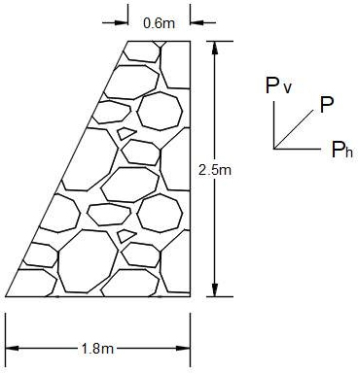
Total pressure(P) = 0.5* k_{a}* γ_{soil}* H²
=0.489×20×2.5²)
=30.56KN/m
Horizontal Components of pressure
Ph=Pa*cos 25
=30.56×cos 25.64
=27.55KN/m
Vertical component,
Pv =Pa*sin 25.64°
=30.56×sin 25.64°
=13.22KN/m

Slide 23
Computation of Forces and Moments
Sn | Description | Forces(Kn/M) |  | Lever Arm | Moments About Toe (KnM/M)
 |  | Vertical | Horizontal |  | Clockwise | Anticlockwise
1 | W1=0.6×2.5×24 | 36 |  | 1.5 | 54
2 | W2=0.5×1.2×2.5×24 | 36 |  | 0.8 | 28.8
3 | 𝑃_{𝑣} | 13.22 |  | 0.8 | 10.576
4 | P_{h} |  | 27.55 | 0.833 |  | 22.94
 | ∑ | 85.22 | 27.55 |  | 93.376 | 22.94
FOS against sliding
= Resisting force/sliding force = µ*R_{V}/R_{H}
=0.6*(85.22/27.55)
=1.8>1.5 (safe)
FOS against overturning
= Resisting moment/overturning moment
= 93.37/22.94
=4.4>2 (safe)

Slide 24
Traffic Volume Study
Type of vehicle | No. of vehicle per hour(a) | No. of projected vehicle per day(a*10) | Equivalency factor | PCU
Motorcycle | 90 | 900 | 0.5 | 450
Bus | 5 | 50 | 3 | 150
Car | 8 | 80 | 1 | 80
Truck (Mini) | 4 | 40 | 1.5 | 60
Van | 3 | 30 | 1 | 30
Total |  | 1100 |  | 770

Slide 25
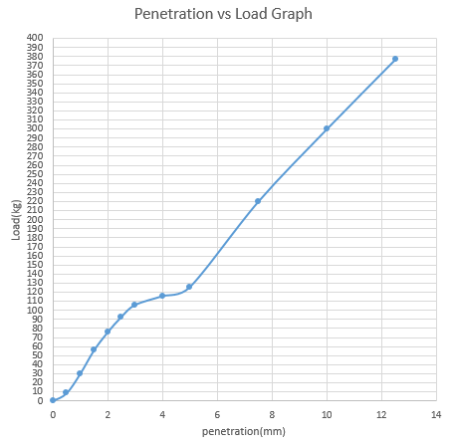
CBR Test
CBR test is done in Laboratory and penetration and their respectively loads obtained.
CBRat2.5mm = Load at 2.5mm penetration/standard load
= 92.82/1370*100%
= 6.77%
CBRat5mm = Load at 2.5mm penetration/standard load
=125.8/2055*100%
= 6.22%

Slide 26
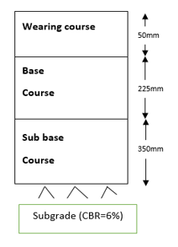
Pavement design
Subgrade CBR obtained from lab = 6.77%
So, Adopting, subgrade CBR as 6%.
PCU = 770 PCU
n =10 years
Traffic growth rate = 8%
N =365*((1+r)^{n}-1)/r)*VDF*LDF
=365*770((1+0.08)¹⁰-1)/r)*1.5*1
=6.10*10⁶ esal
Here, Traffic class is T6 and subgrade strength class is S3.
From chart,
Thickness of surface course = 50 mm
Thickness of base course = 225 mm
Thickness of sub-base course = 350 mm

Slide 27
Design of Road on “Smart Road” Software
DTM Import 3D points
Triangulation
Draw Boundary
Calculate contour lines
Data Input Design Parameters
Draw plan, profile and cross-section

Slide 28
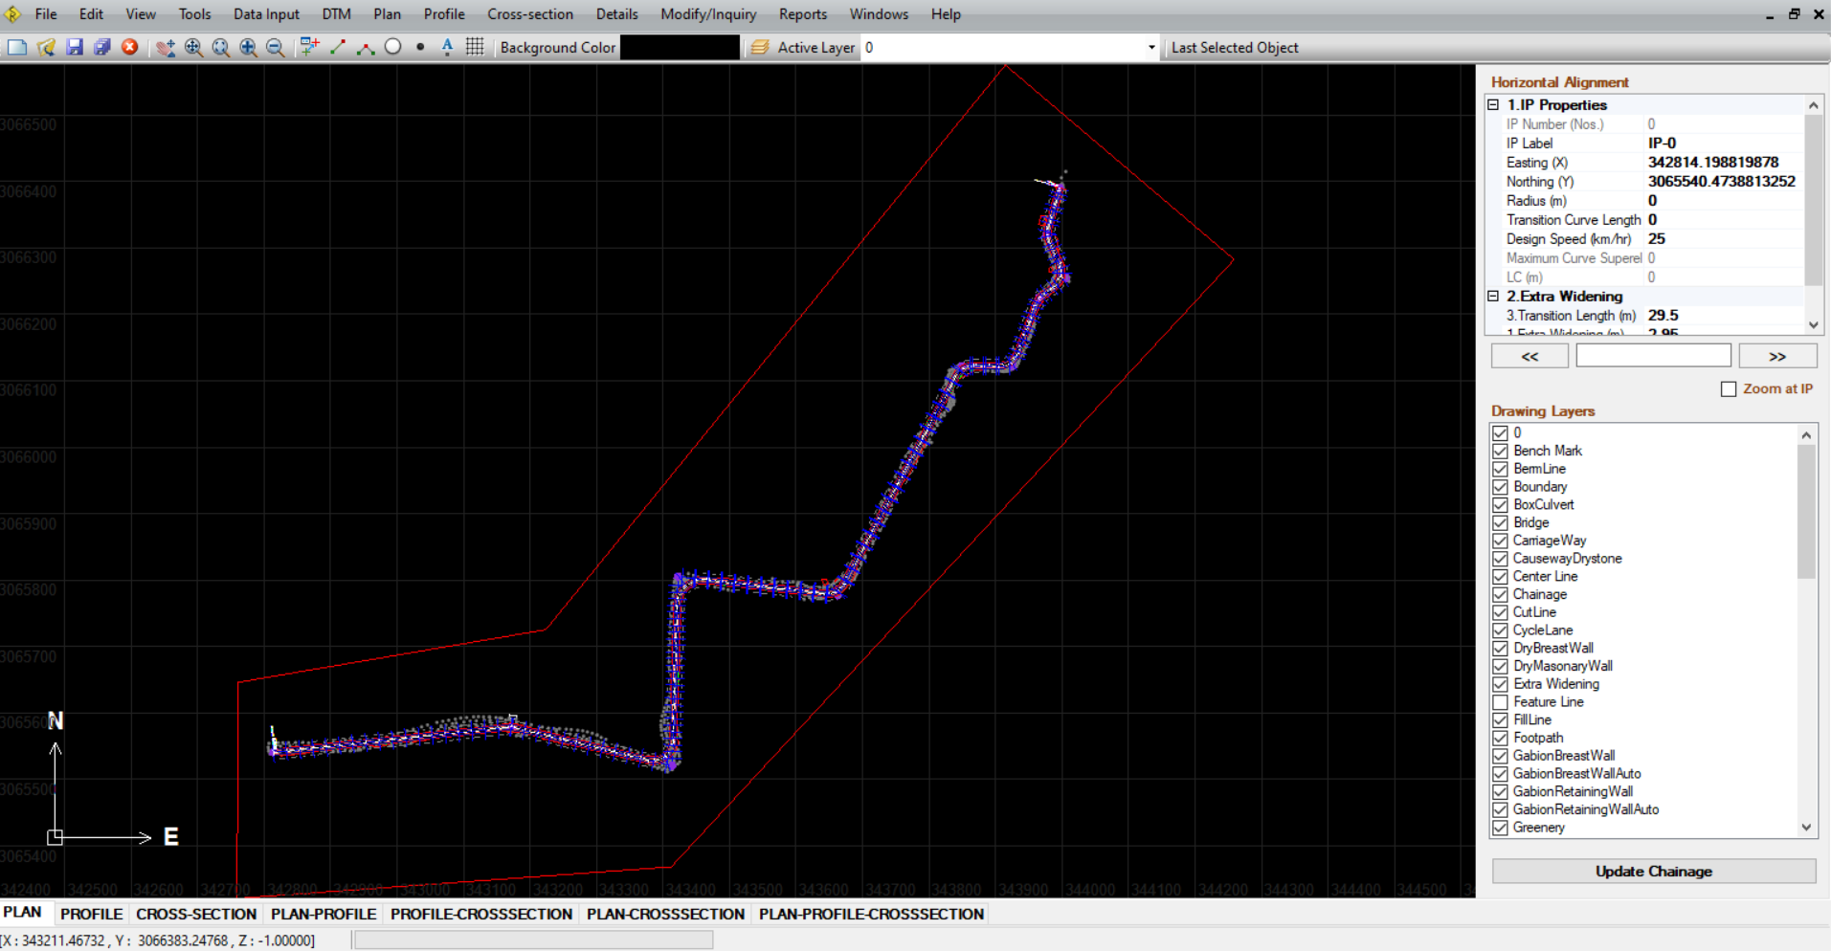
Plan

Slide 29
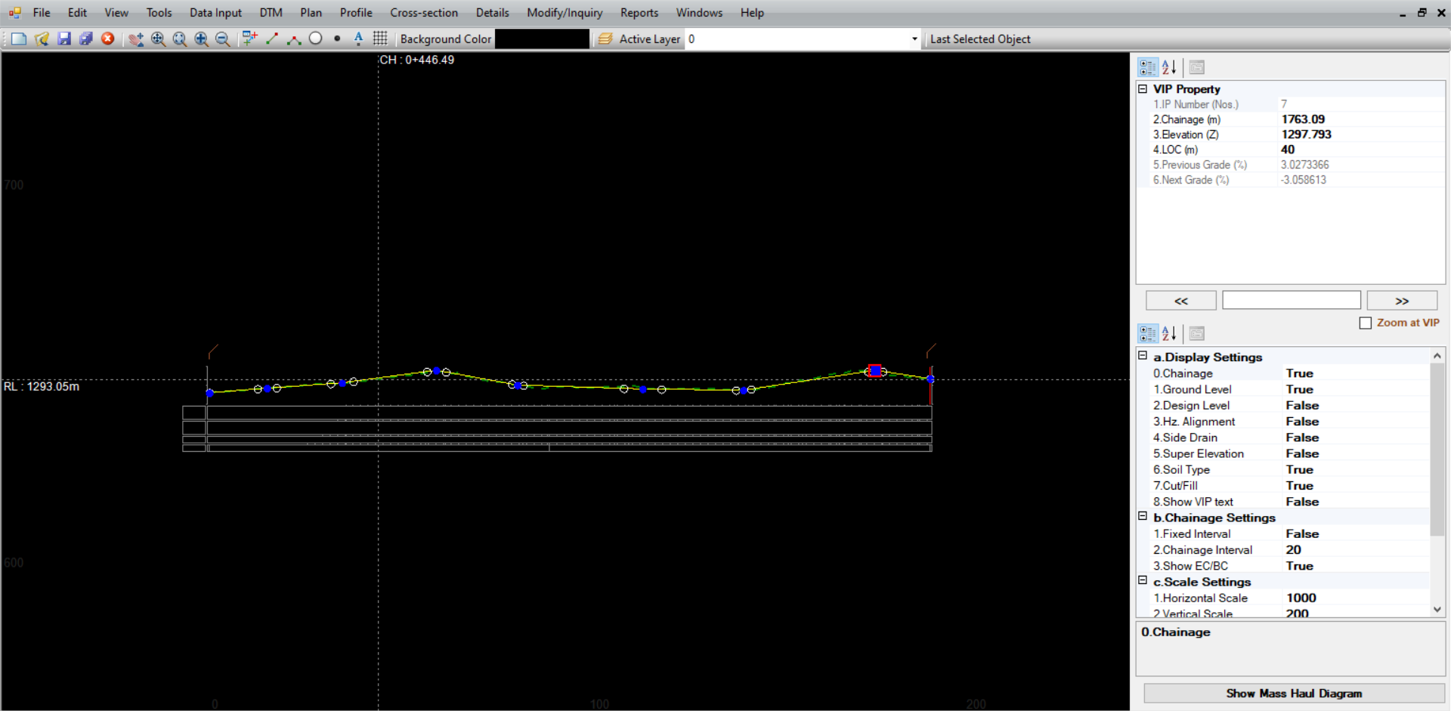
Profile

Slide 30
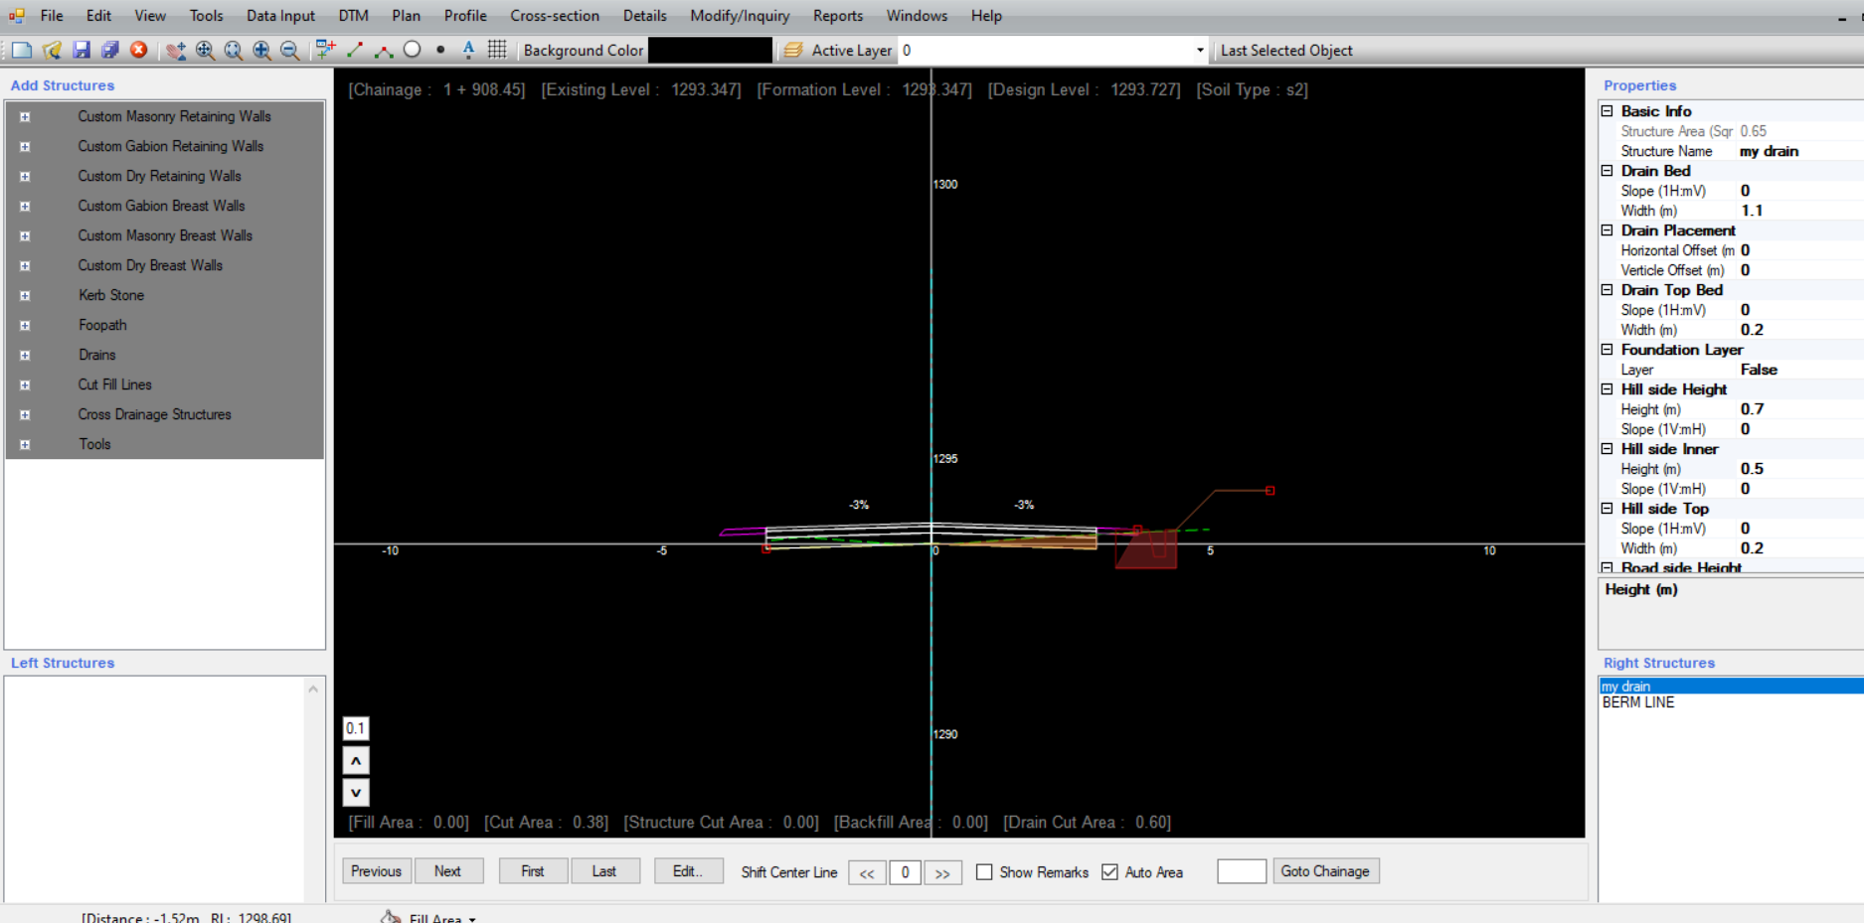
Sample Cross section

Slide 31
Quantity Estimate
Based on the cross-section designs at 20 m interval.
Quantity estimate regarding earthwork, drain, pavement, retaining structures, etc.

Slide 32
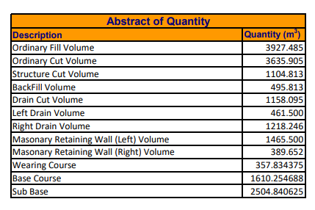

Slide 33
Cost Estimation
Determination of rate per unit of a particular item of work.
Based on DoR’s norms and District rate of Bhaktapur ( fiscal year 2076/77).
Computation of calculation of the quantities required and expenditure likely to be incurred.
Pre calculates the cost of the work.

Slide 34
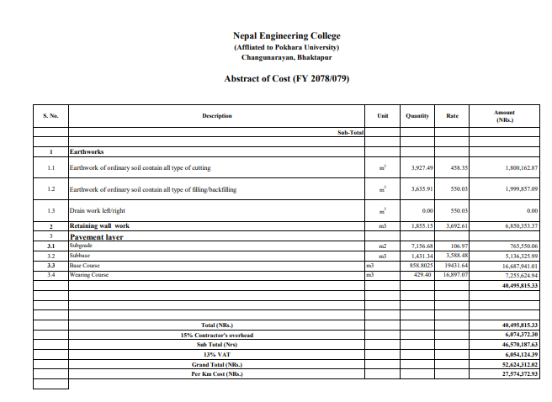

Slide 35
Result & Conclusion
Topographic map was prepared after detailed engineering survey.
Profile and cross section of alignment was prepared with the help of smart road
The total volume of cutting and filling are 3635.905 m³ and 3927.485 m³.
The total cost of the project having a length of 1+908 Km is estimated to be NRs. 526,24,312.02. The total cost per Km is NRs. 2,7574372.93.

Slide 36
Recommendations
Adequate compensation arrangements are to be provided
Relocation of the settlement which lies within the right of way
Provide proper market to local people to uplift their living standard

Slide 37
Thank You !!!!

