Slide 1




WELCOME TO OUR
PRESENTATION
MHP HUB
TION

Slide 2


Foodie

Slide 3
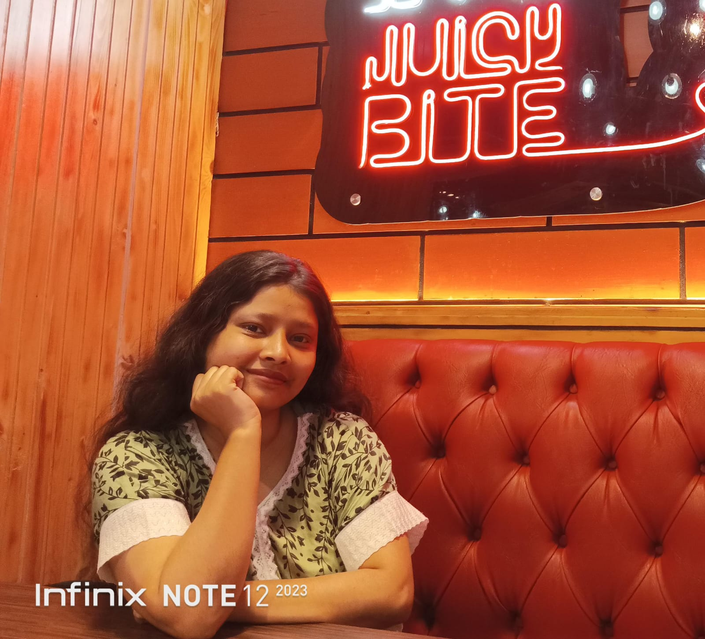
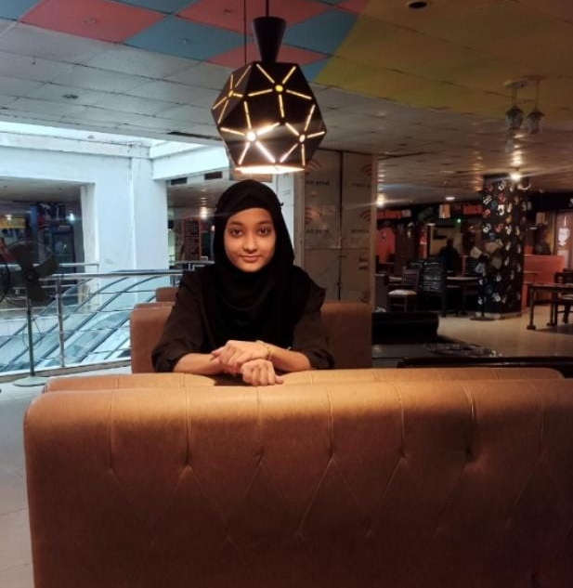
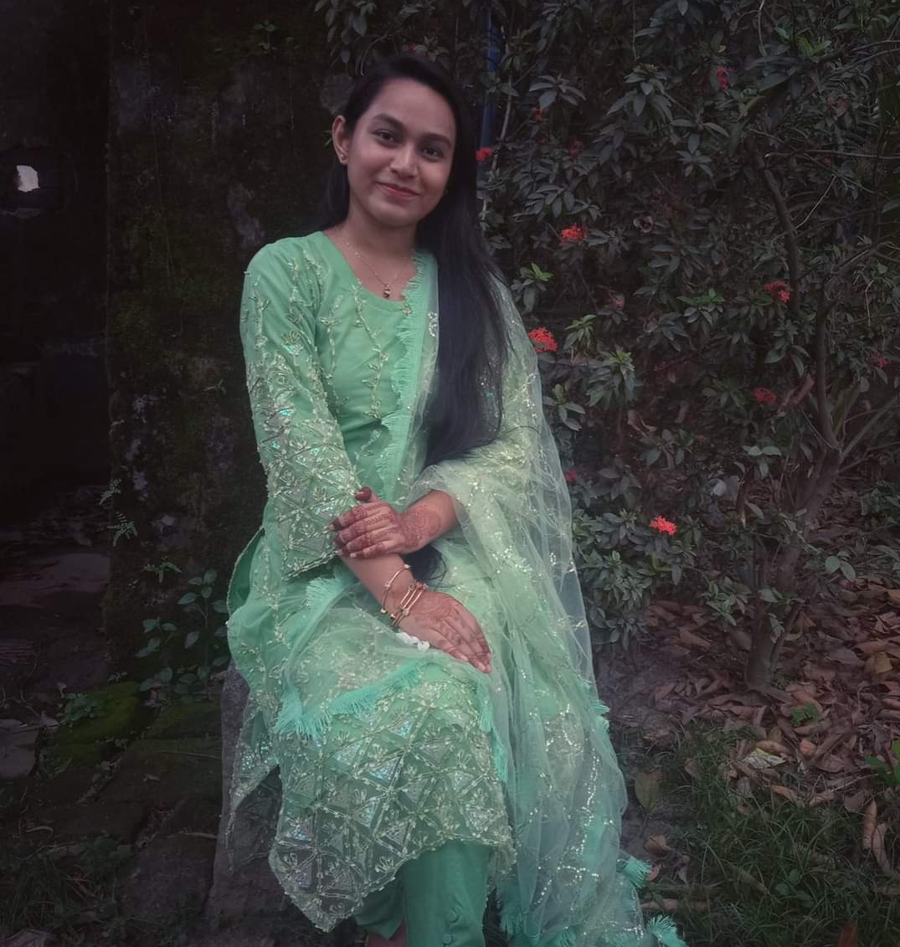
Presented By-
Font an Engineer
Puja Mazumder
Team Leader
Hammy Haricha Himu
Back an Engineer
Jannatul Mawa

Slide 4
INTRODUCTION
Do you want to enjoy great tasting family meals at home but have no time to cook or unable to cook because of an illness, injury or new baby ? Then "Foodie" is here to help you. We have experienced cook for affordable meal and dining experiences in your home. We cater to your needs as per your schedule. We are providing so many services related on Chef and Cooking.
...

Slide 5
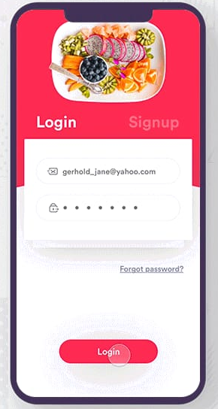

How it works
Log in or signup
Personalize your request
Receive menu proposals
The Minimum Chef cleans up after and leaves discreetly
The Chef cooks in your kitchen and serves the meal to your guests.

Slide 6
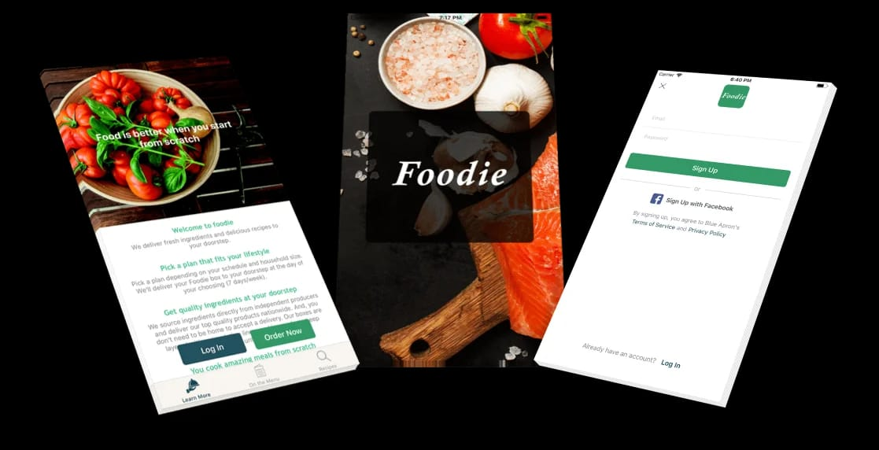

Services That We Offered
• Weekly, bimonthly, and monthly
meal packages
• Weekly meals that fit your
dietary and nutritional needs
• Food and beverage pairing events
• Vacation home cooking
• Private cooking classes for individuals, couples, and groups
• Dinner parties for 2 to 100+ people
• Live Cooking Demonstrations.

Slide 7
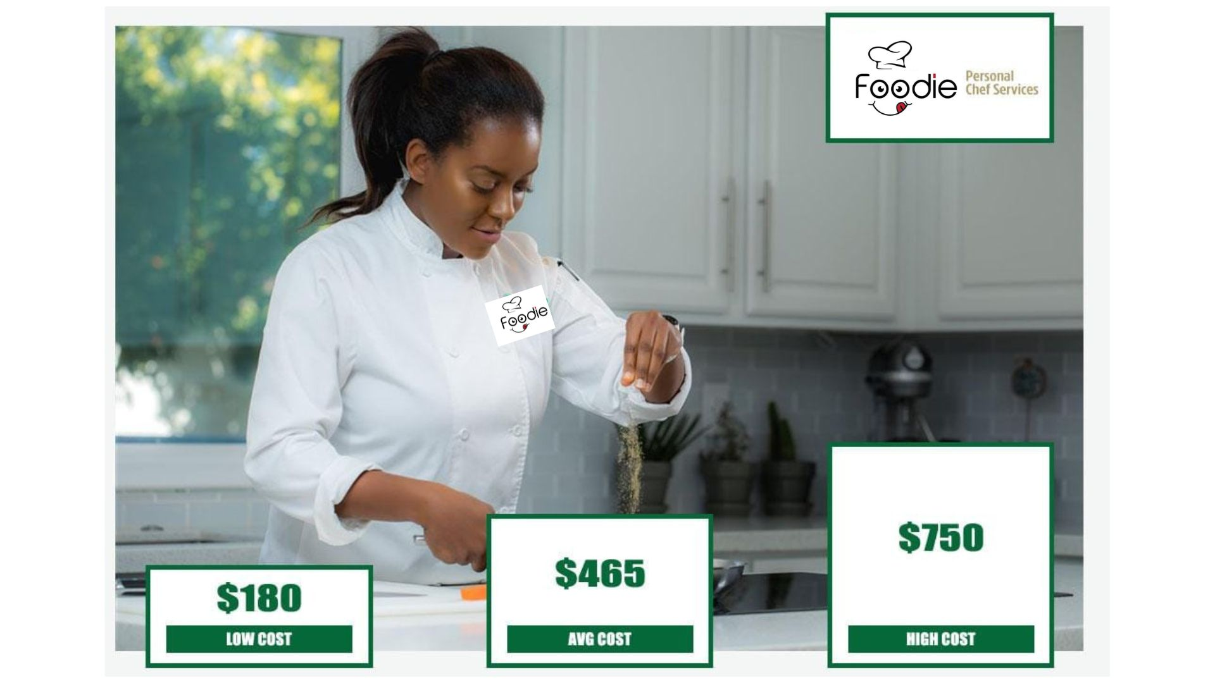
Cost Of a Personal Chef
The cost of hiring a private chef in Chittagong
can very based on several factors, including the
number of people in our group or seasonality.
Larger groups tend to have a different
average rate per person compared to
smaller groups that hire a chef:
Booking prices range from 20,000+tk.
For 10-20 people:17,000+tk
For 30-40 people:35,000+tk
For 50 to more people:65,000+tk
If we want to get free quotes, just fill out our form and receive tailored
proposals for the event.

Slide 8
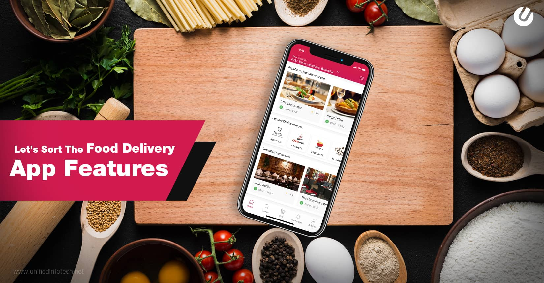
Feature
Check the freshness of food and ingredients.
Supervise and coordinate activities of cooks and other food preparation workers.
Develop recipes and determine how to present dishes.
Plan menus and ensure the quality of meals.
Inspect supplies, equipment, and work areas for cleanliness and functionality.

Slide 9
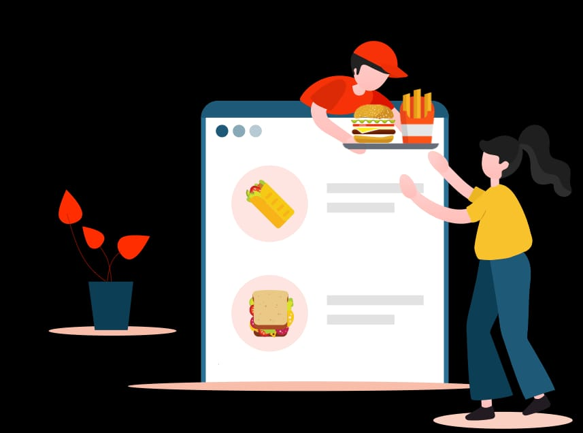
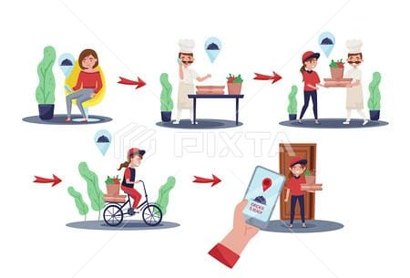

Long and irregular working hours.
Home kitchens are less equipped than commercial kitchens
Work can be inconsistent
Time commitment.
Problem

Slide 10
THANK YOU

