Slide 1
MARKETPLACE FOR NORTHWEST
Dr. Chandra Mouli KOTTETI – Client/mentor
Kiran Kumar Gundapuneni – Backend developer
Sajida Mohammad – Front-end developer
Hari Kiran Aluri – Team lead/ Backend developer
Usha Pati – Tester/QA

Slide 2





Team Members
KIRAN GUNDAPUNENI
SAJIDA MOHAMMAD
DR.CHANDRA MOULI
KOTTETI
HARI KIRAN ALURI
USHA PATI

Slide 3

Table of Contents
Introduction
Deployment Cycle
EC2 Deployment
Caching Mechanism
First Level Cache
Second level Cache
Spring Boot
send email notifications,
Amazon SNS
Lessons Learnt
Kiran Gundapuneni

Slide 4
Introduction
In this phase we are planning to deploy our application on the cloud using AWS Service on EC2 Instance
We are setting up the infrastructure and deploying the backend and front end in two phases
For backend we are planning to deploy it as Jar files
Kiran Gundapuneni

Slide 5
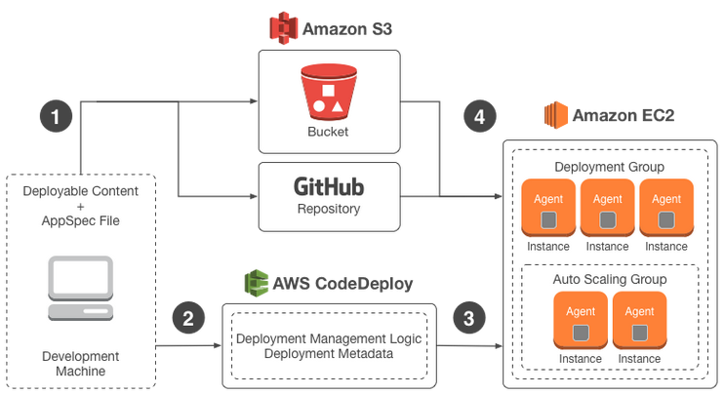
Deployment cycle
In this stage we can see the flow of the application if it is deployed from development machine to AWS Instance
Fig 1.1.Deployment life cycle
Kiran Gundapuneni

Slide 6
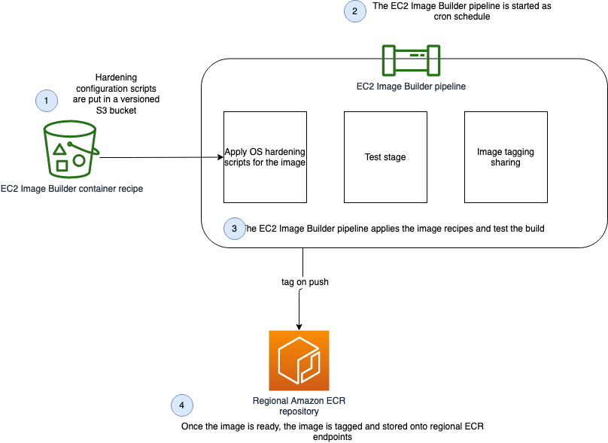
Docker
Fig 1.2.Docker workflow
Kiran Gundapuneni

Slide 7
Caching in Hibernate
First level Cache – Also known as Session Cache which is enabled by default
Second Level Cache – Optional Cache which is shared across multiple sessions and additional configuration is required to enable it
Sajida Mohammad

Slide 8
Enable Second level cache
Add a dependency in pom.xml file called eh-cache
Add a property use_second_level_cache = true, in configuration file
Add a property region.factory.class = ehcache to let hibernate know that second level cache is handled
Provide @Cacheable annotation to the Java object and the strategy
Sajida Mohammad

Slide 9
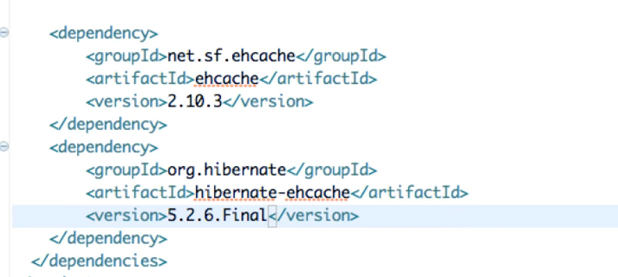
Dependency in pom.xml
Fig 2.1. Dependency in pom.xml file
Sajida Mohammad

Slide 10
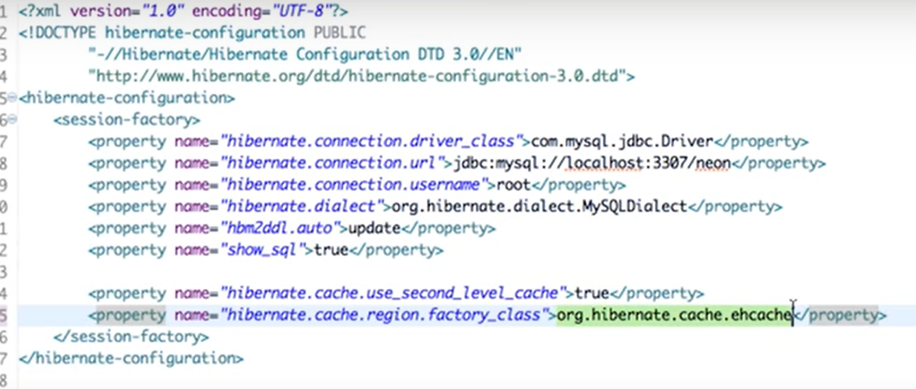
Configuration file
Fig 2.2. Hibernate Configuration file
Sajida Mohammad

Slide 11
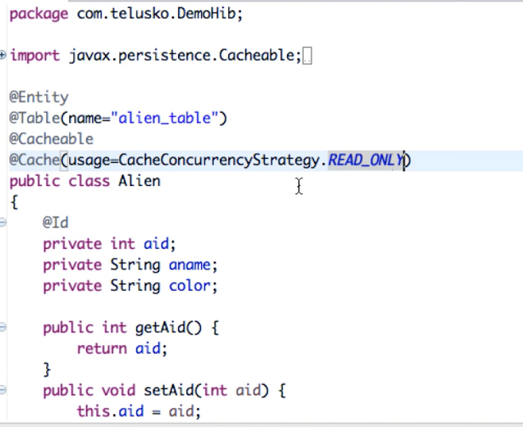
Java class
Fig 2.3.Java Class
Sajida Mohammad

Slide 12

Advantages of Caching
Reduced Database Access
Faster Response Time
Improved Scalability
Reduced Costs
Sajida Mohammad

Slide 13




Introduction to Spring Boot and Email Notifications
Spring Boot is a popular framework for building Java applications so you can focus on writing business logic instead of boilerplate code.
Spring Boot also has a rich set of features, including support for email notifications.
Email notifications are an essential part of many applications, providing a way to communicate with users and keep them informed about important events
In this presentation, we will explore how to set up a Spring Boot project with email capabilities, configure email properties, and send emails using the Java Mail API.
Hari Kiran Aluri

Slide 14
Three approaches for sending Emails in Spring Boot
Using JavaMailSender:The JavaMailSender interface is provided by Spring Boot and allows you to send emails using the Java Mail API.
1
Using Spring Boot's email starter:Spring Boot's email starter is a pre-configured implementation of the JavaMailSender interface.
2
Using third-party email services:You can use third-party email services such as SendGrid, Amazon SES, or Mail gun to send emails.
3
Hari Kiran Aluri

Slide 15
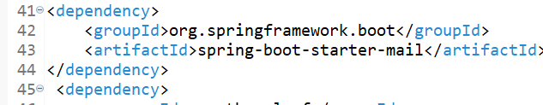
POM.XML File Dependency
Fig 3.1. show Spring boot Started mail dependency
Hari Kiran Aluri

Slide 16
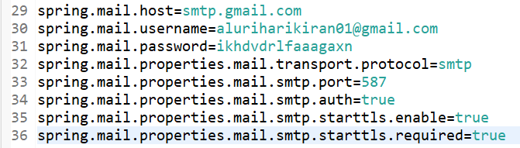
Configuring email properties in Spring Boot
Fig 3.2.Show Application. Properties Files
Hari Kiran Aluri

Slide 17
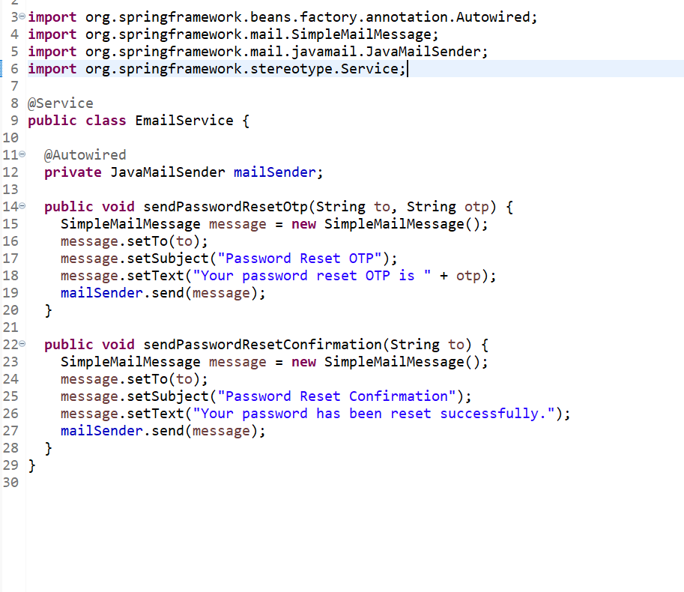
Sending Emails in Spring Boot
Fig 3.3.Show the method which sends the OTP
Hari Kiran Aluri

Slide 18
Amazon SNS
Simple Notification Service (AWS SNS) is a web service that automates the process of sending notifications to the subscribers attached to it
SNS provides this service to both application-to-person and application-to-application. It uses the publishers/subscribers paradigm for the push and delivery of messages
Amazon SNS has no upfront costs and you can pay as you go. With Amazon SNS, you can also mark your SMS messages as Transactional or Promotional based on the use-case and content of your messages
Usha Pati

Slide 19
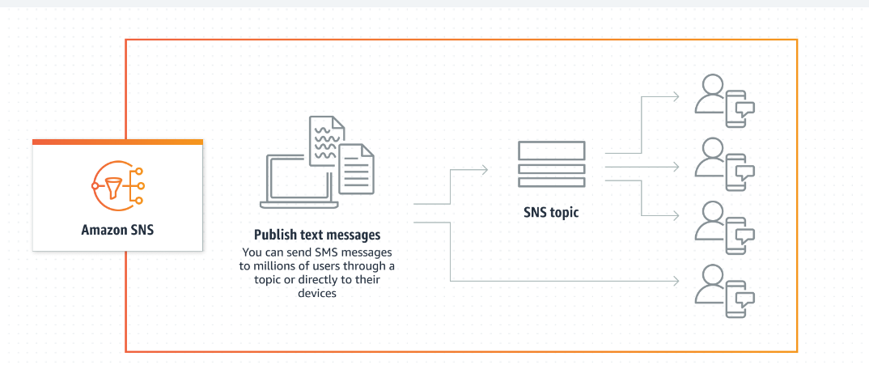
Working of Amazon SNS
Fig 4.1. Working of Amazon SNS
Usha Pati

Slide 20
Benefits of using SNS
SNS increases Durability
SNS increases Security
SNS ensures accuracy
SNS reduces and simplifies the cost
SNS supports SMS in over 200 countries
Usha Pati

Slide 21
Lessons Learnt
Sending SMS using Amazon Simple Notification Service
Unable to create EC2 instance because of unauthorized usage on AWS account
Set up the cleanup process by reaching the AWS support
Unable to receive OTP on user accounts due to Google Security configurations on the Gmail
Enabled two-step verification and generated app password
Usha Pati

Slide 22
Summary
Develop a Web Application- Marketplace for Northwest Missouri a application to buy and sell used products
Used Vue, Spring boot ,AWS technologies for Application Development
Deploying the application in Amazon EC2
Used Amazon SNS in order to establish the communication between
buyer and seller
Usha Pati

Slide 23
References
GitHub link : https://github.com/harichowdary-aluri/gdp_1-project
Amazon SNS creation guide : https://docs.aws.amazon.com/sns/latest/dg/welcome.html
Hibernate Caching: https://www.tutorialspoint.com/hibernate/hibernate_caching.html
Amazon EC2 Guide: https://docs.aws.amazon.com/AWSEC2/latest/WindowsGuide/concepts.html
Usha Pati

Slide 24

THANK YOU

Slide 25


Slide 26
Team Members
KIRAN GUNDAPUNENI
SAJIDA MOHAMMAD
DR.CHANDRA MOULI
KOTTETI
HARI KIRAN ALURI
USHA PATI

Slide 27
MARKETPLACE FOR NORTHWEST
Dr. Chandra Mouli KOTTETI – Client/mentor
Kiran Kumar Gundapuneni – Backend developer
Sajida Mohammad – Front-end developer
Hari Kiran Aluri – Team lead/ Backend developer
Usha Pati – Tester/QA

