Slide 1
Bigdata Systems
FISAT
Haridas Narayanaswamy
https://haridas.in
19/Feb/2019

Slide 2
About me
9+ Years of experience.
Mainly into Web application development, Machine Learning and Devops.
Last few years focusing mainly in bigdata and Deep learning problems.
https://haridas.in
@haridas_n

Slide 3
Agenda
Introduction to the big-data problems
How we can scale
Hadoop introduction
Setup a Hadoop cluster

Slide 4
Main components of a Computer
???
Notes:
What’s the size of biggest single node that we can have ?
Distributed systems are way to go

Slide 5
IO bound vs CPU bound problems
Downloading a file
Bitcoin mining ( proof of work )
Watching a movie
Notes:
IO bound includes reading from memory or disk

Slide 6

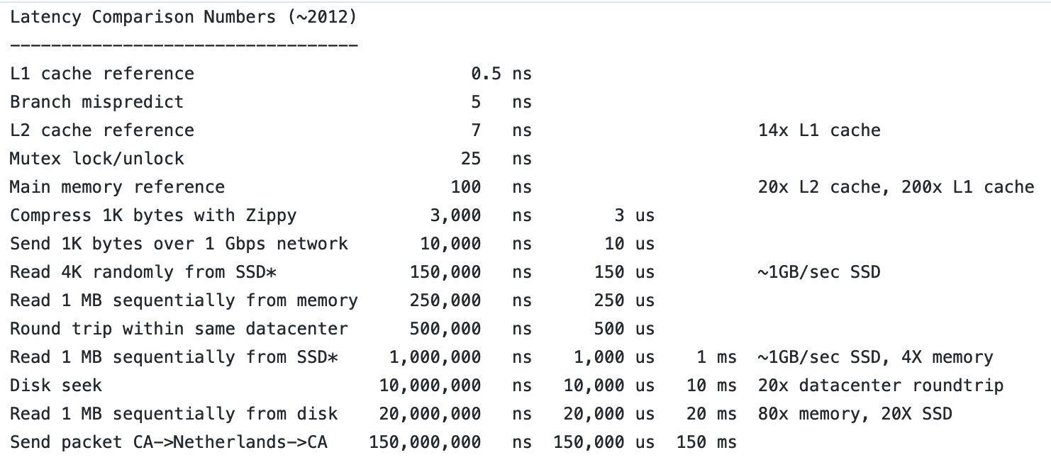
Latency Numbers
Copy a movie to USB !
Sorting a number on RAM

Slide 7
Application Architectures
Online
Standalone
Distributed

Slide 8
Monolithic
All on single machine
Every application starts here
Notes:
No backups
If something fails we lose data
A black box

Slide 9
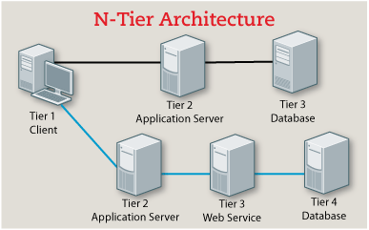
N-tier systems
Multiple services in your application
Separation of concerns
Master-slave database systems
Load balancer
Caching layer
Pretty good for standard application workloads.
Notes:
Small to mid scale companies can make use of it.
Startups
Those who don’t generate too much data, can stick to it..
Mainly social media sites generates huge volume of contents.

Slide 10
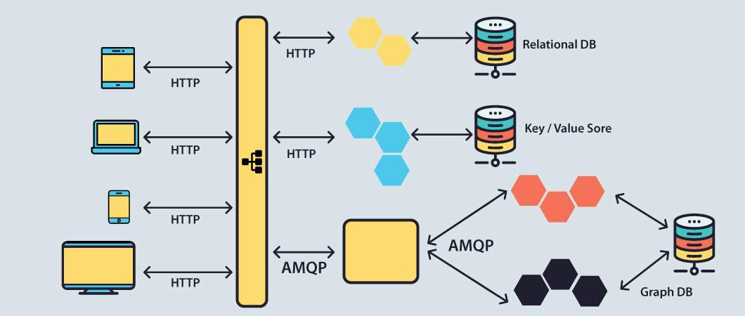
SOA and Micro services
Service Oriented Architecture
Each service will do only one task – fine grained separation, hence named as micro-services
API Gateways
Messaging Systems
Scalable Databases accessible to micro services
Caching services
Etc.
Notes:
SOA and micro-services are some time compared differently, as SOA is not that granular level compared to micro-services.
Monolithic architecture is the starting point for all of theses.

Slide 11
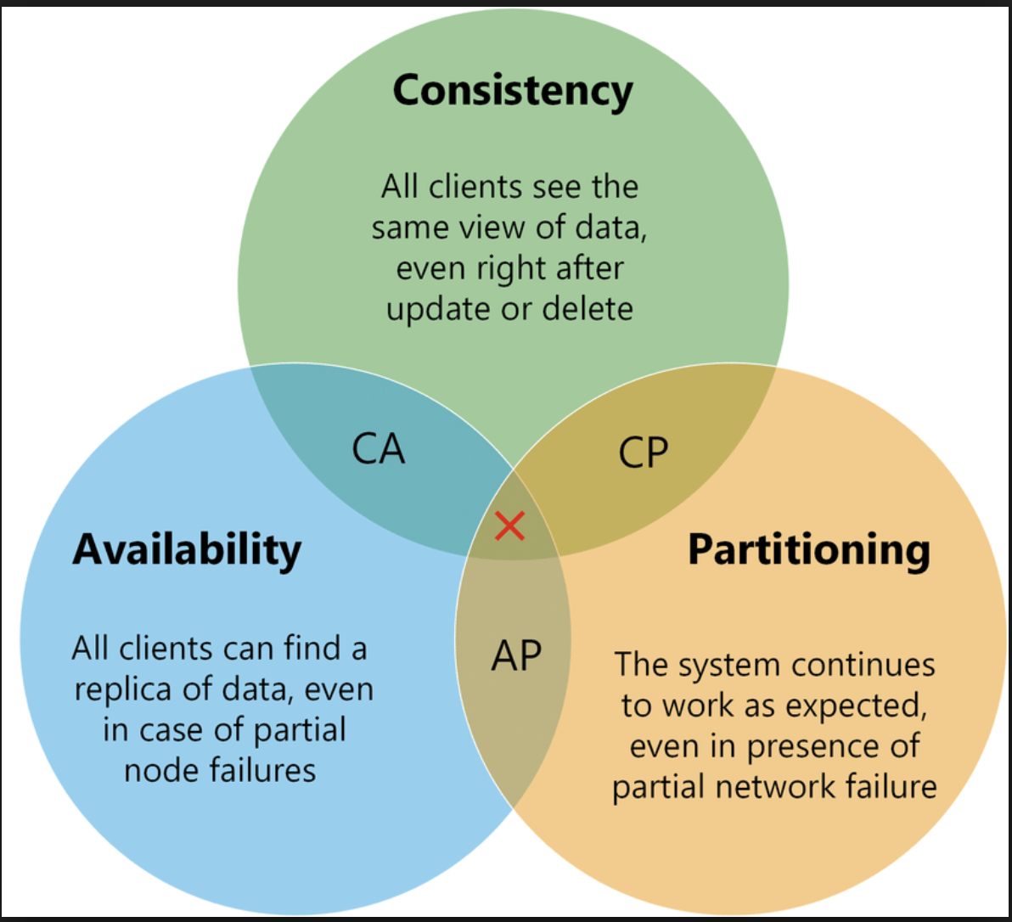
CAP Theorem
Consistency
Availability
Partition tolerance
Eventual Consistent systems
Split brain problem
Notes:
Database – strongly consistent

Slide 12
Bigdata platforms
Where they fit in ?
Offline vs Online systems
Notes:
After seeing these architectures, where is this bigdata problem ?
Stream of data generated by online systems
Data warehouse

Slide 13
Count number of unique hits from India
Consider this scenario for Facebook
Daily total log file comes is in Peta bytes
One machine can’t save it
Other scenarios
User click tracking
Tracking effectiveness of an Ad
Notes:
Huge data at storage side, compute is sitting at different location.
RDBMS database systems aren’t good fit for unstructured data.
How we can speed up processing ?

Slide 14
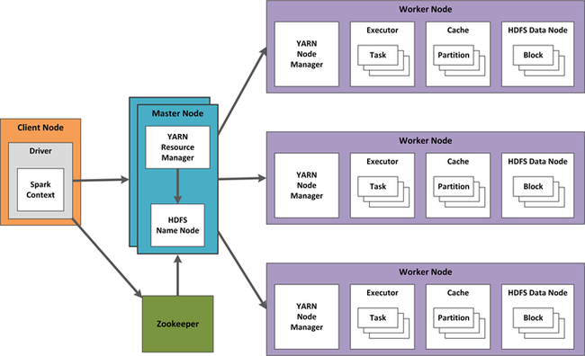
Hadoop
Every node can store the data - HDFS
Every node can do processing using its data locally. Aka data locality is guaranteed. (YARN)
Easily scalable
Redundant and fault tolerant
Main Components
Name Node
Data Node
Resource Manager
Node Manager

Slide 15
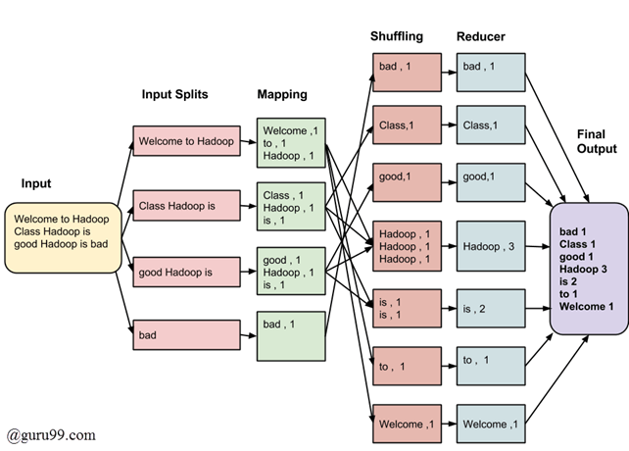
Map-Reduce compute model
Main stages of map-reduce
Dynamic programming ?
Bring code to data location
Data locality
How we can use map-reduce to count unique hits from a region ?

Slide 16
Hybrid environments
Storage on cloud storages s3/azure storage
Execution engine on our cloud or Kubernetes.

Slide 17
Workshop

Slide 18
We are hiring Talents
Send your Resume to haridas.n@imagina.com
pramati.com
imaginea.com

Slide 19
Thank you
Haridas N <hn@haridas.in>

