Slide 1
SECURE DATA HIDING IN IMAGES USING STEGANOGRAPHY
CAPSTONE PROJECT
Presented By: Hari Devadharshini
Student Name : Hari Devadharshini
College Name & Department : Vel Tech High Tech dr.Rangarajan dr.Sakunthala Engineering college

Slide 2
OUTLINE
Problem Statement
Technology used
Wow factor
End users
Result
Conclusion
Git-hub Link
Future scope

Slide 3
PROBLEM STATEMENT
The project aims to develop a secure steganography system that hides encrypted messages in images using AES encryption and LSB steganography. This ensures that even if the hidden data is extracted, it remains unreadable without the correct decryption key. The system will include a user-friendly GUI for easy encoding and decoding. It provides a confidential communication method by integrating cryptography and image processing to protect sensitive information.

Slide 4
TECHNOLOGY USED
Programming Language:
Python
Libraries & Frameworks:
Pillow → For image processing (steganography using LSB)
PyCryptodome → For AES encryption and decryption
Tkinter → For GUI development
Base64 → For encoding encrypted messages
Platforms Used:
Windows
IDLE Python

Slide 5
WOW FACTORS
Dual-Layer Security – AES encryption + LSB steganography for extra protection.
User-Friendly GUI – No coding required, simple encryption & decryption.
Password-Protected Decryption – Ensures only authorized access.
Minimal Image Distortion – Hidden data does not affect image quality.
Fast & Efficient – Optimized for quick processing.
Cross-Platform – Works on Windows, Linux, and macOS.
Real-World Applications – Secure messaging, watermarking, forensics.

Slide 6
END USERS
Cybersecurity Professionals – Secure data transmission & covert communication.
Journalists & Activists – Hide sensitive information from surveillance.
Forensic Investigators – Extract hidden data for digital investigations.
Government & Military – Secure confidential communications.
Intellectual Property Owners – Watermarking & copyright protection.
General Users – Private messaging without detection.
This project benefits anyone needing secure, hidden communication in digital images.

Slide 7
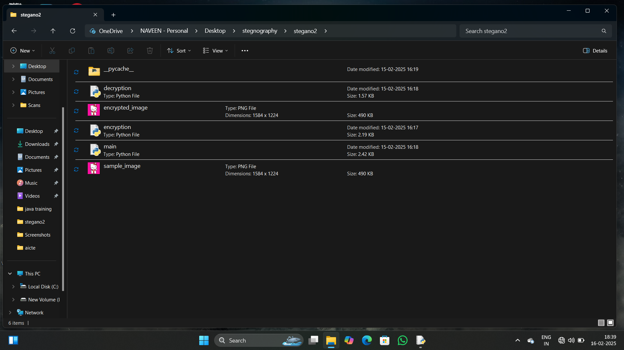
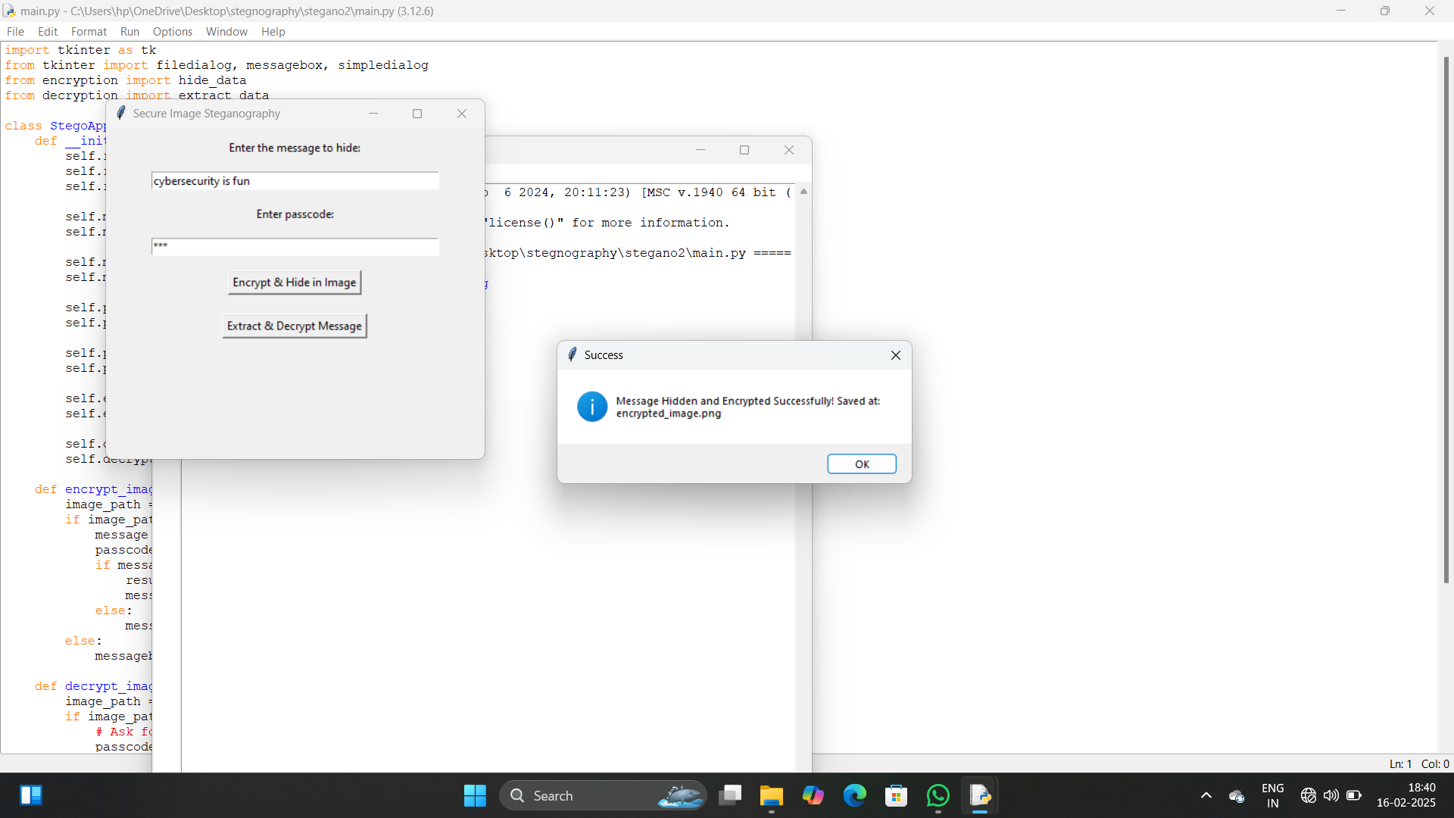
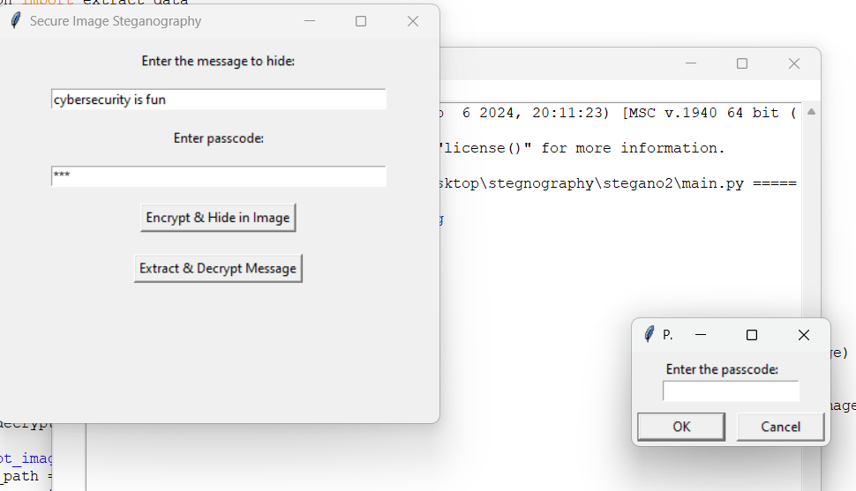
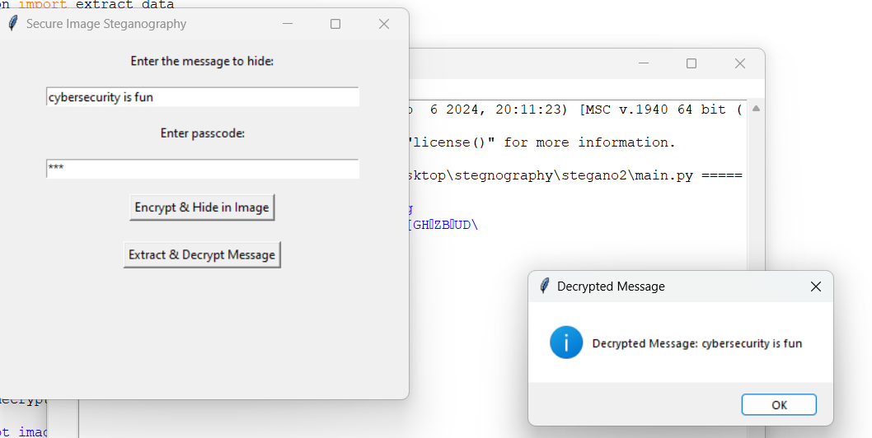
RESULTS

Slide 8
CONCLUSION
This project successfully addresses the challenge of secure data transmission by integrating AES encryption with LSB steganography. By encrypting messages before embedding them in images, it ensures that even if extracted, the data remains unreadable without the correct key. The user-friendly GUI enhances accessibility, allowing anyone to securely hide and retrieve messages without technical expertise.
With applications in cybersecurity, forensics, secure messaging, and intellectual property protection, this project provides a practical, efficient, and secure method for confidential communication.

Slide 9
GITHUB LINK
https://github.com/haridevadharshini/steganography

Slide 10
FUTURE SCOPE(OPTIONAL)
1. Support for Multiple File Types – Extend steganography to hide data in audio, video, and PDF files.
2. Advanced Encryption Techniques – Implement stronger encryption methods like RSA or hybrid encryption for enhanced security.
3. AI-Based Steganalysis Prevention – Improve security against AI-powered detection techniques.
4. Cloud Integration – Enable secure online storage and retrieval of hidden messages.
5. Mobile App Development – Develop an Android/iOS app for easy access on mobile devices.
6. Multi-Layer Steganography – Embed data across multiple images for increased protection.
7. Blockchain for Verification – Use blockchain technology to verify message authenticity and prevent tampering.

Slide 11
THANK YOU

