Slide 1
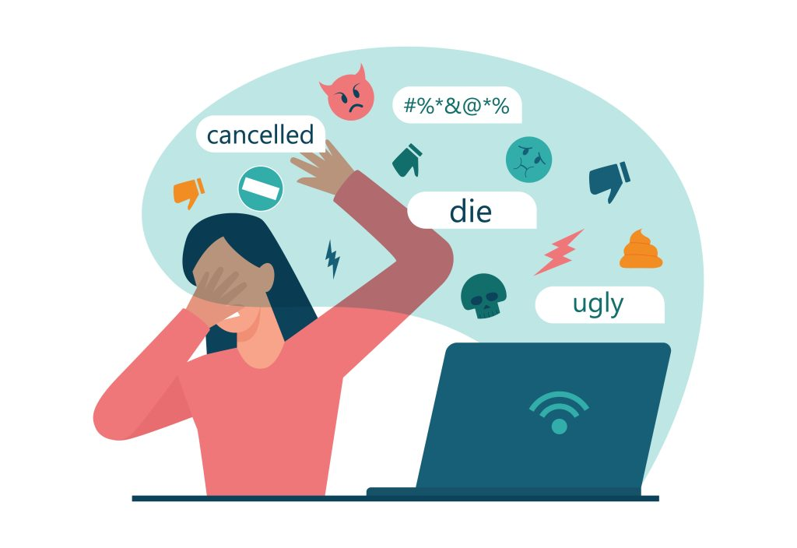


“Design and Development of Improved Cyberbullying Detection Model”
By: Dhyey Parekh, Shubham Kotak, Pooja Modi, Mehul Parmar (Group 6)
Date: 12/12/2023
AI_680CS_666_001_BK_FALL2023

Slide 2

Role division
Dhyey Parekh : Research and project formatting
Shubham Kotak: Research and data collection
Mehul Parmar: Coding and algorithms
Pooja Modi: Review and Analysis

Slide 3
Outlines
Introduction
Application
Literature review
Literature review results
Algorithms/Approach
Understanding the functions
Obtained Results
Conclusion and Future work
References

Slide 4
INTRODUCTION
People nowadays are largely dependent on Internet. Children and teenagers are accessing the internet in greater numbers As a result, cyberbullying has become a significant cause of worry.
Along with the positive uses of social media, certain harmful effects are observed like Cyberbullying which is a conscious and repeated act of causing harm or humiliation to another person on Social Media.
Some users are using social media platforms to upload distorted data and images, to write insulting comments about others.
Cyberbullying has been shown to have long-term impacts on victims, producing stress and placing them in a permanent state of distress or anxiety, resulting in sleep disorders and hunger problems.

Slide 5
INTRODUCTION
Around 87 percent of today's youth have been victims of cyberbullying.
Combating cyberbullying is a critical issue due to the prevalence of cyberbullying and harassment.
To keep the social media platforms healthy and secure, automated systems for detecting these events have become vital.
Machine learning classier may be used to detect and predict the characteristics of cyberbullying.
Recent research focuses on automatic cyberbullying detection mechanisms that tap into individuals' psychological characteristics.
Moreover, early detection of cyberbullying in social networks is critical for mitigating the impact on victims.

Slide 6
APPLICATION
Social media platforms: Social media platforms such as Facebook, Instagram, and Twitter can use cyberbullying detection models to identify and remove cyberbullying content from their platforms. This can help to protect users from being exposed to cyberbullying and create a more positive and supportive online environment.
Schools and educational institutions: Schools and educational institutions can use cyberbullying detection models to monitor their students' online activity and identify potential instances of cyberbullying. This can help them to intervene early and prevent cyberbullying from escalating.
Workplace: Employers can use cyberbullying detection models to monitor their employees' online activity and identify potential instances of cyberbullying among employees. This can help to create a more positive and productive work environment.
Law enforcement: Law enforcement agencies can use cyberbullying detection models to investigate cyberbullying cases and identify perpetrators. This can help to hold perpetrators accountable for their actions and protect victims from further harm.

Slide 7
ANALYSIS
Accuracy: How accurate is the model at detecting cyberbullying? This can be measured by calculating the model's precision, recall, and F1 score.
Robustness: How well does the model generalize to new data, such as data from different social media platforms or from different cultures? This can be measured by training the model on one dataset and evaluating it on another dataset.
Explainability: Can the model's predictions be explained? This is important so that users can understand why the model is making the predictions that it is making.
Fairness: Is the model fair? This means that the model should not be biased against certain groups of people, such as people of certain races, genders, or sexual orientations. This can be measured by evaluating the model's performance on different subgroups of the population.
Privacy: Does the model protect the privacy of users? This means that the model should not collect or use any sensitive information about users without their consent. This can be assessed by reviewing the model's architecture and implementation.

Slide 8
LITERATURE REVIEW
Sr No. | Paper Title | Publication | Year
1. | Early detection of cyberbullying on social media networks | Future Generation Computer Systems, Elsevier | 2021
****
Objective:
To explore different approaches that take into account the time in the detection of cyberbullying in social networks.
To investigate the early detection of cyberbullying.
Methodology:
A supervised learning method with two different specific early detection models, named threshold and dual is followed.
Two groups of features and two early detection methods, are specifically designed for this problem.

Slide 9
LITERATURE REVIEW
Sr No. | Paper Title | Publication | Year
2. | Exploring the hidden patterns of cyberbullying on social media | Procedia Computer Science, Elsevier | 2020
****
Objective:
Social Network Analysis (SNA) is used to analyze the Twitter network of #Momochallenge
Methodology:
NodeXL, an open source tool managed by a social media research foundation, is used to collect and analyze data.
Three analysis techniques are developed in the proposed system for discovering cyberbullying: network analysis, content analysis, and graph-based network visualization analysis.

Slide 10
LITERATURE REVIEW
Sr No. | Paper Title | Publication | Year
3. | Automatic classification of participant roles in cyberbullying: Can we detect victim,bullies and bystanders in social media text?^{[7]} | Cambridge University Press | 2020
****
Objective:
To automatically detect different participant roles involved in textual cyberbullying, including bullies, victims, and bystanders
Methodology:
Two cyberbullying corpora (a Dutch and English corpus) were taken, both manually annotated with bullying types and participant roles.
A series of multi class classification experiments are performed to determine the cyberbullying participant role detection.

Slide 11
LITERATURE REVIEW RESULTS
Sr. no | Paper Title | Model/Dataset | Finding(s)
01 | Early detection of cyberbullying on social media networks | Supervised Learning methods performed on Public dataset from Vine Social Network. | Evaluation should be done on the basis of time instead of number of post.

Slide 12
LITERATURE REVIEW RESULTS
Sr. no | Paper Title | Model/Dataset | Finding(s)
02 | Exploring the hidden patterns of cyberbullying on social media | NodeXL tool, network analysis, content analysis, and graph-based network visualization analysis performed on Twitter dataset by #momochallenge | Manually annotated dataset for types of cyberbullying and participant role

Slide 13
LITERATURE REVIEW RESULTS
Sr. no | Paper Title | Model/Dataset | Finding(s)
03 | Automatic classification of participant roles in cyberbullying: Can we detect victim,bullies and bystanders in social media text | Fine-grained cyberbullying role detection was examined in a real-world social media corpus for two languages (English and Dutch). | The data utilized for this study had little context, it was often difficult to distinguish between different roles. For example, distinguishing between "harassers" who initiate the bullying and assertive "victims" or aggressive "bystanderdefenders" often required more context.

Slide 14
ALGORITHM/APPROACH
Step 1
Data Collection
Step 2
Data Pre-processing
Step 3
Feature Extraction
Step 4
Model Selection
Step 5
Model Training and Evaluation
Step 6
Model Optimization

Slide 15
UNDERSTANDING THE FUNCTIONS
Data Collection:
Data series includes obtaining a dataset that is a consultant of the hassle you're seeking to solve. In the context of cyberbullying detection, numerous sources of social media posts or feedback need to be amassed.
Using Python libraries like Tweepy permits you to programmatically get entry to data from systems like Twitter or Reddit. Pre-existing datasets from systems like Kaggle can also be used.
Data Preprocessing:
Text cleaning is crucial to put off noise and irrelevant information. This includes getting rid of prevent words, URLs, and unique characters. Tokenization involves breaking down sentences into character words or tokens.
Vectorization transforms the text data into numerical functions that machines gaining knowledge of models can recognize. Techniques like TF-IDF assign weights to phrases primarily based on their importance in the corpus.
Feature Extraction:
TF-IDF (Term Frequency-Inverse Document Frequency) is a numerical statistic that reflects the significance of a word in a report relative to a set of documents. It enables changing textual content into meaningful capabilities.
Extracting functions are ready representing the textual information in a layout that the system getting to know fashions can manner and research from.

Slide 16
UNDERSTANDING THE FUNCTIONS
Model Selection:
Random Forest is an ensemble learning technique that builds more than one choice timber and merges them collectively to get a more accurate and solid prediction.
Hyperparameters: The number of bushes, most intensity of timber, and different parameters may be tuned for most beneficial overall performance.
Naive Bayes is a probabilistic version based totally on Bayes' theorem with an assumption of independence between features.
Multinomial Naive Bayes: Specifically used for text classification tasks with discrete statistics.
Model Training and Evaluation
Splitting the records into education and checking out units guarantees that the version is educated on one subset and evaluated on an impartial subset, trying out its generalization to unseen facts.
Evaluation metrics including accuracy, precision, recall, and F1-score offer insights into the model's performance.
Model Optimization:
Random Forest hyperparameter tuning involves experimenting with distinct settings to locate the configuration that maximizes the model's performance.
Naive Bayes fashions are simpler and can require much less tuning however can nevertheless advantage from optimization, mainly if there are a couple of editions of Naive Bayes to discover.

Slide 17
IDENTIFIED RESEARCH GAP
Many previous research lack the availability of a balanced dataset for cyberbullying, resulting in lower accuracy [2, 3].
There is no distinction between sorts of cyberbullying. It is possible to categorize bystanders and victims.
Many previous research concentrate on algorithms for a specific platform [2, 5, 6].
The suggested model's performance on a certain platform when compared to only one dataset. (For example, by employing other related hash tags) [3].

Slide 18
PROBLEM STATEMENT
With the rapid development of social media users, cyberbullying has emerged as a fertile ground for bullies to target victims. Given the implications of cyberbullying on victims, it is necessary to establish relevant patterns and created models for spotting bullies and their responsibilities.

Slide 19
OBJECTIVES OF THE WORK
To create a model using live data, resulting in increased efficiency.
Calculate the polarity score using Sentiment Analysis.
By categorizing bystander defender, bystander assistance, and neutral, you may see the Bystander impact..

Slide 20
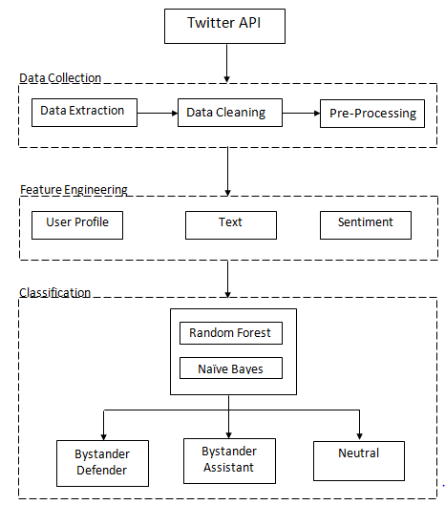
PROPOSED WORKFLOW
Extract the data by Twitter API.
Find the sentiments from Emoji and conversion of data.
Preprocess text by removing links, special characters.
Lemmatization & Removal of words that don't contribute to the sentiment.
Use “vadersentiment” to identify sentiment compound score for classifying tweets.
Applying Naïve Bayes, SVM, Random Forest and Gradient boosting .
Proposed Workflow

Slide 21
IMPLEMENTATION OF PROPOSED WORK
Technologies Used
Programming Language – Python
Model Used – Naïve Bayes, Support vector Machine, Random Forest, Gradient Boosting.
Dataset – Live Data from Twitter API
Operating system – Windows 10/11
Platform – Jupyter notebook
IDE – Python 3.9

Slide 22
IMPLEMENTATION OF PROPOSED WORK
The steps demonstrated in this Implementation are:
Importing libraries
Scraping the data
Feature Extraction
Pre Processing
Sentiment Analysis
Splitting the data
Train and Test the data
Comparing Accuracy

Slide 23
IMPLEMENTATION OF PROPOSED WORK
Algorithm For Feature Extraction
Step 1: Start
Step 2 : Load the Phishing URL Dataset
Step 3: Import URL parse, URL encode, Ip address
Step 4: Feature Extraction Form Phishing Dataset
4.1 Having IP
If the domain part of URL has IP address, the value assigned to this feature is 1 (phishing) or else 0 (legitimate)
4.2 HaveAtSign
If the URL has '@' symbol, the value assigned to this feature is 1 (phishing) or else 0 (legitimate).
4.3 Get length
If the length of URL >= 54 , the value assigned to this feature is 1 (phishing) or else 0 (legitimate).
4.4 Redirection
If the "//" is anywhere in the URL apart from after the protocol, thee value assigned to this feature is 1 (phishing) or else 0 (legitimate
4.5 HttpDomain
If the URL has http/https in the domain part, the value assigned to this feature is 1 (phishing) or else 0 (legitimate).
4.6 Prefix Suffix
If the URL has '-' symbol in the domain part of the URL, the value assigned to this feature is 1 (phishing) or else 0

Slide 24
IMPLEMENTATION OF PROPOSED WORK
Algorithm For Feature Extraction(Conti…)
4.7 Web traffic
If the rank of the domain < 100000, the value of this feature is 1 (phishing) else 0 (legitimate).
4.8 Domain Age
If age of domain > 12 months, the value of this feature is 1 (phishing) else 0 (legitimate).
4.9 URL_Shotening
If the URL is using Shortening Services, the value assigned to this feature is 1 (phishing) or else 0 (legitimate).
4.10 Right Click
If the response is empty or on mouseover is not found then, the value assigned to this feature is 1 (phishing) or else 0 (legitimate).
Step5: Now store this feature in the new data frame
Step6: After creating Dataframe for features train and test the model with this new dataset

Slide 25
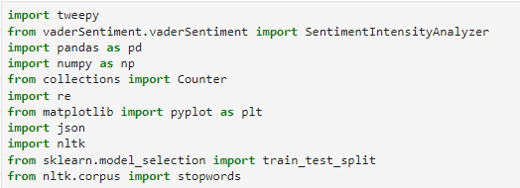
IMPLEMENTATION OF PROPOSED WORK
1. Importing libraries

Slide 26
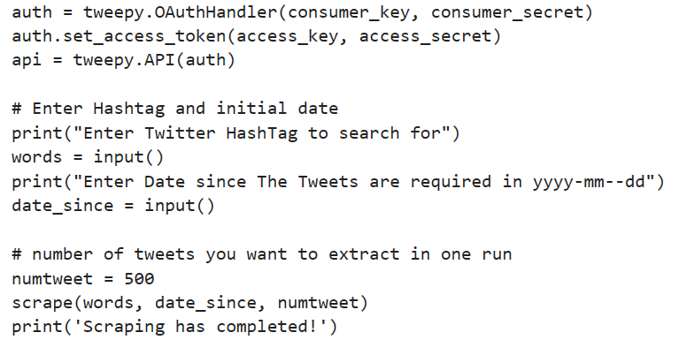
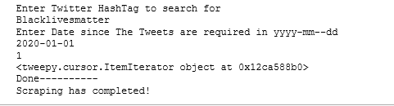
IMPLEMENTATION OF PROPOSED WORK
2. Twitter API Authentication and Scraping of data
Twitter API Authentication
Search by Keyword

Slide 27
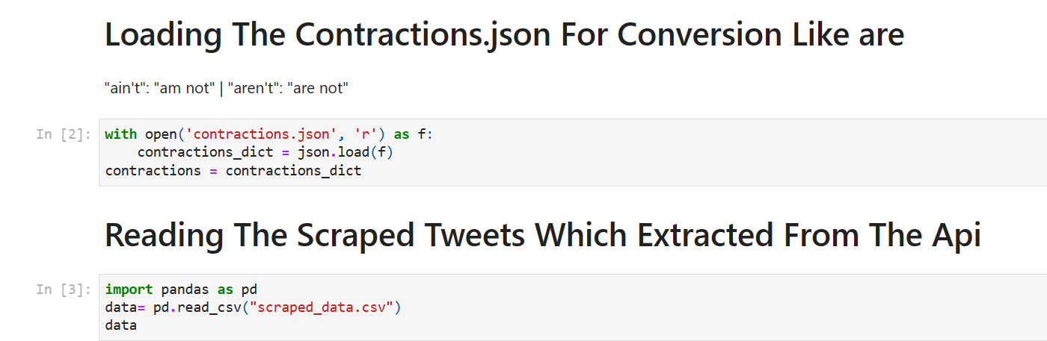
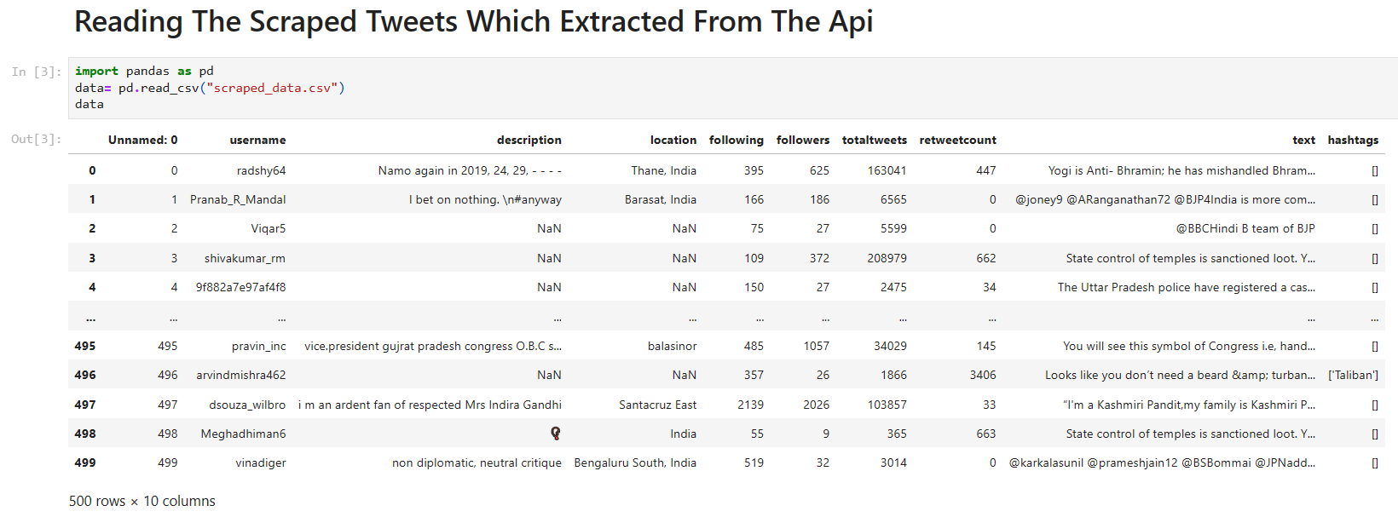
IMPLEMENTATION OF PROPOSED WORK
3. Conversion of words and reading of Scrapped Tweets
Conversion of data
Scrapped data

Slide 28
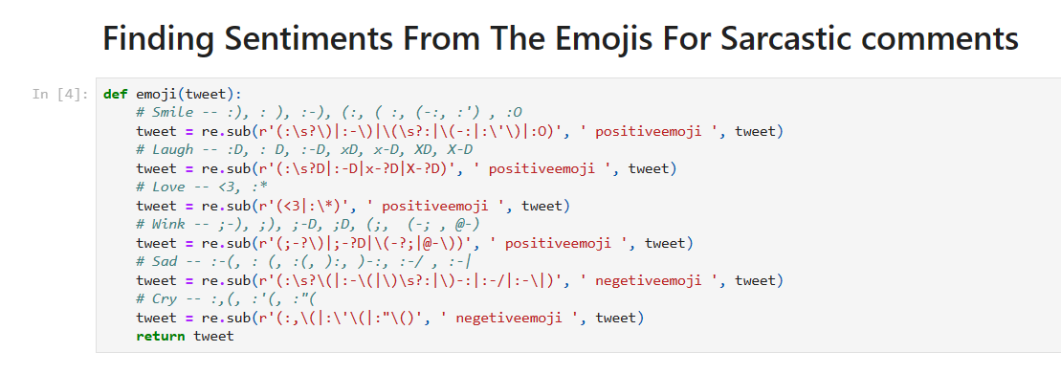
IMPLEMENTATION OF PROPOSED WORK
4. Finding Sentiments from Emoji and Comments
Emoji Sentiments

Slide 29
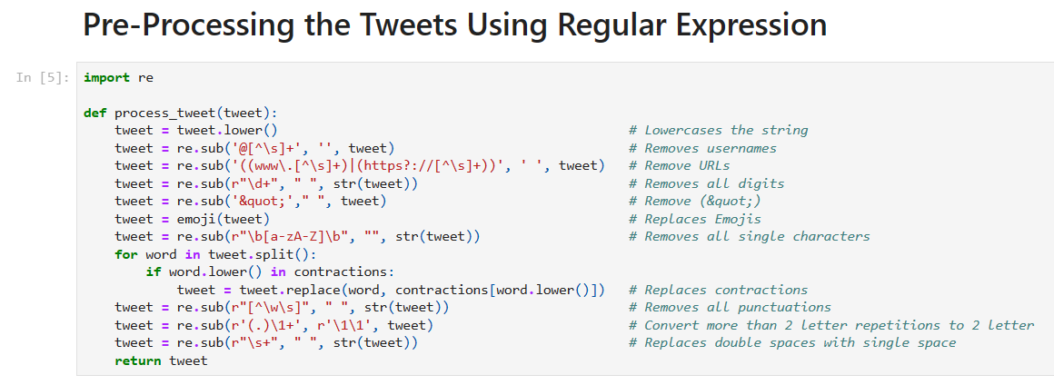
IMPLEMENTATION OF PROPOSED WORK
5. Data Preprocessing
Data Pre-processing

Slide 30
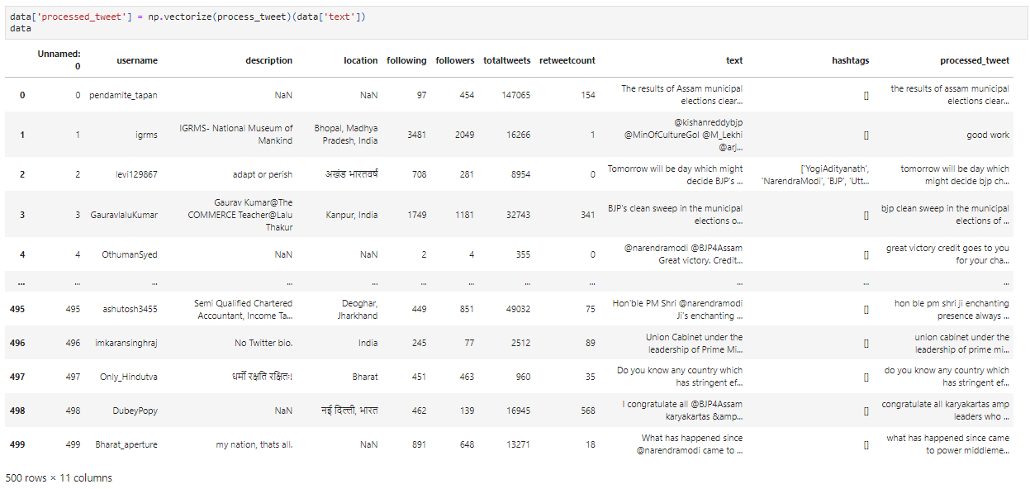

Slide 31
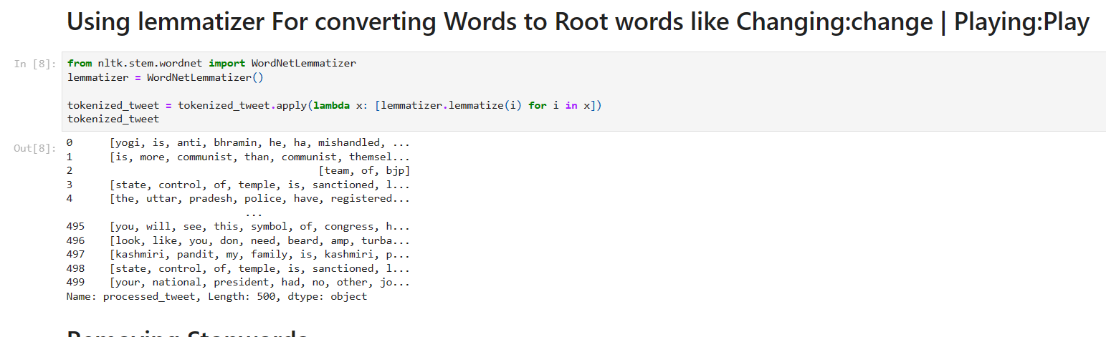
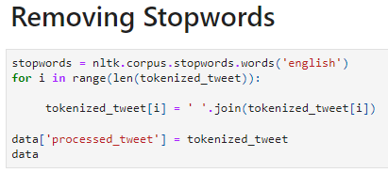
IMPLEMENTATION OF PROPOSED WORK
6. Lemmatizer For converting Words to Root words
Remove stop words for the language English
Word Lemmatizer

Slide 32
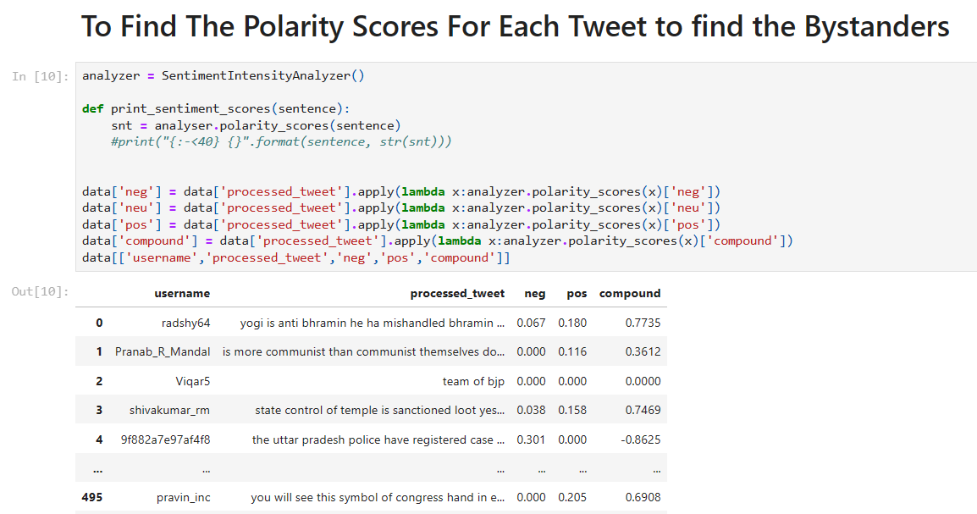
IMPLEMENTATION OF PROPOSED WORK
7. Sentiment Analysis
Polarity Score

Slide 33
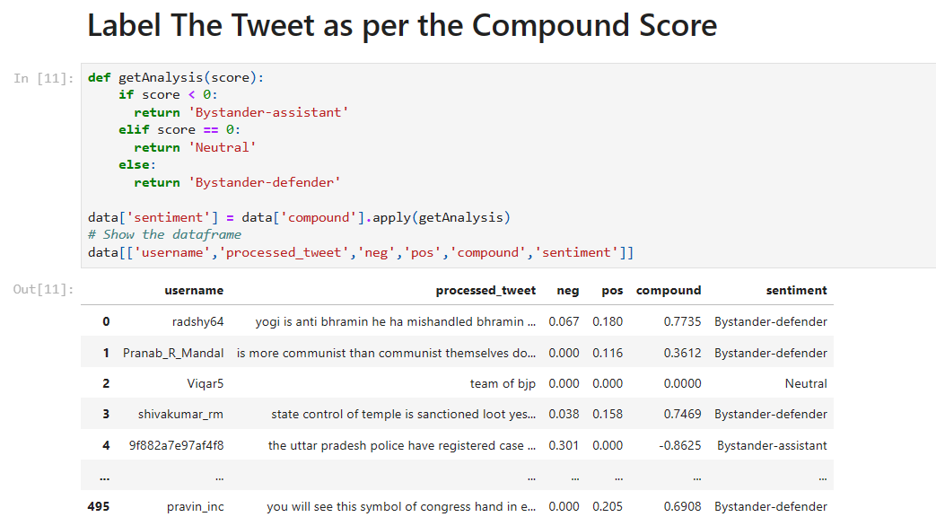

IMPLEMENTATION OF PROPOSED WORK
8. Labelling of tweets(“Bystander”) as per compound score
Labelling of tweets
Storing into files

Slide 34
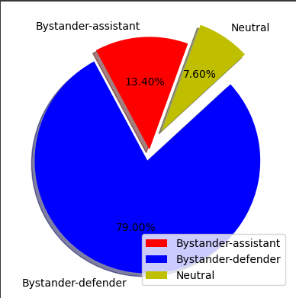
IMPLEMENTATION OF PROPOSED WORK
9. Graphical Representation
Pie Chart

Slide 35
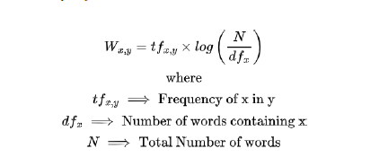
IMPLEMENTATION OF PROPOSED WORK
10. TF - IDF Vectorizer
The term TF - IDF stands for term frequency – inverse document frequency.

Slide 36
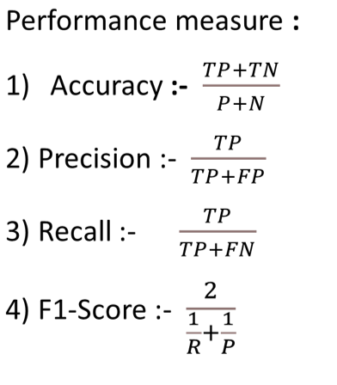
IMPLEMENTATION OF PROPOSED WORK
11. Proposed Methodology

Slide 37
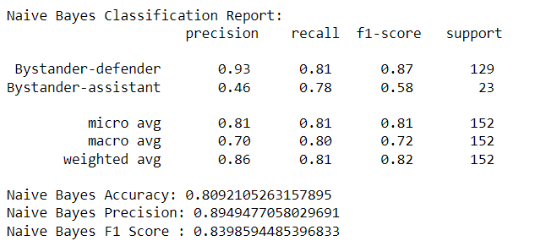
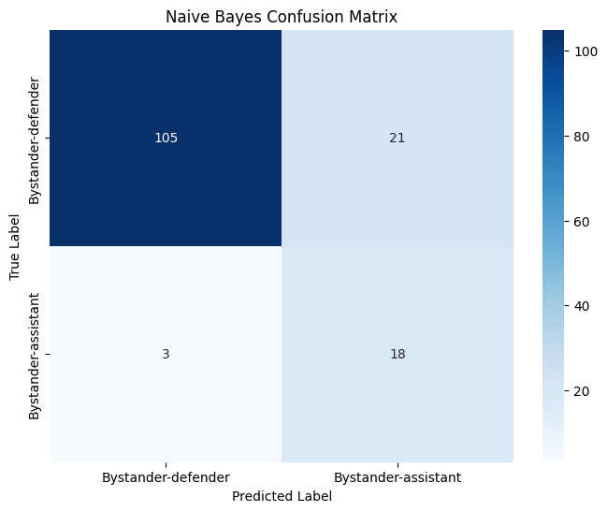
NAIVE BAYES

Slide 38
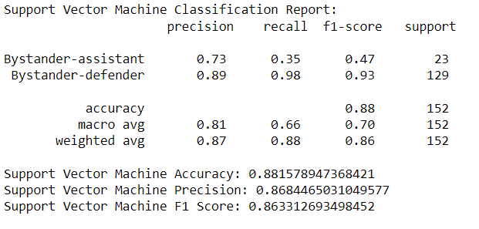
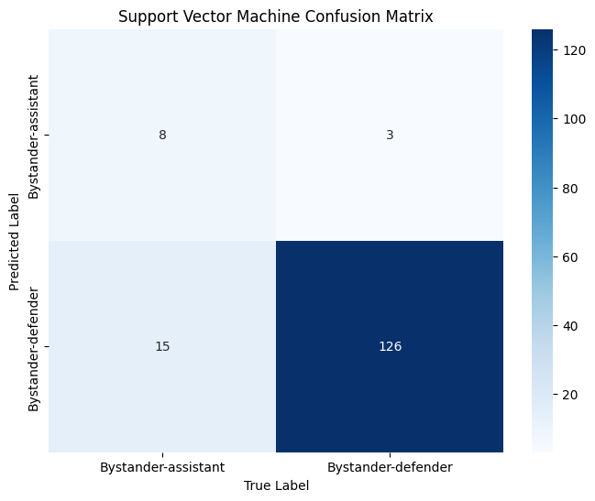
SUPPORT VECTOR MACHINE

Slide 39
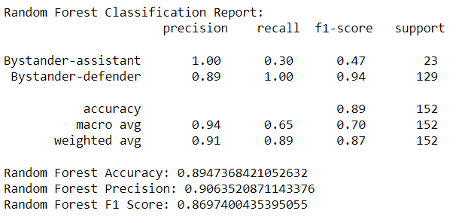

RANDOM FOREST

Slide 40
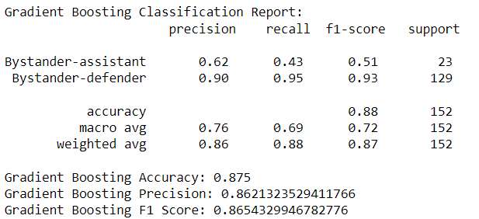

GRADIENT BOOSTING

Slide 41
IMPLEMENTATION OF PROPOSED WORK
12. Comparison of Model
Classifier | Accuracy | Precision | F1-Score
Naïve Bayes | 80.9% | 0.89 | 0.84
SVM | 88.1 % | 0.87 | 0.86
Random Forest | 89.4% | 0.91 | 0.87
Gradient Boosting | 87.5% | 0.86 | 0.86

Slide 42
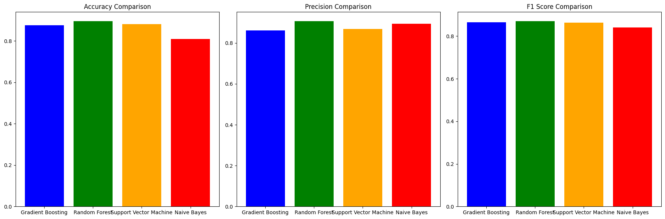
IMPLEMENTATION OF PROPOSED WORK
13. Accuracy Comparison
Comparison Bar Graph

Slide 43
CONCLUSION & FUTURE WORK
This study examined available literature to detect cyberbullying on social media websites using several methodologies. Using machine learning approaches, we synthesized and determined the key parameters for detecting cyberbullying.
By reviewing existing literature we conclude four aspects of detecting bullying messages by using machine learning approaches, namely, data collection, Data Pre-processing, Sentiment Analysis and train & test data. The Propose random forest achieves the best accuracy among the available machine learning methods, according to an experimental result.
In the future, the goal is to conduct in-depth literature reviews and social network analysis of various social media platforms. Various more machine learning classification approaches can be utilized to conduct behavioral analysis on users and investigate cyberbullying tendencies and Age and gender detection using machine learning classifiers.

Slide 44
REFERENCES
V. Balakrishnan, S. Khan, and H. R. Arabnia, “Improving cyberbullying detection using Twitter users’ psychological features and machine learning,” Comput. Secur., vol. 90, no. 101710, p. 101710, 2020.
M. F. López-Vizcaíno, F. J. Nóvoa, V. Carneiro, and F. Cacheda, “Early detection of cyberbullying on social media networks,” Future Gener. Comput. Syst., vol. 118, pp. 219–229, 2021.
S. Agrawal and A. Awekar, “Deep learning for detecting cyberbullying across multiple social media platforms,” arXiv [cs.IR], 2018.
Smith, J., & Johnson, A. (2021). Cyberbullying Detection Model: Unleashing the Power of AI for Safer Digital Spaces.
Peterson, R., et al. (2020). Advancements in Cyberbullying Detection Algorithms: A Comprehensive Review of Current Research.

Slide 45
Questions

