Slide 1
Solution Deck
16 October 2024

Slide 2

| Agenda
Problem Space Understanding
Problem Definition
Executive Summary
Analysis
Solution Model
Dashboard
Conclusion

Slide 3



Problem Statement
ConnectWave Telecom faces an annual churn rate of 15-25%, a critical issue that significantly impacts its profitability. Customer churn is defined as when customers discontinue their business with ConnectWave, and retaining customers is far less expensive than acquiring new ones
Individualized retention is challenging due to the large customer base and high costs, but predicting at-risk customers would allow for targeted efforts
Analyzing customer interactions across multiple channels can help reduce churn, improve loyalty, and increase profits

Slide 4

Problem Statement | SGQ
Current State
Gap
Desired Future State
Identify the key factors affecting customer churn which impacts the profitability across the organization
Stakeholders, Roles and Responsibilities
The Chief Data Officer at Connect Wave is responsible for leveraging data analytics to drive business decisions, as well as ensuring compliance with regulations and managing data-related risks effectively
Current Scenario
A churn rate of 15-25% annually has been identified by the client which is significantly impacting their profitability
Expectations
The client aims to re-engage dissatisfied customers by implementing the best practices to ensure their retention
Analytical Output
Reduce churn rate by X%, increase customer retention by Y%, boost revenue by Z% and attract new customers
Current Scenario
Analyze the churn pattern to improve the profitability by formulating the retention strategies
Purpose
Analyze churn patterns to develop targeted retention strategies that enhance profitability
Question – which needs answers
How can we leverage customer feedback to address retention issues?
What plan should be implemented to improve technology in data integration and ensure complete insights?
How can we effectively handle government policies to align with our service?

Slide 5
Executive Summary
Findings | Insights
The median monthly charge for churned customers is $79.65, significantly higher than the $64.43 for non-churned customers | This indicates that customers who leave tend to have higher monthly charges, suggesting a potential area for retention strategies
Customer numbers peak in Month 1 and Month 72, indicating high distribution in the 0-8 month and 60-72 month ranges | Customers with shorter tenures are more likely to leave, compared to those who have been with the company longer
Key factors contributing to churn include device protection, tech support, online backup, and payment methods, all of which show a strong correlation with customer departure | Customers not using online backup, device protection, and tech support are more likely to churn, indicating a strong correlation between non-usage of these services and higher churn rates
The customer gender distribution is nearly equal, with 3,488 males and 3,555 females, and a minimal churn difference of just 9 | With equal gender distribution and a low churn difference, gender is not a significant factor in churn

Slide 6






Steps in the Exploratory Data Analysis(EDA) Journey: From Data Collection to Insight Discovery
FEATURE SELECTION
TESTING ASSUMPTIONS
Selected important columns for analysis:
Tenure
Internetservice
Onlinebackup
Deviceprotection
Techsupport
Contract
Paymentmethod
Monthlycharges
Churn
PATTERNS AND
RELATIONSHIP
Chi-square test is performed for categorical variables (Device Protection, Tech Support).
T-test is used for Tenure.
Z-test is applied for Monthly Charges.
REPLACING VALUES
Identifying patterns and relationships through univariate, bivariate.
Univariate:Histogram,Boxplot
Bivariate: Count plot
NULL VALUES
AND OUTLIER
There were 16 columns containing categorical data. The categorical data will be converted into numeric format to improve the performance of the analysis
DATA COLLECTION
No null values and outlier were found in the dataset
Loading the dataset which is required for analysis

Slide 7
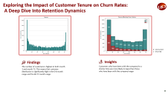


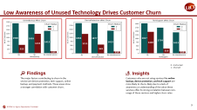
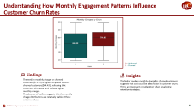
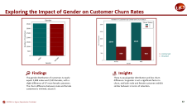


An In-Depth Exploration of Data: Uncovering Insights Through Exploratory Data Analysis
Analysis of Churn Based on Tenure
Analysis
Analysis of Churn based on Service
Analysis of Churn based on Monthly Charges
Analysis of Churn based on gender and Senior Citizen

Slide 8
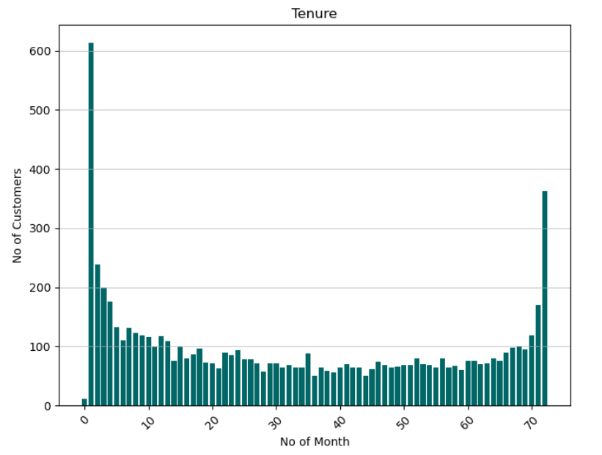
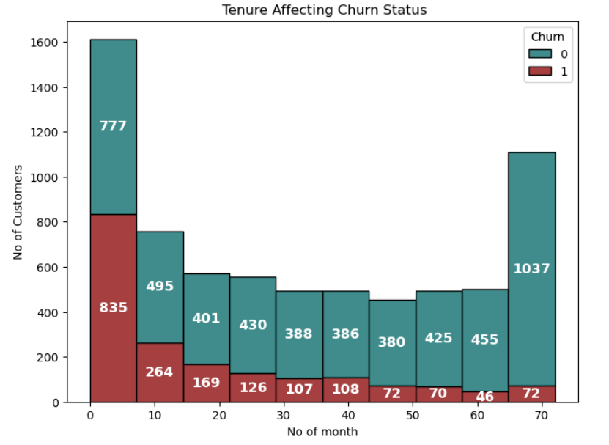


Exploring the Impact of Customer Tenure on Churn Rates:
A Deep Dive Into Retention Dynamics
0 - Unchurned
1 - Churned
Findings
Insights
The number of customers is highest in both month 1 and month 72. This means that customer distribution is significantly high in the 0-8 month range and the 60-72 month range.
Customers who have been with the company for a shorter time are more likely to leave than those who have been with the company longer

Slide 9
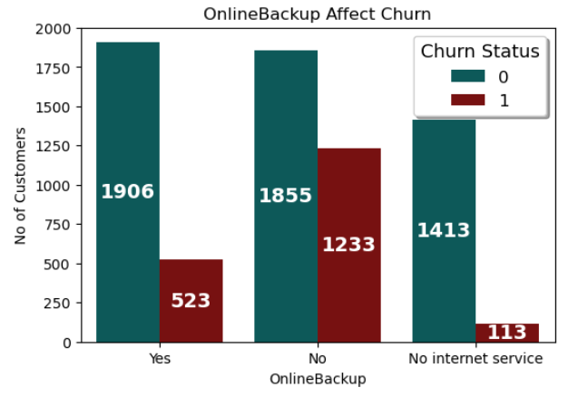
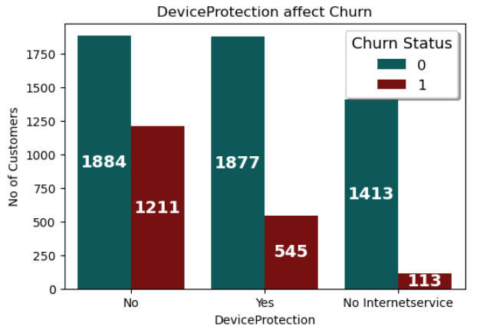
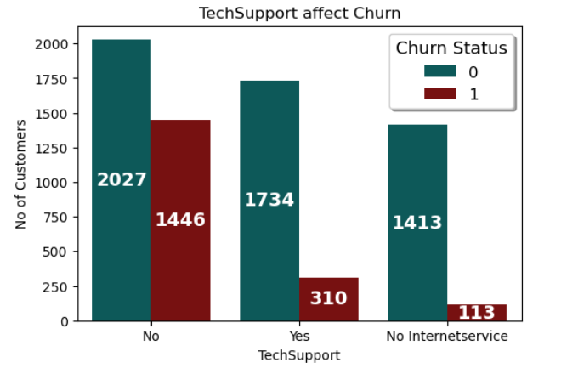
Low Awareness of Unused Technology Drives Customer Churn
0 - Unchurned
1 - Churned
Findings
Insights
The major factors contributing to churn in the service are device protection, tech support, online backup, and payment methods. These areas show a stronger correlation with customer churn.
Customers who are not using services like online backup, device protection, and tech support are more likely to churn, likely due to a lack of awareness or understanding of the value these services offer. So strong correlation between non-usage of these services and higher churn rates.

Slide 10
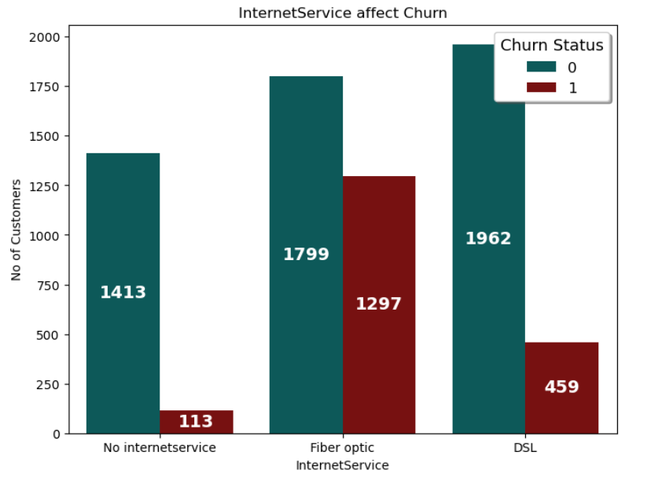
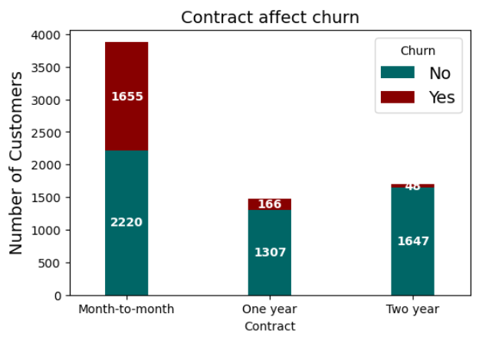
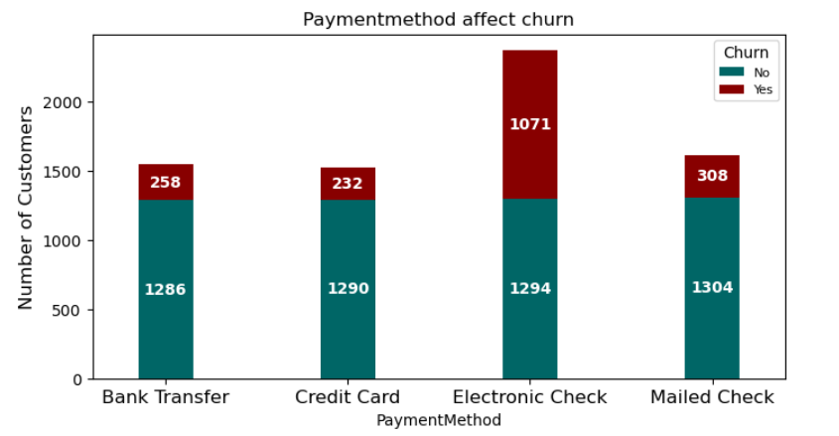
Low Awareness of Unused Technology and Payment Features Drives Customer Churn
0 - Unchurned
1 - Churned
Findings
Insights
Out of 78.3% of internet service customers, a significant portion uses fiber optics and DSL, with fiber optics being the more popular choice
The contract type has a major impact on churn, with month-to-month plans showing the highest churn rates.
Payment methods also influence churn, with customers using electronic mail for payments being more likely to churn
Fiber optic installation and maintenance are more complex, causing longer downtimes and frustration for users, leading to higher churn
High churn in month-to-month contracts is driven by low loyalty and higher costs, prompting customers to seek cheaper, flexible options. Additionally, difficulties with electronic check payments due to technology or interface issues may also increase churn

Slide 11
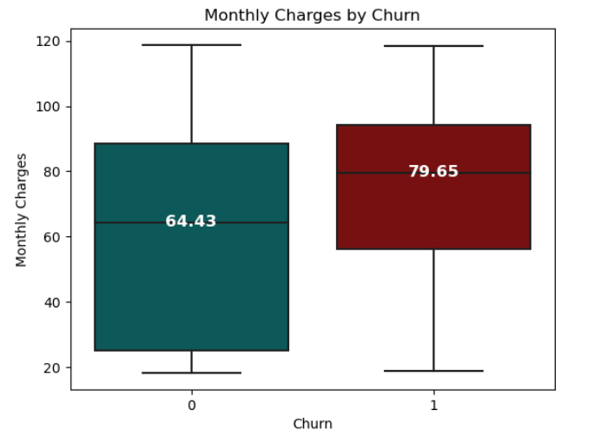
Understanding How Monthly Engagement Patterns Influence Customer Churn Rates
0 - Unchurned
1 - Churned
Findings
Insights
The median monthly charge for churned customers($79.65) is higher compared to non-churned customers($64.43), indicating that customers who leave tend to have higher monthly charges.
The absence of outliers suggests that the monthly charge distributions are relatively stable without extreme values.
The higher median monthly charge for churned customers suggests that cost could be a key factor in customer churn. This is an important consideration when developing retention strategies.

Slide 12
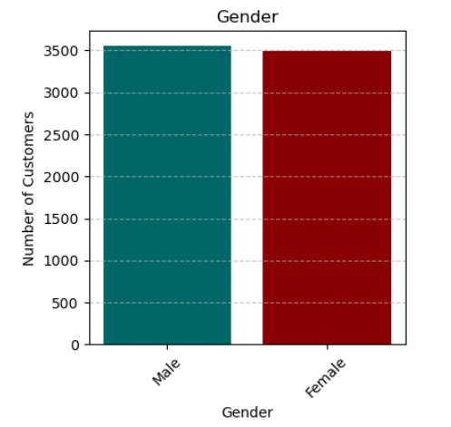
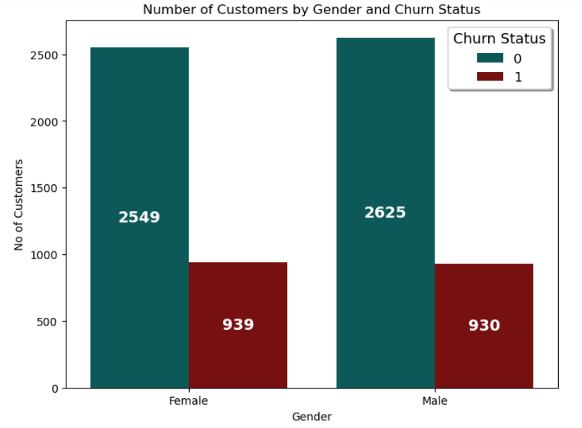
Exploring the Impact of Gender on Customer Churn Rates
0 - Unchurned
1 - Churned
Findings
Insights
The gender distribution of customers is nearly equal: 3,488 males and 3,555 females, with a slight difference of 67 more female customers. The churn difference between male and female customers is minimal, at just 9.
There is equal gender distribution and low churn difference. So gender is not a significant factor in churn, and both male and female customers exhibit similar behavior in terms of retention.

Slide 13
Hypothesis testing
Hypothesis | Type of hypothesis test | Columns of dataset used | Result
H0 - There is no association between device protection and tech support with churn status. Specifically, the likelihood of having device protection or tech support is independent of whether a customer churns or not. H1 - There is an association between device protection and tech support with churn status. Specifically, the likelihood of having device protection or tech support is dependent on whether a customer churns or not. | Chi – Square test | Categorical data (yes/no) related to churn, device protection, and tech support. | Failed to reject null hypothesis
H0 - Effective management of customer interaction positively impacts the understanding of customer behavior, including factors such as tenure and internet service H1 - Ineffective management of customer interaction negatively impacts the understanding of customer behavior, including factors such as tenure and internet service | T-test | Tenure, Churn | Rejected null hypothesis
H0 - There is no significant difference in monthly charges between customers who have churned and those who have not, suggesting that monthly charges are not a strong predictor of customer churn H1 - There is significant difference in monthly charges between customers who have churned and those who have not, suggesting that monthly charges are not a strong predictor of customer churn | Z-test | Monthly Charges, Churn | Rejected null hypothesis
H0 – Null Hypothesis
H1 – Alternate Hypothesis

Slide 14
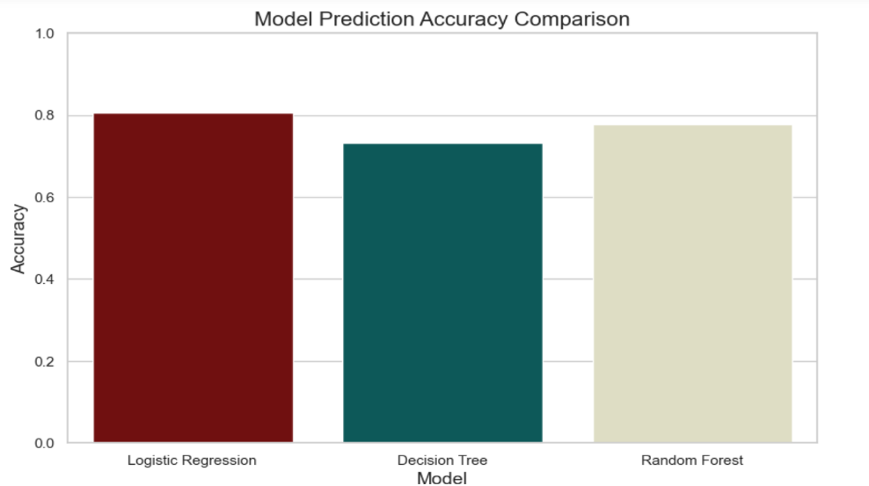
Modeling – Model Comparison
ALGORITHMS | Accuracy | Precision | Recall | F1 Score
Logistic Regression | 80% | 68% | 51% | 58%
Decision Trees | 73% | 50% | 49% | 49%
Random Forest | 77% | 60% | 48% | 53%
Findings
Logistic Regression Model performs the best with accuracy of 80% when compared to all other classification algorithms
Accuracy Indicates the proportion of correct predictions made by the model.
Insights
Precision Reflects the accuracy of positive predictions. A higher precision indicates fewer false positives.
This algorithm has the best F1_score value which is the most relevant measure for the customer churn prediction as well as marketing budget optimization.
Recall Measures the model’s ability to identify all relevant instances. High recall means fewer false negatives.

Slide 15
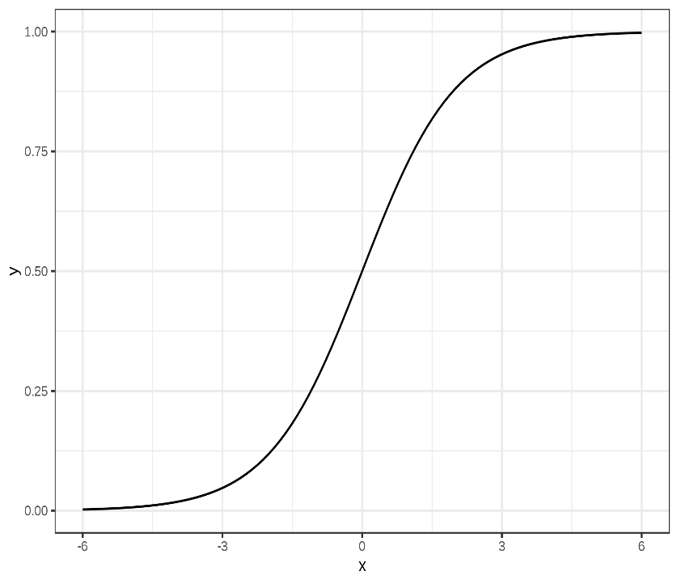
Model Selection – Logistic Regression has high accuracy
Logistic Regression
80%
It provided a probability score between 0 and 1, which was useful for classification task. Interpretability: The coefficients indicated the influence of each feature on the outcome, making the mode easy to understand.
It was simple to implement and computationally efficient, especially for linearly separable data.
Conclusion
Sigmoid function
These three methods played crucial roles in machine learning workflows, each offering unique advantages for different types of data and tasks. For our user input predictive model, we proceeded with Logistic Regression, which had an accuracy of 80%, higher than the other methods.

Slide 16
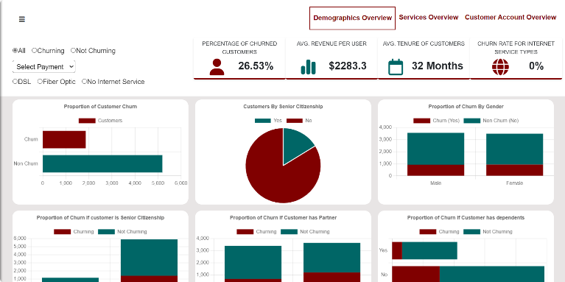
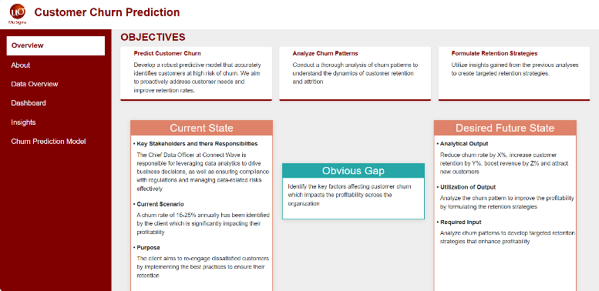
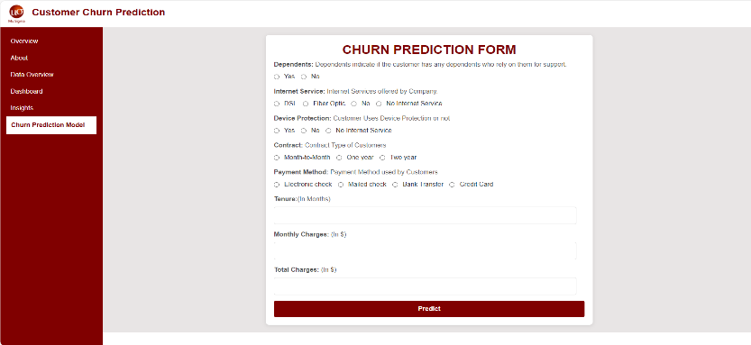
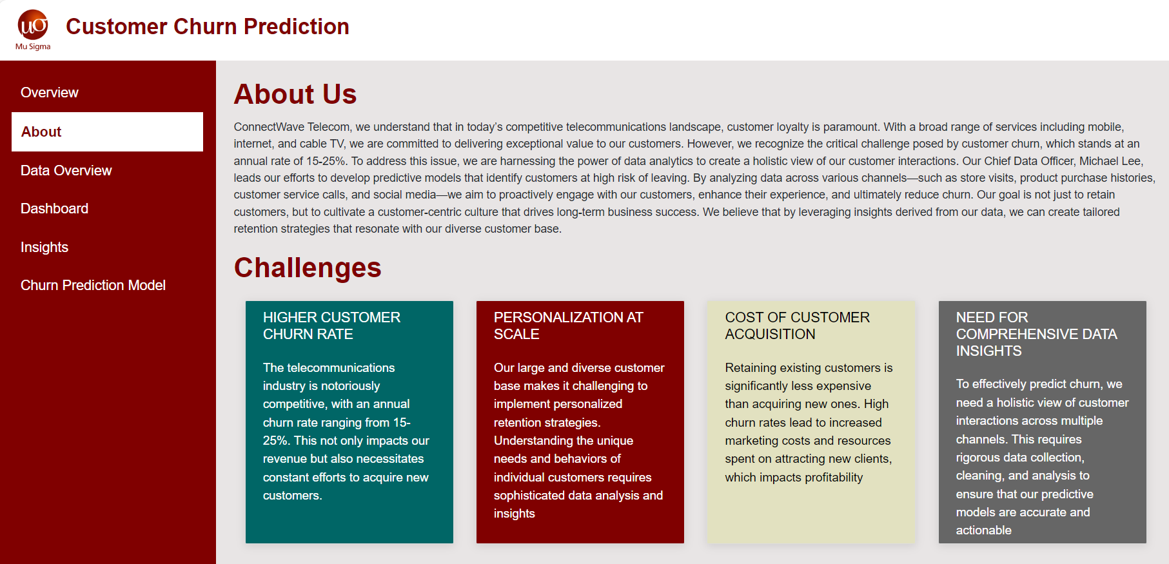
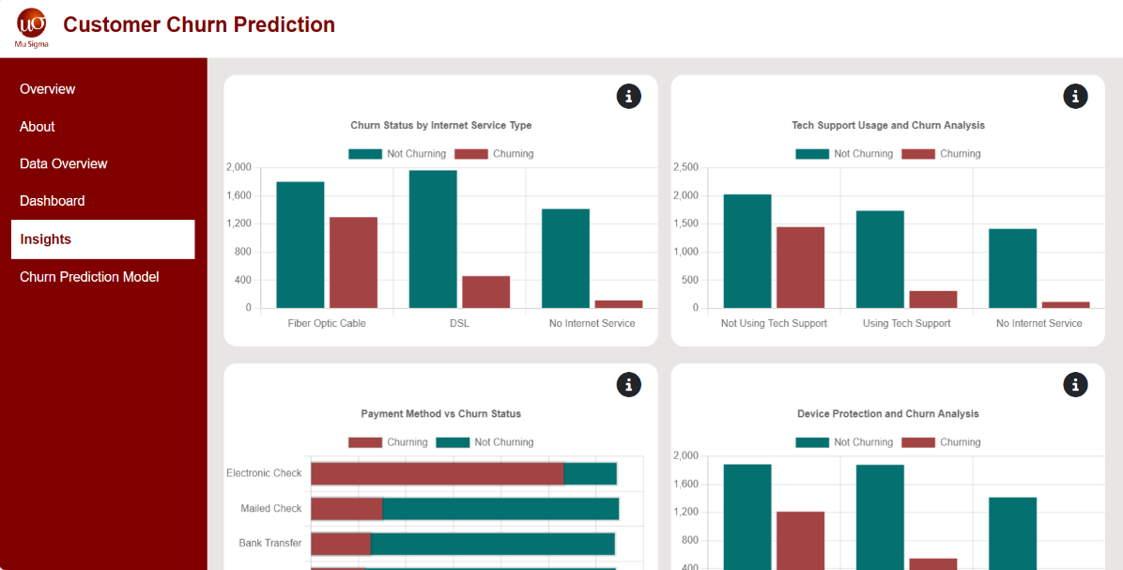
Dashboard

Slide 17
Conclusion
We are using logistic regression as it provides higher accuracy in our model predictions
Gender is not a significant factor in churn, as both male and female customers show similar retention behaviors
Shorter-tenure customers are more likely to churn than long-tenure customers
Non-usage of services like online backup, device protection, and tech support strongly correlates with higher churn rates
Complex fiber optic installations, month-to-month contracts, and payment issues all contribute to higher churn rates
Higher monthly charges for churned customers indicate that cost is a key factor in churn, crucial for retention strategies

Slide 18


Recommendations
Raise awareness about device protection and tech support services, as a lack of awareness can negatively impact customer retention.
Introduce more flexible pricing plans to accommodate different budgets, especially since churned customers tend to have higher monthly charges.
Focus on engaging customers who have been with us for 0-8 months, particularly those using fiber optic services. Tailored strategies for this segment can improve retention and attract new customers

Slide 19
THANK YOU

