Slide 1
BUDDY
- The Secured Social Media Website
Done By ,
Name : K.P. Haries EH,DFIR ,…
Department : M.Sc – Software Systems [CT –PG]
Date : 5/5/2021
MENDOR
Ms. K. Karthiga (AP/M.Sc)

Slide 2
OUTLINE
OBJECTIVE
INTRODUCTION
FEATURES
SOFTWARE REQUIREMENTS
BUDDY MODULES
ADM – OUR OWN FIREWALL
HOW BUDDY WAS DIFFERENT FROM OTHER COMPETITORS ?

Slide 3
OBJECTIVE
A social network service focuses on the building and verifying of online social networks for communities of people who share interests and activities, or who are interested in exploring the interests and activities of others, and which necessitates the use of software.
Most services are primarily web based and provide a collection of various ways for users to interact, such as messaging, queries, Advices and file uploading.
Providing Sophisticated Security To users.

Slide 4
INTRODUCTION
Buddy is a social media website focuses on the building and verifying of online social networks for communities of people who share interests and activities, or who are interested in exploring the interests and activities of others, and which necessitates the use of software.
In Buddy , I used bootstrap UI , html, css , react JS for front-End development , PHP and MySQL database for back-end development. This is my project which has full stack social media website .
Buddy has so many modules . i.e. admin panel , user registration , blog , advertisement , socialmedia integration , posting pictures & videos , video & audio calling , sent messages , payments and emoji and ADM – (Advance Defense Mechanism ) for website security purposes .

Slide 5
FEATURES
1. Messages: This application provides the message passing between friends through online. So communication facility is easy through this application.
2. Edit Profile : End users will modify and upload the photos
3. Invite the friends: End users send the invitation request to his/her friends. After login the corresponding user he will see the invitation request and two text boxes (Yes, No).If user clicks on the “Yes" then that user is added into community else otherwise that user is just ignored.
4. Communities: In the communities section all the friends of end users will show with photos and names. If end user clicks on a particular photo then it will show the details of that particular user.
5. File Attachments: This module is an added advantage of this application. Because in this module dynamically create one folder and upload the personal documents to that folder. This folder is having personal documents of a particular user.

Slide 6
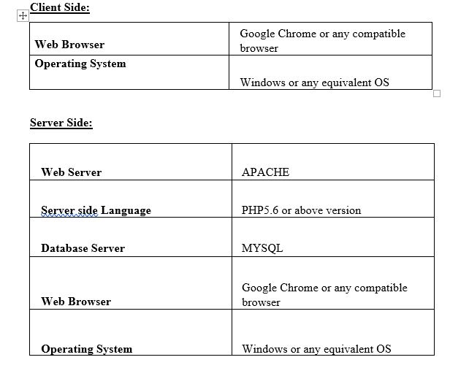
SOFTWARE REQUIREMENTS

Slide 7
BUDDY MODULES
ADMIN PANEL
USER REGISTRATION
BLOG
ADVERTISEMENT
SOCIAL MEDIA INTEGRATION
POSTING IMAGES AND VIDEOS
VIDEO AND AUDIO CALLING
PAYMENT GATEWAY
SENDING TEXT MESSAGES

Slide 8
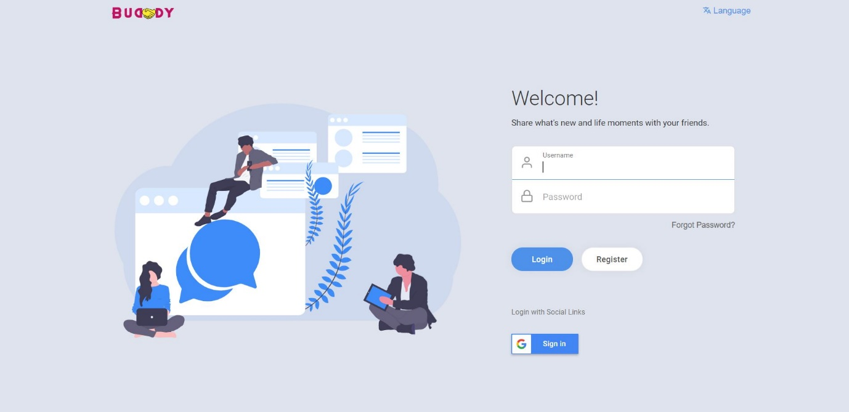
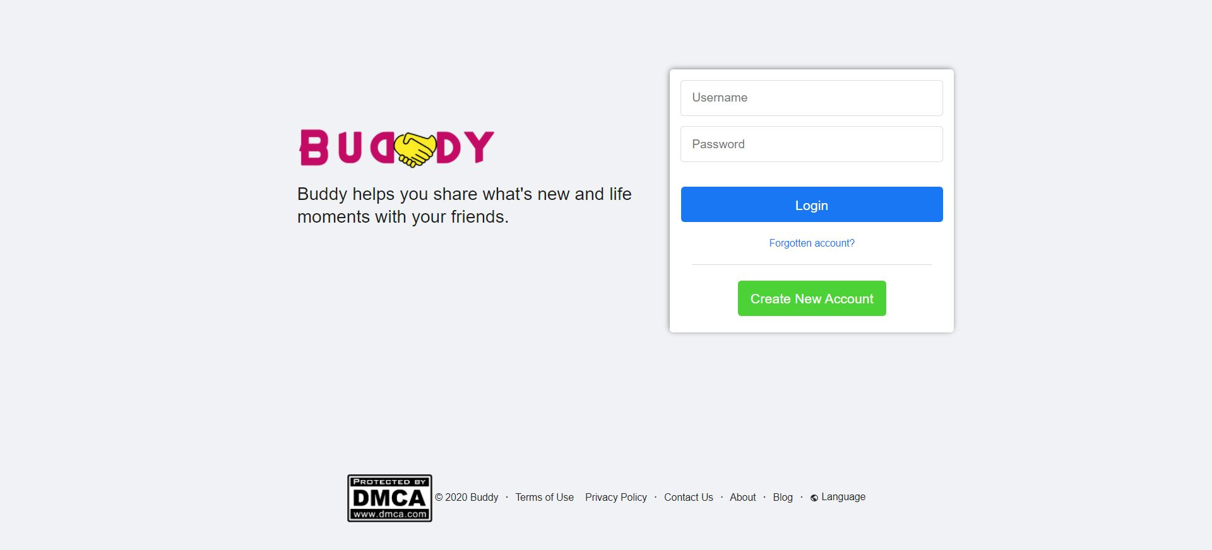
INDEX PAGE
INDEX PAGE ( VERSION 1 )
INDEX PAGE ( VERSION 2 )

Slide 9
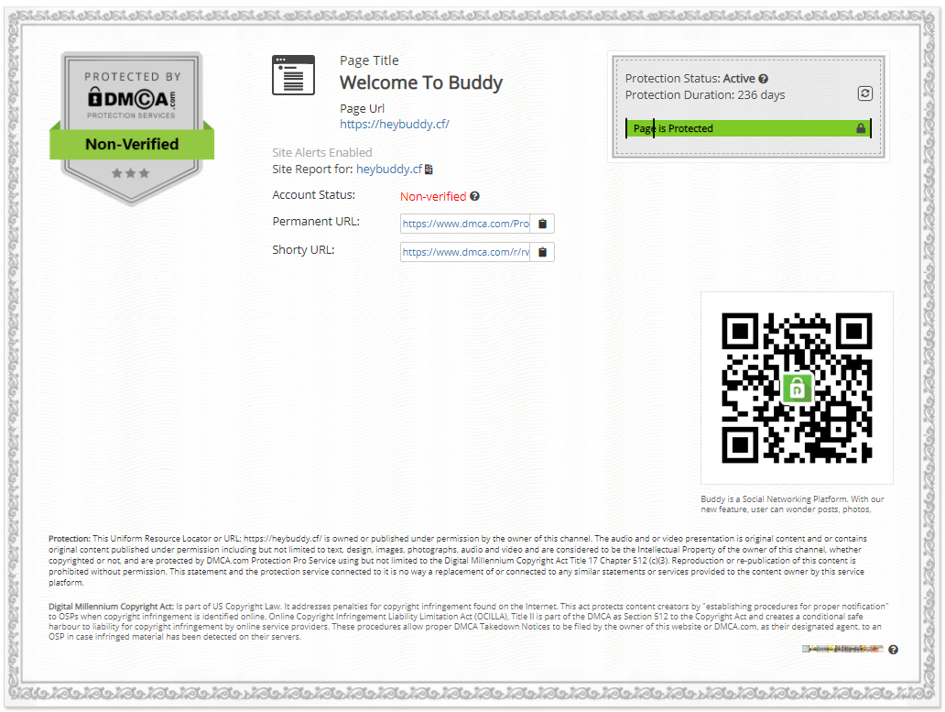
DMCA COPYRIGHT – GLOBAL LICENSE APPROVED

Slide 10
ADM ( Advance Defence Mechanism )
ADM was specially developed for Buddy website to maintain security mechanism to ensure security and protect users from cyber attacks .
ADM protects major of all cyber attacks like sql injection , xss injection , DDOS attack , dynamic proxy (TOR) with flooding attacks .
ADM also detect VPN , TOR and bot to protect our users from malicious activities of attackers.

Slide 11
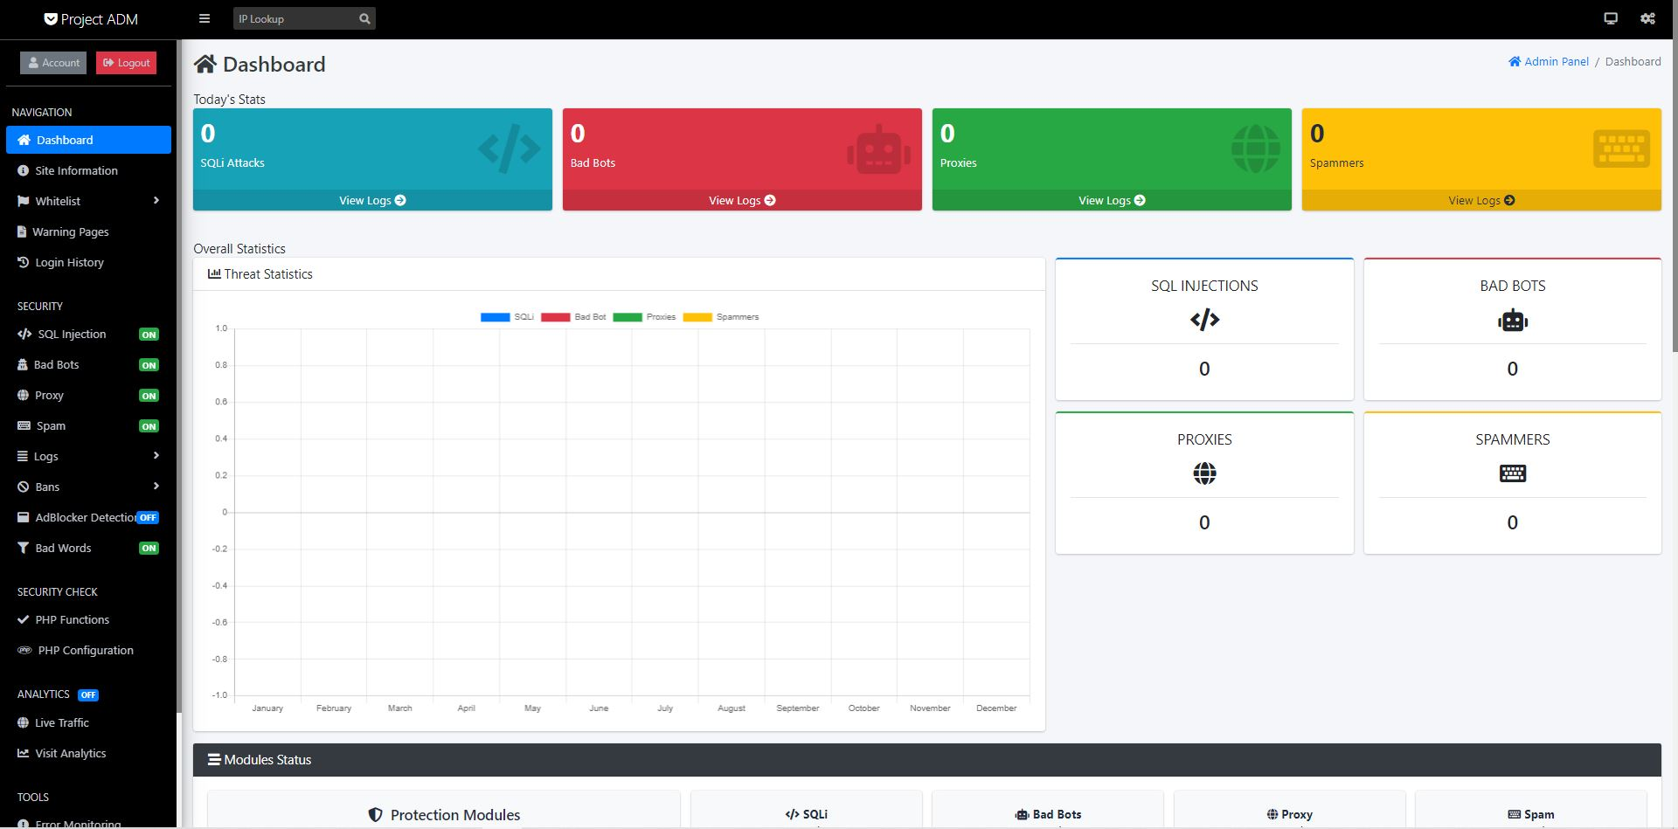
ADM ( Advance Defence Mechanism )

Slide 12
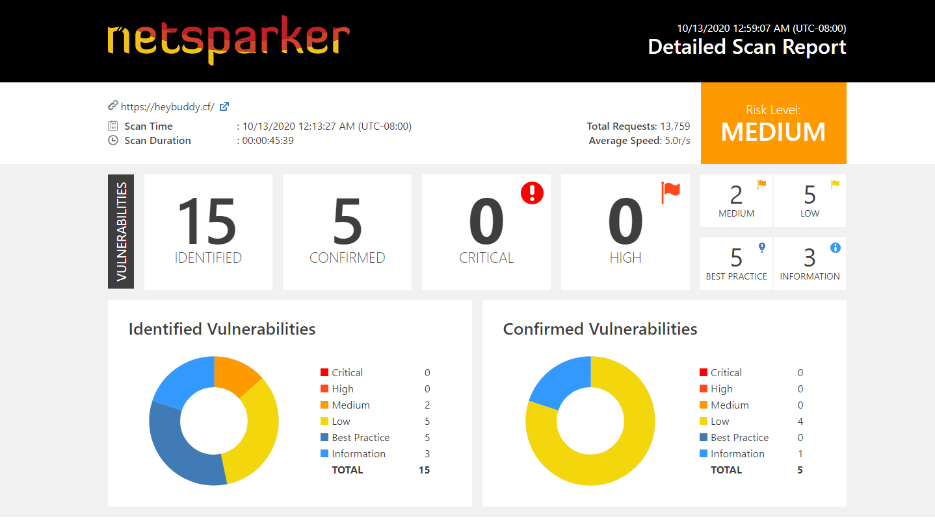
NETSPARKER VULNERABILITY REPORT (SAMPLE)

Slide 13
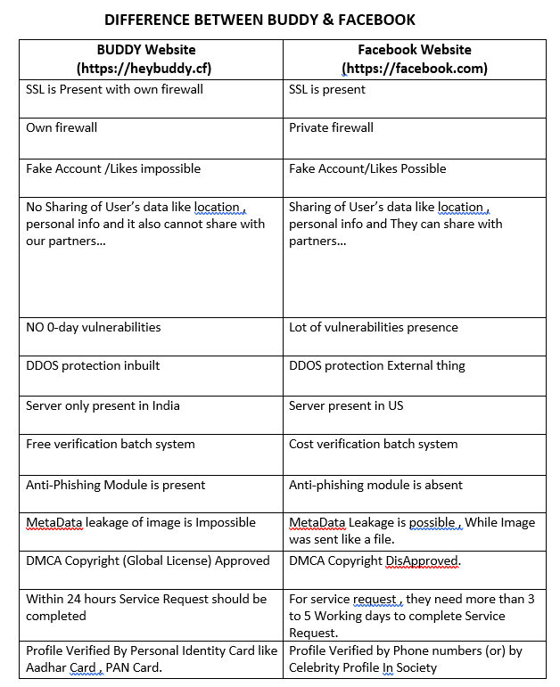
HOW BUDDY WAS DIFFERENT FROM OTHER COMPETITORS ?

Slide 14
CONCLUSION
The Application was designed in such a way that future changes can be done easily. The following conclusions can be deduced from the development of the project.
It gives appropriate access to the authorized users depending on their permissions.
It effectively overcomes the delay in communications.
Updating of information becomes so easier.
System security, data security and reliability are the striking features.
The System has adequate scope for modification in future if it is necessary.
NETSPARKER VULNERABILITY REPORT ( FULL REPORT)
Notes:
In Slide Show mode, select the arrows to visit links.

Slide 15
ANY QUERIES ???
THANK YOU

