Slide 1
Digital-ID-For-ALL (DIFA)
Team: Akshay ,Prateek , Shijin &Vinod

Slide 2
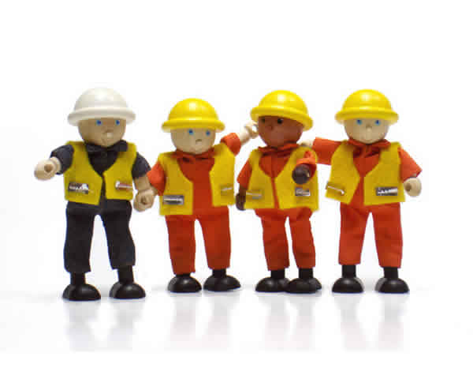
The Problem:
A Migrant Worker who arrives at a new locality may not have all the necessary skills or training to understand, what are their entitlements.
The worker may not be aware of all the requirements to practice a particular trade in the locality. A contact program for such migrant worker will offer him an upskilling opportunity.
Carrying documents along with them to prove that they are skilled to all job sites may not be a practical solution.

Slide 3
Skill Net
SKILLNET is a Blockchain network that can help in the validation of verifiable claims with respect to identity, participation in contact programs and jobs completed by migrant workers.
A Skill Verification Network (SKILLNET) on Blockchain serves as a Skill Attestation Platform to prove that the workers are experienced in specific Trade required for doing a job.
DIFA (Digital ID for All ) is a Decentralized Digital ID generate on demand by SkillNET.
Migrant worker can use a DIFA based QR Code to participate in a contact program.

Slide 4

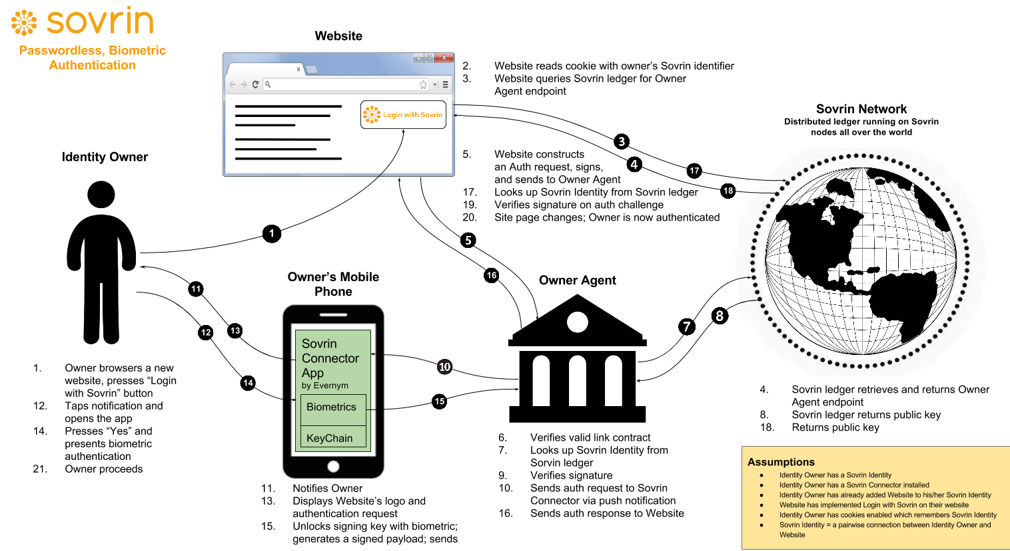


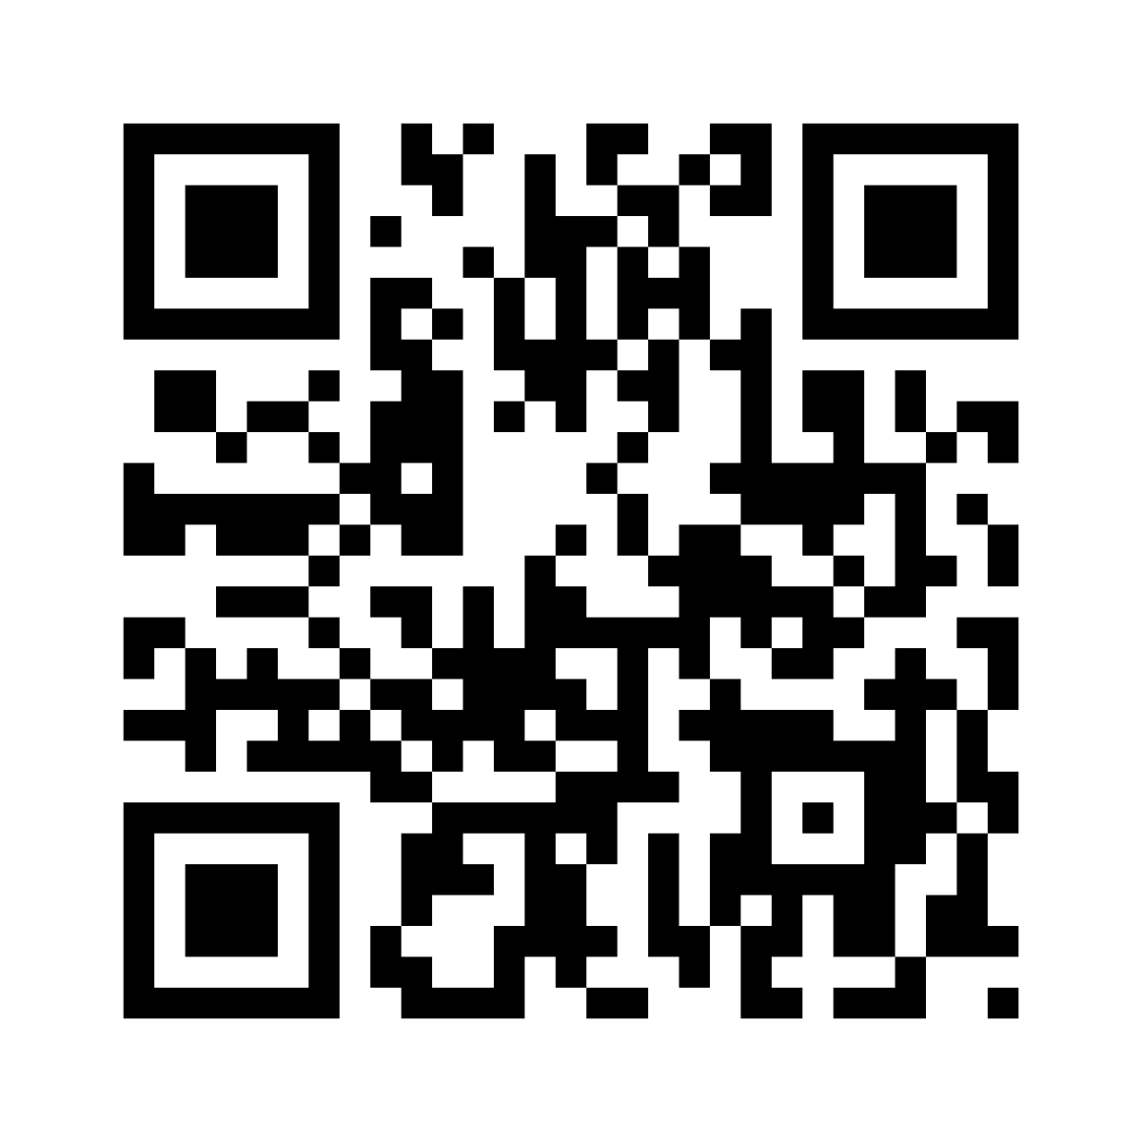

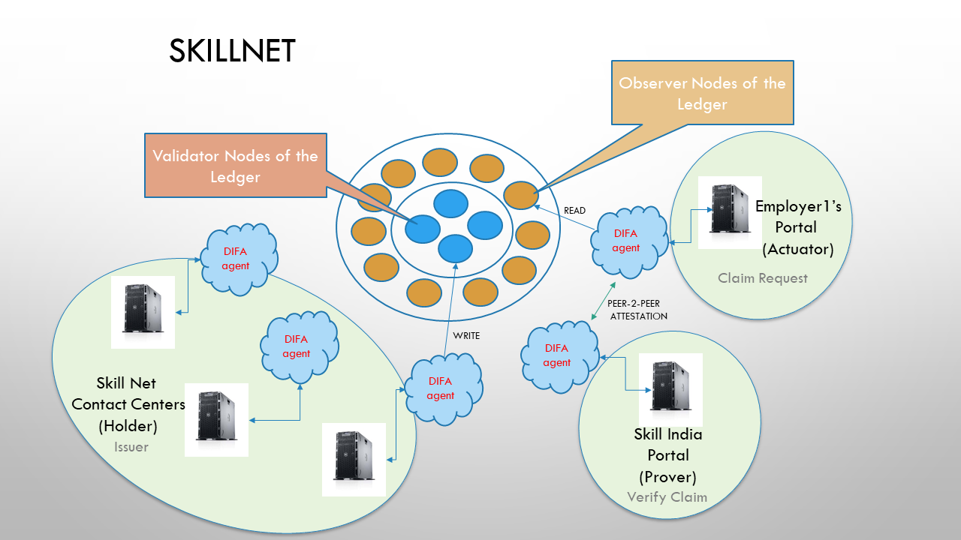
DIFA
2
7
Employer
1
6
Verifies Documents
Post Job
Feedback
visits
Skill-Net
Registry
SkillNet
Contact Center Coordinator
DIFA
Application
for a Job with Contact program
Details Embedded
DIFA
Signatures as Proof
5
Generates
DIFAs
Shares DIFA QR Code
collects
3
SkillNet
Contact Center
Claim Request
4
Contact Program
Contact Program Coordinator
SkillNet
Notes:
*Worker collect QR with embedded OTP that will expire on the day of the program
When a physical transfer of key is done at the contact center the Worker can carry the same to the Contact Program.
Aadhaar has to be carried , QR code of aadhaar is used , like in case of EVMs.

Slide 5
Skill-Net: Features
Distributed Ledger System to Empower Migrant Workers
Self Sovereign ID for Migrant Workers
Peer 2 Peer Attestation of Document
DIFA : Unique IDs for Contract programs with expiry built in
Built in Privacy
ZKP (Zero Knowledge Proofs)
Skill Net -Registry for
Proofs in Public Domain
Skill Net Services
Attestation
Repudiation
Validation
Trust Anchor Model ( Issuer, Verifier , Prover)

Slide 6

SKILLNET
Observer Nodes of the Ledger
Validator Nodes of the Ledger
READ
Employer1’s
Portal
(Actuator)
DIFA agent
DIFA agent
Claim Request
PEER-2-PEER
ATTESTATION
DIFA agent
DIFA agent
WRITE
DIFA agent
Skill Net
Contact Centers
(Holder)
Skill India
Portal
(Prover)
Issuer
Verify Claim

Slide 7

SKILLNET Services
Provides proofs of Contact Programs attended, Jobs completed , documents in possession based on verified claims raise against SKILLNET Registry.
Uploads DIFA
SKILLNet Services Overview:
SKillNet Centers uploads DIFAs
Claims on DIFA are verified and self-signed by Validator Nodes & Trust Anchors
Digital, hashed representation Proofs
Encrypted DIFAs will be stored in Blockchain
When Migrant provides consent then the proofs are shared to the contact center/employer
Contact Center
Shares DIFAs
Consent
Shares DIFAs
Request
Claims
DIFA encrypted and stored in SkillNET Registry
Employer

Slide 8
Consensus (built-in)
Sustaining SKILLNET
Consensus based on:
Proof Of Holding a Document
Based on Document Shared at contact Centers
Proof Of Participation in CP
Based on Verified Contact Programs
Proof Of Reputation
BASED ON JOBS COMPLETED
Community driven governance model
CONTACT CENTER Credibility on SKILLNET LINKED TO EMPLOYERS FEEDBACK
Trust Anchor (Add more participants COMMUNITY CENTERS)
Incentives Training MIGRANT Workers by trainers from the community
Organize Events TO TRAIN WORKERS
Open source from day one.

Slide 9
SKILLNET Roll out
M4 : Offer SKILLNET based Services
Attestation
Repudiation
Validation
M3 : Foundation , Extension
Community Initiatives
Services Plugins Deduplication
Extend to Public Services
Bootstrap SKILLNET
Expanding SKILLNET
-Adding Programs
- Contact Centers
Community Building
- Foundation
- Crowd sourcing
Sustaining
SKILLNET
- Incentives to trainers
from community
- Contact Centers
- Employment Services
SKILLNET Services
M2 : Develop Client Components
Libraries
CLi’s
APIs
TestNets
Dashboard DApp
M1 : Prototype
metadata capture
Connectors, Agents
Self attestation, Trust Anchors
DIFA/DDO on Storage Hub
DIFA Verification

Slide 10
Summary of Benefits
DIFA powered SKillNET Will empower migrant workers and presents them an opportunity to UPSKILL THEMSELVES.
SKILLNET INCENTIVES Communities to conduct Programs for MIGRANT WORKERS
MIGRANTS ONLY SHARE REQUIRED INFORMATION AT ANY POINT IN TIME.
AUTHORITIES GET ACCESS TO Only What they need IN CASE OF VERIFICATION.
EMPLOYERS and MIGRANTS NEED NOT Carry PHYSICAL DOCUMENT EVERYWHERE and VERIFICATION IS A QUICKER PROCESS.
.

Slide 11
Thank You…

Slide 12
SKILLNET
A Skill Verification Network (Skill Net) on Blockchain serves as a Skill Attestation Network to prove that the workers are experienced in specific Trade. The Skill Attestation Network will also enable the worker to self-nominate/attend any available upskilling programs at contact centres in their area.
The migrant work can register them self or through a Trusted authority and get registered on SkillNet.
For every eligible contact program Skill Net will issue a unique DIFA (Digital ID For All) to the Migrant Worker using which the worker can attend and complete the upskilling program.
Skill Net Application takes into account certain basic documents that can prove without divulging unnecessary personal information about the worker into the public domain.

Slide 13
Skill-Net Components
Blockchain Protocol Layer
Ledger
Validator Nodes
Observer Nodes
Agents
Off-chain Components
Document Parsers
ID generators for Migrant Workers
SkillNet Registry: Managing Proofs for Verified Claims
Deduplication Tools
Audit Tools/External System Connectors (India Stack/Aadhaar)

Slide 14
TRUST Model
DIFA
Connectors
DIFA
Connectors
Employer
(Actuator)
Repo-Registry
(Issuer)
DIFA
(Verifier)
Wrapper
Wrapper
DIFA
Client
DIFA
Client
agent
agent
agent
wallet
wallet
wallet
Ledger
Contact Center
(Holder)
Employer
(Prover)
Wrapper
Wrapper
DIFA
Client
agent
agent
DIFA
Client
wallet
wallet
DIFA
Connectors
DIFA
Connectors

Slide 15
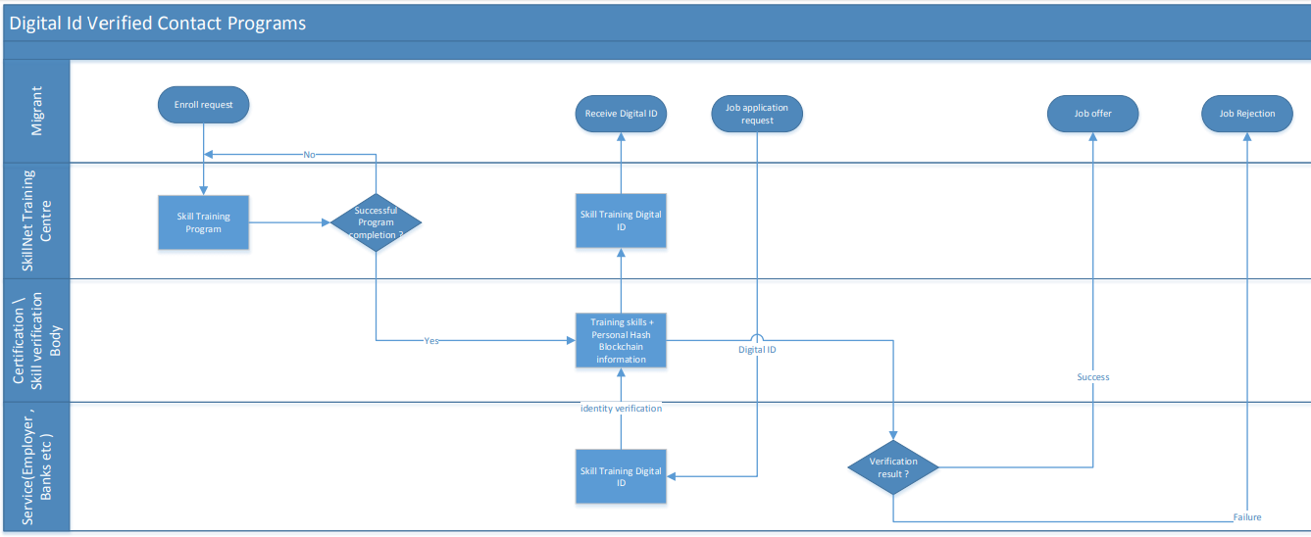
DIFA Cross Functional Flow Diagram

