Slide 1
Collections in Java
By Hari Galla (189021)

Slide 2
What are Collections?
A ‘Collection’ in simple terms refers to a group of objects. These objects represent real-life entities.
Java provides us with a framework consisting of many interfaces and classes that help us in effectively and efficiently storing and processing these objects.
Based on the method of storing and retrieving, they serve a variety of purposes.
Notes:
https://speckyfox.com/list/understanding-list-collection-in-java-with-real-life-example/
https://howtodoinjava.com/java-collections/
https://www.jitendrazaa.com/blog/java/complete-java-collection-tutorial-for-the-beginner/
https://www.janbasktraining.com/blog/java-collections-framework/

Slide 3
Practical Use of collections…
Let’s take an example of a company, where you have thousands of employees. Now your task is to sort the employee based on their seniority and show the result. A List interface will easily allow you to do so just by a single keyword.
Now lets say in an another task you need to maintain a log of how many people exactly are entering a particular auditorium. A Set interface will allow you to keep track of the unique entries.

Slide 4
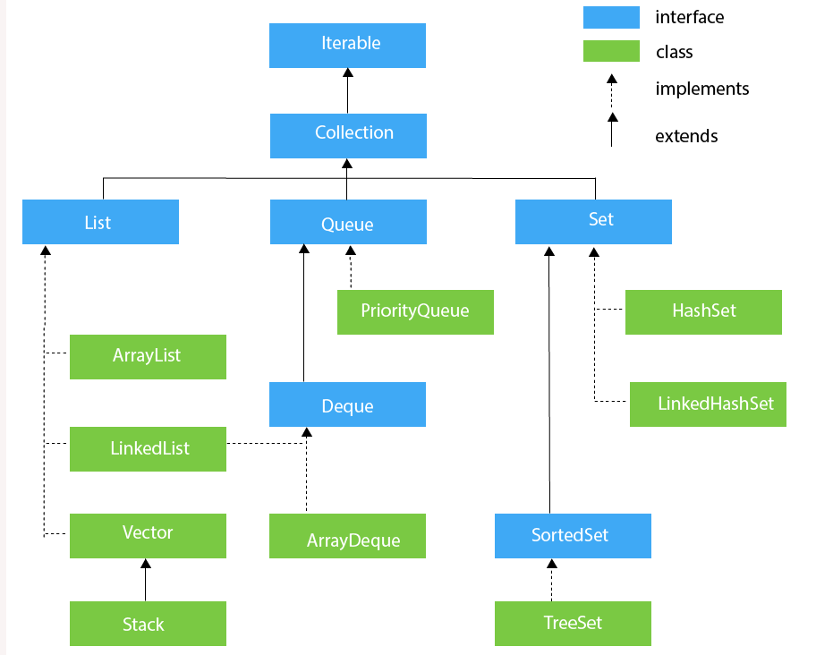
Collection interface in java
These are divided solely depending on the process which has been used for the storing and retrieving
Notes:
1.1. Collection
Collection interface is at the root of the hierarchy. Collection interface provides all general purpose methods which all collections classes must support (or throw UnsupportedOperationException). It extends Iterable interface which adds support for iterating over collection elements using the “for-each loop” statement.
All other collection interfaces and classes (except Map) either extend or implement this interface. For example, List (indexed, ordered) and Set (sorted) interfaces implement this collection.

Slide 5
List interface
Consists of the following classes –
ArrayList: Resizable-array implementation of the List interface with default size of 10. Implements all optional list operations, and permits all elements, including null.
Vector: This class is roughly equivalent to ArrayList except it is Synchronized.
LinkedList: Linked list implementation of the List and Queue interfaces. Implements all optional operations, and permits all elements (including null).
Notes:
1.2. List
Lists represents an ordered collection of elements. Using lists, we can access elements by their integer index (position in the list), and search for elements in the list. index start with 0, just like an array.
Some useful classes which implement List interface are – ArrayList, CopyOnWriteArrayList, LinkedList, Stack and Vector.

Slide 6
Set interface
Consists of 2 classes and an interface –
HashSet : Unique, Unsorted and Unordered. This class permits the null element.
LinkedHashSet : Unique, Ordered and Unsorted. Allows null values.
Interface SortedSet: Consists of ‘TreeSet’
Unique, and Sorted in ascending order by default.
Notes:
1.3. Set
Sets represents a collection of sorted elements. Sets do not allow the duplicate elements. Set interface does not provides no guarantee to return the elements in any predictable order; though some Set implementations store elements in their natural ordering and guarantee this order.
Some useful classes which implement Set interface are – ConcurrentSkipListSet, CopyOnWriteArraySet, EnumSet, HashSet, LinkedHashSet and TreeSet.

Slide 7
A keyword to remember– ‘collections. Sort()’
All the sub-classes of ‘Collection’ Interface can be sorted using this keyword. No matter what type of object it holds you can define how you want to sort the collection.
Override ‘compareTo’ method from Comparable Interface - A object is capable of comparing itself with another object. Ex – Sorting a list of employees based on their Employee Id.
Override ‘compare’ method from Comparator Interface –Here we can sort the collection on the basis of multiple elements such as id, name, salary etc.

Slide 8
There’s something we have missed…
Maps are not exactly part of the ‘Collection’ Interface as maps work with key/value pairs, while the other collections work with just values.
However without the Map interface, the collection is not complete. The Java collection classes encompass of two main root interfaces of Java collection classes. One is The Collection interface (java.util.Collection) and the other is the Map interface (java.util.Map)
MAPS
Notes:
1.4. Map
The Map interface enable us to store data in key-value pairs (keys should be immutable). A map cannot contain duplicate keys; each key can map to at most one value.
The Map interface provides three collection views, which allow a map’s contents to be viewed as a set of keys, collection of values, or set of key-value mappings. Some map implementations, like the TreeMap class, make specific guarantees as to their order; others, like the HashMap class, do not.

Slide 9
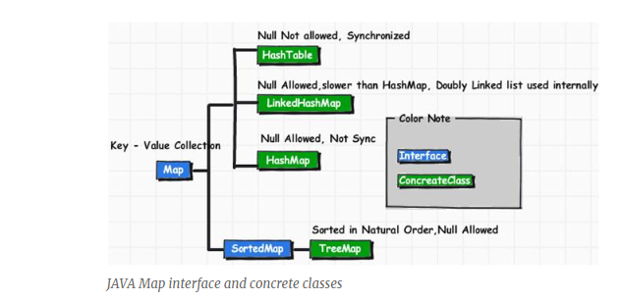
Map interface
Notes:
HashMap: The HashMap class is roughly equivalent toHashtable, except that it is unsynchronized and permits nulls.
HashTable: Hash table based implementation of the Map interface. This implementation provides all of the optional map operations, and permits null values and the null key. This class makes no guarantees as to the order of the map; in particular, it does not guarantee that the order will remain constant over time.
LinkedHashMap: Hash table and linked list implementation of the Map interface, with predictable iteration order. This implementation differs from HashMap in that it maintains a doubly-linked list running through all of its entries. This linked list defines the iteration ordering, which is normally the order in which keys were inserted into the map (insertion-order). Note that insertion order is not affected if a key is re-inserted into the map.
TreeMap: This class guarantees that the map will be in ascending key order, sorted according to the natural order for the key’s class (seeComparable), or by the comparator provided at creation time, depending on which constructor is used.

Slide 10
Thank you

