Slide 1
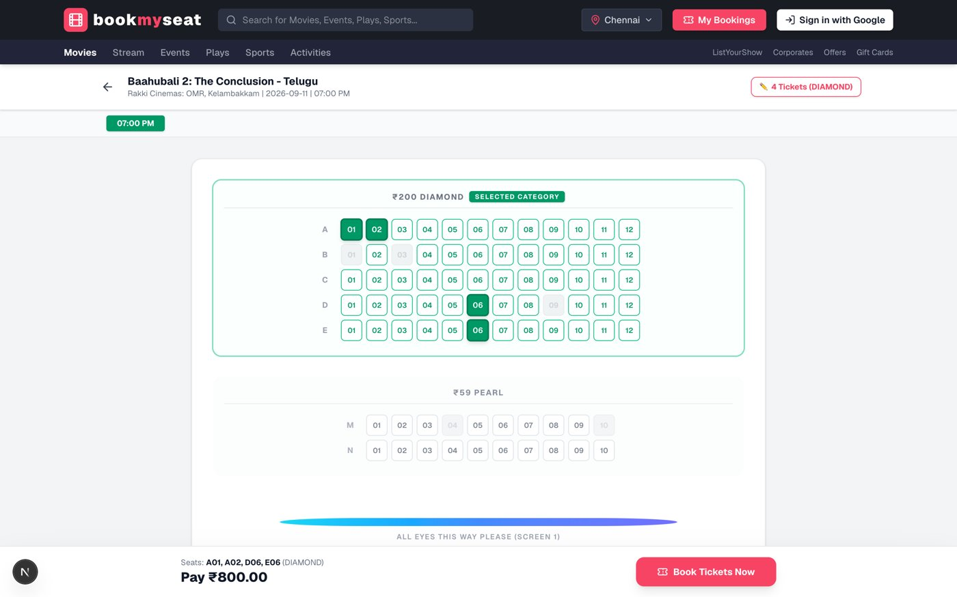
bookmyseat
Movie Ticket Booking System
Next.js 16 · Auth.js · Prisma · Neon Postgres
Browse movies, pick a showtime, choose seats, book tickets.

Slide 2
What BookMySeat does
1
Discover
2
Choose
Hero carousel, language and city filters, search across movies.
Pick a showtime at one of 5 Chennai multiplexes, 7 days ahead.
3
Pick seats
4
Book & manage
Live seat map with Diamond and Pearl categories and running total.
Google sign-in, instant e-ticket, booking history and cancellation.

Slide 3
Architecture
Browser
Next.js 16
Prisma
Neon Postgres
React 19 UI
Tailwind CSS v4
App Router
REST route handlers
Type-safe ORM
transactions
Serverless, pooled
connections
Auth.js + Google OAuth
Sessions, users and accounts are stored in the same Postgres database via the Prisma adapter.
REST API: /api/movies · /api/theaters · /api/showtimes · /api/showtimes/[id]/seats · /api/bookings

Slide 4
Why Neon Postgres
Serverless
Branching
Scales to zero when idle and wakes on demand. A good fit for a student or demo workload.
Copy-on-write branches give each feature or test its own database in seconds.
Plain Postgres
Pooled connections
Relational integrity, foreign keys, unique constraints and ACID transactions.
A built-in pooler keeps Next.js route handlers from exhausting connections.

Slide 5
Database schema
movies
seats
movie_id PK
title, genre, language
duration, rating
poster_url, release_date
seat_id PK
showtime_id FK
seat_number, category
is_booked
UNIQUE(showtime, seat)
showtimes
showtime_id PK
movie_id FK
theater_id FK
show_date, show_time
price_classic / prime / recliner
booking_seats
booking_id FK
seat_id FK
PK(booking, seat)
theaters
bookings
theater_id PK
name, location, city
total_screens
cancellation_status
booking_id PK
booking_ref UNIQUE
user_id FK
showtime_id FK
total_amount, seats_list
users (Auth.js)
id PK, email
accounts, sessions
verification_tokens

Slide 6
Booking is one atomic transaction
Verify session
Auth.js rejects unauthenticated requests with 401.
1
Check seats
Inside the transaction, read the selected seats. If any is booked, abort.
2
Create booking
Insert the booking row with a BMS-xxxxxx reference.
3
Mark seats
Set is_booked = 1 and link seats in booking_seats.
4
Commit
All writes succeed together, or none are applied.
5

Slide 7
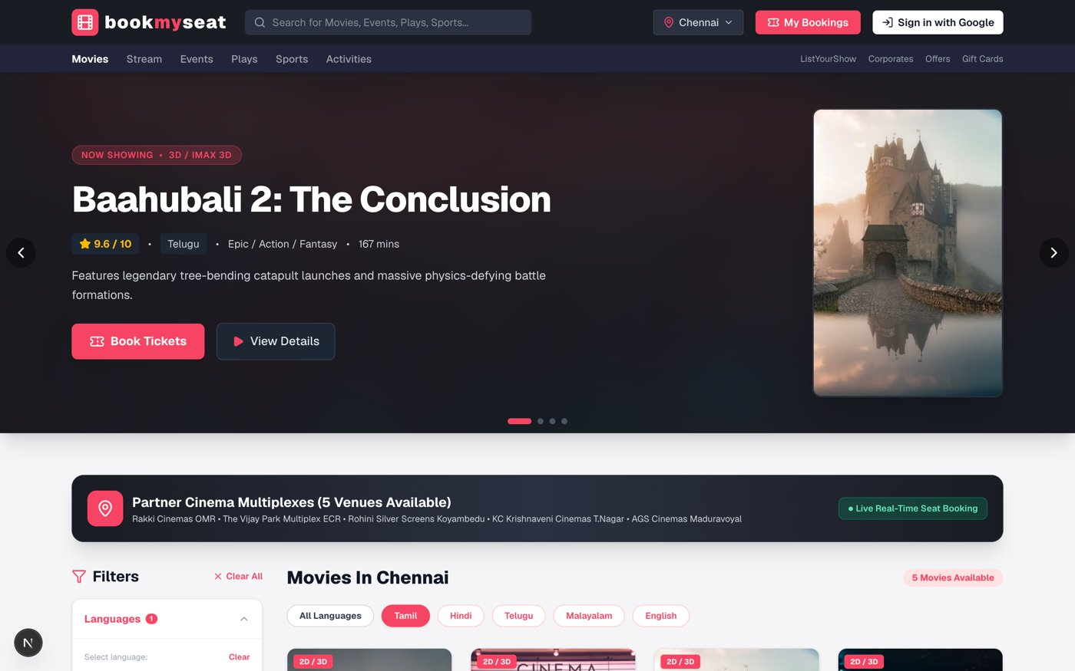
The app: browse and book
Home: hero carousel, language filters, partner cinemas
Seat map: category pricing and running total

Slide 8
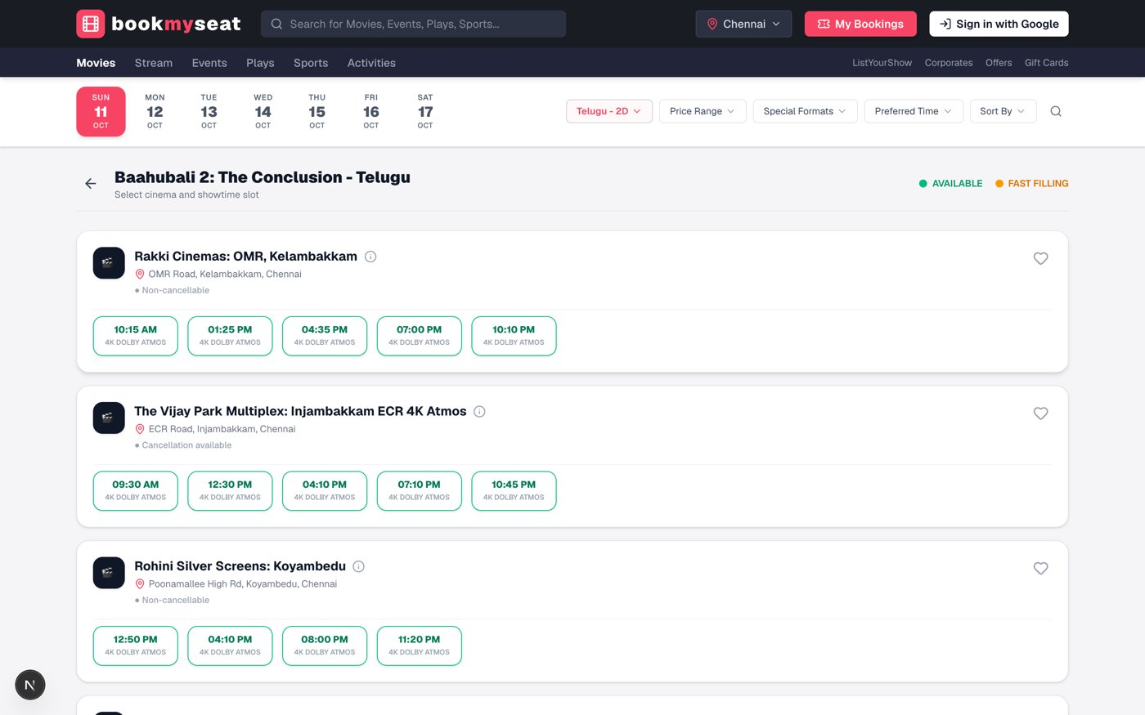
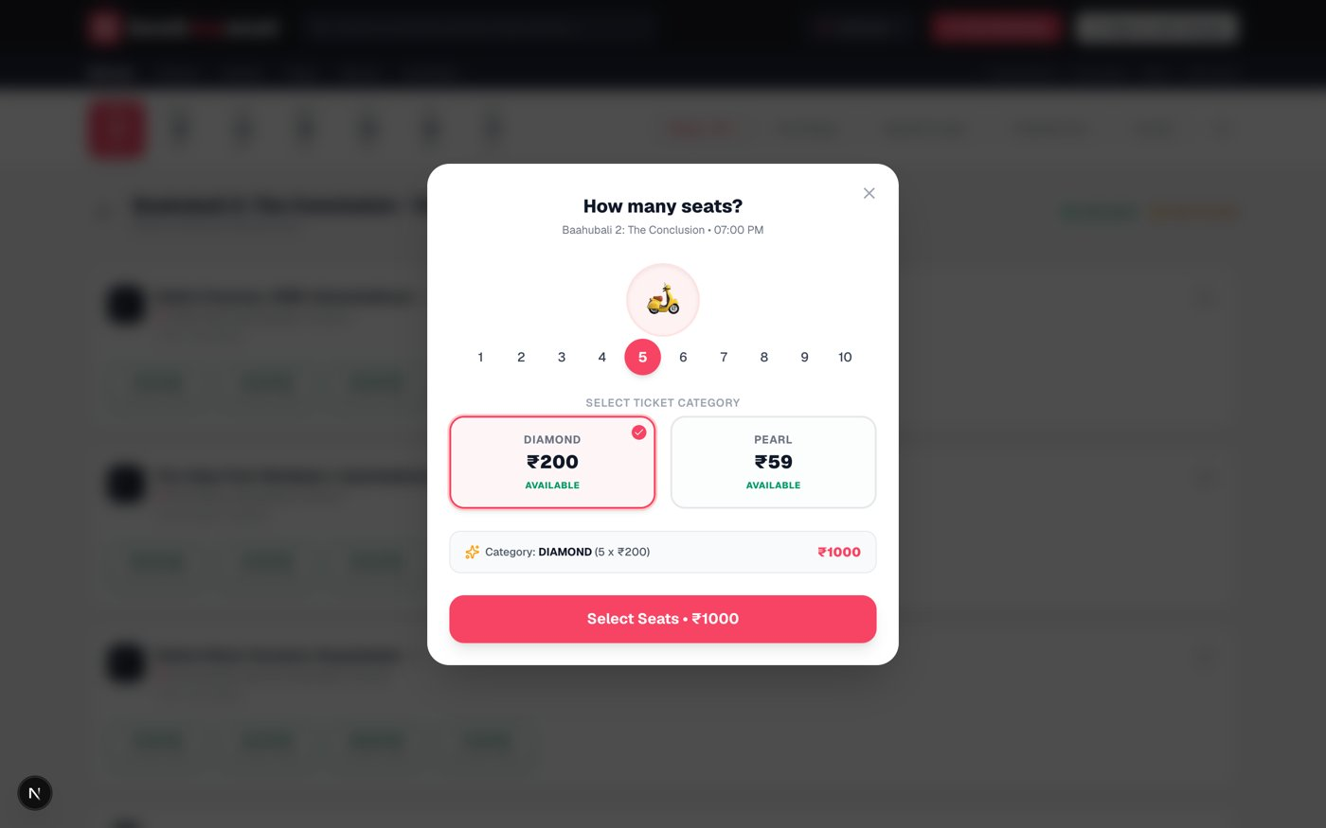
The app: showtimes and seat count
Showtimes grouped by cinema and date
Choose how many tickets before picking seats

Slide 9
Authentication and admin
Sign-in
Admin dashboard
Google OAuth through Auth.js v5
Database sessions stored in Neon Postgres
Bookings are tied to the user id
Users only see and cancel their own bookings
Allowlist via ADMIN_EMAILS env var
requireAdmin guard on every admin API route
Tabs for movies, theaters and showtimes
Seat layouts are generated automatically for new showtimes

Slide 10
Seed data at a glance
20
5
7
80
movies in 5 languages
Chennai multiplexes
days of showtimes
seats per show
Seat categories: Diamond (rows A-E, 12 seats each) and Pearl (rows M-N, 10 seats each). Tamil, Hindi, Telugu, Malayalam and English titles.

Slide 11
Tech stack
Frontend
Next.js 16 (App Router, Turbopack), React 19, Tailwind CSS v4, lucide-react
Backend
Next.js route handlers (REST), TypeScript
Data
Prisma ORM, Neon serverless PostgreSQL, Prisma Migrate and seed script
Auth
Auth.js (next-auth v5) with Google provider and Prisma adapter
Tooling
ESLint, tsx, Docker (planned)

Slide 12
Next steps
Payment gateway integration
Seat holds with expiry to prevent checkout races
Email and SMS ticket delivery
Neon branches for preview deployments
Dockerised deployment
Thank you
Questions?

