Slide 1
ProjectBuddy - From First Idea to Final Touch.
Christoph Braun, Hariram Gopalakrishnan, Shally Kapoor, Patrik Saile, Sara Schönhöfer

Slide 2





From Concept to MVP: A Structured Development Process
Problem Description
Research & Validation
Product Design
MVP
Demo
Key Takeaways

Slide 3

DIY Projects Often Fail Before They Even Begin
I have an idea… now what?
Problem
DIY projects require planning, material sourcing and step-by-step guidance
Information is scattered across videos, blogs and online shops
Beginners struggle to estimate the required materials and tools
Finding the right products in a local hardware store is time-consuming
Unclear instructions and missing materials lead to frustration and wasted money

Slide 4
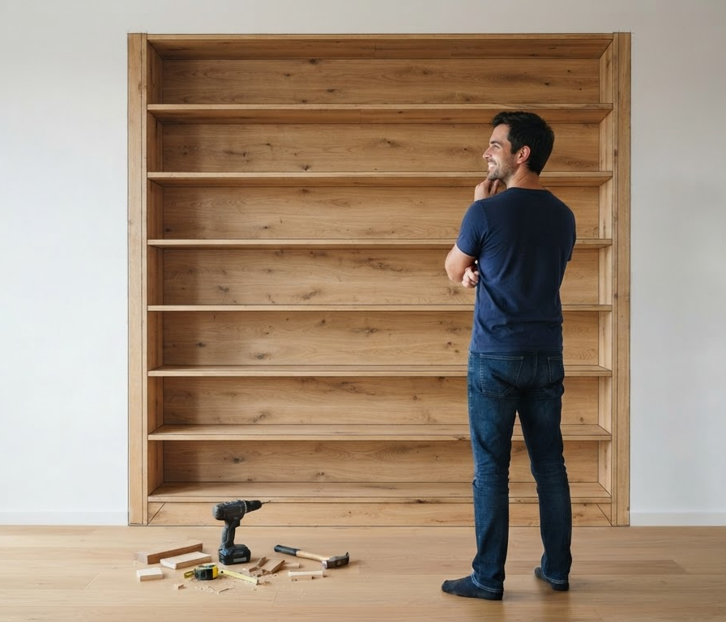
One Idea Should Be Enough to Start a DIY Project
Users describe their DIY idea in natural language – ProjectBuddy transforms it into a structured project plan
Describe
ProjectBuddy generates a list of required materials and tools
PREPARE
ProjectBuddy helps users find where to find the required materials
FIND
ProjectBuddy provides clear, structured instructions for each project phase
BUILD

Slide 5
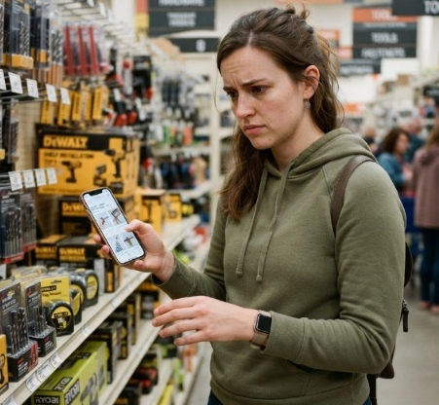
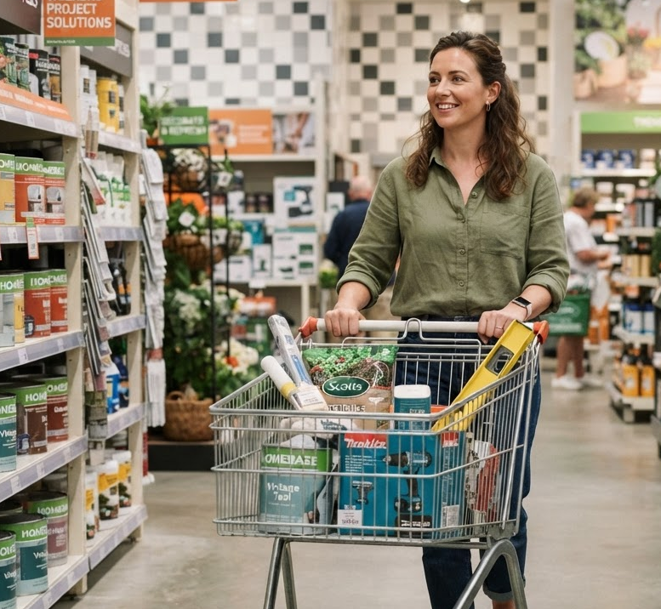


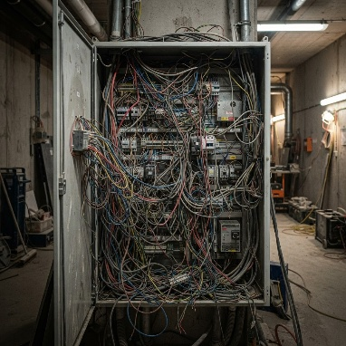
We Help DIY Beginners Turn Ideas into Achievable Projects
Beginner
Josie, 19
Erlangen
Student, working student
Student apartment
Simple step-by-step instructions
Avoid mistakes and feel confident
Break projects into small tasks
Know costs before starting
Achieve quick wins and build confidence
1
Occasional
Andrea, 32
Schwabach
Bank clerk
House
Save time with ready-made plans
Adapt projects to individual needs
Work at your own pace
Reuse materials and avoid waste
Discover ideas and customize projects
2
X

Slide 6
Roadmap Release

Slide 7
MOSCOW

Slide 8
MoSCoW prioritisation of Baumarkt Buddy
All 51 requirements from our product spec, sorted into Must, Should, Could and Won't
M
Must 27
S
Should 10
C
Could 6
W
Won't 8
FR-02 Free-text project entry
FR-03 Recognise project type
FR-05 Max. 3 follow-up questions
FR-06 Materials, tools, PPE list
FR-08 Catalogue products only
FR-11 Price, stock, aisle
FR-15 Safety stop + hand-off
FR-04 Confirm size and load
FR-09 Compatibility check
FR-10 Explain each item
SR-01 Guesses ≠ facts
SR-07 Keep manufacturer warnings
SR-09 Exclude high-risk work
SR-02 No wall check from photos
SR-03 Wall type + load first
SR-04 Don't add anchor ratings
SR-05 Explain detector limits
SR-06 Missing evidence = stop
SR-08 Re-check after changes
SR-10 Expert sign-off
NFR-01 Mobile-first, < 2 min
NFR-03 Model-failure fallback
NFR-04 GDPR, no login
NFR-05 AI guidance labelled
NFR-07 Prompt-injection safe
NFR-10 Catalogue apart from code
NFR-02 List in < 5 s
FR-12 Alternatives
FR-16 Assembly steps
FR-01 Save and resume
FR-07 Items already owned
FR-13 Store by postcode
FR-14 Offline checklist
FR-17 Export and share
NFR-06 Security basics
NFR-08 Accessibility
NFR-09 German and English
FR-18 Verified aisle location
FR-02 Photos
FR-19 Barcode scanning
FR-20 Assembly tracking
FR-22 Share with associate
NFR-11 Monitoring
FR-21 Reservations
FR-23 Multi-retailer baskets
FR-24 Voice, visualisation
Native apps
Indoor navigation
Payment, checkout
Electrics, gas, structure
Walls from photos
Baumarkt Buddy · MoSCoW prioritisation
1
Notes:
This is the whole board on one slide. The Must column is the biggest because it holds all ten safety requirements. Should is mostly about using the app between visits; Could needs real store data or partners; Won't is either later or never.

Slide 9
Why we prioritised it this way
M
Must
Safe, catalogue-only lists for low-risk and gated wall projects (R1 + R2), plus every safety requirement.
Decisions for the team
The spec marks FR-01 to FR-17 all as P0. For a 2-week MVP we moved seven to Should and photo input to Could.
The load limits (25 kg on plasterboard, 50 kg overall) come from our earlier Phase 1 draft and still need sign-off.
Next: confirm the Must list, then build R1 against these IDs.
S
Should
Makes the app useful between visits and in the aisle (mostly R3).
C
Could
Pilot extras that need store data or partners (R4).
W
Won't
Later (spec priority P2) or deliberately excluded by the spec.
Baumarkt Buddy · MoSCoW prioritisation
2
Notes:
Two decisions are open: whether the team accepts the stricter Must list compared with the spec, and the load limits. Once those are settled we build Release 1 against these requirement IDs.

Slide 11
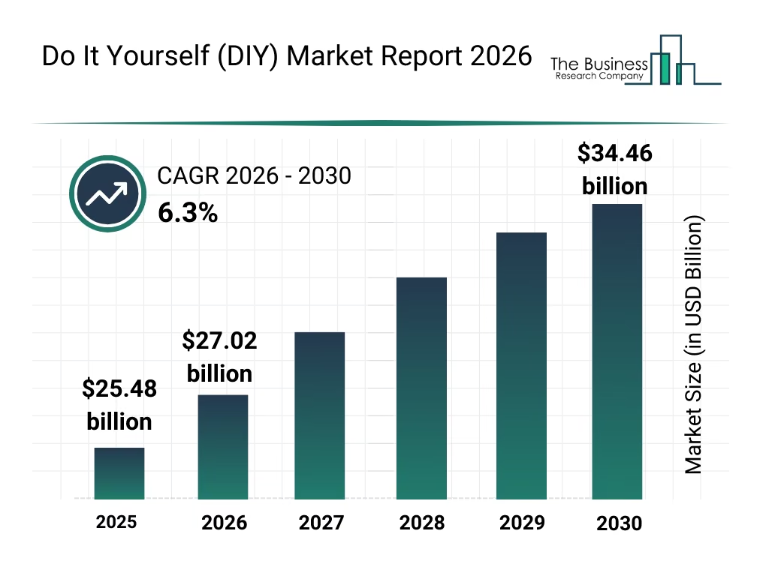
DIY Market Is Evolving Through New Consumer Needs and Trends
Trends
Social Media as a Source of Inspiration
Consumers discover DIY projects through videos and social networks and use digital tutorials to guide their own projects.
Urban Gardening and Outdoor Living
Balconies, small gardens, and green living spaces are increasingly used for leisure, home improvement, and growing plants or food.
The global DIY market is expected to grow steadily over the next few years
North America was the largest region in 2025, and Asia-Pacific is the fastest growing region
Creative Hobbies and Personalisation
DIY extends beyond home improvement to creative leisure activities such as crafting, pottery, and personalised decoration.
Renovating Instead of Buying New
Consumers are looking for cost-effective ways to improve their homes rather than replacing everything with new products
Source: Do It Yourself (DIY) Market Growth Forecast Report 2026-2030, European Home Improvement Trends & Consumer Insights | USP, Neue Studie von Appinio und OBI zeigt: Heimwerken liegt voll im Trend – Social Media als DIY-Inspirationsquelle

Slide 12








An Established DIY Market Still Leaves Room for a More Connected Experience
 |  | Description To Plan | Automatic Material List | Instore Finder | Personalized Guidance
 | heyOBI | ✗ | ✗ | ✓ | ✗
 | Hornbach | ✗ | ✗ | ✗ | ✗
 | Bauhaus | ✗ | ✗ | ✓ | ✗
 | toom | ✗ | ✗ | ✗ | ✗
 | Hagebau | ✗ | ✗ | ✗ | ✗
 | Lowe‘s | ✓ | ✓ | ✗ | ✓
 | Home Depot | ✓ | ✓ | ✓ | ✓
 | Heimwerk AI | ✓ | ✗ | ✗ | ✗
US companies
Source: Do It Yourself (DIY) Market Growth Forecast Report 2026-2030

Slide 13

Tools Used
Market Research
Image Generation

