Slide 1
VOICE OF PUBLIC
Group Members:
Fariha Ashir - CMA19CS021
Harigovind S - CMA19CS025
Harikrishnan E V - CMA19CS026
Department Of CSE,CCET

Slide 2
INDEX
Introduction - 3
Objectives - 4
Previous works - 5-7
Problem statement - 6
System analysis - 7
Overview of the project - 8
Problem Definition - 9
System specifications - 10
Proposed architecture - 11
System description - 12-13
Use case diagram - 14
Conclusion - 15
References - 22

Slide 3
1.INTRODUCTION
The project titled “VOICE OF PUBLIC” is a public service system for informing the grievances of public to government.
The main aim of introducing this web application “VOICE OF PUBLIC” is to easier the public services
This Web App allows the public can directly request their problems to concerned authority’s through online without going offices

Slide 4
2.OBJECTIVES
The main objective of this project is to solve public grievances easily.
It helps Public to directly request their grievances to concerned authority’s through online without going offices.
Public can save their valuable time by using this application.
Public can see their current status of request easily.
It is very user friendly for public.

Slide 5
3.PREVIOUS WORKS
Student Grievance System is a web application to maintain the dignity of the college or institute by ensuring a conflict-free atmosphere by promoting good student-teacher relationships. The students can lodge their complaints through this system which will be redressed by the institute and Admin can view the resolving status of all grievance
https://docs.google.com/document/d/1-x21f1Lc_dtwQ7daHD323LcG6HyKYTsx/ edit?usp=drivesdk&ouid=115818951295144682307&rtpof=true&sd=true

Slide 6
3. i ) PROBLEM STATEMENT
Student satisfaction is a major concern for any educational institute. However, many a time the students fail to express their concerns & issues or fail to reach out for proper support from the organization. Neither is there any system to address the conflicts or issues faced by the students. This eventually leads to students' dissatisfaction. Hence, to maintain the dignity of the college or institute by ensuring a conflict-free atmosphere by promoting good student-teacher relationships we have developed a Student Grievance System that will address the students' issues & grievances. The students can lodge their complaints through this system which will be redressed by the institute. This python-based student grievance cell will also look into matters of harassment thus creating a protective environment for students.

Slide 7
3. ii ) SYSTEM ANALYSIS
Advantages
It provides a fair and speedy means of grievance handling.
The affected person need not consult grievance cell members directly to register complaints.
Saves time of affected person and cell members
Builds harmonious education atmosphere in campus
Disadvantages
Visual effect of product during manually purchasing the product is different from viewing the product in your device

Slide 8
4.OVERVIEW OF THE PROJECT
‘VOICE OF PUBLIC’ is a web based platform where public can addresses there grievances through this platform.
Public can directly request their grievance to concerned authority’s through online without going government offices and public can see the status of requested issue.
Officers can respond to requests online immediately and officers can view, respond to public request, update the status of public request.
Requests send by public are received by concerned government officer , most of the similar requests from public side will be considered by officer with highest priority and respond to it immediately.

Slide 9
5.PROBLEM DEFINITION
Finding best effective way to solve public grievances easily using web technology.
There are lot of areas that in our State need to be developed by solving their problems. If we take a particular rural area , we can see many problems that haven't been solved still. It may because of the problems may haven't notified to the related authority’s or they purposefully hide the problem . So ,the people in rural area will not get a development and they may have to live through this problem.

Slide 10
6.SYSTEM SPECIFICATIONS
Front end – HTML CSS
Back end – JAVASCRIPT(JS)
Database - Firebase
Tools used - vscode, google chrome or Microsoft edge

Slide 11
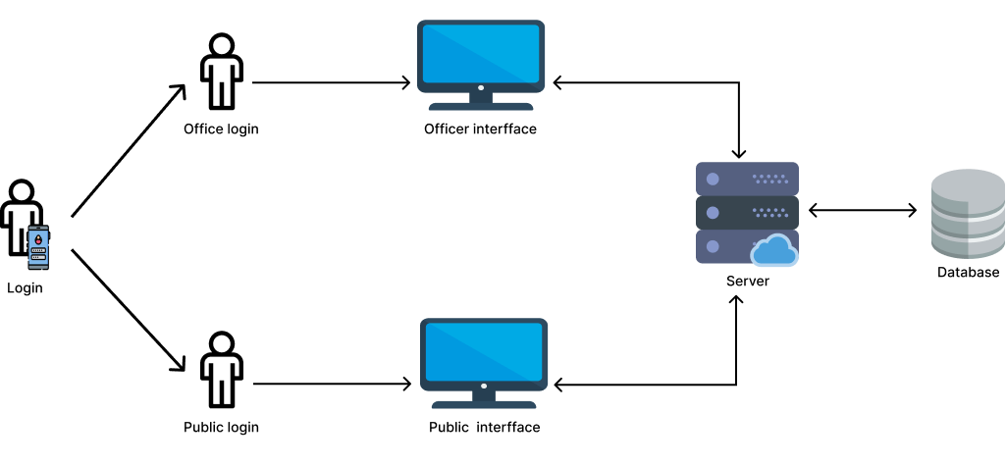
7.PROPOSED ARCHITECHURE

Slide 12
8.SYSTEM DESCRIPTION
The system comprises of 2 major modules with their sub-modules as follows:
1.Officer Module
Login-officer can login into the system using username and password.
Signup – new user can signup by filling the details .
Update status – officer can update status.
Logout – officer can logout from the page.

Slide 13
2.Public Module
Login –user can login into system using username and password.
Public can addresses their status
Signup – New public can signup
Registration process can be done by providing basic details and new user name and password

Slide 14
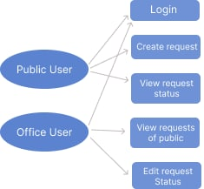
9.USE CASE DIAGRAM

Slide 15
10.CONCLUSION
Here, we found a solution for above problem. we created a ‘VOICE OF PUBLIC’ platform where public can upload our grievances to platform. It encourages public to upload their problems as a post. Public can directly request their problems to concerned authority’s through online without going offices. Officers can respond to requests online immediately. Public can see their status of concerned problem easily. Our project must be an essential ingredient to the wealth of nation . In future ,it can be implemented higher levels which provide easy recovery to public issues by deeply studying their problems.

Slide 16
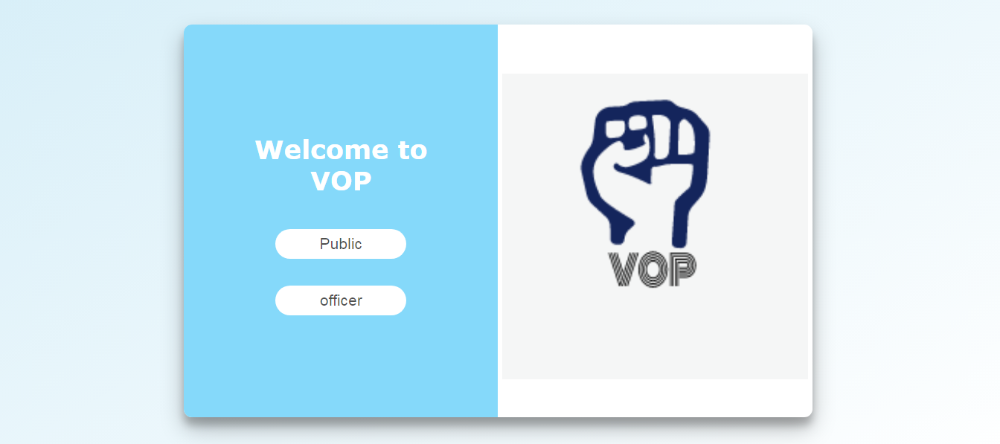
MAIN PAGE

Slide 17
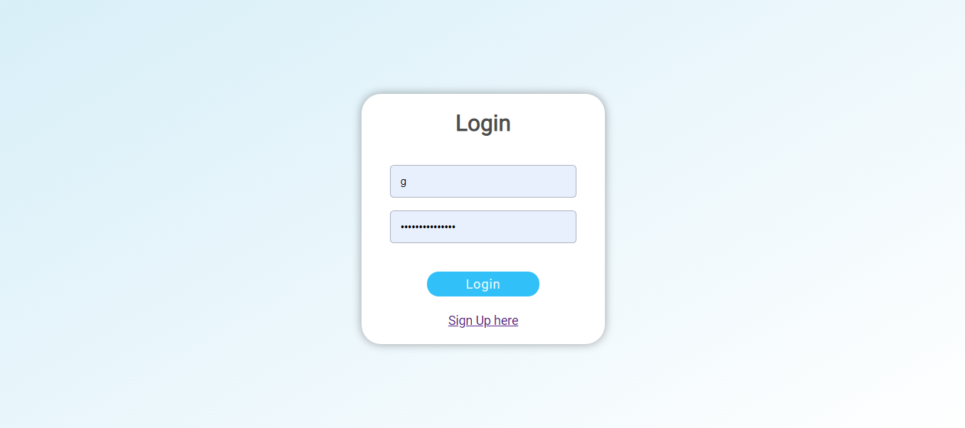
LOGIN PAGE

Slide 18
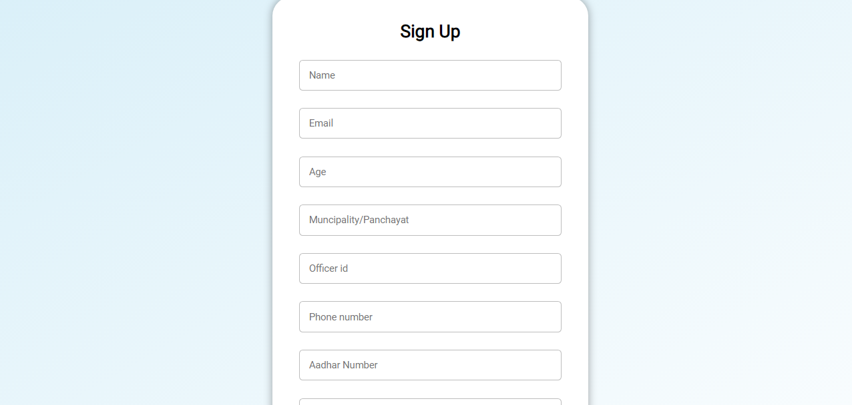
OFFICER SIGNUP

Slide 19
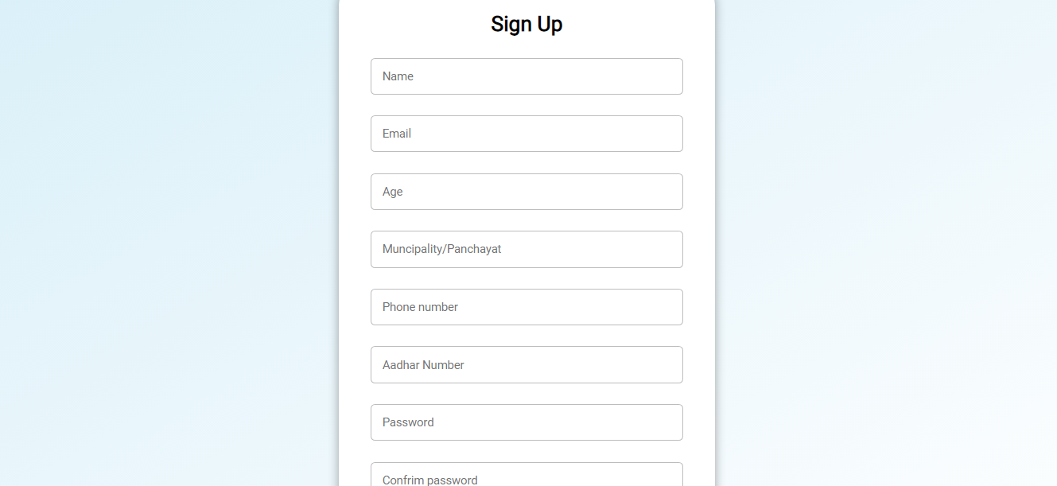
PUBLIC SIGNUP

Slide 20
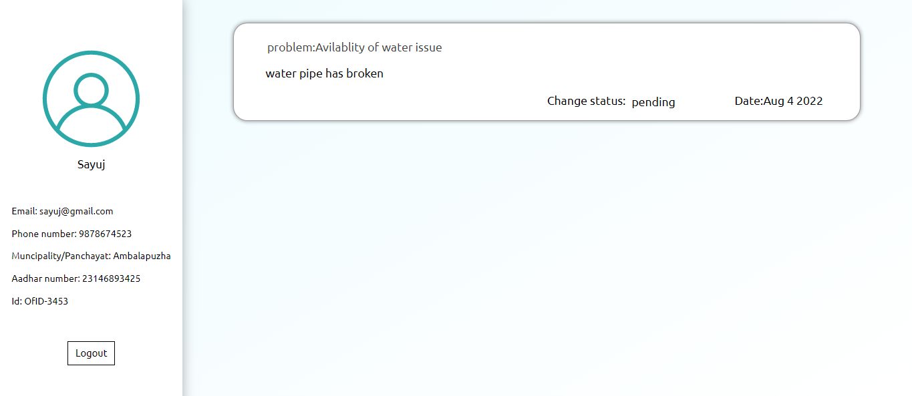
OFFICER MODULE

Slide 21
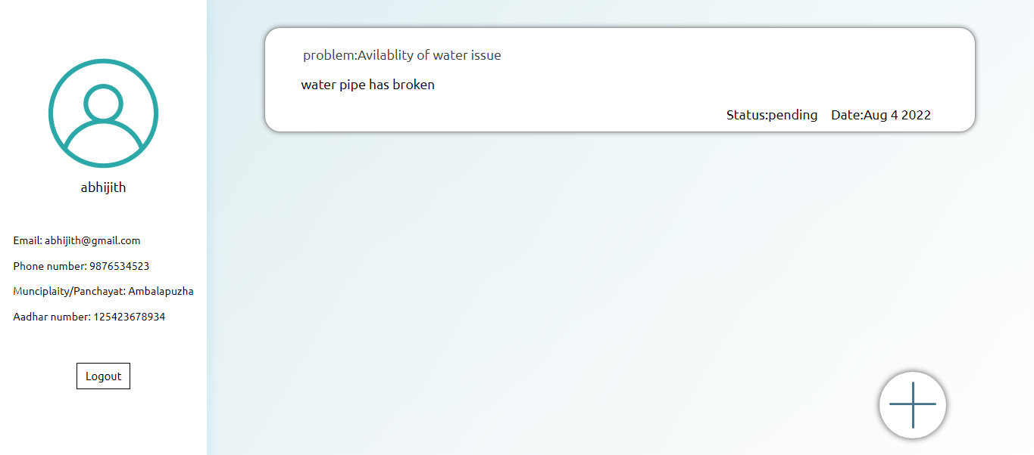
PUBLIC MODULE

Slide 22
11.REFERENCES
1.Nevon Projects - https://nevonprojects.com
2.W3school - ▪ https://www.w3schools.com/html/html_intro.asp
▪ https://www.w3schools.com/css/css_intro.asp
▪ https://www.w3schools.com/js/

Slide 23
THANK YOU

