Slide 1
TEST DESIGN
BY
BUG Squashers

Slide 2
Product Backlog
A product backlog is a prioritized list of work for the development team that is derived from the roadmap and its requirements. The most important items are shown at the top of the product backlog so the team knows what to deliver first.
Created by Product Owner.
The development team pulls work from the product backlog, either continually (kanban) or by iteration (scrum).
A team's roadmap and requirements provide the foundation for the product backlog. Roadmap initiatives break down into several epics, and each epic will have several requirements and user stories.
Factors that influence the prioritization
Customer priority
Urgency of getting feedback
Relative implementation difficulty
Symbiotic relationships between work items (e.g. B is easier if we do A first)

Slide 3
Sprint Backlog
A sprint backlog is a list of work items your team plans to complete during a project sprint. These items are usually pulled from the product backlog during the sprint planning session.
A clear sprint backlog clarifies the DOs and DONTs—during each sprint.
The Scrum master or product owner, creates the sprint backlog.
While a product backlog tracks what the product team works on, whereas a sprint backlog is a subset of the product backlog and lists the work items to complete in one specific sprint.

Slide 4
Waterfall Model vs V model
The V-Model and the Waterfall Model are both software development methodologies used in project management. While they share some similarities, they also have differences.
Phases and Progression
Waterfall Model: The Waterfall Model is a linear and sequential approach to software development. It consists of distinct phases (Requirements, Design, Implementation, Testing, Deployment, Maintenance) that are completed one after the other in a strict, top-down fashion.
V-Model: The V-Model also follows a sequential approach, but it emphasizes the connection between development phases and their corresponding testing phases. For each development phase, there is a corresponding testing phase, and they are aligned in a V-shaped diagram. For example, the Requirements phase is followed by the System Testing phase, and the Design phase is followed by the Integration Testing phase.

Slide 5
Flexibility
Waterfall Model: The Waterfall Model is rigid and less adaptable to changes once the project has started. It assumes that all requirements can be defined upfront and doesn't handle changes well without going back to earlier phases.
V-Model: While the V-Model still relies on a defined set of requirements, it is more accommodating to changes because it emphasizes testing at each stage. This means that issues and changes can be identified earlier in the process, reducing the cost and effort required to address them.
Risk Management:
Waterfall Model: Risk management is limited in the Waterfall Model because it doesn't incorporate testing until the later stages. Issues and risks may not become apparent until the testing phase, which can be late in the project timeline.
V-Model: The V-Model incorporates risk management more effectively because it identifies potential issues and risks at each phase through testing. This allows for better risk mitigation and early problem identification.

Slide 6
Iterative vs. Sequential
Waterfall Model: Waterfall is a purely sequential model, where each phase flows into the next without revisiting previous phases.
V-Model: The V-Model includes feedback loops through testing phases, allowing for a degree of iteration and correction at each stage.
Complexity
Waterfall Model: The Waterfall Model is generally used for simpler projects with well-defined requirements. It may not be suitable for complex or large-scale projects.
V-Model: The V-Model can be applied to both simple and complex projects, and its emphasis on testing makes it better suited for projects where quality assurance is critical.
In summary, the Waterfall Model is a straightforward, linear approach with limited flexibility, while the V-Model introduces a stronger focus on testing and risk management, making it more adaptable and suitable for projects where early issue detection and correction are essential. The choice between these models depends on the specific project requirements, complexity, and the degree of flexibility needed.

Slide 7
Boundary Value Analysis (BVA)
Boundary Value Analysis (BVA) is a software testing technique used to design test cases around the boundaries of input values. It is particularly useful for identifying defects related to boundary conditions, as these are often where software tends to behave differently or encounter errors. BVA focuses on testing values that are on or near the edges of an input domain, as these are more likely to cause issues.
Identify the Input Range
Categorise
Select Values on the Boundaries
Design Test Cases
Execute Test Cases

Slide 8
BVA Example
Working Day Application:
An application that determines whether a day is considered a working day or a holiday based on temperature of that day. In this case, the optimum temperature range is from 11 to 40 degrees, which is considered as a working day, otherwise it's Holiday.
Test Case 1 (Minimum Temperature): Input: 11 degrees Expected Output: Working day – Valid
Test Case 2 (Maximum Temperature): Input: 40 degrees Expected Output: Working day – Valid
Test Case 3 (Below Minimum Temperature): Input: 10 degrees Expected Output: Holiday – Invalid
Test Case 4 (Above Maximum Temperature): Input: 41 degrees Expected Output: Holiday – Invalid

Slide 9
Equivalence Partitioning
Equivalence partitioning, in software testing, is also known as Equivalence Class Partitioning or ECP for short. It's a testing technique that divides the input data into different partitions or classes, where each partition is expected to exhibit similar behaviour. This helps in reducing the number of test cases while ensuring that representative test cases are selected from each partition to verify the software's functionality.
Total 5 steps are included in the equivalence partitioning.
Define a range
Categorize
Take values
Write tests for those values
Test cases

Slide 10
Equivalence Partitioning Example
Testing education loan eligibility feature in a banking app.
DEFINE A RANGE: Range from 17 to 30 years of age is only considered as valid the range in this example.
CATEGORIZE: categorizing age ranges for a bank educational loan application
0-16= 11(invalid)
17-30= 25(valid)
31++ = 33(invalid)
Take specific values from each range: Range 1=11
Range 2=25
Range 3= 33
Total test =3= total test cases
Values: 3
Test cases: 3

Slide 11
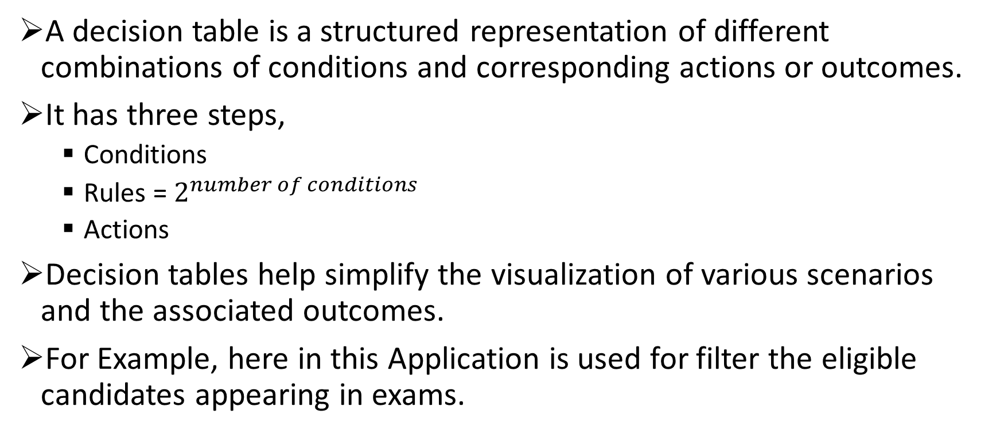
Decision Table
A decision table is a structured representation of different combinations of conditions and corresponding actions or outcomes.
It has three steps,
Conditions
Rules = $2^{number of conditions}$
Actions
Decision tables help simplify the visualization of various scenarios and the associated outcomes.
For Example, here in this Application is used for filter the eligible candidates appearing in exams.

Slide 12

Here subjects included in the exam syllabus are considered as conditions(C1-C5). Also, C1, C2, C5 should be True and either C3 or C4 must be True to Pass the exam.
Here rules = $2^{5}=32$

