Slide 1

Name: Abhinav A.S Reg. No.: 17BCE0673 Type: Hackathon Position: Qualified in top 10 Product Name: Pari (A web app with both backend and front-end completed which helps during coordination of relief materials after a disaster. Certificate Attached in next page.
Additional Learning

Slide 2
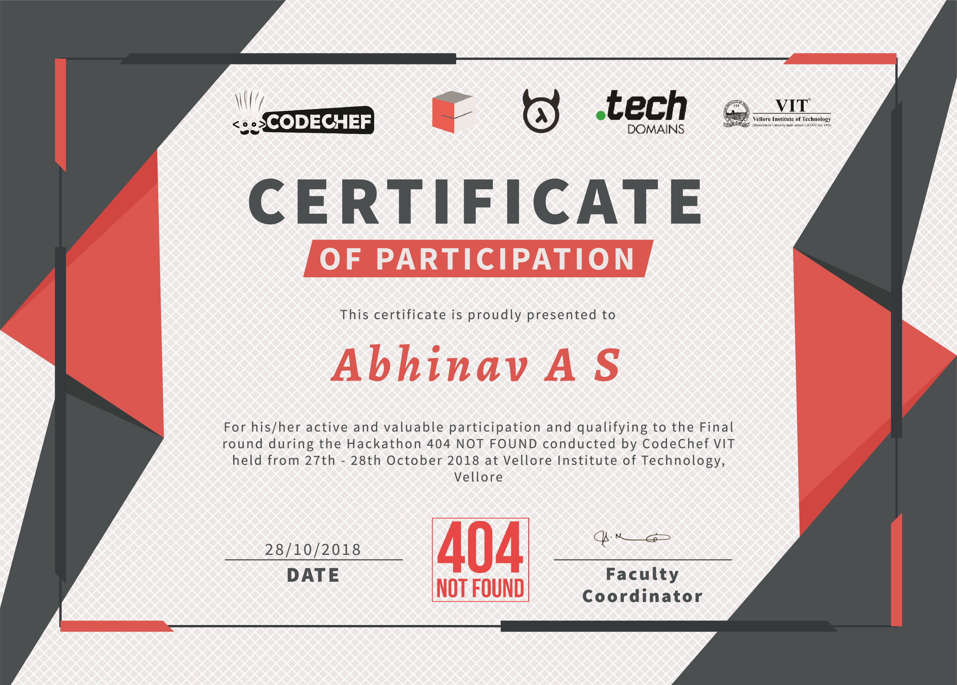

Slide 3

A Perfect Saviour at the Right Time!
Made with ♥ from Team Codemons

Slide 4
Natural Calamity
Why is this a issue?
Every year natural disasters kill around 90 000 people and affect close to 160 million people worldwide. Natural disasters include earthquakes, tsunamis, volcanic eruptions, landslides, hurricanes, floods, wildfires, heat waves and droughts.

Slide 5
Is relief material actually reaching?
RecENT ASSAM FLOODS
Close to 12 lakh people in 24 districts of Assam continued to reel under floods as the death toll reached 59 in the state.
Meanwhile, though the district administration has been claiming to have distributed sufficient relief material, there were reports from different flood hit areas regarding non receipt of adequate relief materials.

Slide 6
How efficient is the system for sending relief materials optimally?
RECENT KERALA FLOODS
Rescue teams are getting many fake messages and outdated information about incidents that have occurred many days ago.

Slide 7
Here is where comes into the picture…

Slide 8

PARI is an organisation established to meet the needs of the souls unheard during the hardest of times. We try our best to bridge the gap between the people and the NGOs. PARI makes sure that the donations are in safe hands and are reached safely.

Slide 9

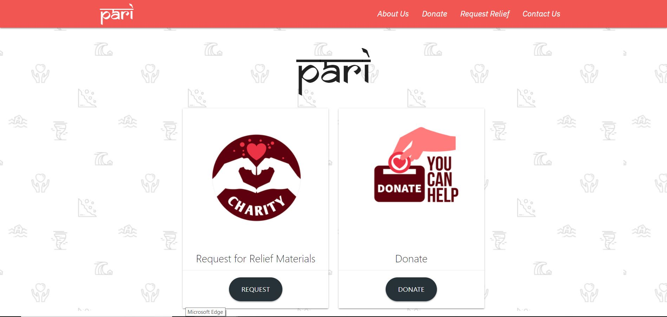
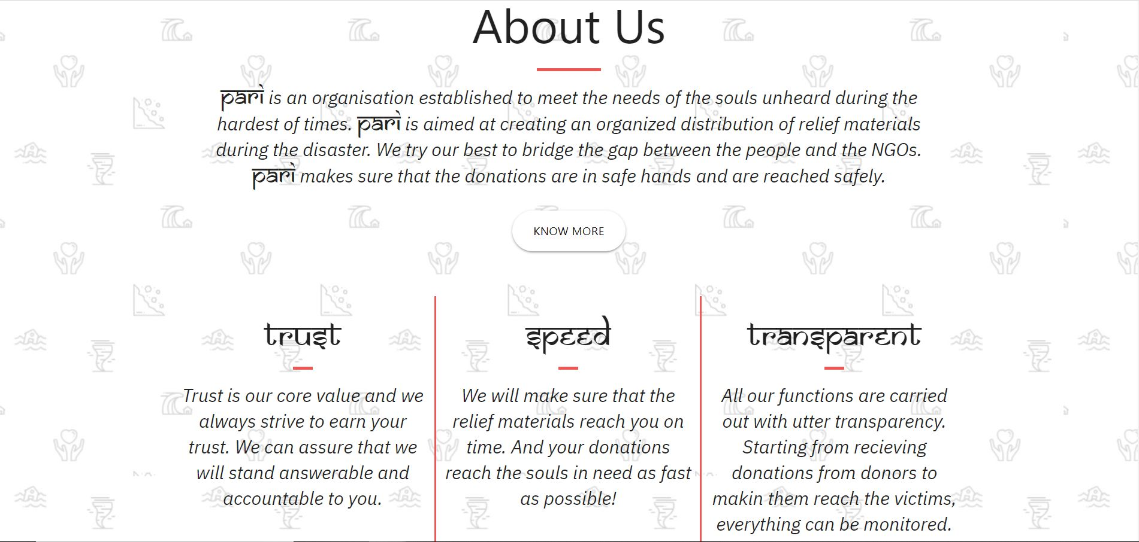
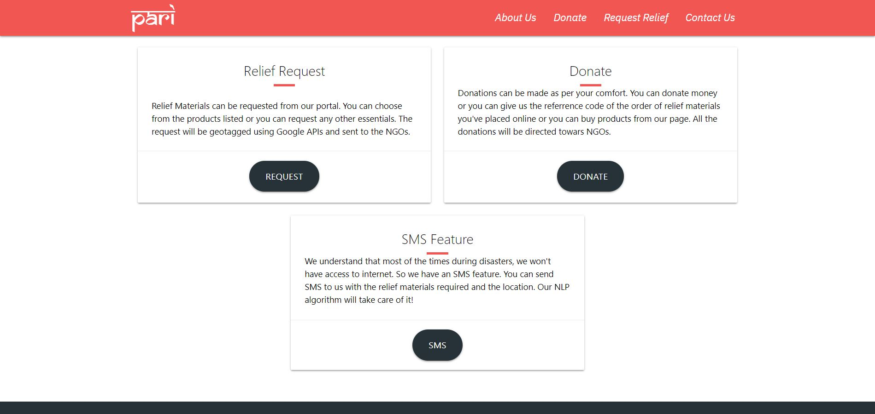

Slide 10
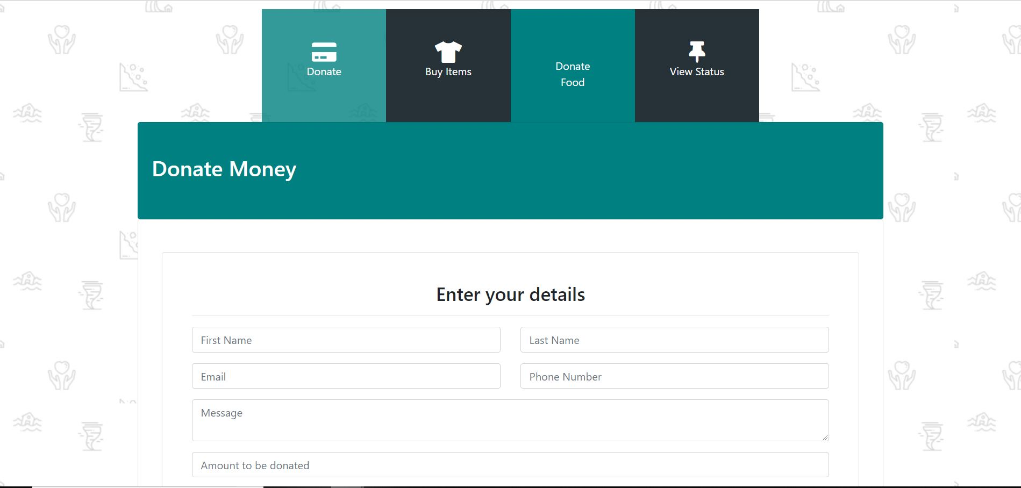
Donations made Easy!
You scan donate money or you can just share the reference code of the order of relief materials with us.
You can also shop for relief items through our portal!
All these donations are directed to NGOs

Slide 11
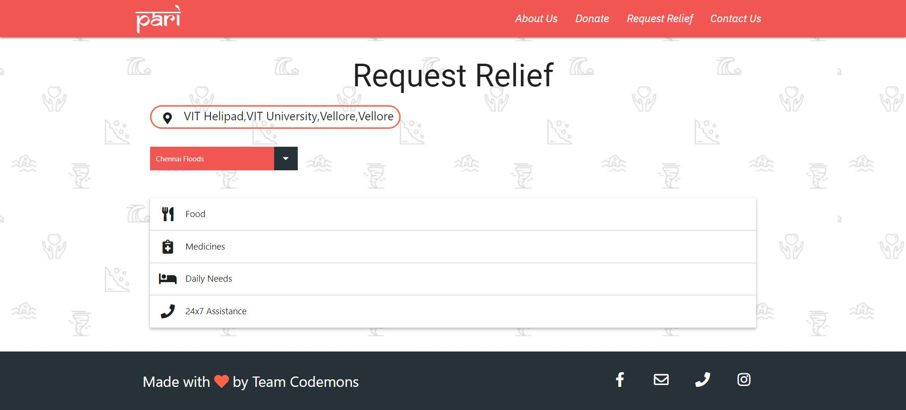
Request Relief
You can select from the list on our portal or you can let us know if you need anything else.
We’ll try our best to satisfy your needs..

Slide 12

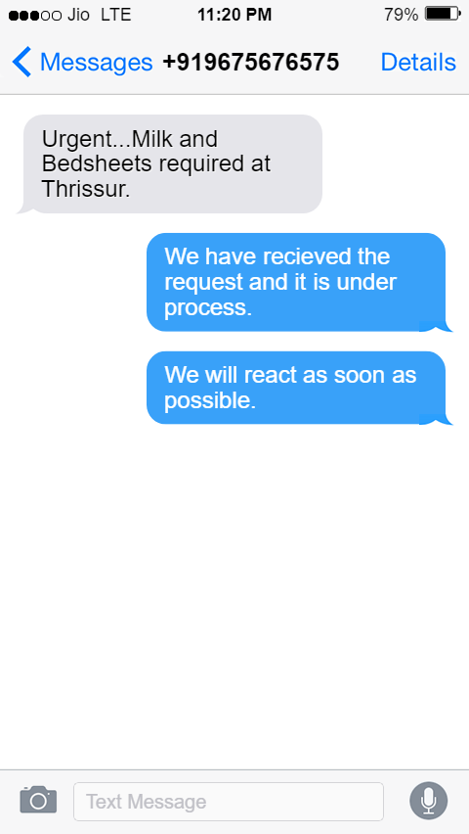
Here comes our Unique Feature…
We can understand that the internet access during a disaster is hard to… So we have an SMS relief feature which allows you to send an SMS regarding the relief material required and the location which will be geotagged and sent to the nearest NGO to you…!

Slide 13
