Slide 1

INVENTORY MANAGEMENT SYSTEM
Team
Crew X
Aarya B
Soorya K
Dhuruv Swamy R
Hariharan K
Sam Naveenkumar V

Slide 2
PROBLEM STATEMENT
Inefficient inventory management system in laboratory faces several challenges, including stockouts, overstocking, theft, and difficulty in tracking items.
Waste of time, component loss, and reduced productivity for researchers and laboratory staff.

Slide 3
IDEA APPROACH
To overcome the problems in laboratories caused by stockouts, overstocking and loss of raw materials using smart inventory management system.
To provide a real-time visibility and automate the inventory tracking to replenish the process.
To develop an advanced laboratory inventory management system that leverages mordern technologies.

Slide 4
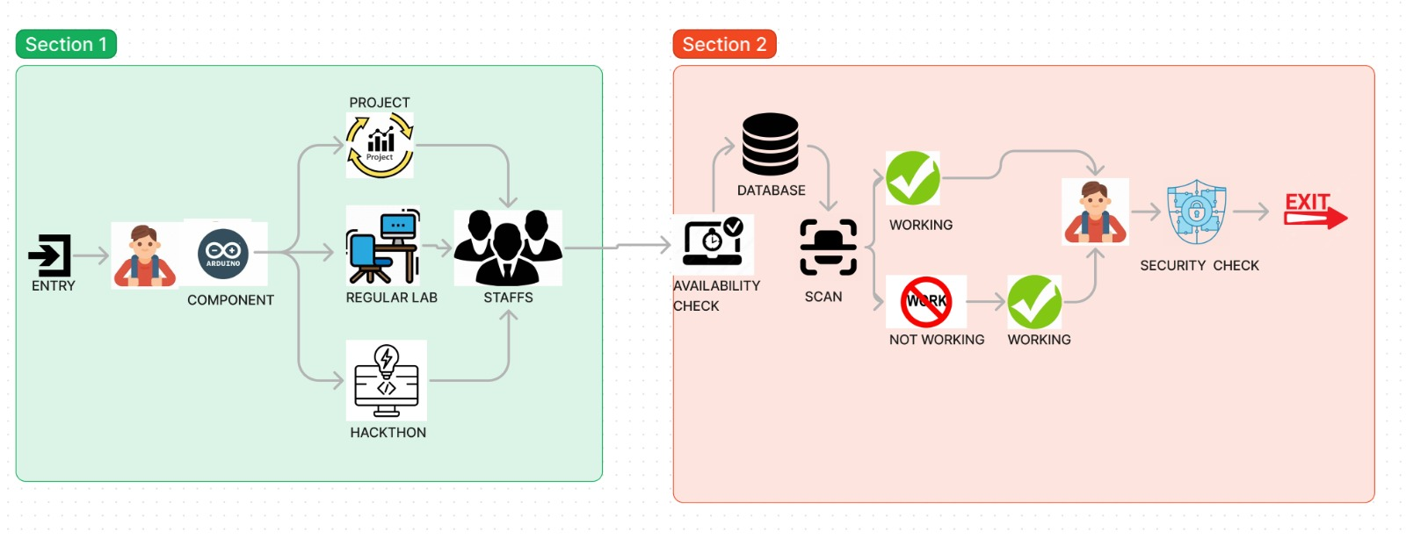
WORKFLOW

Slide 5
TECHNOLOGY STACK: FRONTEND HTML CSS JS BACKEND MONGODB ANGULAR JS | UNIQUENESS OF OUR PROJECT ANTI TAMPER LABELS SMART SHELF SYSTEM PASSIVE RFID TAGS UNIQUE USER PROFILES

Slide 6
Solution
Our Efficient Inventory Management System Enables Staff in IOT Lab to effectively maintain:
Efficient resource tracking
Budget management
Security And theft prevention
Time saving & Cost Efficient
Shelves segregation
Predictive Analysis
Dynamic database integration

