Slide 1
K.RAMAKRISHNAN COLLEGE OF TECHNOLOGY
(AUTONOMOUS), TRICHY
CAMPUS PLACEMENT PREDICTION USING MACHINE LEARNING
AGI1242 - MACHINE LEARNING | MINI PROJECT
PRESENTED BY
GUIDED BY
[REGISTER NO.] - [TEAM MEMBER 1 NAME]
[REGISTER NO.] - [TEAM MEMBER 2 NAME]
[REGISTER NO.] - [TEAM MEMBER 3 NAME]
[FACULTY NAME, QUALIFICATION]
[DESIGNATION / DEPARTMENT]

Slide 2
PROBLEM STATEMENT
Placement is uncertain: students do not know early whether their profile is strong enough for campus drives.
Static cut-offs: placement cells use fixed CGPA and backlog limits that ignore aptitude, coding and other skills.
Many factors, no clear picture: marks, aptitude, coding, projects, internships and certificates all matter together.
Late guidance: weak areas are found only after drives are over, so training is not targeted.
Manual analysis: checking hundreds of student records by hand is slow and subjective.
Predict whether a student will get placed or not, using academic performance, aptitude, coding skills and other placement-related factors, and find which of Logistic Regression, Decision Tree and Random Forest does it best.

Slide 3
OBJECTIVE
To build a machine learning system that predicts the placement status of a student and compares three classification algorithms.
Collect and clean student data: CGPA, 10th / 12th %, backlogs, aptitude, coding, communication, projects, internships, certifications.
Train Logistic Regression, Decision Tree and Random Forest with tuned parameters.
Compare them using accuracy, precision, recall, F1-score and ROC-AUC on unseen data.
Find which factors influence placement the most.
Give a live demo where a student's details give a prediction and improvement hints.

Slide 4
LITERATURE SURVEY
No. | Paper | Work done | Limitation / gap
1 | A. D. P. Kumar et al. Predicting Student Employability Using Machine Learning: A Comparative Study of Classification Algorithms. ICCSCE 2025. | Logistic Regression, Random Forest and XGBoost; accuracy 88.37%, 93.02% and 95.34%. | Needs a full stack (Flask, React, MongoDB); heavy for a college mini project.
2 | A. Pathak, M. Matcha, M. Gopisetti, S. Joshi. A Machine Learning Framework for Predicting Student Placement Outcomes. Ing. des Systemes d'Information, 30(7), 2025. | Kaggle data of 2,966 students; seven models with GridSearchCV; voting classifier best (89.23%). | Features have no aptitude or coding scores.
3 | M. Kumar, N. Walia, S. Bansal, G. Kumar, K. Cengiz. Predicting college students placements based on academic performance using ML approaches. IJMECS, 15(6), 2023. | Random Forest found best using academic factors. | Overfitting reported by Pathak et al.: 96% training vs 64.62% test accuracy.
4 | C. K. Srinivas et al. Students placement prediction using machine learning. IJRASET, 8(5), 2020. | Logistic Regression on academic percentages and technical skills. | Single algorithm; no comparison with other models.
5 | S. Byagar, R. Patil, J. Pawar. Maximizing campus placement through machine learning. J. Advanced Zoology, 45(S4), 2023. | SVM, Naive Bayes and Logistic Regression; communication and aptitude matter beyond marks. | No tree-based models compared.
Gap: few studies compare Logistic Regression, Decision Tree and Random Forest together on academic plus aptitude and coding features with a ready demo.
All reference links: https://claude.ai/artifact/4ftiCkXwZTuR1yWqZ6Nzbr

Slide 5
EXISTING SYSTEM
How it works today
Limitations
Placement cell shortlists by fixed CGPA and backlog cut-offs.
Staff study past records by hand or in spreadsheets.
Students get advice only from seniors or after drives.
Research models mostly use academic marks only.
Many studies test one algorithm or need a heavy web stack.
Static cut-offs ignore skills.
No early warning for students.
Aptitude and coding scores not used.
No fair comparison of algorithms.
Overfitting in single models.
No simple demo for students.

Slide 6
SYSTEM ARCHITECTURE
Users
Student | Placement Officer
Presentation Layer (Web demo - app.py)
Student form, prediction result, model comparison table and charts
Technology Used
Python 3
pandas, NumPy
scikit-learn
matplotlib, joblib
Eclipse + PyDev
Prediction Layer (predict.py)
Input validation, probability from 3 models, majority vote, improvement hints
Machine Learning Layer (models.py, evaluate.py, train.py)
Logistic Regression, Decision Tree, Random Forest, GridSearchCV, metrics and charts
Data Layer (data_preparation.py)
placement_data.csv: cleaning, imputation, scaling, one-hot, 80/20 split; saved models

Slide 7
PROPOSED SYSTEM
A Python machine learning pipeline that cleans student data, trains three algorithms, compares them and serves predictions in a browser demo.
Student data (CSV)
Clean, impute, scale, encode, split 80/20
Train 3 algorithms with GridSearchCV
Evaluate on unseen test set
Predict one student + hints
Browser demo
Algorithms compared
Logistic Regression
Linear baseline, gives probability
Decision Tree
Easy to read if-then rules
Random Forest
200 trees, reduces overfitting
Data: 1,200 students, 10 numeric features + branch (synthetic dataset; real CSV can replace it).

Slide 8
LIST OF MODULES
1
2
3
Dataset and EDA
Data Preparation
Model Training
Student records, class balance, CGPA and internship trends
Cleaning, imputation, scaling, one-hot encoding, split
3 algorithms tuned with 5-fold GridSearchCV
4
5
6
Evaluation and Comparison
Prediction and Hints
Web Demo Interface
Accuracy, precision, recall, F1, ROC-AUC, confusion matrix
Probability from 3 models, vote, areas to improve
Browser form, results, comparison table and charts

Slide 9
MODULE 1: DATA PREPARATION
Cleaning: removes duplicate students and turns impossible values (such as CGPA above 10) into missing values.
Missing values: numbers are filled with the median, branch with the most common value.
Scaling: numeric features are standardised so that Logistic Regression learns fairly.
Encoding: branch is converted to 0/1 columns with one-hot encoding.
Split: 80% training and 20% testing, keeping the same placed ratio (stratified).
data_preparation.py - preprocessing pipeline
numeric = Pipeline([
("impute", SimpleImputer(
strategy="median")),
("scale", StandardScaler())])
categorical = Pipeline([
("impute", SimpleImputer(
strategy="most_frequent")),
("onehot", OneHotEncoder(
handle_unknown="ignore"))])
prep = ColumnTransformer([
("num", numeric, NUMERIC_FEATURES),
("cat", categorical, CATEGORICAL)])
X_train, X_test, y_train, y_test = \
train_test_split(X, y, test_size=0.20,
stratify=y, random_state=42)
Implemented in: data_preparation.py: clean_data(), build_preprocessor(), get_splits()

Slide 10
MODULE 2: MODEL TRAINING
Three algorithms: Logistic Regression, Decision Tree and Random Forest (200 trees).
One pipeline: preprocessing and model are joined, so test data never leaks into training.
Tuning: GridSearchCV with 5-fold cross-validation picks the best parameters by F1-score.
Saving: each tuned model is saved with joblib and reused by the demo.
models.py - tuning with GridSearchCV
"Random Forest": (
RandomForestClassifier(
n_estimators=200,
random_state=42, n_jobs=-1),
{"clf__max_depth": [5, 10, None],
"clf__min_samples_leaf": [1, 3, 5]})
pipe = Pipeline([
("prep", build_preprocessor()),
("clf", estimator)])
search = GridSearchCV(pipe, grid,
cv=5, scoring="f1", n_jobs=-1)
search.fit(X_train, y_train)
return search.best_estimator_
Implemented in: models.py: candidate_models(), train_model(); train.py

Slide 11
MODULE 3: PREDICTION AND WEB DEMO
Validation: every field is checked for range, so wrong input shows a clear message.
Prediction: all three models give placement probability; 0.5 or more means PLACED.
Majority vote: shows how many of the 3 models predict placement.
Hints: values below the median of placed students are listed as areas to improve.
Browser demo: run app.py and a page opens; strong and weak sample profiles load in one click.
predict.py - predict_student()
row = pd.DataFrame([clean])[FEATURES]
results = {}
for name, model in load_models().items():
prob = float(
model.predict_proba(row)[0, 1])
results[name] = {
"placed": prob >= 0.5,
"probability": prob}
votes = sum(r["placed"]
for r in results.values())
return {"results": results,
"votes": votes,
"hints": _hints(clean)}
Implemented in: predict.py: validate(), predict_student(); app.py

Slide 12
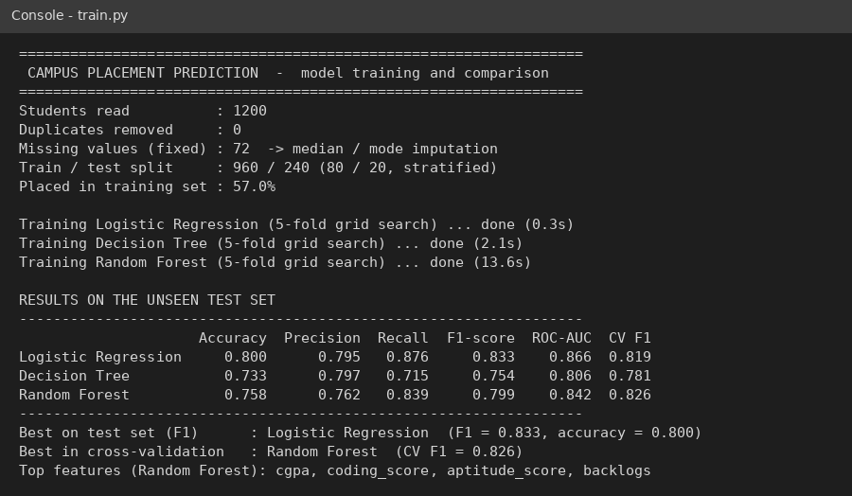
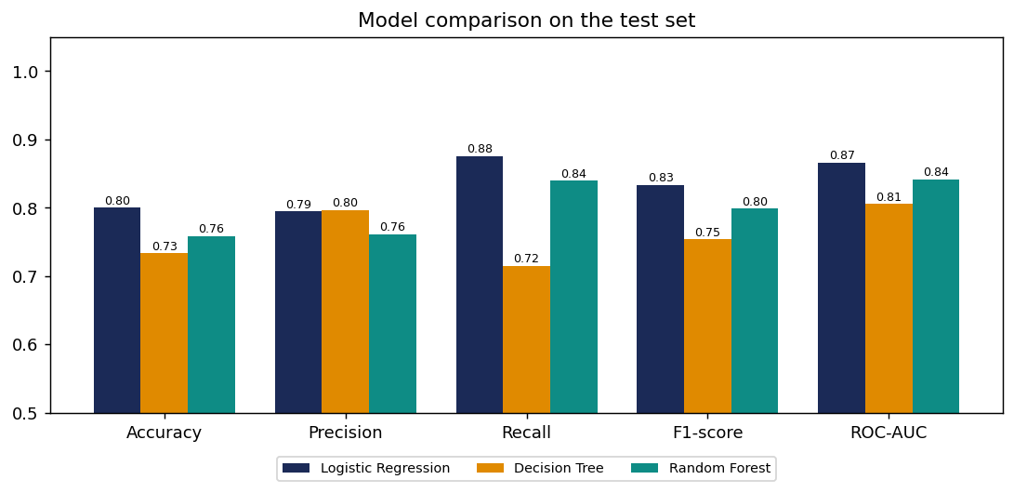
OUTPUT 1: TRAINING AND COMPARISON
Console output of train.py: data cleaning, split and test-set results of the 3 algorithms
Model comparison chart: Logistic Regression is best on the test set, Random Forest in cross-validation

Slide 13
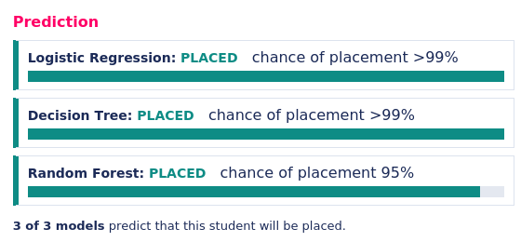
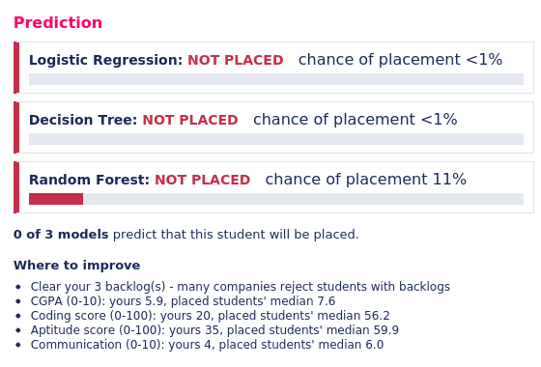
OUTPUT 2: LIVE PREDICTION DEMO
Strong profile (CGPA 8.6, coding 85): all 3 models predict PLACED
Weak profile (CGPA 5.9, 3 backlogs): NOT PLACED, with where to improve

Slide 14
CONCLUSION AND FUTURE ENHANCEMENT
Conclusion
The system predicts campus placement from academic, aptitude and coding factors and compares three algorithms on unseen data. On our 1,200-student dataset Logistic Regression scored best on the test set (accuracy 80.0%, F1 0.833) and Random Forest was best in cross-validation (F1 0.826); CGPA, coding score, aptitude score and backlogs were the strongest factors. The browser demo gives instant predictions with improvement hints.
Future Enhancements
Train on the real placement records of the college for better accuracy.
Add XGBoost, SVM and a voting ensemble; explain predictions with SHAP.
Predict company-wise placement and expected salary range.
Host the demo online for students with a login.

Slide 15
THANK YOU
Queries?

