Slide 1
K.RAMAKRISHNAN COLLEGE OF TECHNOLOGY
(AUTONOMOUS), TRICHY
QUEUE MANAGEMENT SYSTEM FOR COLLEGE SERVICES USING JAVA
CGB1201 - JAVA PROGRAMMING | MINI PROJECT
PRESENTED BY
GUIDED BY
[REGISTER NO.] - [TEAM MEMBER 1 NAME]
[REGISTER NO.] - [TEAM MEMBER 2 NAME]
[REGISTER NO.] - [TEAM MEMBER 3 NAME]
[FACULTY NAME, QUALIFICATION]
[DESIGNATION / DEPARTMENT]

Slide 2
PROBLEM STATEMENT
Long, crowded queues: students wait physically at the office, library, fees section and certificate counters.
No fair order: queue jumping and arguments happen because there is no token or fixed sequence.
No waiting-time information: students cannot know their position or how long they must wait, so class time is wasted.
Urgent cases not handled: senior citizens, differently-abled students and emergencies get no systematic priority.
No records for staff: waiting time, service time and daily load are never measured for better planning.
How can we build a simple Java application that gives every student a token, serves students in an organised order and shows live waiting information, so that waiting time and crowding in college services are reduced?

Slide 3
OBJECTIVE
To develop a Java-based queue management system that organises student queues for college services, reduces waiting time and removes crowding.
Provide one platform with separate queues for Office, Library, Fees Section, Certificates and Administrative Services.
Issue a unique token number (such as L-004) to each student on registration and login.
Serve students in an organised order: first come first served, with priority tokens first.
Show every student the live position and estimated waiting time.
Give staff simple controls to call next, complete or skip tokens, and show a public 'Now Serving' board.
Store data permanently and give daily statistics for better service planning.

Slide 4
LITERATURE SURVEY
No. | Paper | Work done | Limitation / gap
1 | GovQueue: A Queue Management and Token Generation System for Public Offices. Int. J. for Multidisciplinary Research (IJFMR). | Online token generation, live queue tracking and counter assignment using FCFS scheduling. | Built for public offices; not designed for several college service counters.
2 | N. Muskan, A. Ahmed S., N. Kavya, S. Afnan. Virtual Queue Management System with Application to Admission Processes. Iconic Res. & Eng. Journals, Vol. 9, Issue 6, 2025. | Flask web application with tokens and real-time queue tracking for admissions. | Limited to the admission process only.
3 | G. S. Espinosa, M. R. Serrano, H. A. Balmes. Automated Enrollment Queueing System in a University. MSEUF Research Studies, Vol. 21. | Enrollment queueing software to shorten waiting lines and avoid noisy name calling. | Covers enrollment only; no other campus services.
4 | R. Reina, J. B. Gautama. Queue information system framework for the Student Service Center, Binus University. ComTech, Vol. 5, No. 2, 2014. | Framework to show queue number and queue history to students at a service centre. | Framework-level design; no ready desktop tool or priority handling.
5 | D. E. Aroba. Investigating a Virtual Queueing System, Durban University of Technology case study, 2024. | Studies virtual queues to cut physical waiting using real-time updates and analytics. | Research study with recommendations, not a ready college tool.
Gap: no lightweight Java tool covers all college services with priority tokens, a live display board and wait-time estimation. The proposed system fills it.
All reference links: https://claude.ai/artifact/JGZwePyTRB2RTDMAPGuhKM

Slide 5
EXISTING SYSTEM
How it works today
Limitations
Students stand in a physical line at each counter.
Paper slips, registers or verbal order decide who is next.
Staff call names aloud in a crowded hall.
Each service works separately, with no common system.
Commercial token machines need special hardware or paid subscriptions.
Long waiting time and crowding.
Unfair order and queue jumping.
No position or waiting-time information.
No priority for senior or urgent cases.
No data about waiting time or daily load.
High cost and complex setup for small colleges.

Slide 6
SYSTEM ARCHITECTURE
Users
Student | Staff
Presentation Layer (Java Swing GUI)
LoginPanel, StudentPanel, StaffPanel, DisplayBoard
Technology Used
Java 21 (JDK)
Java Swing (Nimbus)
Java NIO file I/O
SHA-256 hashing
Eclipse IDE
Business Logic Layer
QueueService: login, register, issue token, priority order, call next, complete / skip, wait estimate, statistics
Data Access Layer
DataStore: reads and writes records (can be replaced by JDBC / MySQL)
Data Storage
users.txt, tokens.txt (token records with status and timestamps)

Slide 7
PROPOSED SYSTEM
A desktop Java application where every student gets a token, waits with live information and is called in order by staff.
Student logs in
Selects a service
Token issued
(e.g. L-004)
Waits: live position and est. time
Staff calls next
(priority first)
Served: Complete or Skip
Key features
5 service queues
Staff-set priority
Live display board
Wait-time estimate
Walk-in tokens
Daily statistics

Slide 8
LIST OF MODULES
1
2
3
User Authentication
Token Generation
Queue Management & Priority
Student register / login, staff login, SHA-256 passwords
Unique token per service, one active token per student
Ordered queue, priority first, call next
4
5
6
Counter Service
Tracking & Wait Estimation
Display Board & Data Storage
Complete, skip (no-show), walk-in tokens
Live position, estimated time, notifications
Now Serving board, files, daily statistics

Slide 9
MODULE 1: TOKEN GENERATION
Purpose: gives every student a unique token for the chosen service.
Numbering: each service has its own series (O-001, L-002, F-003 ...) that restarts every day.
Fair use: a student can hold only one active token per service.
Priority: decided by the staff after checking ID (senior citizen, differently-abled, emergency); students cannot self-select it.
Status: every new token starts as WAITING and is saved with its issue time.
QueueService.java - issueToken()
public synchronized Token issueToken(
String studentId, String name,
ServiceType service, boolean priority,
boolean walkIn) {
// one active token per student/service
int max = 0;
for (Token t : tokens)
if (t.date.equals(today())
&& t.service == service)
max = Math.max(max, t.number);
Token t = new Token();
t.number = max + 1; // L-001, L-002
t.priority = priority;
t.status = Token.Status.WAITING;
t.issuedAt = now();
tokens.add(t);
saveTokens(); // saved to tokens.txt
return t;
}
Implemented in: QueueService.issueToken(), issueWalkIn(), StudentPanel.getToken()

Slide 10
MODULE 2: QUEUE AND PRIORITY
Ordering rule: staff-approved priority tokens first, then token number (first come first served).
Call Next: staff pick a service and counter; the first waiting token becomes SERVING.
Two counters: each service has two counters that can serve at the same time.
Safety checks: a busy counter cannot call again until the token is completed or skipped.
Skip: no-show students are marked SKIPPED so the line keeps moving.
QueueService.java - waitingList() and callNext()
// queue order: priority first, then number
return tokens.stream()
.filter(t -> t.date.equals(today())
&& t.service == s
&& t.status == Token.Status.WAITING)
.sorted(Comparator
.comparing((Token t) -> !t.priority)
.thenComparingInt(t -> t.number))
.collect(Collectors.toList());
// Call Next
Token t = waitingList(s).get(0);
t.status = Token.Status.SERVING;
t.counter = counter;
t.calledAt = now();
saveTokens();
Implemented in: QueueService.waitingList(), callNext(), complete(), skip(), StaffPanel

Slide 11
MODULE 3: TRACKING AND WAIT TIME
Live position: students see their place in the queue, refreshed every 2 seconds.
Smart estimate: waiting time uses today's real service times, blended with a default value.
Alert: a pop-up tells the student when the token is called and which counter to visit.
Display board: a public screen shows the token now serving at every counter.
Statistics: staff see waiting, completed, average service time and average waiting time.
QueueService.java - estimatedWait()
// average service time (smoothed)
return (s.defaultMinutes * 3 + sum)
/ (3 + n);
// estimated wait for a waiting token
int pos = position(t);
double perToken =
avgServiceMinutes(t.service)
/ t.service.counters;
return (int) Math.ceil(
(pos - 1) * perToken
+ perToken / 2.0);
// StudentPanel: Swing Timer refresh
timer = new Timer(2000,
e -> refresh());
Implemented in: QueueService.position(), estimatedWait(), avgServiceMinutes(), StudentPanel, BoardPanel

Slide 12
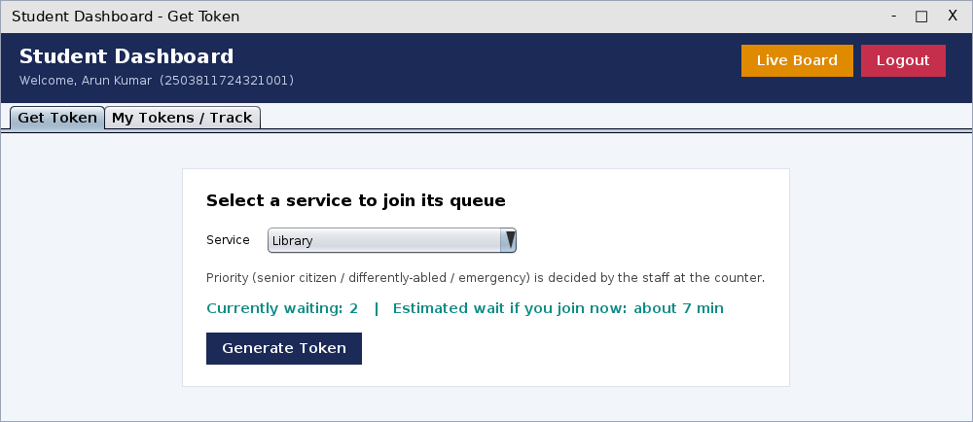
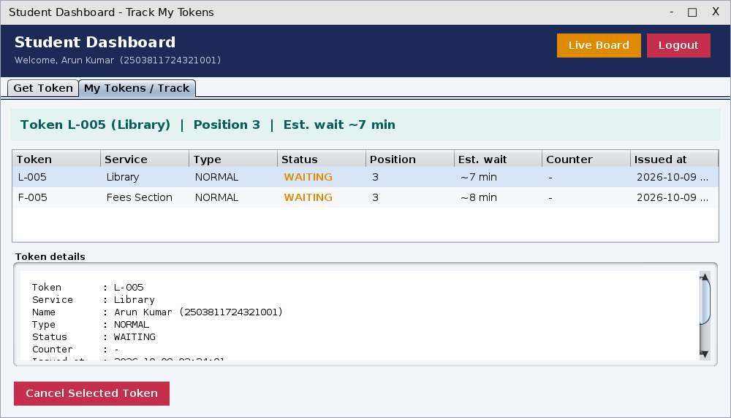
OUTPUT 1: STUDENT SIDE
Student selects a service; priority is decided by staff, not the student
After getting a token: live position, estimated wait and status details

Slide 13
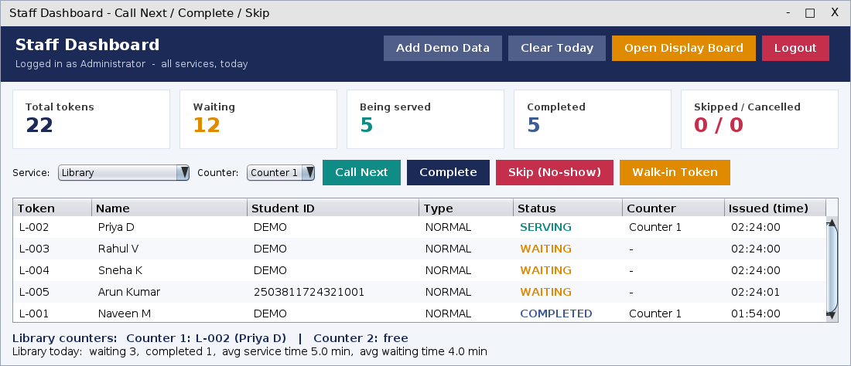
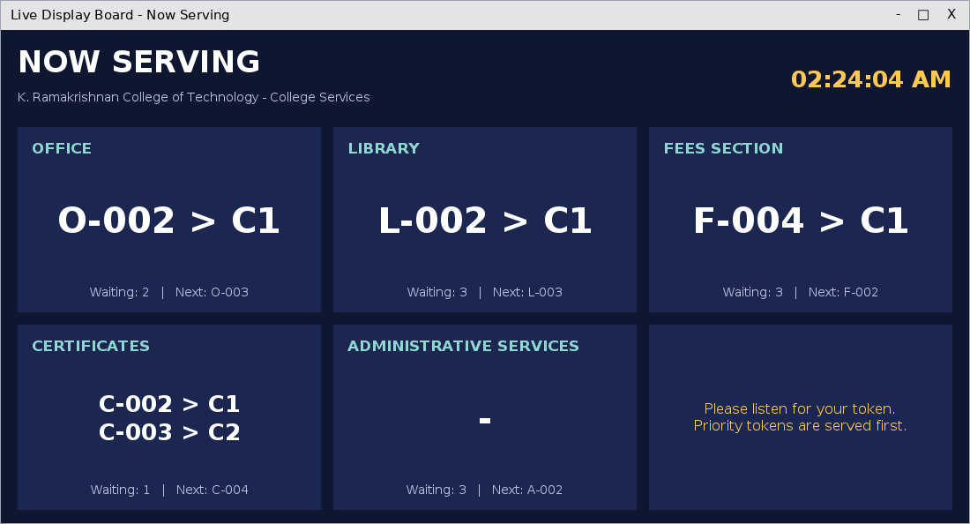
OUTPUT 2: STAFF SIDE AND BOARD
Staff dashboard: Call Next, Complete, Skip, Priority On/Off, walk-in, statistics
Public 'Now Serving' board with the token at every counter

Slide 14
CONCLUSION AND FUTURE ENHANCEMENT
Conclusion
The Queue Management System gives every student a token, serves students in an organised order with priority handling and shows live position and waiting time. Staff manage five college services from one screen, and a display board removes crowding at the counters. The Java logic passed all 20 self-tests.
Future Enhancements
SMS / e-mail / mobile alerts when the token is near.
Move storage to MySQL using JDBC for many users.
QR-code token and online appointment booking.
Voice announcement and reports on peak hours.

Slide 15
THANK YOU
Queries?

