Slide 1

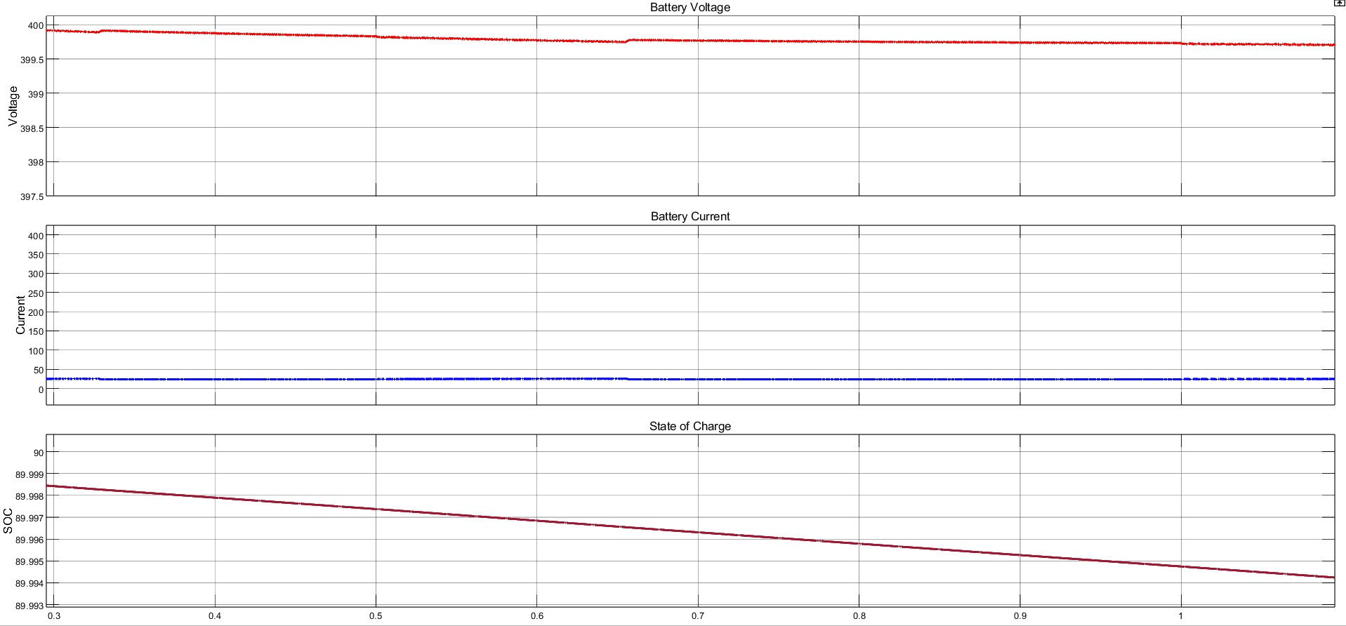
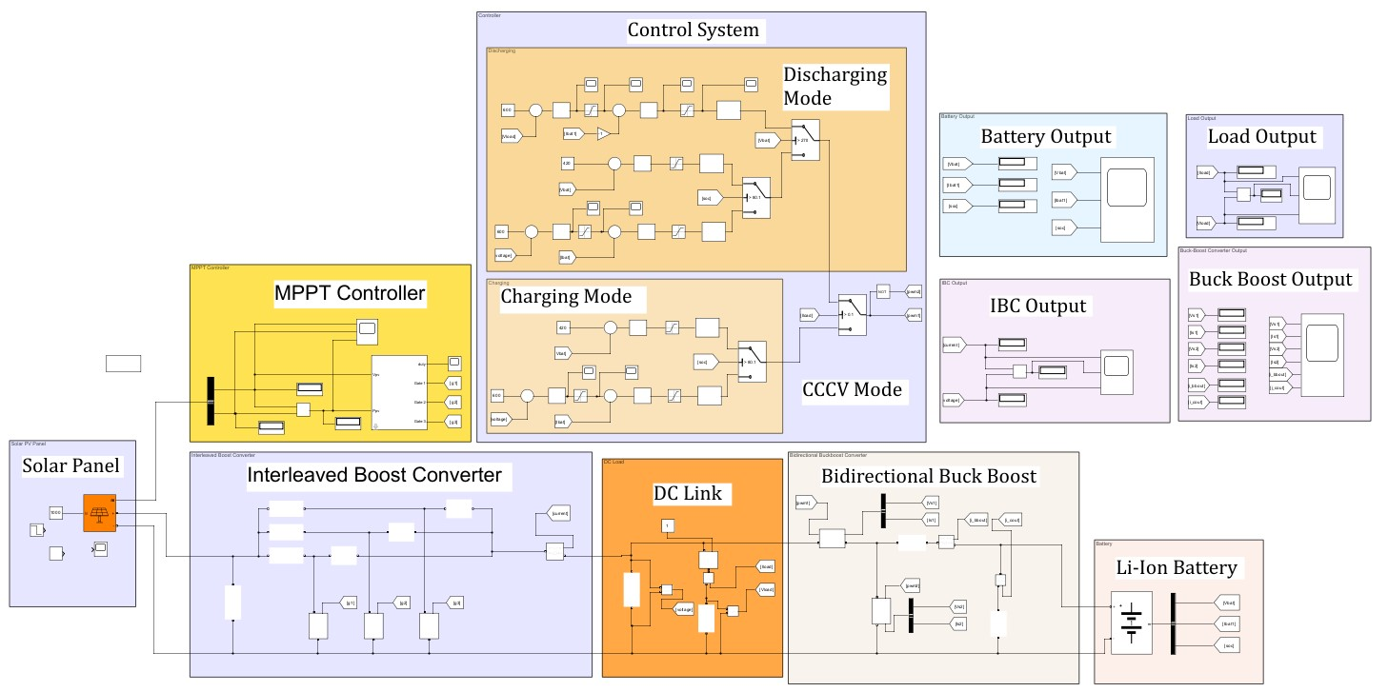
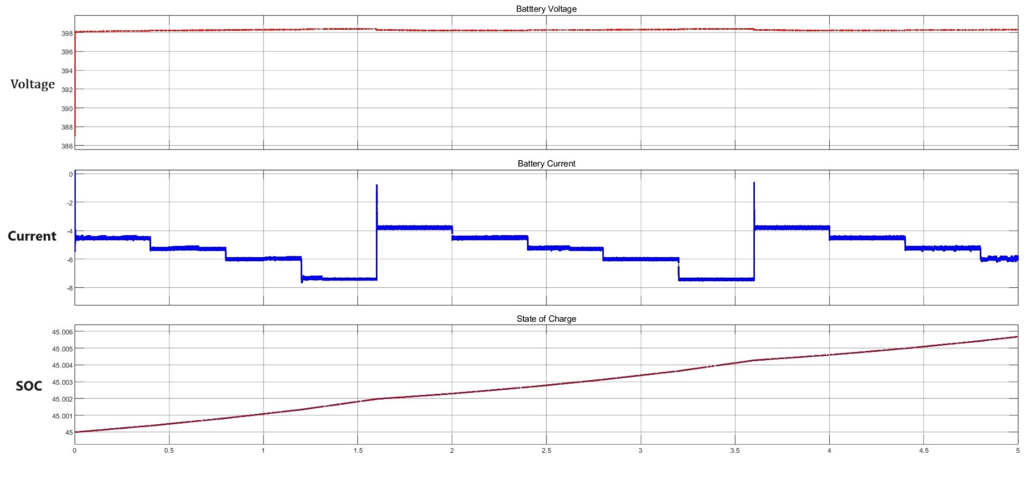
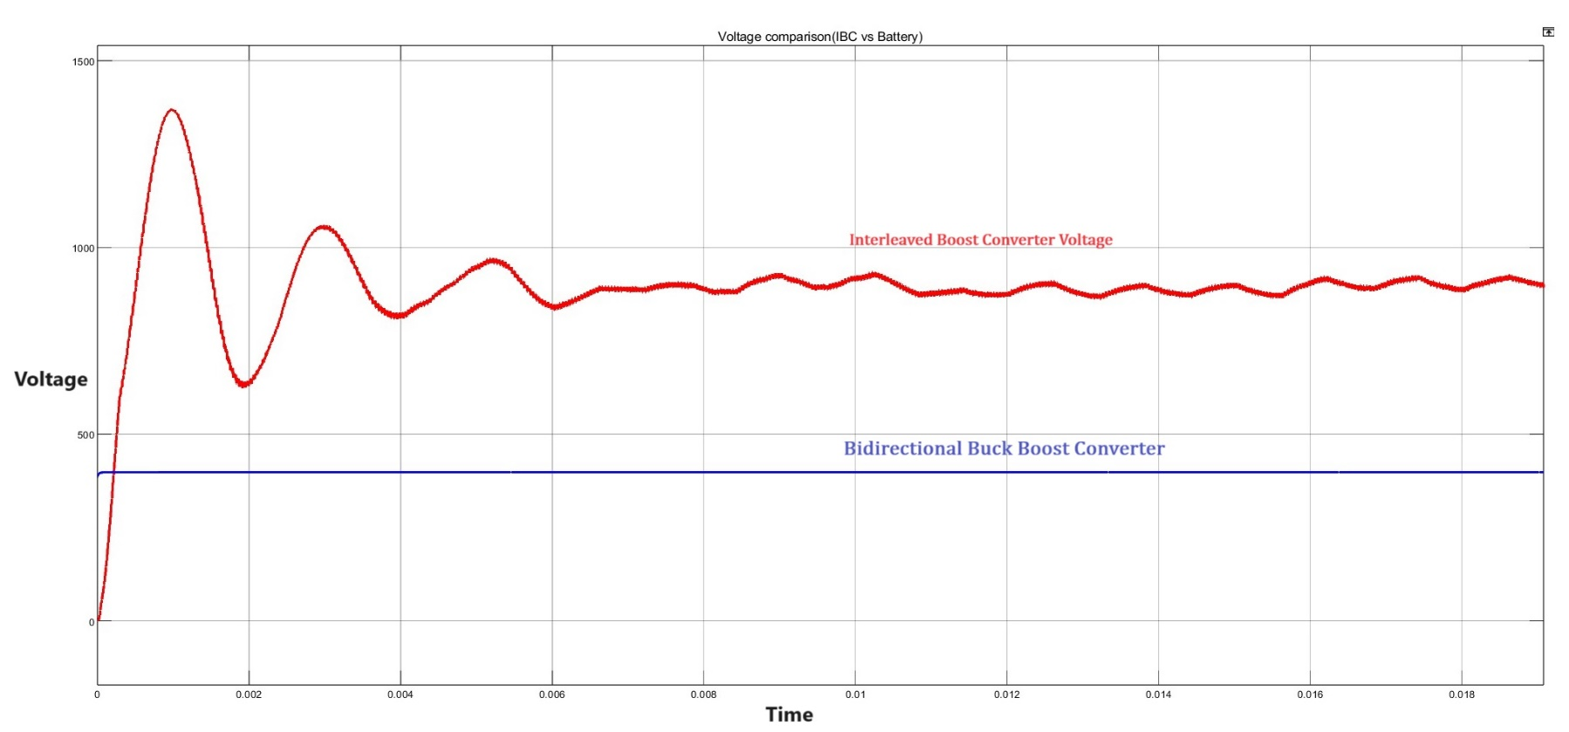
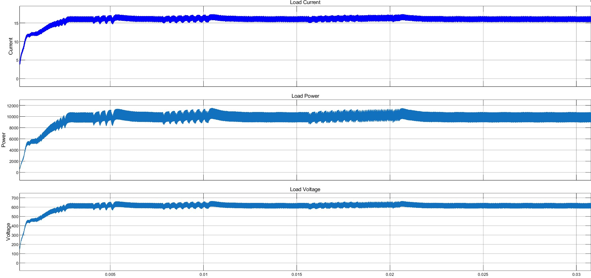
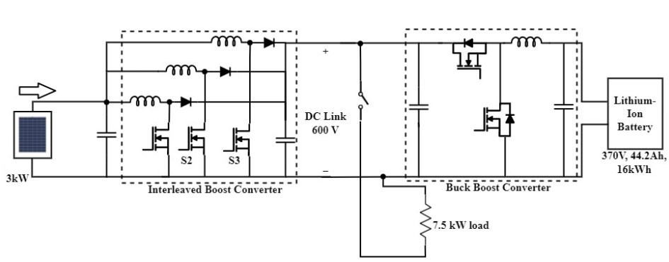

SOLAR BATTERY CHARGING SYSTEM WITH INTERLEAVED BOOST CONVERTER & BIDIRECTIONAL BUCK BOOST CONVERTER
Hariharan.P
Dr. Hemarani.P
Department of Electrical Engineering
National Institute of Technology Calicut, Kozhikode.
ABSTRACT
This project focuses on the design and This project designs an efficient solar battery charging system that integrates a three-phase interleaved boost converter and a bidirectional buck-boost converter for enhanced power management. The MPPT controller maximizes energy capture from the solar panels, while the converters regulate power flow, ensuring efficient charging and discharging of the Li-ion battery. The system ensures stable voltage during battery discharge, promoting long battery life and reliable power delivery. MATLAB/Simulink simulations confirmed the system's effectiveness in optimizing solar energy utilization and maintaining a continuous, stable power supply to the load, even under varying environmental conditions.
METHODOLOGY
The project utilizes a three-phase interleaved boost converter to step up the voltage from solar panels, reducing current ripple and increasing efficiency. A bidirectional buck-boost converter manages the charging and discharging of the Li-ion battery. The MPPT controller ensures optimal energy capture by adjusting the converter's duty cycle to track the solar panel's maximum power point. The converters operate at a 50 kHz switching frequency and maintain stable voltage levels for the battery charging and discharging processes.
RESULTS
The results from the MATLAB/Simulink simulations demonstrate that the system maintains a stable output, with voltage ripple controlled at 1% and current ripple at 5%. The three-phase interleaved boost converter efficiently steps up the voltage, and the bidirectional converter successfully manages the charging and discharging processes of the Li-ion battery. Overall, the system shows improved energy efficiency and reliable performance across different operational conditions.
This project successfully demonstrates an efficient solar energy management system using advanced power electronics. The three-phase interleaved boost converter optimizes voltage boosting, while the bidirectional buck-boost converter ensures stable energy storage and discharge. Simulation results confirm the system’s capability to maintain high efficiency, optimize solar energy capture, and provide reliable power. This project contributes to the development of more effective solar energy systems, integrating control strategies and power converters to achieve sustainable energy solutions.
SIMULATION SETUP
INTRODUCTION
Solar energy has emerged as a leading renewable energy source, but efficiently capturing and managing solar power remains a challenge. This project tackles these challenges using advanced power electronics to improve solar energy management. By integrating a three-phase interleaved boost converter and a bidirectional buck-boost converter, the system enhances energy storage and power flow to a Li-ion battery. The goal is to maximize energy capture, reduce losses, and ensure a stable power supply, contributing to more efficient and sustainable solar power systems.
Fig.:- Battery Discharging
The simulation includes a solar panel, MPPT controller, interleaved boost converter, bidirectional buck-boost converter, and Li-ion battery. The MPPT optimizes solar power, the boost converter increases voltage, and the bidirectional converter manages charging and discharging. The DC link stabilizes voltage during battery discharge.
Fig.:- Battery Charging
EQUATIONS USED
Fig.:- IBC Vs Buck Boost
GENERAL BLOCK DIAGRAM OF THE SCHEME
$L = Vin· D.\frac{\left(1 − D\right)}{∆IL · fs}$
$C =\frac{\left(D · \left(1 − D\right)\right)}{(8Lf 2 s ( ∆Vo / Vo ))}$
$​ Pmax = Vmp × Imp$
$\text{Gid}\text{(}\text{s}\text{) = }\text{(}\text{Vin}\text{/ } \text{L} \text{)}\text{· }\text{(}\text{D}\text{(1 − }\text{D}\text{) }\text{ / }\text{s}\text{)}$
Gvd(s) = (Vo / C ) .(1 / s)
Fig.:- DC Link
CONCLUSIONS
Solar Panels: Provide the primary energy input, with an MPPT controller to optimize energy capture.
Three-Phase Interleaved Boost Converter: Steps up the input voltage from the solar panels, ensuring smooth power flow with reduced current ripple.
Bidirectional Buck-Boost Converter: Manages the charging and discharging of the Li-ion battery, ensuring stable energy storage and retrieval. The DC link maintains constant voltage during battery discharge to reliably supply power to the load.
MODE OF OPERATION
The system operates in two modes:
Charging mode: The bidirectional buck-boost converter steps down the voltage to charge the battery, while the MPPT controller maximizes solar energy capture.
Discharging mode: The converter steps up the battery voltage to power the load. The DC link maintains stable voltage, ensuring smooth power flow and reliable performance.

