Slide 1
DIGITAL PORTFOLIO
STUDENT NAME: HAIRHARAN S REGISTER NO AND NMID:astvu32332324u0902
DEPARTMENT: BCA
COLLEGE: Voorhees College/Thiruvalluvar University

Slide 2
Project Title digital Portfolio
Student ditial portfolio
USING TOOL🔧🛠️
HTML
CSS AND JAVASCRIPT

Slide 3
AGENDA
1.P1.Problem Statemen 2.Project Overvie 3.End User 4.Tools and Technologie 5.Portfolio design and Layout6 6.Features and Functionalit 7.Results and Screenshot
8.Conclusion
9.Problem Statement

Slide 4
ℙℝ𝕆𝔹𝕃𝔼𝕄 𝕊𝕋𝔸𝕋𝔼𝕄𝔼ℕ𝕋
PROBLEM STATEMENT
Many students and beginnersin web developmentstruggle to
showcase their skills effectively. A personal portfolio website
provides a professional way to display projects,share contact
details, and demonstrate technical abilities.

Slide 5
🇵‌🇷‌🇴‌🇯‌🇪‌🇨‌🇹‌ 🇴‌🇻‌🇪‌🇷‌🇻‌🇮‌🇪‌🇼‌
PROJECT OVERVIEW
This project is a responsive personal portfolio website
built with HTML, CSS, and JavaScript. It includes
sections such as Home, About, Projects, and Contact.
The website is mobile-friendly and highlights both
design and functionality.

Slide 6
END USERS
End Users Students who want to showcase academic or personal projects Recruiters and employers reviewing candidate skill Anyone interested in the student’s journey and projects

Slide 7
🅃🄾🄾🄻🅂 🄰🄽🄳 🅃🄴🄲🄷🄽🄾🄻🄾🄶🄸🄴🅂
Tools and Technologies
• HTML5 – for structuring content
• CSS3 – for styling and responsive layout
• JavaScript (ES6) – for interactivity (menu toggle,
smooth scrolling)
• GitHub – for version control and hosting

Slide 8
PORTFOLIO DESIGN
PORTFOLIO DESIGN AND LAYOUTS
• Header & Navbar: Sticky navigation with toggle
menu for mobile • Hero Section: Introduction with name and tagline
• About Section: Profile image and student background • Projects Section: Grid of project card
• Contact Section: Email and phone details

Slide 9
FERTURES AND FUNCTIONALITY
FEATURES AND FUNCTIONALITY Responsive design (desktop & mobile) .
Interactive navigation menu Project showcase with hover effects
Contact section with clickable email/phone links

Slide 10
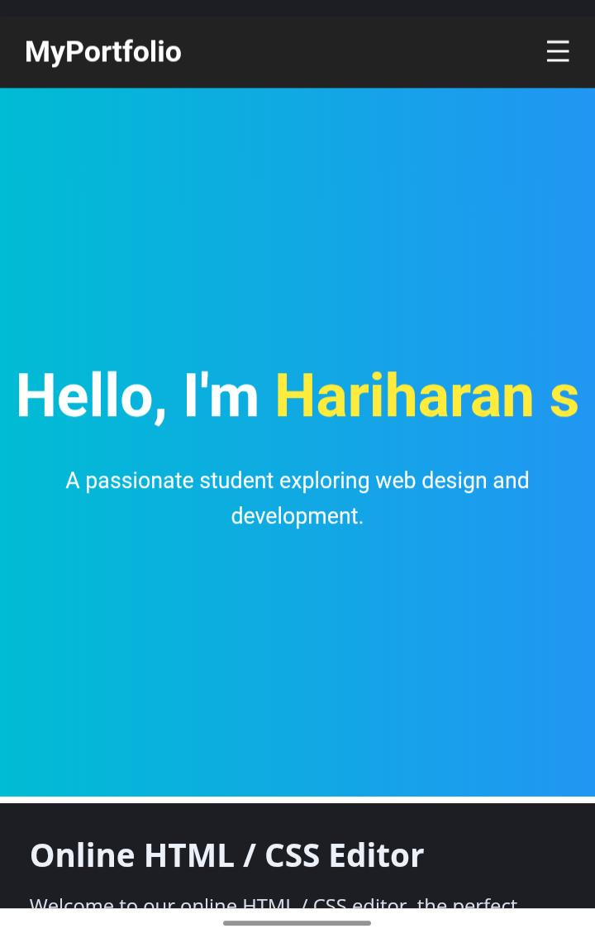
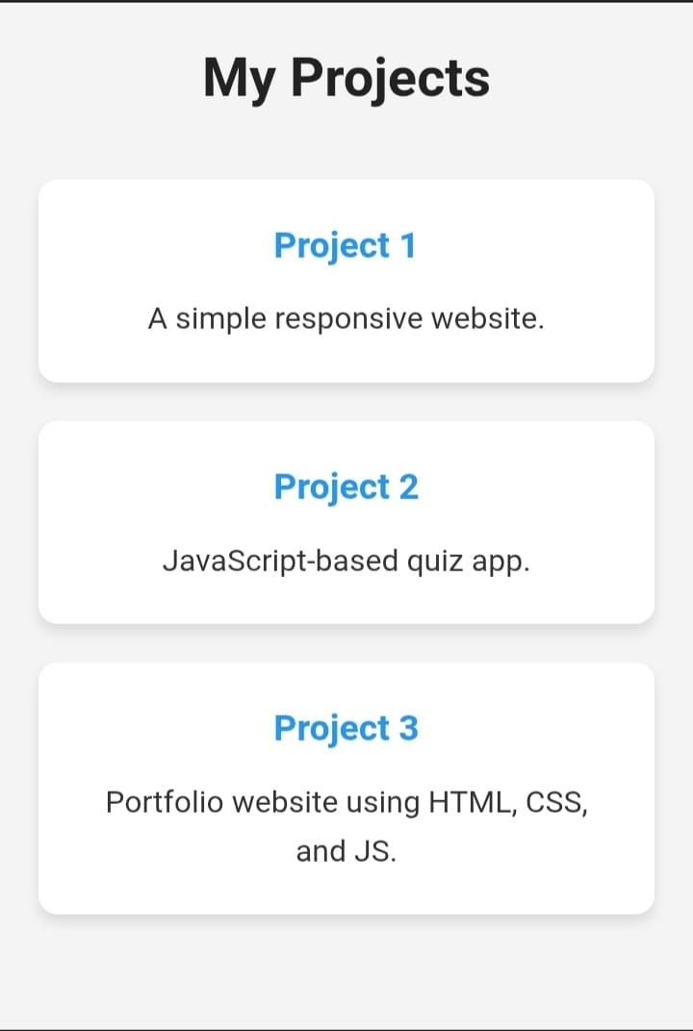
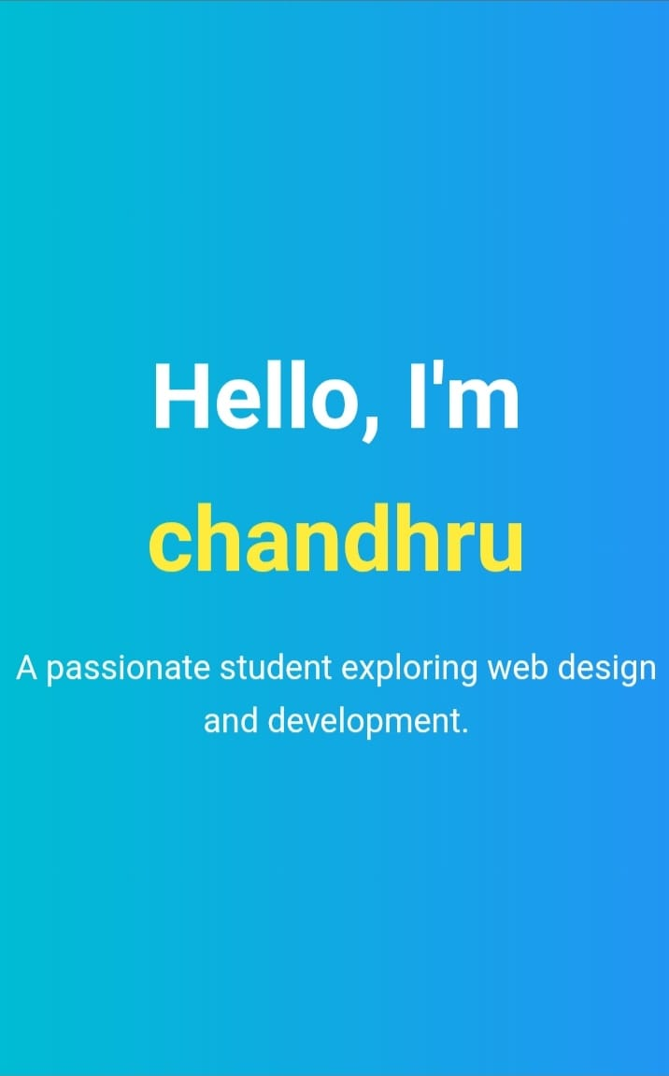
🅢︎🅒︎🅡︎🅔︎🅔︎🅝︎ 🅢🅗︎🅞︎🅡︎🅣︎ 🅦︎🅔︎🅑︎

Slide 11
Conclusion
The portfolio website provides a professional platform to highlight skills and projects It demonstrates the
use of fundamental web technologies and serves as a
foundation for more advanced web development.

