Slide 1

ACADEMIC YEAR 2026-2027
Project Review – Phase 1
Student Learning Adaptability Assessment Tool
A Multi-Dimensional Academic Intelligence System
Presented by:
KAVIPRIYA P 7376232CB126 CSBS

Slide 2
Introduction
In modern academic institutions:
Academic marks are tracked separately.
Reward points and skill systems are separate.
Attendance monitoring is independent.
Mentors manually analyze student performance.
There is no unified system that evaluates overall learning adaptability.

Slide 3
Problem Statement
The current system lacks:
Integrated academic and skill analysis
Early identification of low adaptability students
Structured recovery tracking
Root cause diagnosis of weak performance
Centralized adaptability intelligence
This leads to delayed mentoring and reactive support.

Slide 4
Existing System Analysis
Current portals provide:
PT1, PT2, Semester results
Reward points and department averages
Skill progress levels
Attendance data
However:
These systems operate independently
No consolidated analysis exists
No adaptability intelligence is generated

Slide 5
Proposed Solution Overview
The objective of this project is to:
Integrate academic, reward, and attendance data
Measure adaptability across multiple dimensions
Identify low adaptability students early
Provide diagnostic insights
Support mentor intervention tracking
Improve academic decision-making

Slide 6
Multi-Dimensional Adaptability Model
The system evaluates adaptability across 5 dimensions:
Academic Adaptability
Skill Engagement
Attendance Discipline
Deadline Responsiveness
Recovery Index
Each dimension is independently scored and visualized.

Slide 7
Adaptability Score Calculation
Weighted Model:
30% Academic Performance
25% Skill Engagement
15% Attendance
15% Deadline Discipline
15% Recovery Index
Final Score Classification:
0–40 → Low Adaptability
41–70 → Moderate Adaptability
71–100 → High Adaptability

Slide 8
Technology Stack
Frontend:
React.js
Tailwind CSS
Backend:
Node.js & Express
Database:
MongoDB
Security:
JWT Authentication
bcrypt password hashing
Deployment:
Render & MongoDB Atlas

Slide 9
Technology Stack Justification
React.js:
Component-based UI suitable for dashboards and charts.
Node.js & Express:
Efficient REST API development.
Handles adaptability calculation logic.
MongoDB:
Flexible schema suitable for multi-dimensional student data.
JWT:
Secure role-based authentication.
This stack supports scalability, flexibility, and rapid development.

Slide 10
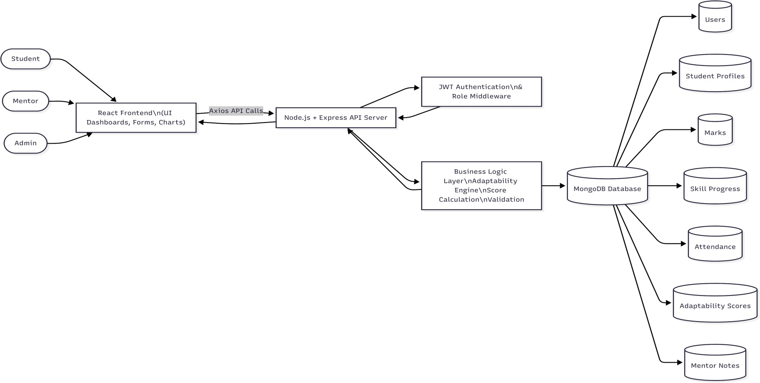
System Architecture Diagram

Slide 11
System Flow Explanation
User logs in through the frontend.
Backend validates credentials and generates JWT.
User requests dashboard data.
Backend retrieves academic, attendance, and skill records.
Adaptability scores are calculated.
Results are returned to frontend.
Dashboard visualizations are displayed.

Slide 12
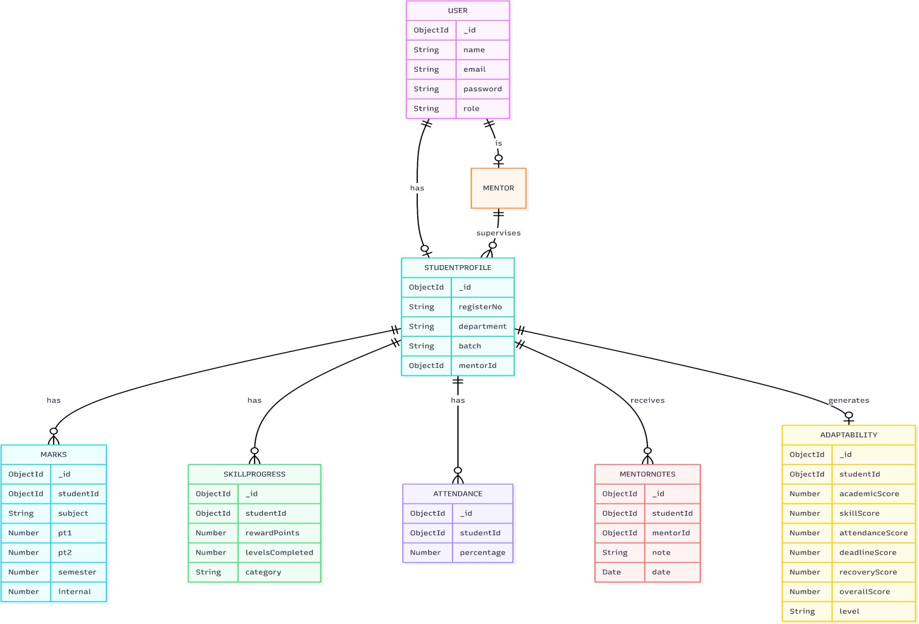
ER DIAGRAM

Slide 13
ENTITY RELATIONSHIPS
One User can be one Student or Mentor or Admin
One Student has many Marks records
One Student has many SkillProgress entries
One Student has one Attendance summary
One Student has one Adaptability record per semester period
One Mentor supervises many Students
One Student can have many MentorNotes

Slide 14
Database Schema Design
User _id : ObjectId name : String email : String password : String role : String (Admin/Mentor/Stude nt) | Student _id : ObjectId registerNo : String department : String batch : String mentorId : ObjectId | Marks studentId : ObjectId subject : String pt1 : Number pt2 : Number semesterNo : Number semester : Number internal : Number | MentorNotes _id : ObjectId studentId : ObjectId mentorId : ObjectId note : String actionType : String // Advice / Warning / Follow-up date : Date

Slide 15
SkillProgress studentId : ObjectId rewardPoints : Number levelsCompleted : Number category : String | Attendance studentId : ObjectId percentage : Number semesterNo: Number | Adaptability studentId : ObjectId academicScore : Number skillScore : Number attendanceScore : Number deadlineScore : Number recoveryScore : Number overallScore : Number level : String semesterNo : Number calculatedAt : Date

Slide 16
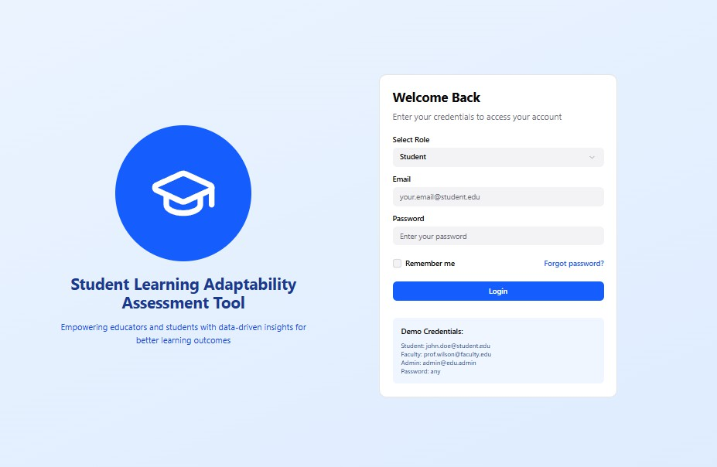
UI Interface Designs
LOGIN PAGE

Slide 17
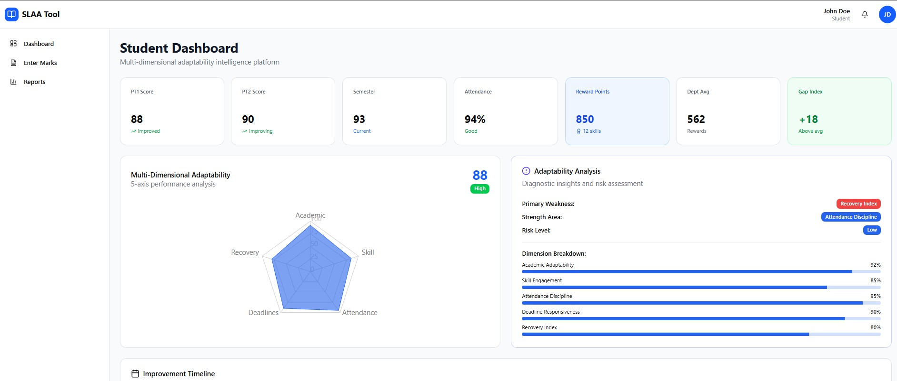

Slide 18
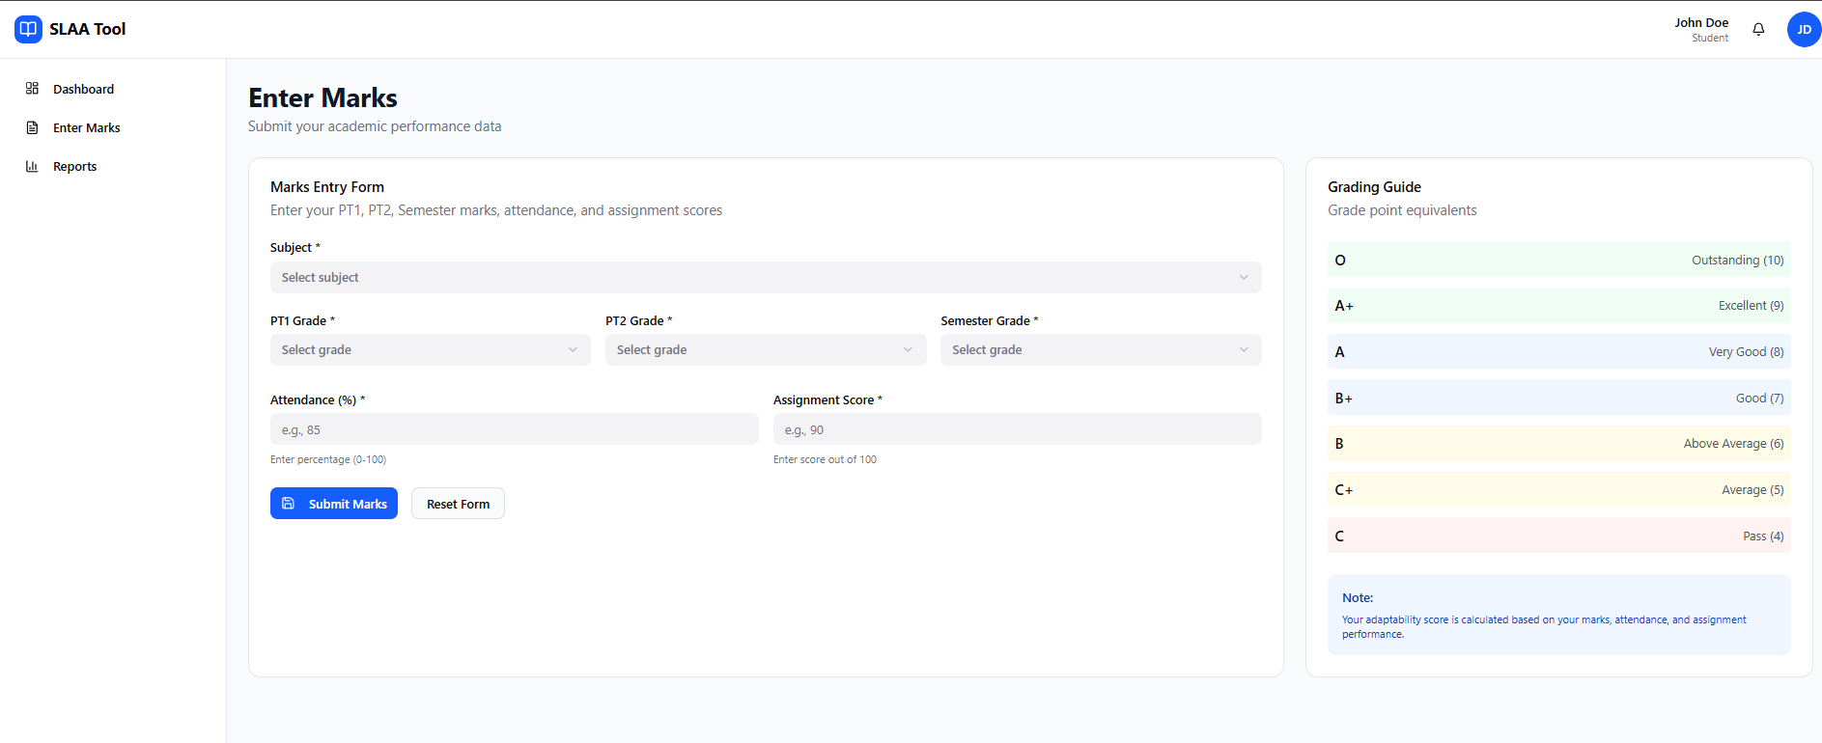

Slide 19
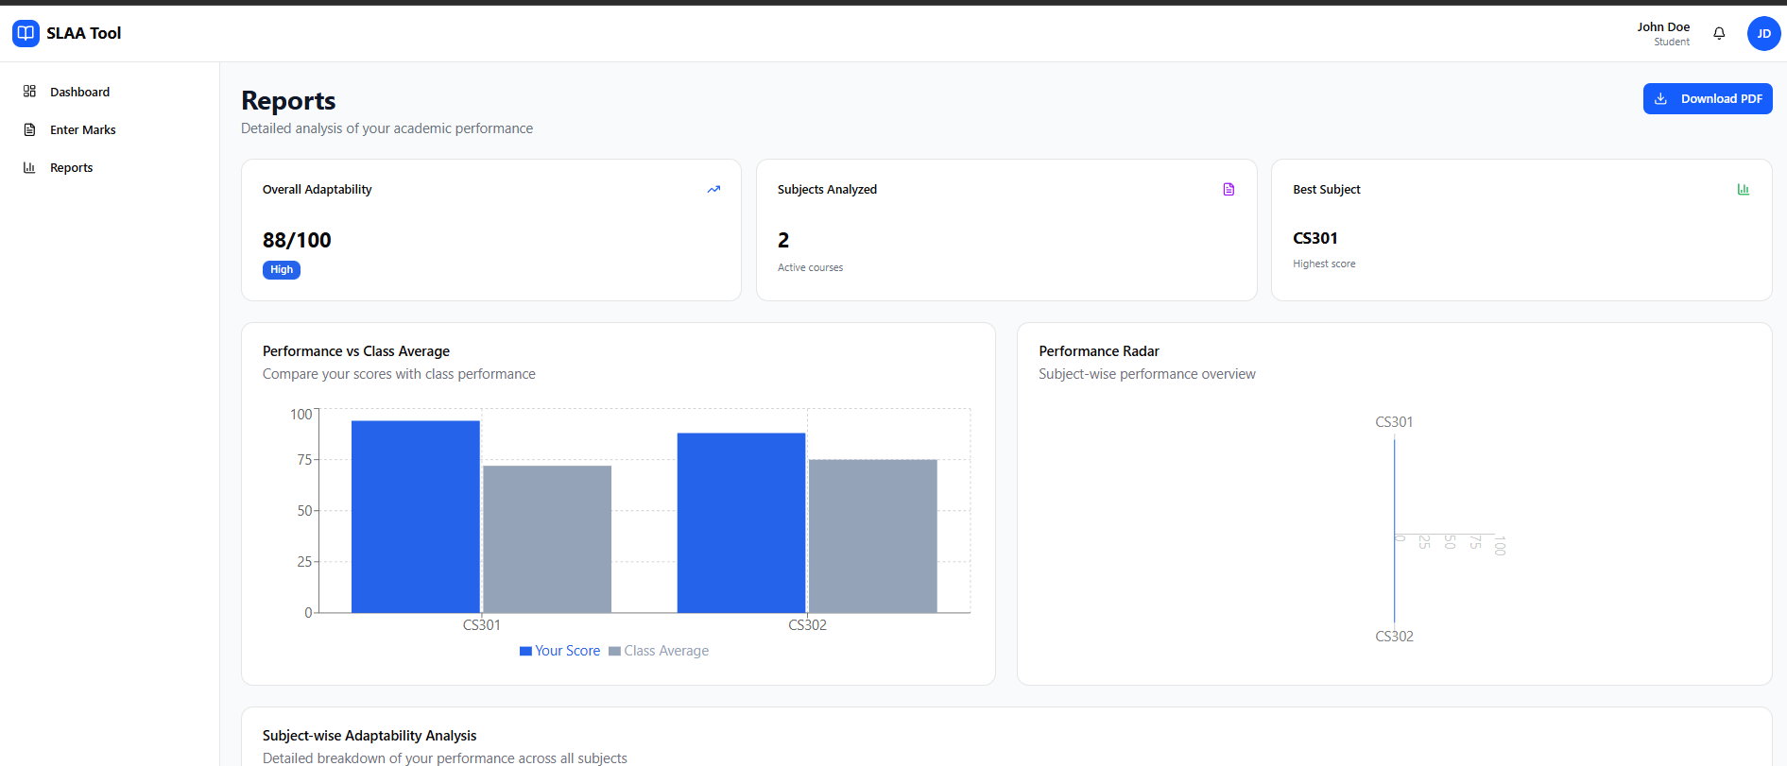

Slide 20
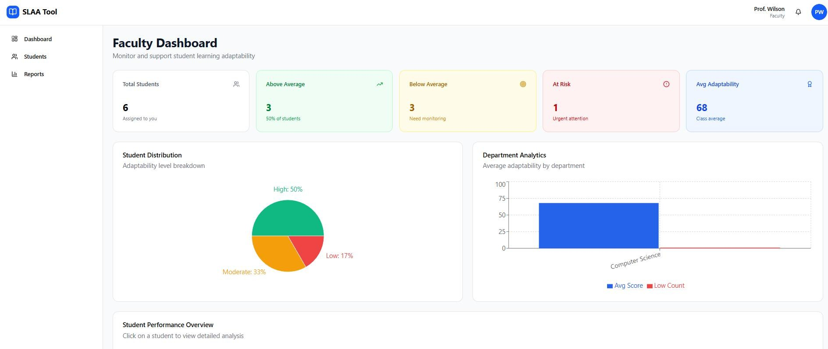

Slide 21
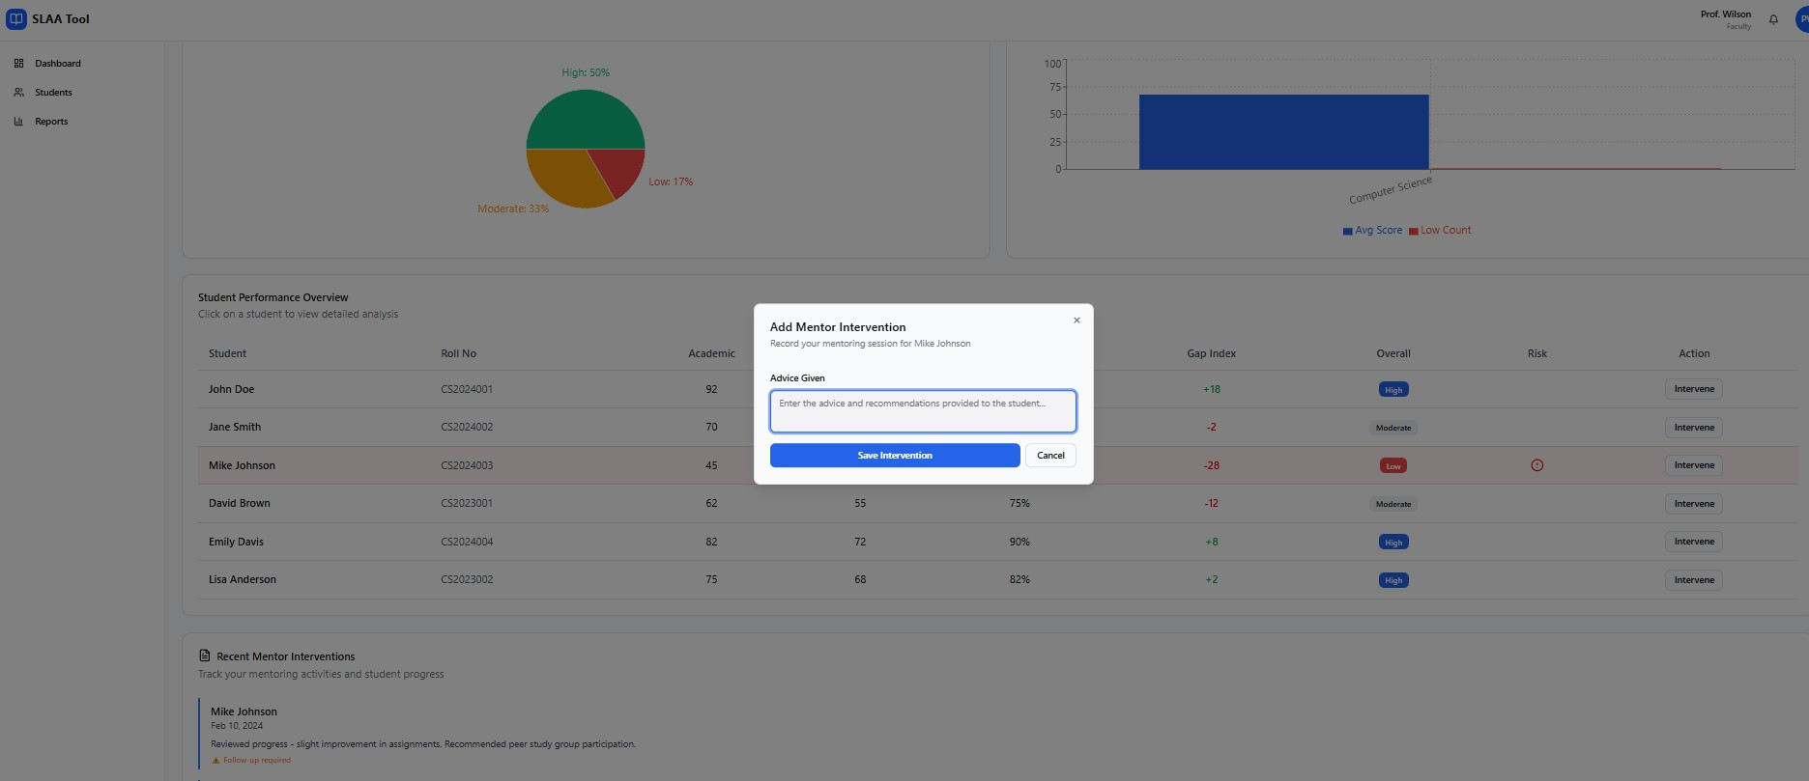

Slide 22
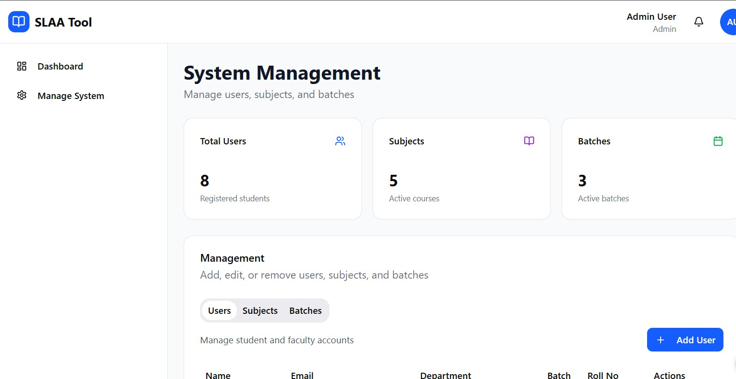

Slide 23
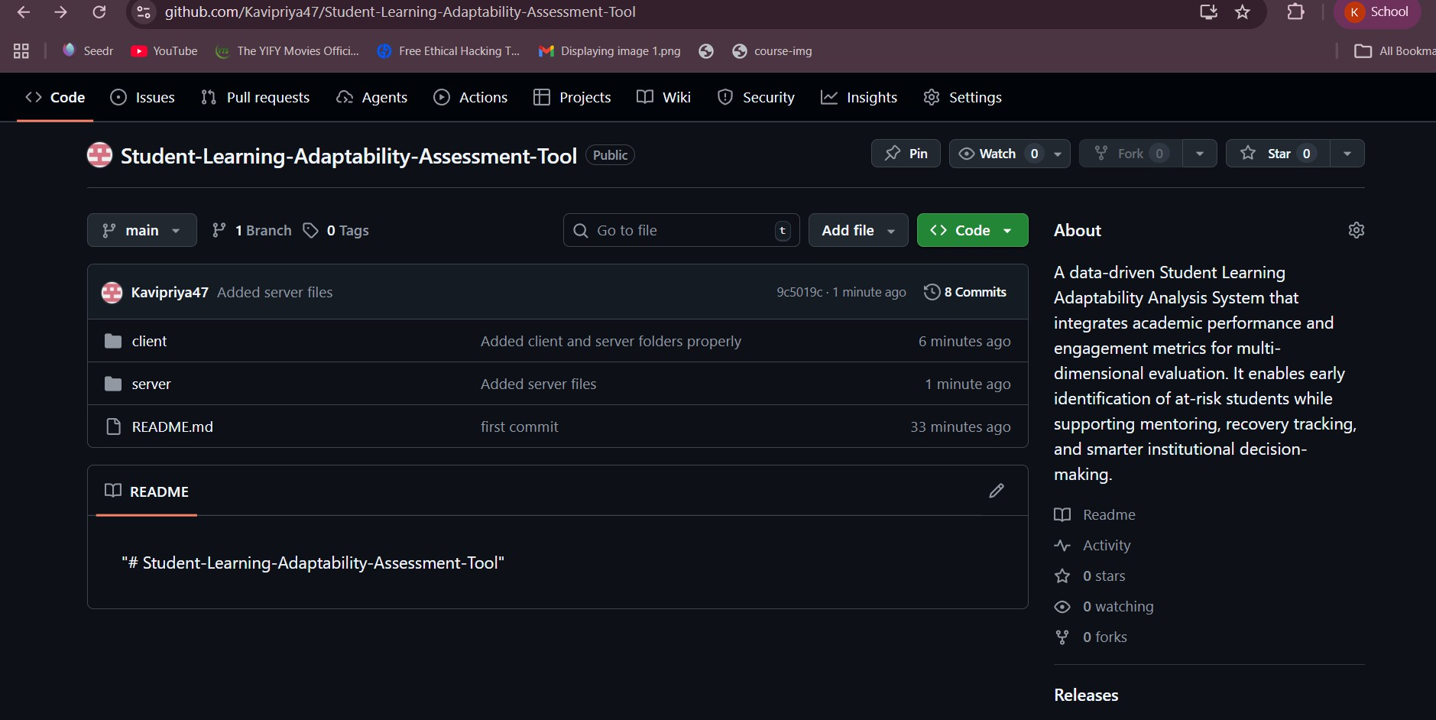
Project Boilerplate Setup

Slide 24
Benefits of the System
For Students:
Self-awareness
Goal tracking
Early improvement
For Mentors:
Reduced manual analysis
Targeted mentoring
Better performance monitoring
For Institution:
Improved adaptability tracking
Data-driven decision making
Early academic intervention

Slide 25
Conclusion
The Student Learning Adaptability Assessment Tool:
Integrates academic and engagement parameters
Provides structured multi-dimensional evaluation
Identifies low adaptability students early
Supports mentoring and recovery tracking
Enhances institutional academic intelligence
It transforms isolated academic data into actionable insights.

