Slide 1
Robot Operating System

Slide 2

Why ROS?
Because creating truly robust, general-purpose robot software is hard.
From the robot's perspective, problems that seem trivial to humans often vary wildly between instances of tasks and environments.
Dealing with these variations is so hard that no single individual, laboratory, or institution can hope to do it on their own.
ROS was built from the ground up to encourage collaborative robotics software development
Notes:
Talk about shadow hand – 27 DoF
Simple task example
Example of collaborative development

Slide 3

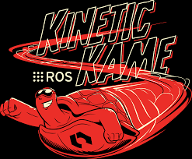
Brief of Installation
Oracle VirtualBox
Lubuntu 16.04
Kinetic kame
Desktop-Full Install
ROS, rqt, rviz, robot-generic libraries, 2D/3D simulators, navigation and 2D/3D perception

Slide 4
ROS architecture
The Filesystem level
The Computation Graph level
The Community level

Slide 5
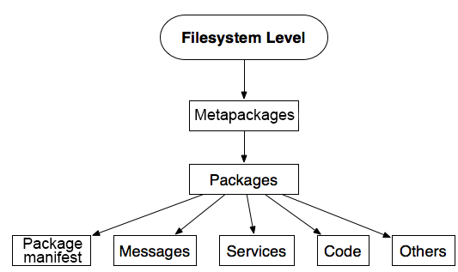
The Filesystem level
The main goal of the ROS Filesystem is to centralize the build process of a project while at the same time provide enough flexibility and tooling to decentralize its dependencies

Slide 6
Packages: Packages form the atomic level of ROS. A package has the minimum structure and content to create a program within ROS.
Package manifests: Package manifests provide information about a package, licenses, dependencies, compilation flags, and so on.
Metapackages: When you want to aggregate several packages in a group, you will use metapackages.

Slide 7
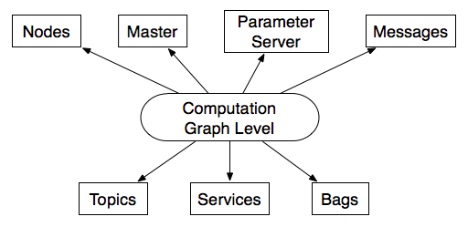
The Computation Graph level
ROS creates a network where all the processes are connected. Any node in the system can access this network, interact with other nodes, see the information that they are sending, and transmit data to the network

Slide 8
Nodes: A node is an executable that uses ROS to communicate with other nodes.
Master: Name service for ROS (i.e. helps nodes find each other)
Parameter Server: Parameter Server gives us the possibility of using keys to store data in a central location.
Messages: ROS data type used when subscribing or publishing to a topic.
Notes:
(parameter server will be
introduced later)

Slide 9
Topics: Nodes can publish messages to a topic as well as subscribe to a topic to receive messages.
Services: Give us the possibility of interacting with nodes.
Bags: Are a format to save and play back the ROS message data
rosout: ROS equivalent of stdout/stderr
roscore: Master + rosout + parameter server

Slide 10
Understanding ROS Nodes
Nodes
an executable file within a ROS package.
ROS nodes use a ROS client library to communicate with other nodes.
Nodes can publish or subscribe to a Topic.
Nodes can also provide or use a Service
Client Libraries
ROS client libraries allow nodes written in different programming languages to communicate:
rospy = python client library
roscpp = c++ client library

Slide 11
The Community level
ROS Community level concepts are the ROS resources that enable separate communities to exchange software and knowledge
Distributions: ROS distributions are collections of versioned metapackages that you can install. ROS distributions play a similar role to Linux distributions.
Repositories: ROS relies on a federated network of code repositories, where different institutions can develop and release their own robot software components.
The ROS Wiki: The ROS Wiki is the main forum for documenting information about ROS

Slide 12
ROS Essentials
Explore the computation graph level in depth

Slide 13
roscore
Roscore is the first thing you should run when using ROS.
In a new terminal- Run:
roscore
Notes:
sudo chown -R <your_username> ~/.ros

Slide 14
rosnode
rosnode is used to see what nodes are running
In a new terminal- Run:
rosnode list
displays information about the ROS nodes that are currently running
rosnode info /rosout
command returns information about a specific node.

Slide 15
rosrun
allows you to use the package name to directly run a node within a package
Syntax-
rosrun [package_name] [node_name]
In a new terminal-
rosrun turtlesim turtlesim_node
In a new terminal-
rosnode list

Slide 16
Understanding ROS Topics
In a new terminal-
rosrun turtlesim turtle_teleop_key
rqt_graph
rqt_graph creates a dynamic graph of what's going on in the system
In a new terminal-
rosrun rqt_graph rqt_graph

Slide 17
rostopic
In a new terminal-
rostopic -h
tool allows you to get information about ROS topics
rostopic echo [topic]
rostopic echo /turtle1/cmd_vel
the data published on a topic.
Let's make turtle_teleop_key publish data by pressing the arrow keys

Slide 18
Other rostopic options
rostopic list
returns a list of all topics currently subscribed to and published.
rostopic list -v
This displays a verbose list of topics to publish to and subscribe to and their type.

Slide 19
ROS Messages
Communication on topics happens by sending ROS messages between nodes.
For the publisher (turtle_teleop_key) and subscriber (turtlesim_node) to communicate the publisher and subscriber must send and receive the same type of message

Slide 20
rostopic type
rostopic type /turtle1/cmd_vel
returns the message type of any topic being published.
rosmsg
rosmsg show geometry_msgs/Twist
We can look at the details of the message using

Slide 21
rostopic continued
let's use rostopic with messages.
rostopic pub
rostopic pub [topic] [msg_type] [args]
publishes data on to a topic currently advertised.
rostopic pub -1 /turtle1/cmd_vel geometry_msgs/Twist -- '[2.0, 0.0, 0.0]' '[0.0, 0.0, 1.8]’
rostopic pub /turtle1/cmd_vel geometry_msgs/Twist -r 1 -- '[2.0, 0.0, 0.0]' '[0.0, 0.0, -1.8]'

Slide 22
Understanding ROS Services and Parameters
ROS Services
Services are another way that nodes can communicate with each other. Services allow nodes to send a request and receive a response.
Rosservice : has many commands that can be used on services
rosservice list
Lists out the services available

Slide 23
rosservice type [service]
rosservice type /clear
returns the service type.
rosservice call [service] [args]
rosservice call /clear
calls the service

Slide 24
Using rosparam
Rosparam
allows you to store and manipulate data on the ROS Parameter Server
parameter server is a shared, multi-variate dictionary
Nodes use this server to store and retrieve parameters at runtime
rosparam list
Lists out the parameters available
rosparam set [param_name]
rosparam get [param_name]
Sets/gets parameters

Slide 25
Creating a Project
Creating a filesystem level to build a simple computation graph

Slide 26
Create and build a workspace:
Workspace
Code base
Why the emphasis?
Organizing code pays off – from collaborative development to release
Integrating with external codes or multiple code files is simpler
Tool used
Catkin - designed in order to efficiently build numerous inter-dependent, but separately developed projects
Notes:
Single Project =! Single C file

Slide 27
create and build a catkin workspace:
mkdir -p ~/catkin_ws/src
cd ~/catkin_ws/
catkin_make
Creates a CMakeLists.txt link in your 'src' folder.
You should now have a 'build' and 'devel' folder
Inside the 'devel' folder you can see that there are now several setup.*sh files
source devel/setup.bash
Notes:
Type all the commands

Slide 28
What are these folders?
The source space contains the source code of catkin packages.
The build space is where CMake is invoked to build the catkin packages in the source space. CMake and catkin keep their cache information and other intermediate files here
CMake - manages the build process of software
The development space (or devel space) is where built targets are placed prior to being installed. This provides a useful testing and development environment which does not require invoking the installation step.
Once targets are built, they can be installed into the install space by invoking the install target

Slide 29
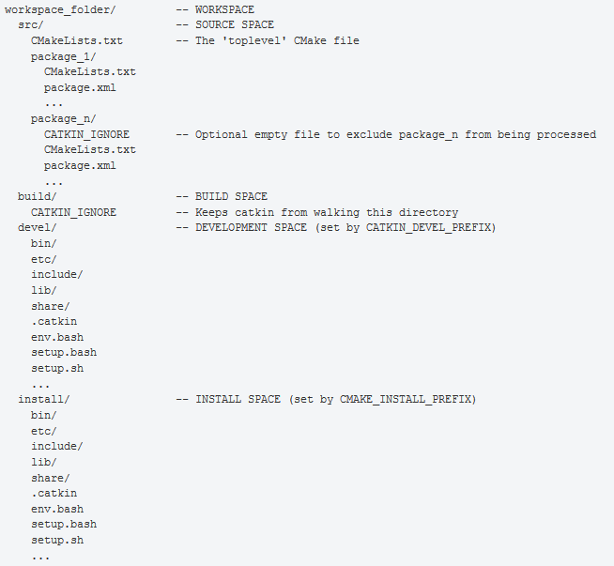

Slide 30
Creating and building a catkin Package
cd ~/catkin_ws/src
catkin_create_pkg beginner_tutorials std_msgs rospy roscpp
catkin_create_pkg <package_name> [depend1] [depend2] [depend3]
cd ~/catkin_ws
catkin_make
source devel/setup.bash

Slide 31
Making sourcing default
echo "source ~/catkin_ws/devel/setup.bash" >> ~/.bashrc
source ~/.bashrc
This is required because ROS relies on the notion of combining spaces using the shell environment. This makes developing against different versions of ROS or against different sets of packages easier.

Slide 32
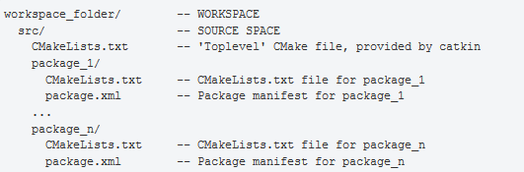
Exploring package

Slide 33
Creating a ROS msg and srv
msg: msg files are simple text files that describe the fields of a ROS message. They are used to generate source code for messages in different languages.
msg files are stored in the msg directory of a package
srv: an srv file describes a service. It is composed of two parts: a request and a response.
srv files are stored in the srv directory.

Slide 34
msgs has a field type and field name per line. The field types you can use are:
int8, int16, int32, int64 (plus uint*)
float32, float64
string
time, duration
other msg files
variable-length array[] and fixed-length array[C]

Slide 35
Using msg
Creating a msg
roscd beginner_tutorials
mkdir msg
echo "int64 num" > msg/Num.msg

Slide 36
Package.xml
description tag
maintainer tag
license tag
dependencies tags
Add
<build_depend>message_generation</build_depend>
<exec_depend>message_runtime</exec_depend>

Slide 37
CMakeLists.txt
Changes
find_package(catkin REQUIRED COMPONENTS
roscpp
rospy
std_msgs
message_generation
)
catkin_package(
...
CATKIN_DEPENDS message_runtime ...
...)

Slide 38
add_message_files(
FILES
Num.msg
)
generate_messages(
DEPENDENCIES
std_msgs
)

Slide 39
Using rosmsg
Making sure ROS can see it
rosmsg show [message type]
rosmsg show beginner_tutorials/Num
rosmsg show Num

Slide 40
Using srv
Creating a srv
roscd beginner_tutorials
mkdir srv
We can copy a service from the rospy_tutorials package
roscp [package_name] [file_to_copy_path] [copy_path]
roscp rospy_tutorials AddTwoInts.srv srv/AddTwoInts.srv

Slide 41
CMakeLists.txt
Changes
add_service_files(
FILES
AddTwoInts.srv
)

Slide 42
Using rossrv
Making sure ROS can see it
rossrv show <service type>
rossrv show beginner_tutorials/AddTwoInts
rossrv show AddTwoInts

Slide 43
Writing a Simple Publisher and Subscriber
roscd beginner_tutorials
mkdir scripts
cd scripts
Publisher Node
chmod +x talker.py
Subscriber Node
chmod +x listener.py

Slide 44
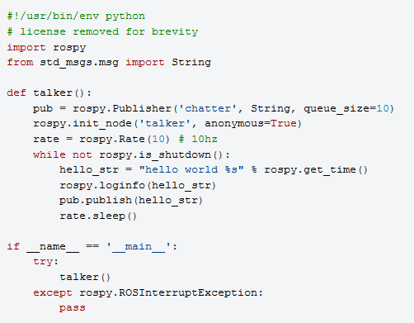

Slide 45
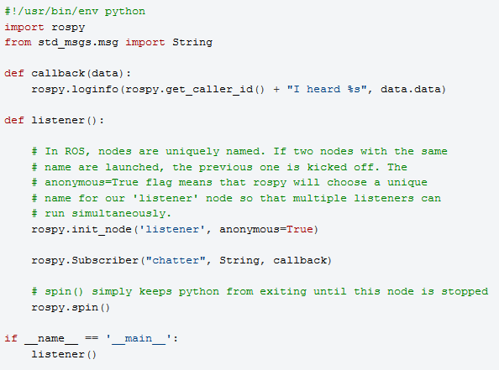

Slide 46
Building your nodes
cd ~/catkin_ws
catkin_make
source ./devel/setup.bash

Slide 47
Examining the Simple Publisher and Subscriber
Running the Publisher
In a new terminal-
roscore
In a new terminal-
rosrun beginner_tutorials talker.py
In a new terminal-
rosrun beginner_tutorials listener.py

Slide 48
Writing a Simple Service and Client
roscd beginner_tutorials
cd scripts
Service Node
chmod +x scripts/add_two_ints_server.py
Client Node
chmod +x scripts/add_two_ints_client.py

Slide 49
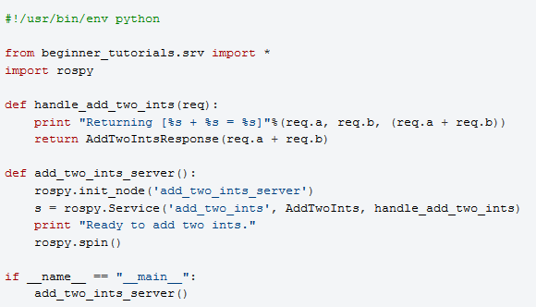

Slide 50
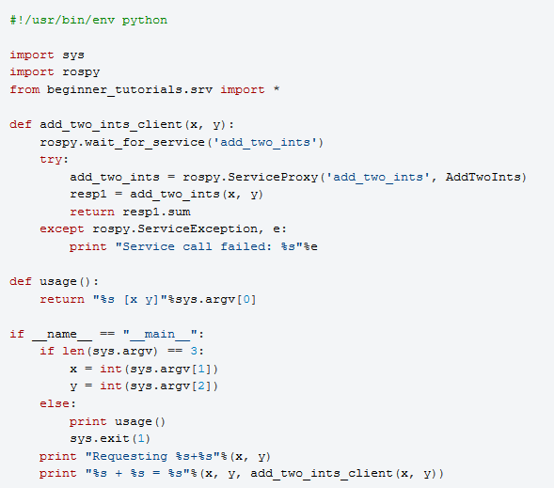

Slide 51
Building your nodes
cd ~/catkin_ws
catkin_make
source ./devel/setup.bash

Slide 52
Examining the Simple Service and Client
Running the Publisher
In a new terminal-
roscore
In a new terminal-
rosrun beginner_tutorials add_two_ints_server.py
In a new terminal-
rosrun beginner_tutorials add_two_ints_client.py 1 3

Slide 53
Using roslaunch
starts nodes as defined in a launch file.
roslaunch [package] [filename.launch]
roscd beginner_tutorials
mkdir launch
cd launch
create a launch file called publishlisten.launch and paste the following:

Slide 54
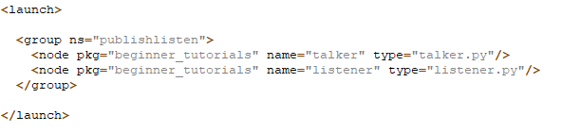

Slide 55
Running roslaunch
In a new terminal-
roslaunch beginner_tutorials publishlisten.launch

Slide 56
Demo

