Slide 1
CAPTURING SCREENSSHOT USING SELENIUM
HARI HARAN D
Used IDE : Eclipse IDE

Slide 2
1 . Introduction
Overview of Selenium
Importance of screenshots in automated testing
Selenium is an open-source and a portable automated software testing tool for testing web applications. It has capabilities to operate across different browsers and operating systems. Selenium is not just a single tool but a set of tools that helps testers to automate web-based applications more efficiently
Importance of screenshots:
Visual validation of test results.
Debugging and troubleshooting.
Documentation of test cases.

Slide 3
Setting Up Selenium
This section will show how we can configure Selenium with Eclipse.
Pre-requisites:
Download and Install Java
Set up the Environment Variables
Install WebDrivers
Download and Install Eclipse

Slide 4
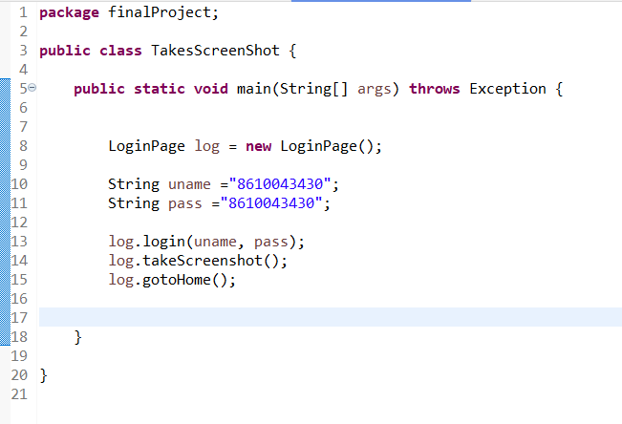
This is the test class Stored in src/test/java in this class we are creating the object for login page and sending credentials to login and calling the Take Screenshot method and gotoHome.
Selenium code for Capturing
Screenshot
Conclusion

Slide 5
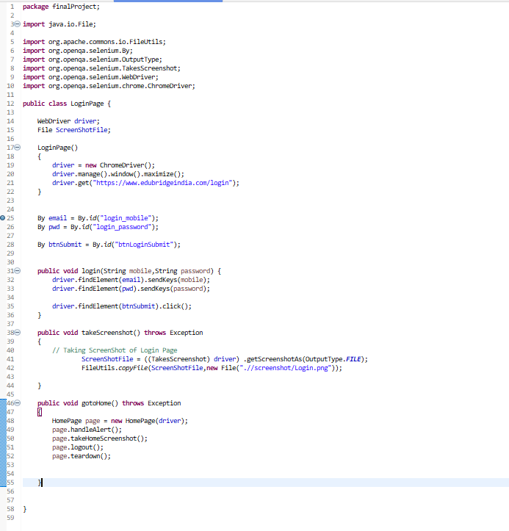
Selenium Code for capturing Screenshot of Login page of Edubridge login site Stored in src/main/java

Slide 6

Output Image of Login page

Slide 7
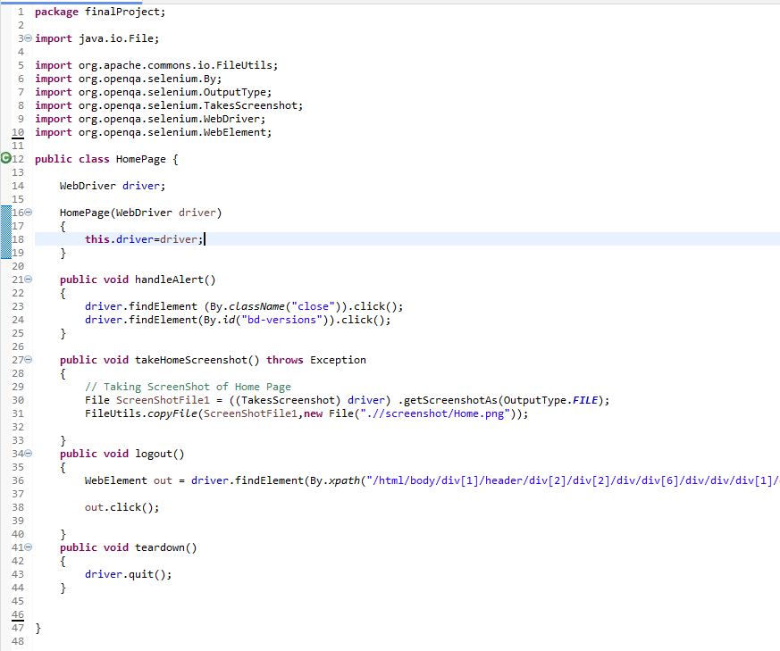
Selenium Code for capturing Screenshot of Home page of Edubridge Site
Stored in src/main/java

Slide 8
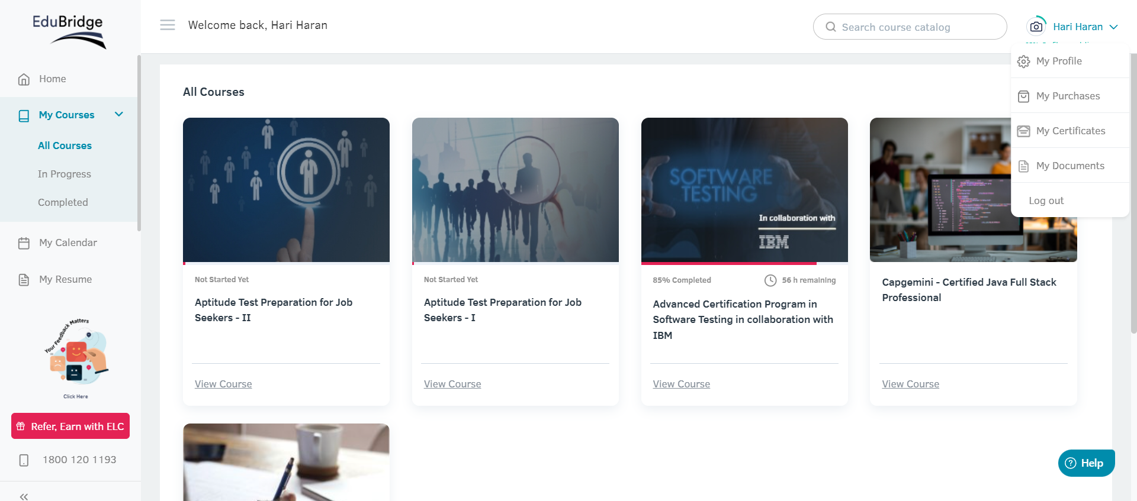
Output image of Home page

Slide 9
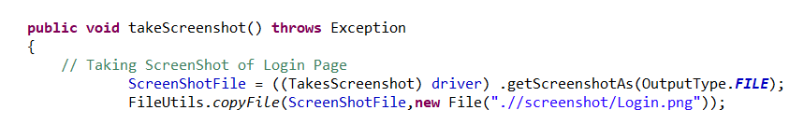

Capturing Screenshots And Store
This is the method is used to take Screenshot
The output of the Screenshot image will stored in folder

Slide 10
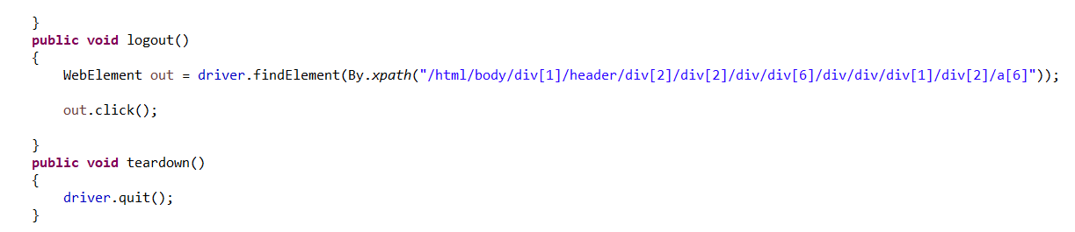
This is the method is used to loguot from the site and close the window

Slide 11
Advantages of Selenium:
Cross-Browser Compatibility: Selenium supports multiple browsers like Chrome, Firefox, Safari, and Internet Explorer, making it easier to test web applications on different platforms.
Platform Independence: Selenium is a cross-platform tool, which means it can be used on different operating systems like Windows, Linux, and macOS.
Support for Multiple Programming Languages: Selenium supports multiple programming languages, including Java, C#, Python, Ruby, and others. This allows developers and testers to choose the language they are most comfortable with.
Large Community and Resources: Selenium has a large and active community. This means there is a wealth of documentation, tutorials, and forums available, making it easier for users to find help and solutions to common problems.
Integration with Other Tools: Selenium can be easily integrated with other tools and frameworks, such as TestNG, JUnit, Maven, and Jenkins, enhancing its capabilities and making it suitable for various testing needs.
Flexibility and Extensibility: Selenium can be extended for various functionalities through its APIs, making it adaptable to different testing scenarios.
Support for Parallel Execution: Selenium allows for the parallel execution of test scripts, which can significantly reduce the overall test execution time.

Slide 12
Disadvantages of Selenium:
Limited Support for Desktop Applications: Selenium is primarily designed for web application testing and has limited support for testing desktop applications.
No Built-in Reporting: Selenium lacks built-in reporting capabilities. Test results need to be managed using external tools or by integrating it with other reporting frameworks.
Learning Curve: For beginners, there may be a learning curve associated with Selenium, especially if they are not familiar with the programming languages it supports.
Handling Dynamic Elements: Selenium can sometimes face challenges when dealing with dynamic web elements that change frequently, requiring additional efforts in script maintenance.
No Image Testing: Selenium cannot directly test images, making it challenging to verify certain visual aspects of a web application.
No Support for CAPTCHA and Barcode Readers: Selenium cannot automate tests that involve CAPTCHA or barcode readers directly, as these features are designed to prevent automated interactions.

Slide 13
Conclusion
Selenium is used to automate testing across several web browsers, including Chrome, Mozilla, Firefox, Safari, and Internet Explorer. Pros of Selenium include its popularity, support for various systems, browsers, and languages, integration with CI/CD platforms, and the ability to test mobile devices. Cons of Selenium include its support for web applications only, lack of built-in image comparison functionality, absence of basic functionality like reports, and lack of technical support. In the final analysis, even if Selenium has a lot to offer in terms of automating web applications, maximizing its value in a testing environment requires careful consideration of its limitations and necessary resources.

Slide 14
THANK YOU ..

