Slide 1
LLM-Assisted Code Commenting on Class-Level Code
Pranav Hariharane, Richard Steve Cruz-Silva
Notes:
Hi, my name is Pranav. My partner for this project is Richard and our project explored LLM-Assisted Code commenting for Class-Level Code.

Slide 2
AGENDA
01
BACKGROUND
02
EXPERIMENT
03
RESULTS
04
CLOSING
Notes:
This is the overall agenda for our presentation.

Slide 3
01
Background
Notes:
First, I’ll go over the background for this project briefly.

Slide 4
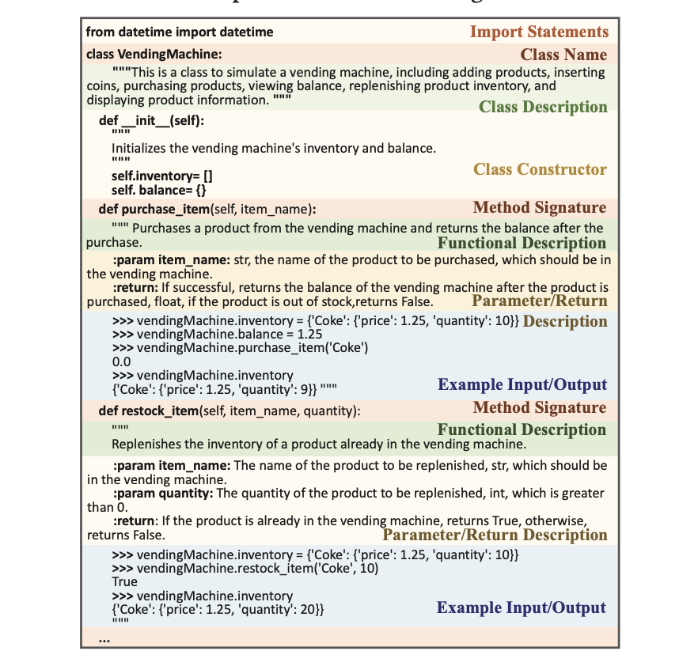
Class-Eval
Notes:
Our project originated from the struggle that LLMs face in performing well in the code generation application which I researched in my midterm paper. Through prior research, we know that LLMs struggle to accurately produce code for complex and difficult programming problems that represent realistic software development scenarios. Thus, we chose to explore how well LLMs can generate comments for realistic software development code since we believe that may provide some insight into how well LLMs can understand and reason about these more complicated code scenarios. In one of the papers that I read, there was a benchmark created called ClassEval. Unlike most other conventional code generation benchmarks, ClassEval tested an LLMs ability to generate code for methods at a class level by providing an LLM with a class template and asking the LLM to generate code for all the methods in the class apart from the constructor. An example of the template for the tasks in this benchmark can be seen in the image in this slide. This benchmark is more representative of realistic software development code compared to other traditional code generation benchmarks which only test an LLMs ability to generate code for function-level coding tasks. So by prompting an LLM to generate comments for class-level code examples from this ClassEval benchmark [1], we are better able to gauge exactly how well LLMs can understand more complex, intricate code and all the contextual dependencies involved in it such as third-party libraries, other class methods, class attributes, etc. We hope the results of our project can provide insights into exactly what needs to be done to improve how LLMs perform in code generation for software development tasks.

Slide 5
Research Questions
How well can LLMs generate high-quality useful comments for methods in class-level code?
How well can LLMs capture the contextual dependencies present in the code through comments?
How do different LLMs compare in their ability to reason about code?
Notes:
These were the main research questions that we explored through our experiment. We first wanted to see how well can LLMs generate high-quality useful comments for methods in class-level code? We also wanted to see how well can LLMs capture the contextual dependencies present in the code through the comments? And lastly, we also wanted to see how different LLMs compare in their ability to reason about code?

Slide 6
02
Experiment
Notes:
Now I’ll go over the experiment we conducted.

Slide 7
Experimental Setup
Manually annotated 100 Python class-level code solutions in ClassEval to serve as ground-truth
Prompted LLMs to annotate 96 class-level code solutions with comments
Prompt = Give 4 examples of annotated class-level code, annotate this target class
LLMs Used: GPT-4, Claude 3.7 Sonnet
Notes:
For our experiment setup, we first manually annotated the methods in the 100 Python class-level code solutions from the ClassEval benchmark with inline comments. Then we randomly chose 4 of these annotated classes to place in our prompt to guide the corresponding LLM in it’s generation of comments for the methods in the target class. After we created our prompt, we prompted the LLM to generate inline comments for the methods in 96 class-level code solutions. We did this for both the GPT-4 and Claude 3.7 Sonnet LLM. We’re also thinking about possibly testing another popular LLM pre-trained on code if we have time later.

Slide 8
03
Results
Notes:
Now I’ll briefly go over some of the results we got from the experiment we conducted.

Slide 9
Quantitative Results
BLEU Scores
Claude: (Min = 0.434, Max = 0.907, Mean = 0.672)
GPT4: (Min = 0.398, Max = 0.888, Mean = 0.650)
Human Evaluation Scores
Compared LLM generated outputs with ground-truth
Assign each output a score(0 - Poorly generated comments, 0.5 - decently generated comments, 1 - very well generated comments)
Claude Average Score: 0.912
GPT4 Average Score: 0.682
Notes:
We used two metrics to evaluate the LLM-generated outputs quantitatively. First, was the BLEU metric which is basically just a word-similarity metric that measures the similarity that the LLM-generated outputs had with the ground-truth examples we manually created. Both the Claude and GPT-4 LLM demonstrated relatively similar performance for this metric with Claude being slightly better. The more important metric however, was the Human Evaluation scores where we manually assigned a score of 0, 0.5, or 1 to each LLM–generated output depending on how well the generated comments described the intent of the code. The Claude LLM demonstrated significantly better performance in this metric which makes sense since the Claude LLM is generally known to be better than GPT for code-related tasks.

Slide 10
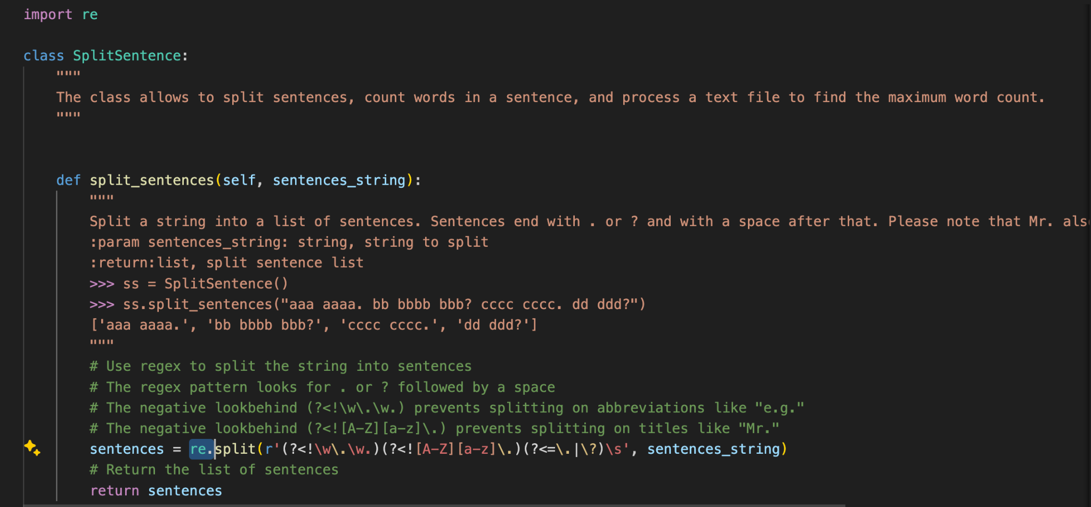
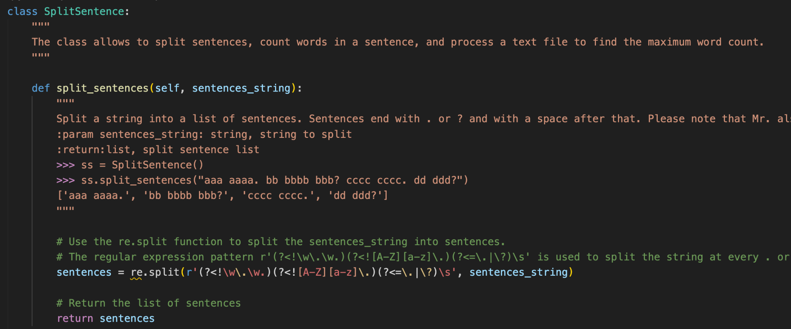
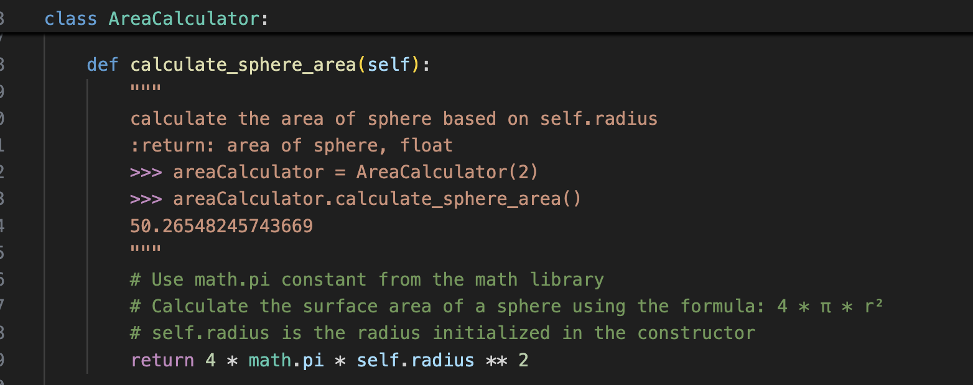
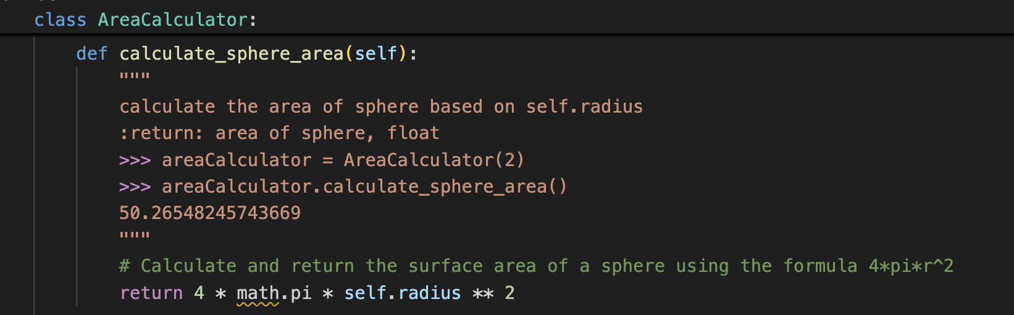
Qualitative Results
Claude
GPT-4
Notes:
On top of the quantitative results, we also tried to analyze a lot of the LLM-generated outputs to see if we could see any significant patterns. One major pattern we saw throughout the outputs for the GPT-4 LLM and the Claude LLM was that the GPT-4 LLM had a harder time noticing the contextual dependencies in the code like the third-party libraries, constants, class methods, etc. while the Claude LLM did a much better job of both noticing and explaining these contextual dependencies through the comments.

Slide 11
THANK YOU
COMPANY NAME
Notes:
That concludes our brief demo describing our project and the main significant results that we have received so far. Thank you all for listening.

